Slide 1

JavaScript Asynchronous Patterns & Other Features
Async Await
Classes
Objects
Dependency Injection
Inversion of Control

Slide 2

Recap -Javascript Characteristics
JavaScript is single threaded
JavaScript is event driven
Events happen – we write code to deal with them
Can use callbacks to do this
JavaScript can be Asynchronous
Order of operation results may differ from order they were called…

Slide 3
Callbacks (again!)

Slide 4

What have Callbacks ever done for us...
Great for things that can happen multiple times
Great if you don't really care about what happened before you attached the listener
Great if it's a straight-forward, stand-alone event with a quick resolution time
Great if callback is not part of sequential process.
E.g. key press event on control.
document.getElementById("demo").addEventListener("keypress", myFunction);
But...

Slide 5
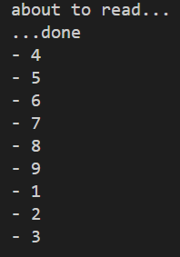
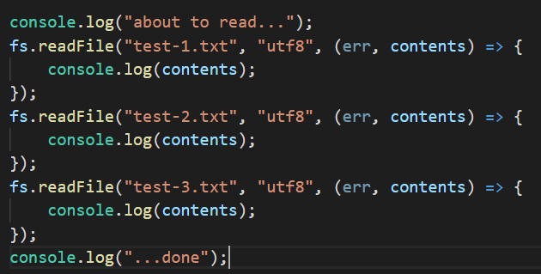
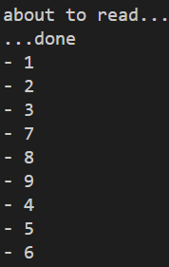
Multiple Callbacks
I want this to happen sequentially… but order of callback events is indeterminate.
Possible Result
Possible Result
Notes:
You have no idea what order the callbacks will execute. Once the callback is registered/scheduled, you’ve no idea when the underlying process (n this case the file read) will report back.

Slide 6
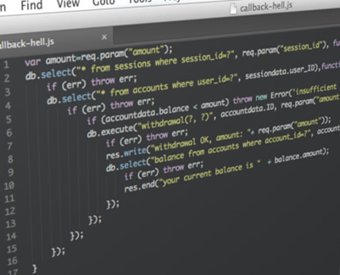
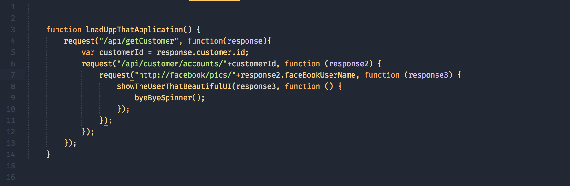
Callback Hell – Multiple sequential requests

Slide 7
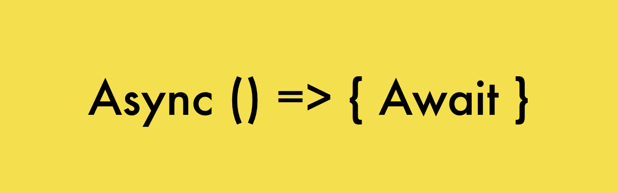
Async Functions
using async/await

Slide 8
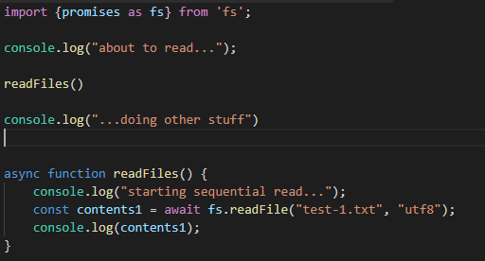
Async/Await !
async/await and promises are essentially the same under the hood
async is a keyword
Used in function declaration
await is used during the promise handling
must be used within an async function
async functions return a promise, regardless of what the return value is within the function.
Available now! in most good browsers as well as Node.js

Slide 9
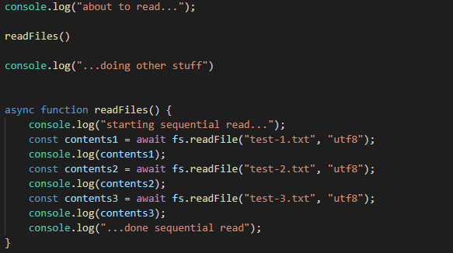
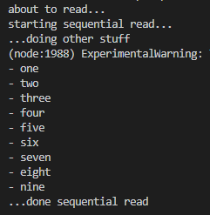
Async/Await Sequential read
output

Slide 10
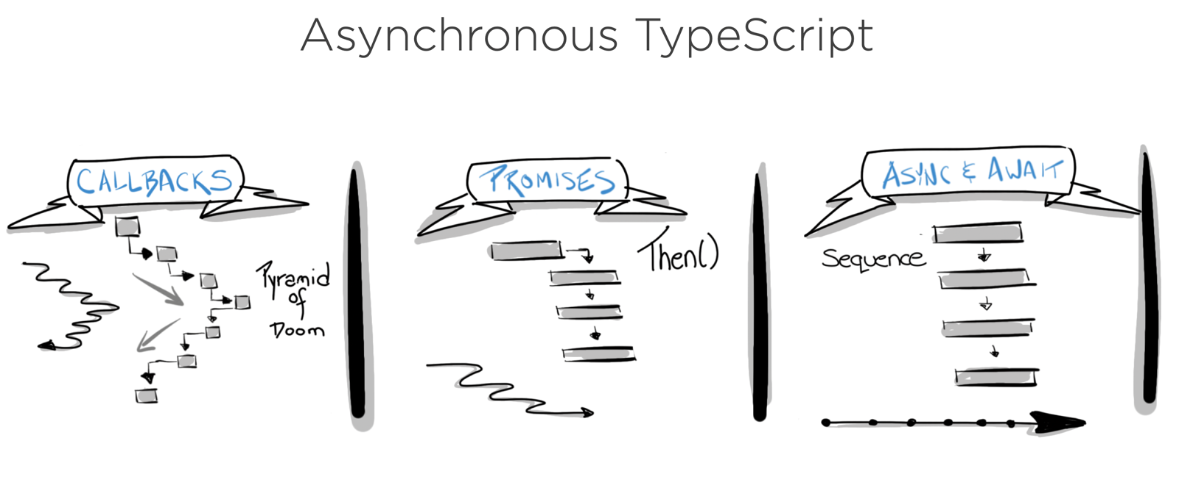
Callbacks vs Promises vs Async-Await
Asynchronous Javascript
This Photo by Unknown Author is licensed under CC BY

Slide 11
Error Handling

Slide 12
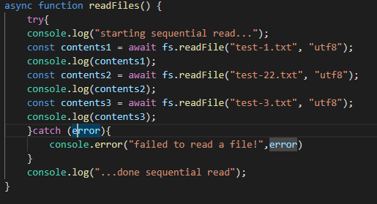
Error Handling – async await
Use try -catch

Slide 13
ES6 Classes

Slide 14
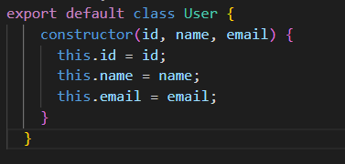
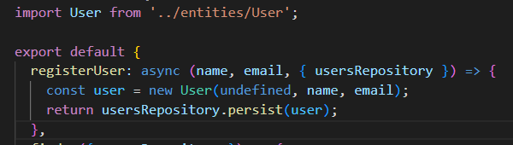


JavaScript Classes
ECMAScript 2015, also known as ES6, introduced JavaScript Classes.
Classes are special functions that facilitate the creation of constructors and prototype-based inheritance.

Slide 15
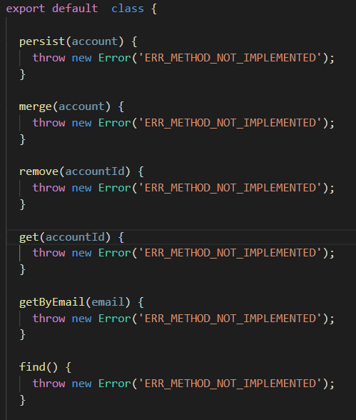
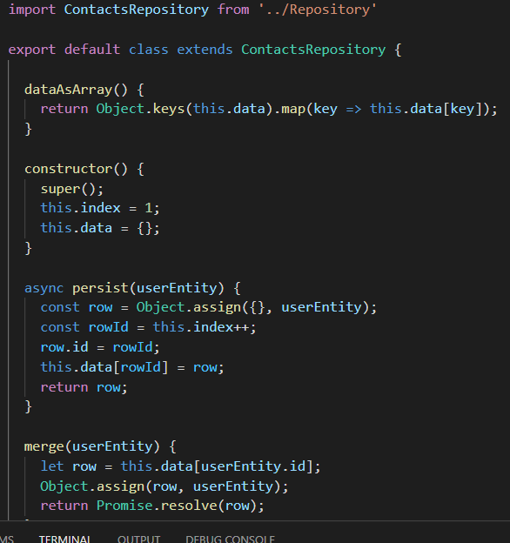


JavaScript Classes - inheritance
To create a class inheritance, use the extends keyword.
A class created with a class inheritance inherits all the methods from another class:
Repository.js

Slide 16
Sources
https://developers.google.com/web/fundamentals/primers/promises
https://stackoverflow.com/questions/2069763/difference-between-event-handlers-and-callbacks
https://medium.com/@Abazhenov/using-async-await-in-express-with-node-8-b8af872c0016

