Slide 1
Testing Web APIs
Frank Walsh

Slide 2
aGenda
Testing
Test Driven Dev/Behaviour Driven Dev
Automated Testing with Postman
Postman Collections
Postman Variables
Assertion framework: Chai
Newman

Slide 3

Test Categories
Static testing
Find typos/basic syntax errors
Unit Testing
Test one single unit in isolation
Integration Testing
Separate units/components work together
End-to-End
Complete flow of project

Slide 4
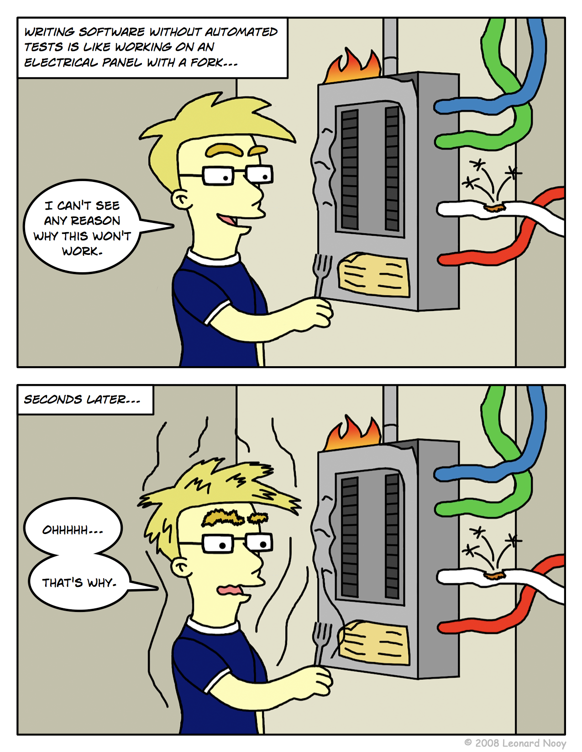
Unit Testing
Code written by developer that exercises a small, specific area of functionality.
“Program testing can be used to show the presence of bugs, but never to show their absence!” – Dijkstra
Up to now – Manual tests with Postman
Not structured
Not repeatable
Not easy

Slide 5
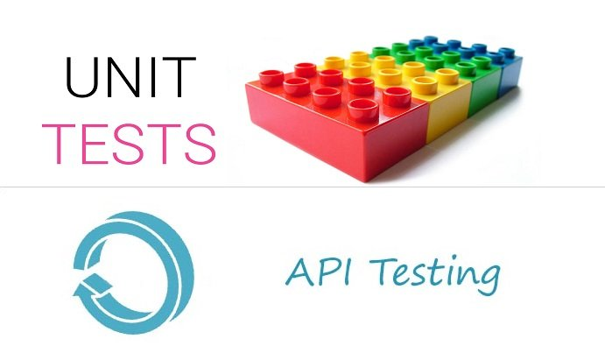
Unit Tests
Unit Tests are specific pieces of code
Tests are written by developers of the code, usually
Sometimes before the code is written
Part of the code repository
They go where the code goes
Use a testing framework
Junit, Jasmine, Chai, Mocha

Slide 6
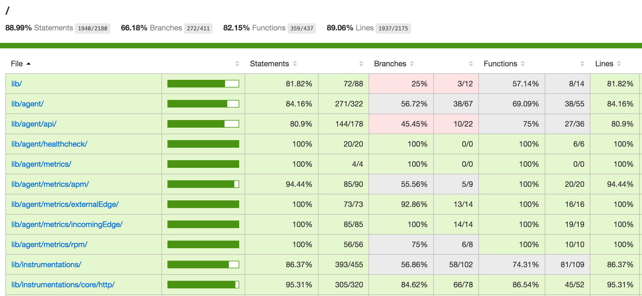
Unit Test convention
All objects and methods
Look for 100% coverage
Although property getters/setters are sometimes omitted
All tests should pass before commits?

Slide 7

Integration testing
Combines several components into a test
Exposes faults in interaction between integrated components
Usually done after unit testing
Performed by devs and independent testers

Slide 8
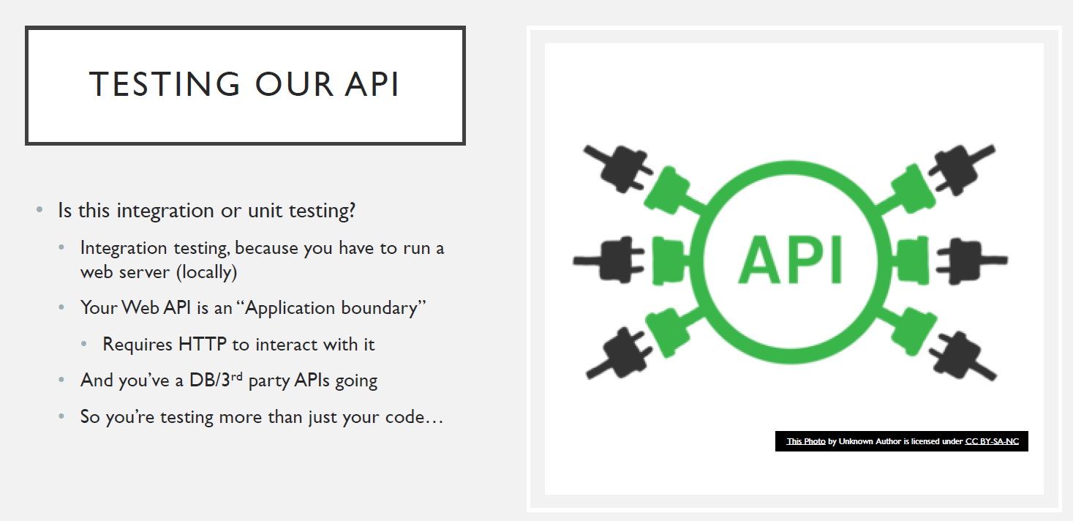

Slide 9
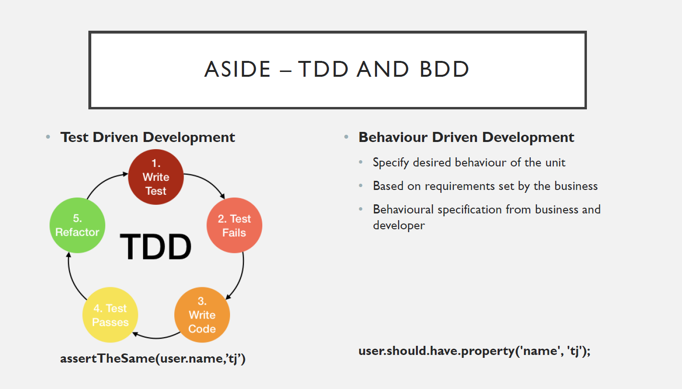
Asside – TDD and BDD
Test Driven Development
define tests first
tests will fail
implement the unit
tests will pass
Developer from requirements spec.
assertTheSame(user.name,’tj’)
expect(user).to.have.property(‘name’).equal(‘tj’)

Slide 10
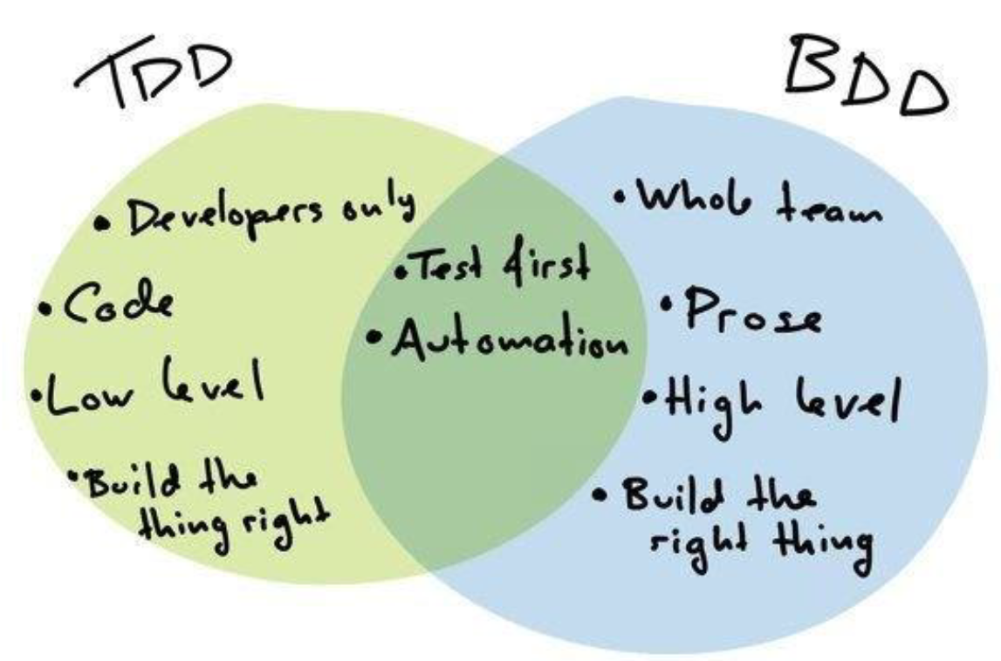
Notes:
Behavior-Driven Development (BDD) and Test-Driven Development (TDD) are two software development methodologies that focus on improving the quality and reliability of software. Although they share some similarities, there are key differences between the two approaches:
Focus and goals:
BDD is focused on the behavior of the application from the user's perspective. It aims to improve communication between developers, testers, and business stakeholders by providing a common language that all can understand. The goal is to ensure that the software meets the desired business outcomes.
TDD, on the other hand, is focused on the developer's perspective. It aims to create a solid foundation of test cases that guide the development process, ensuring that each piece of code is tested before it is integrated into the system. The goal is to produce clean, efficient, and maintainable code.
Test structure:
BDD tests are written in a more natural language format using tools like Cucumber or SpecFlow. These tools use a syntax called Gherkin, which allows tests to be written in a structured, plain-English format that is easy for non-technical stakeholders to understand. This makes it easier for developers, testers, and business stakeholders to collaborate on defining the desired behavior of the application.
TDD tests are typically written in the same programming language as the code being tested, using unit testing frameworks like JUnit or NUnit. The tests are more focused on individual functions and methods, making them more technical and less accessible to non-technical stakeholders.
Process:
In BDD, the process starts by defining the expected behavior of the system in collaboration with business stakeholders. These behaviors are then translated into scenarios, which are broken down into a series of steps. Developers then write code to implement the steps, and tests are created to verify the correct behavior.
In TDD, the process starts with writing a failing test case for a specific functionality. Developers then write code to make the test pass, and once the test passes, they refactor the code to improve its quality. This cycle of writing a failing test, making it pass, and refactoring is repeated until the desired functionality is achieved.
In summary, BDD emphasizes collaboration, communication, and the definition of software behavior from the user's perspective, while TDD focuses on writing tests first to guide the development process and ensure code quality. Both methodologies have their benefits and can be used together or separately, depending on the project requirements and team preferences.
Cucumber

Slide 11
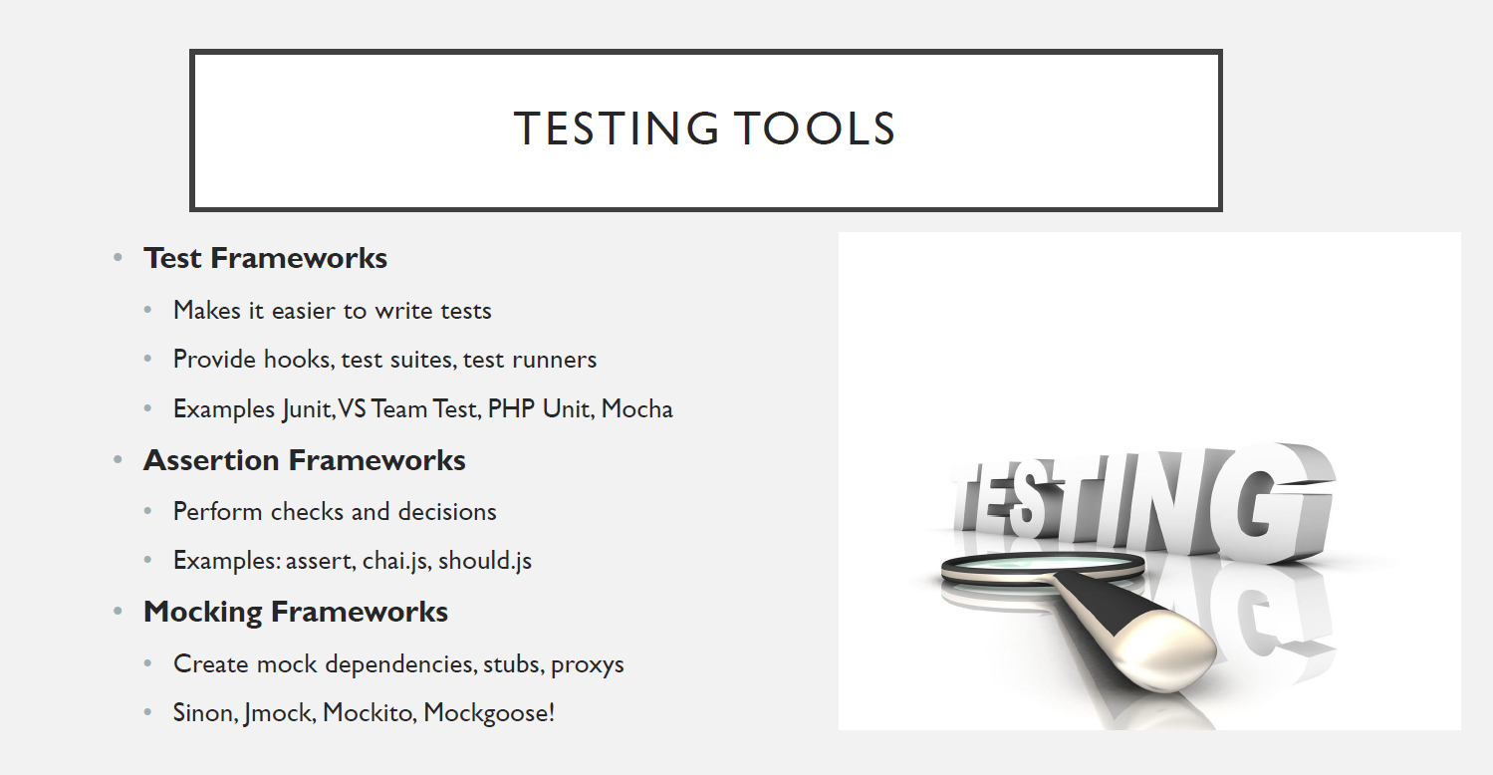

Slide 12
Automated Testing with Postman

Slide 13
Postman Testing
Up to now, manual
Fine for initial development cycle
Better to have more structured method
Regression Testing: check everything still works when you make a change and before committing
Use HTTP requests to test Express App

Slide 14

Chai
BDD / TDD assertion library
Run in browser and server-side (e.g. node)
Features
Expressive syntax
Can test Async code (Promises)
Pluggable
Compatible with test runners such as Karma

Slide 15
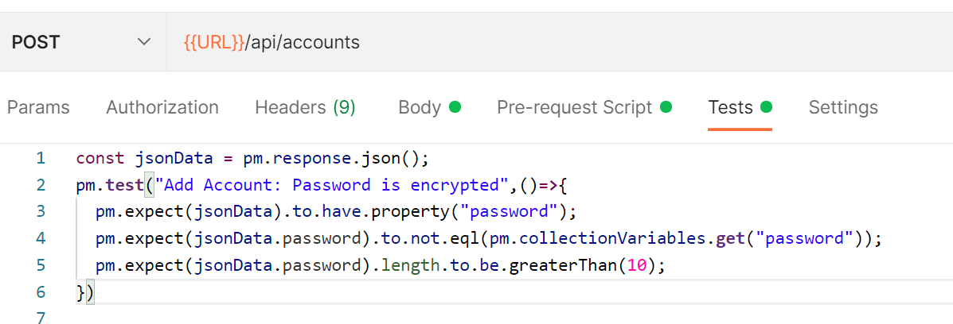
Testing Over HTTP with postman
Postman includes the Chai assertion Library by default
Provide a high-level abstraction for testing HTTP
Can specify pre-request and test scripts as part of Postman Request
Scripts are run when request is sent
Pre-request script can be used to set up scenario(fixture)
Tests script can be used to check request and response is as expected.

Slide 16
Assertions with Chai expect
import chai from ‘chai’;
const expect = chai.expect;
function add(a, b) {
return a + b;
}
const num1 = 5;
const num2 = 3;
const expectedResult = 8;
const result = add(num1, num2);
expect(result).to.equal(expectedResult);
});
});
Chai has several interfaces.
Should, Expect, Assert
Expect allows you to chain together
Readable assertions
Write tests that are closer to natural language.
Suitable for BDD
Chai plugin for postman uses Expect interface

Slide 17
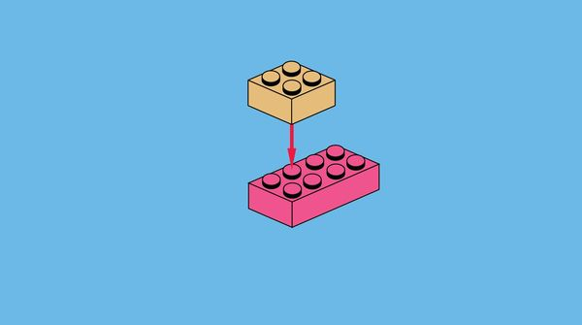
How CHAI works with Postman…
Define Request in Postman as before
Use the Tests tab to define your test in Javascript
The pm object provides functionality for testing your request and response data.
provides access to request and response data, and variables.
Provide description of test using “pm.test”
Use “expect()” to define several test cases into it.

Slide 18
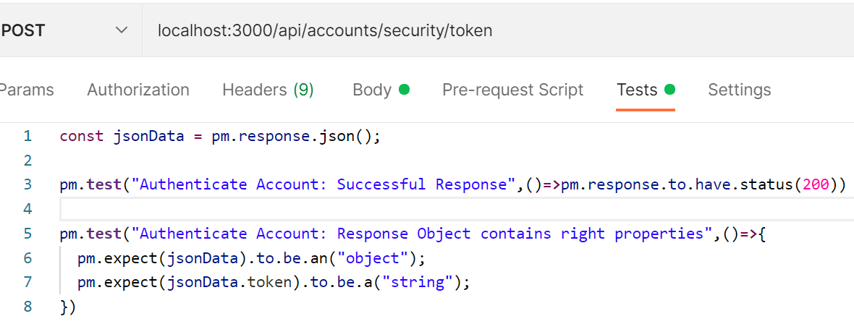
Example – get authentication token
Scenario: Test the authentication endpoint returns a Token
Build request in Postman.
Define test in Tests tab
pm.response.json() returns response body json object
pm.test(..) takes test name and runs test function
The test function specifies the test that uses the pm object to define what’s expected (e.g. content type, status)
Use pm.expect(..) to check response object

Slide 19
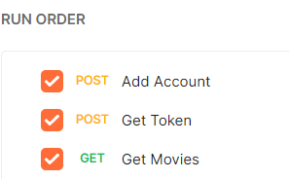
Postman Collections
Account Registration and Movies Access
Collection of related requests to test an API
Can structure a collection run order to test process flow in API
Create Account
Get Authentication Token
Get Movies

Slide 20
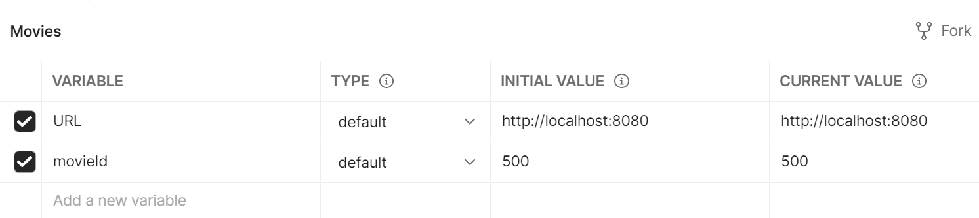
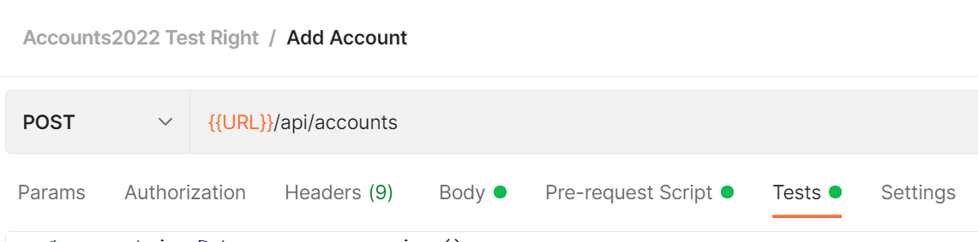
Postman variables
Variables enable you to store and reuse values in Postman
Handy for repeatable testing
Can store the URL in a variable URL and reference it in your requests using {{URL}}
Can use “Dynamic Variables”
Postman uses the faker library to generate sample data.

Slide 21
Variable Scopes
Global
access data between collections
Collection
available throughout the requests in a collection
Environment
scope your work to different environments, for example local development versus testing or production.

Slide 22
Postman Testing Example
Create Collection
1
Create Environment
2
Create Tests
3
Collection of related API requests
Define commonly used variables
Check response is as expected
Run Tests!
4

Slide 23
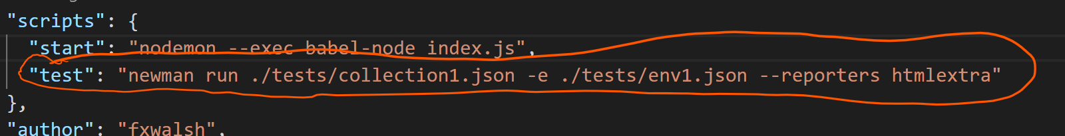
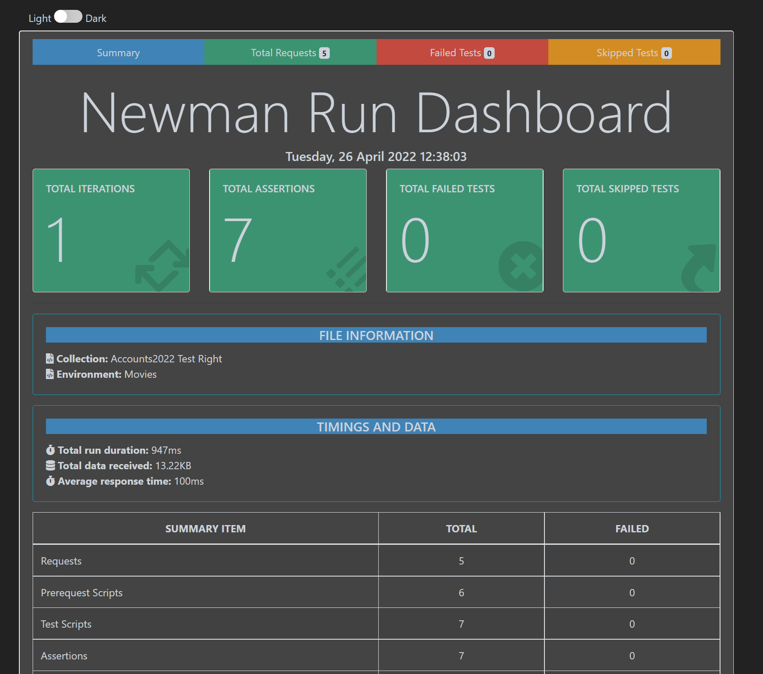
Running the test Externally using Newman
Newman is a command-line collection runner for Postman. Can use it to execute your tests from command line and integrate into Continuous Integration/Continuous Delivery pipeline.
Export Collection as JSON file
Export Environment as JSON file
Install Newman and Newman-html-extre and run on command line
Add test script to your package.json file

Slide 24
Testing Strategies
Right-BICEP
Right – are results CORRECT
B – are boundary conditions correct
I – check inverse relationship
C – Cross check result using other means
E – Force error conditions
P – Performance characteristics

Slide 25
Mocking/Stubbing
FYI….

Slide 26
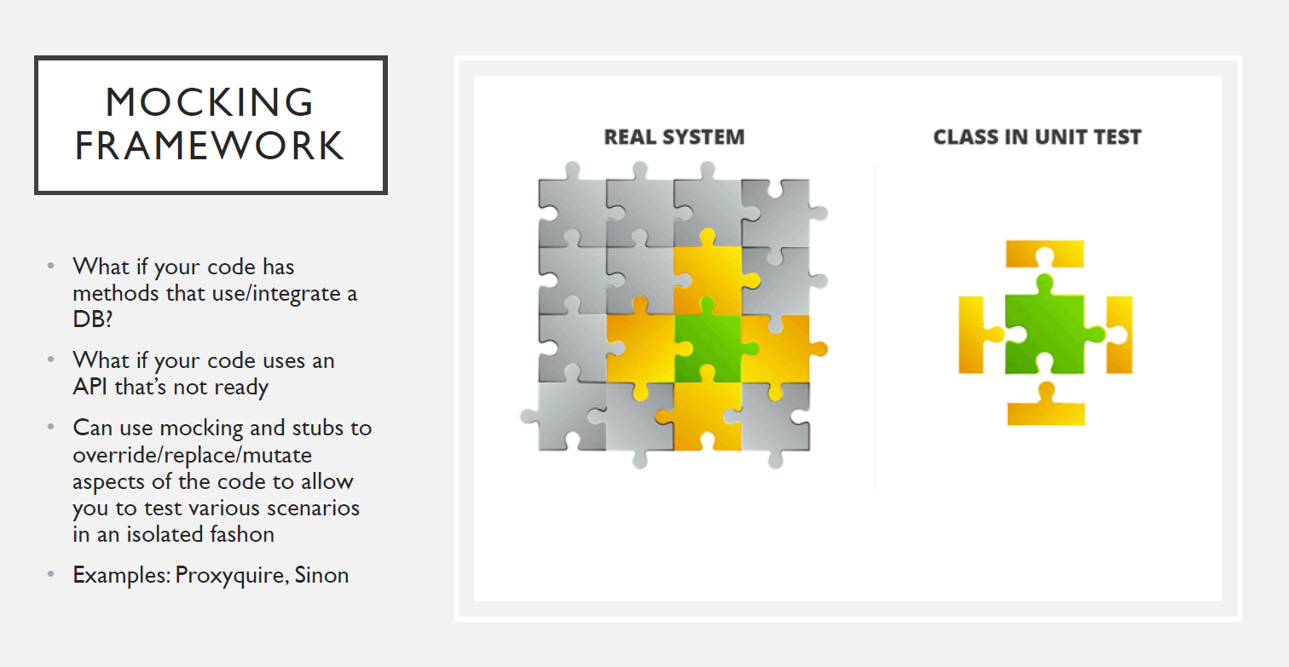

Slide 27
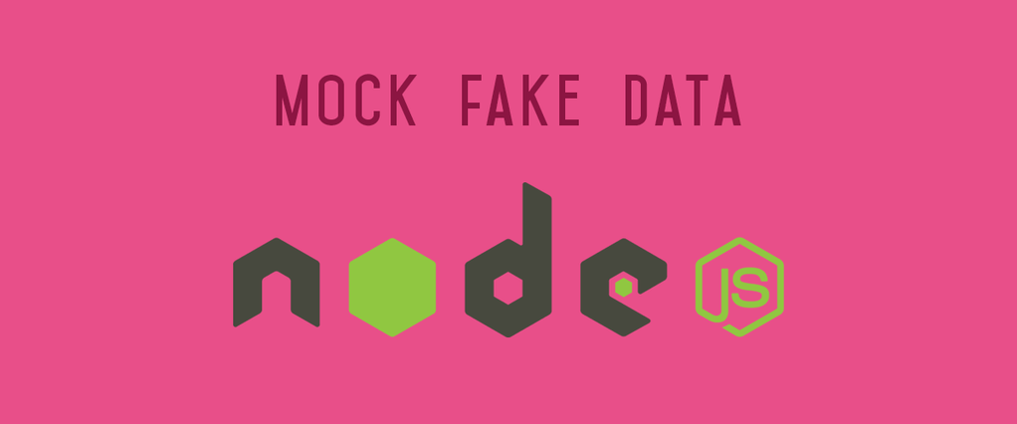
Improvements - Mocking
Unit testing should only concern the unit you’re testing
Should be independent of servers/db dependencies
Tests should just test the unit in question
Unit under test may have dependencies on other (complex) units, e.g. database
To isolate the behaviour of a unit, replace dependencies by “mocks” that simulate the behaviour
DBs are impractical to incorporate into the unit test.
In short, mocking is creating objects that simulate the behaviour of real objects.

Slide 28

Mocking Mongodb
Several mocking frameworks out there
Mockery, PowerMockito
We use Mongoose
How about “Mockgoose”?!
Turns out it exists!
NPM install –save-dev Mockgoose

Slide 29
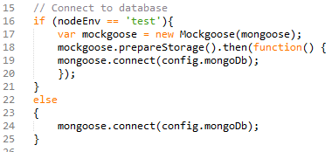
Mockgoose
Mockgoose spins up mongod when mongoose.connect call is made.
Just uses memory store with no persistence.
Can take a while on first test, after which it’s fast
Tests may time out
You can increase mocha wait time describe (…){ this.timeout(10000);

