Slide 1
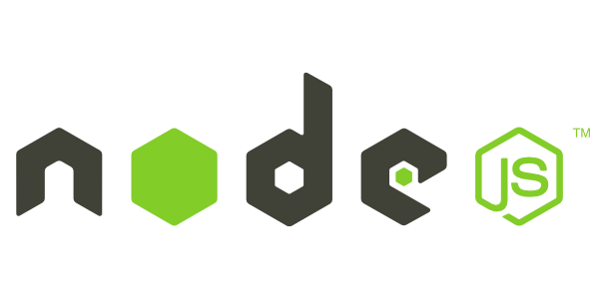
Introduction to Node.js
Frank Walsh
Diarmuid O'Connor

Slide 2

Agenda
What is node.js
The Dev Env for the Labs
Event-based processes
Callbacks in node
Introduction to Express

Slide 3
What's Node: Basics
A Javascript runtime. “Server side JS”
The “.js” doesn’t mean that it’s written completely in JavaScript.
approx. 40% JS and 60% C++
Ecosystem of packages (NPM)
Official site: “Node's goal is to provide an easy way to build scalable network programs”.
Single Threaded, Event based
Supports concurrency using events and callbacks…

Slide 4
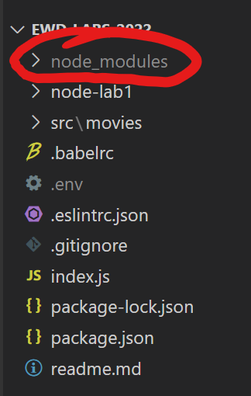



NPM – the Package Manager
Node has a small core API
Most applications depend on third party modules
Curated in online registry called the Node Package Manager system (NPM)
NPM downloads and installs modules, placing them into a node_modules folder in your current folder.
This Photo by Unknown Author is licensed under CC BY-SA-NC

Slide 5
NPM init
You can use NPM to manage your node projects
Run the following in the root folder of your app/project:
npm init
This will ask you a bunch of questions, and then create a package.json for you.
It attempts to make reasonable guesses about what you want things to be set to, and then writes a package.json file with the options you've selected.

Slide 6

NPM Common Commands
npm init initialize a package.json file
npm install <package name> -g install a package, if –g option is given package will be installed globally,
--save and --save-dev
add package to your dependencies
npm install install packages listed in package.json
npm ls –g list local packages (without –g) or global packages (with –g)
npm update <package name> update a package

Slide 7
NPX - the package runner
Makes it easy to run a Node.js based executable that you would normally install via npm.
Can use it at command line to execute packages, even if they are not previously installed.
Very good for one-off commands/tests (like in-class demos!)
Comes with the latest versions of NPM
The following example will execute the babel-node package to transpile and run index.js.
npx babel-node index.js

Slide 8

Node Development Environment

Slide 9
Development Environment Setup for Labs
Node.js:
We just talked about it
Babel:
Allow us to use up-to-date Javascript features, according to ECMAScript Standardisation
Nodemon:
monitor for any changes in your source and automatically restart your node app.
ESLint:
Find, report and fix problems in your javascript
Testing:
Manual: Postman
Automated: Mocha, Should, Sinon (maybe…)

Slide 10
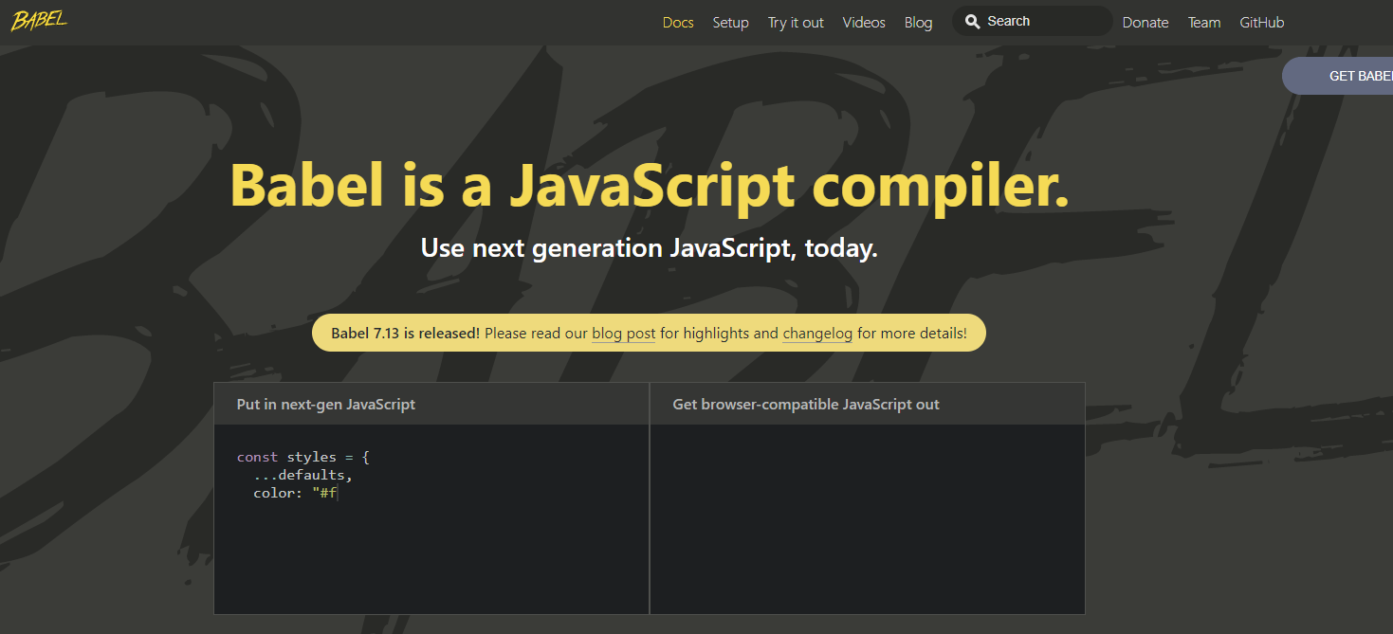
Babel

Slide 11

Node.js and Babel
We’re using ES6+ syntax for front end development
E.g. imports, spread operator, arrow functions, export default
Node.js, as yet, does not support all of the latest and greatest ES6+ features
We can use Babel to “Transpile” code from ES6+ to ES5 before we run it
We will install as Development Dependency for our project
Notes:
DEMO THIS BEFORE EXAMOPLES babel/preset-env is a smart preset that allows you to use the latest JavaScript without needing to micromanage which syntax transforms (and optionally, browser polyfills) are needed by your target environment(s). This both makes your life easier and JavaScript bundles smaller!

Slide 12
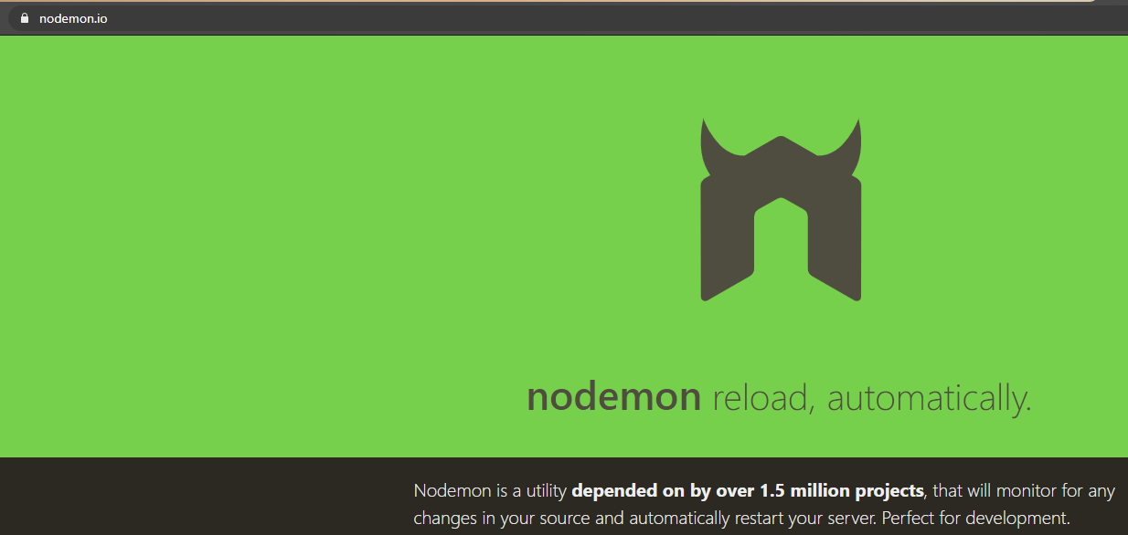
Nodemon

Slide 13
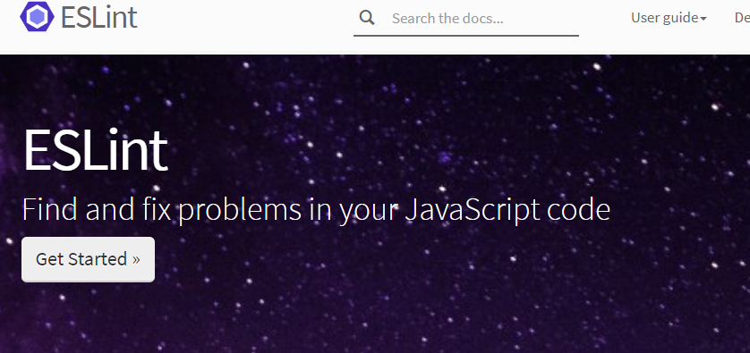
ESLint

Slide 14
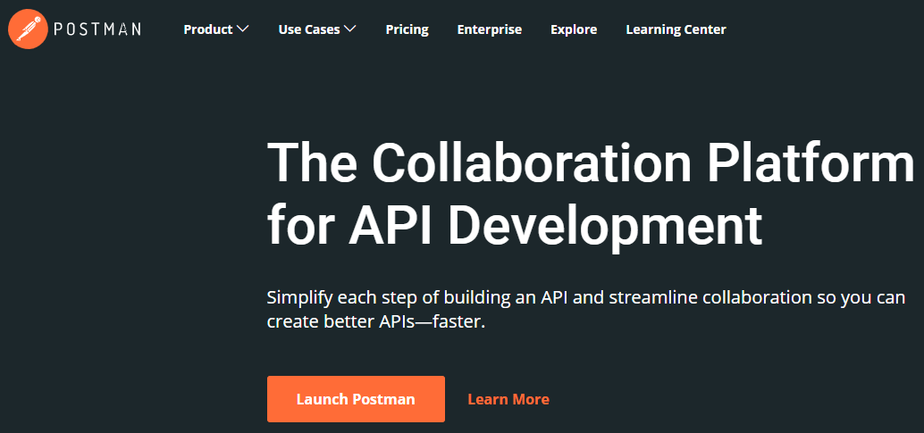
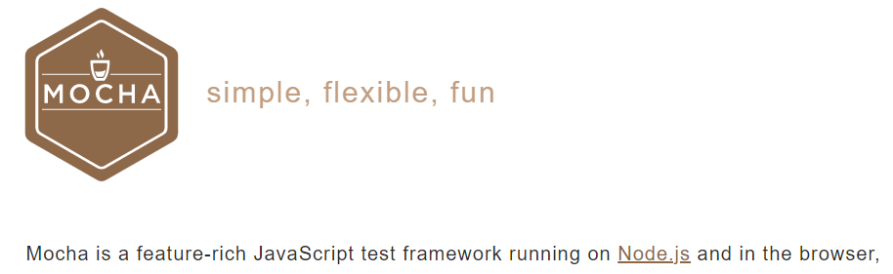
Testing(Maybe…)

Slide 15

Input/Output
Input/Output (io) is slow.
Reading/writing to data store, network access.
Read 4K randomly from SSD* 150,000 ns ~1GB/sec SSD
Round trip over network within same datacenter 500,000 ns
Send packet US->Netherlands->US 150,000,000 ns
This Photo by Unknown Author is licensed under CC BY-NC
I/O operations detrimental to highly concurrent apps (e.g. web applications)
Solutions to deal with this are:
Blocking code combined with multiple threads of execution (e.g. Apache, IIS)
Non-blocking, event-based code in single thread (e.g. NGINX, Node.js)
CPU operations are fast.
L1 cache reference 0.5 ns
L2 cache reference 7 ns
Source: https://gist.github.com/jboner/2841832
1ns = 10⁻⁹ s (0.000000001s)
Notes:
So input output is relatively slow. What I’m talking about here is reading/writing to a data store, any kind of access to resources over a network, even within your organisation. And I mean relative in relation to CPU operations. For example, referencing L1 and L2 cache takes a couple of nano seconds (extremely fast). Accessing 4K from an SSD takes about 150,000 ns. However, sending a packet from the US to the Netherlands and back could take 150 million ns (.15 of a second).
So IO operations can be detrimental to highly concurrent apps yet we do need them (for example, I’ll probably need to access a DB.

Slide 16
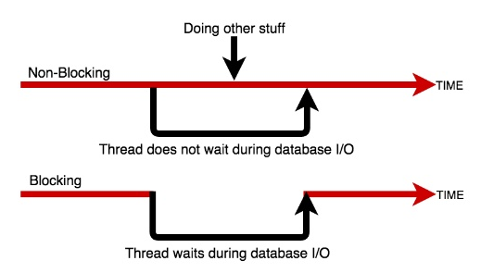
Blocking/Non-blocking Example
Blocking
Read from db and set equal to contents
Print Contents
Do other stuff...
Non-blocking
Read from db
Whenever read is complete, print contents
Do other stuff...

Slide 17
Blocking/Non-blocking example: Javascript
Blocking
import fs from 'fs';
const contents = fs.readFileSync(‘./text.txt’, ‘utf8’);
console.log(contents);
console.log('Doing something else');
Console output
Hello World……
Doing something else
Non-blocking
import fs from 'fs’;
fs.readFile('./text.txt’,’uft8’, (err, contents) => {
console.log(contents);
});
console.log('Doing something else');
Console output
Doing something else
Hello World ……
Notes:
A Callback is a function called at the completion of a given task. This prevents any blocking, and allows other code to be run in the meantime

Slide 18
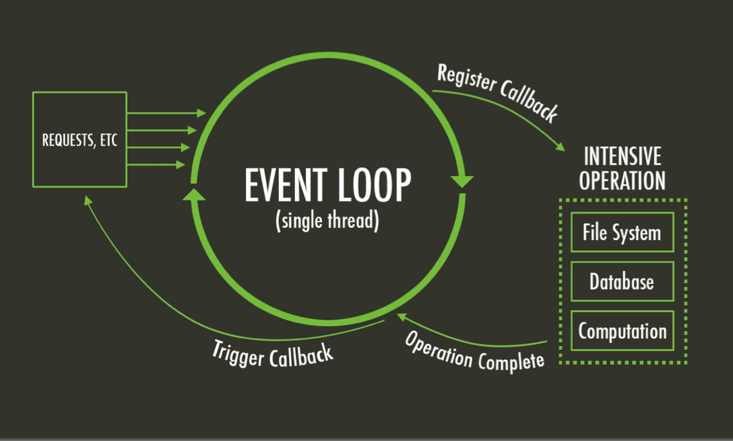
The Node Event Loop and Callbacks
A Callback is a function called at the completion of a given task. This prevents any blocking, and allows other code to be run in the meantime
The Event Loop checks for known events, registers Callbacks and triggers callback on completion of operation
More info here: https://developer.ibm.com/tutorials/learn-nodejs-the-event-loop/
This Photo by Unknown Author is licensed under CC BY-SA
Notes:
Lots of different “phases” in the event loop.
Callback executes during the poll phase after the I/O operation is complete.

Slide 19
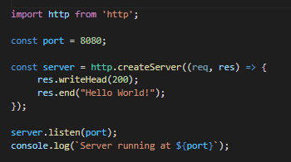
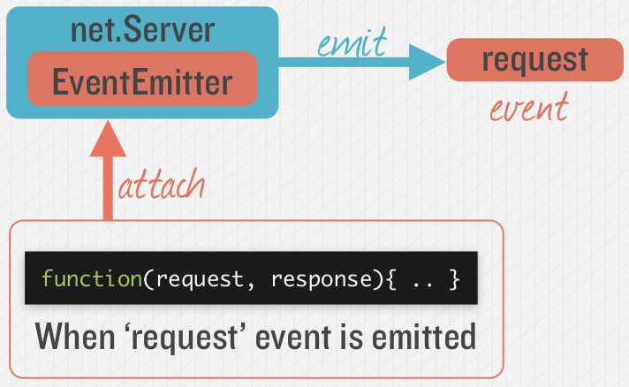

Node.js - Simple HTTP Server
Event Queue
Known Events
request
request
Event Loop
Notes:
Most node applications are waiting for “events” to occur. The event loop waits for events to occur, and then triggers the associated callback function when that event is detected. Node has many built-in events, such as the request event. An instance of Server can emit request events. Here we associate/attach a request listener which is called every time a request evet occurs.

Slide 20
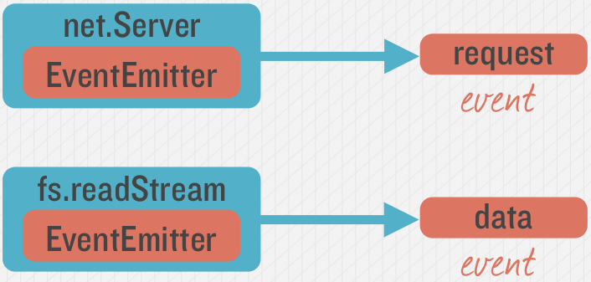
Emitting Event in Node
Many objects can emit events in node.

Slide 21
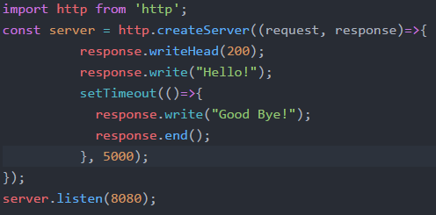
Example – Hello/Goodbye Callback
“Request” Callback
“Timeout” Callback

Slide 22
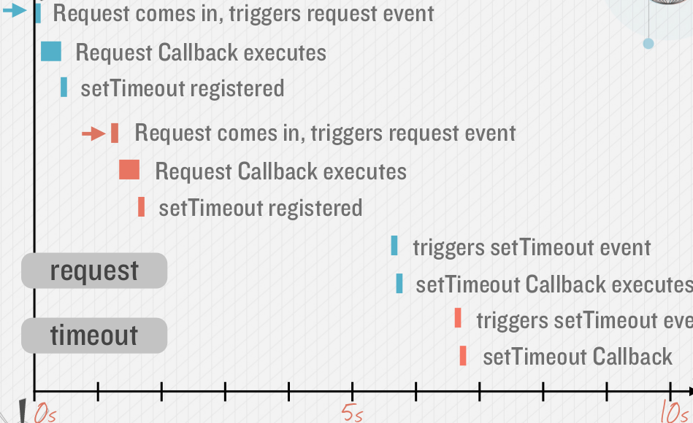
Callback Timeline, Non Blocking
Timing example: 2 requests to web application (indicated by red and blue in diagram)

Slide 23
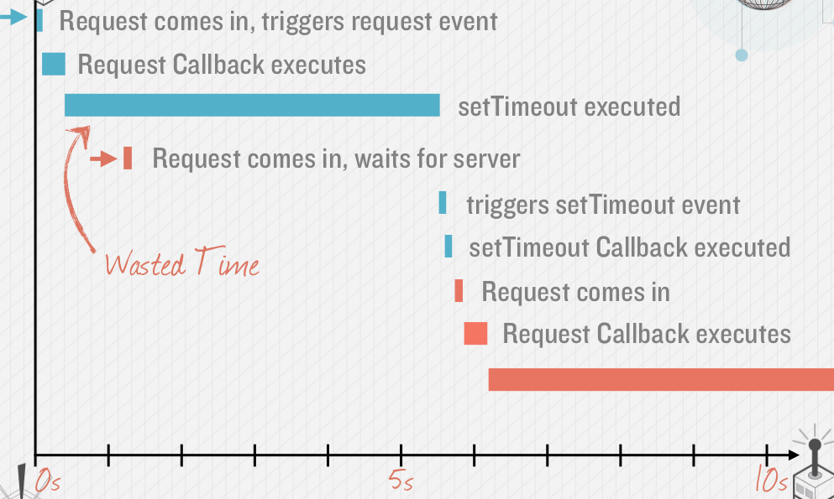
Avoid Blocking Calls in Node.js apps
What if setTimeout() blocked…
setTimeout in previous slide is an example of an asynchronous, non-blocking call.
Avoid potential blocking/ synchronous calls
Activity likely to be blocking should be called asynchronously.
Examples:
Calls to 3rd party Web Services
Database queries
Computationally expensive operations (image file processing)

Slide 24

Node Modules
This Photo by Unknown Author is licensed under CC BY-SA-NC

Slide 25
Node Modules
To install NPM modules, navigate to the application folder and run “npm install”. For example :
npm install express --save
This installs into a “node_module” folder in the current folder.
The --save bit updates your package.json with the dependency
To use the module in your code, use:
import express from 'express';
This loads express from local node_modules folder.

Slide 26
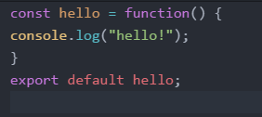
Creating your own Node Modules
We want to create the following module called custom_hello.js:
To access in our application, index.js:
import hello from './custom_hello'; hello();
Export defines what
import returns
Notes:
For everyday use, modules allow us to compose bigger programs out of smaller pieces. Modules become the basic building blocks of the larger piece of software that collectively, they define.
Under the covers, the module keeps track of itself through an object named module. Inside each module, therefore,

Slide 27
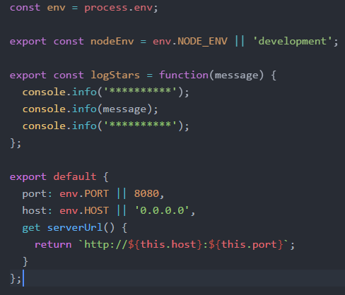
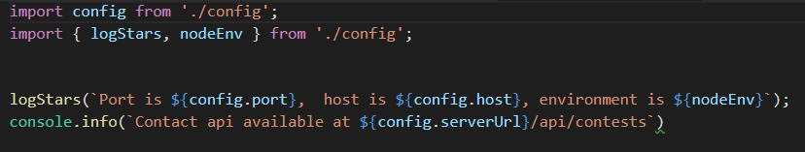
Creating your own Node Modules
Config.js
Exporting Multiple Properties
Accessing in other scripts

Slide 28
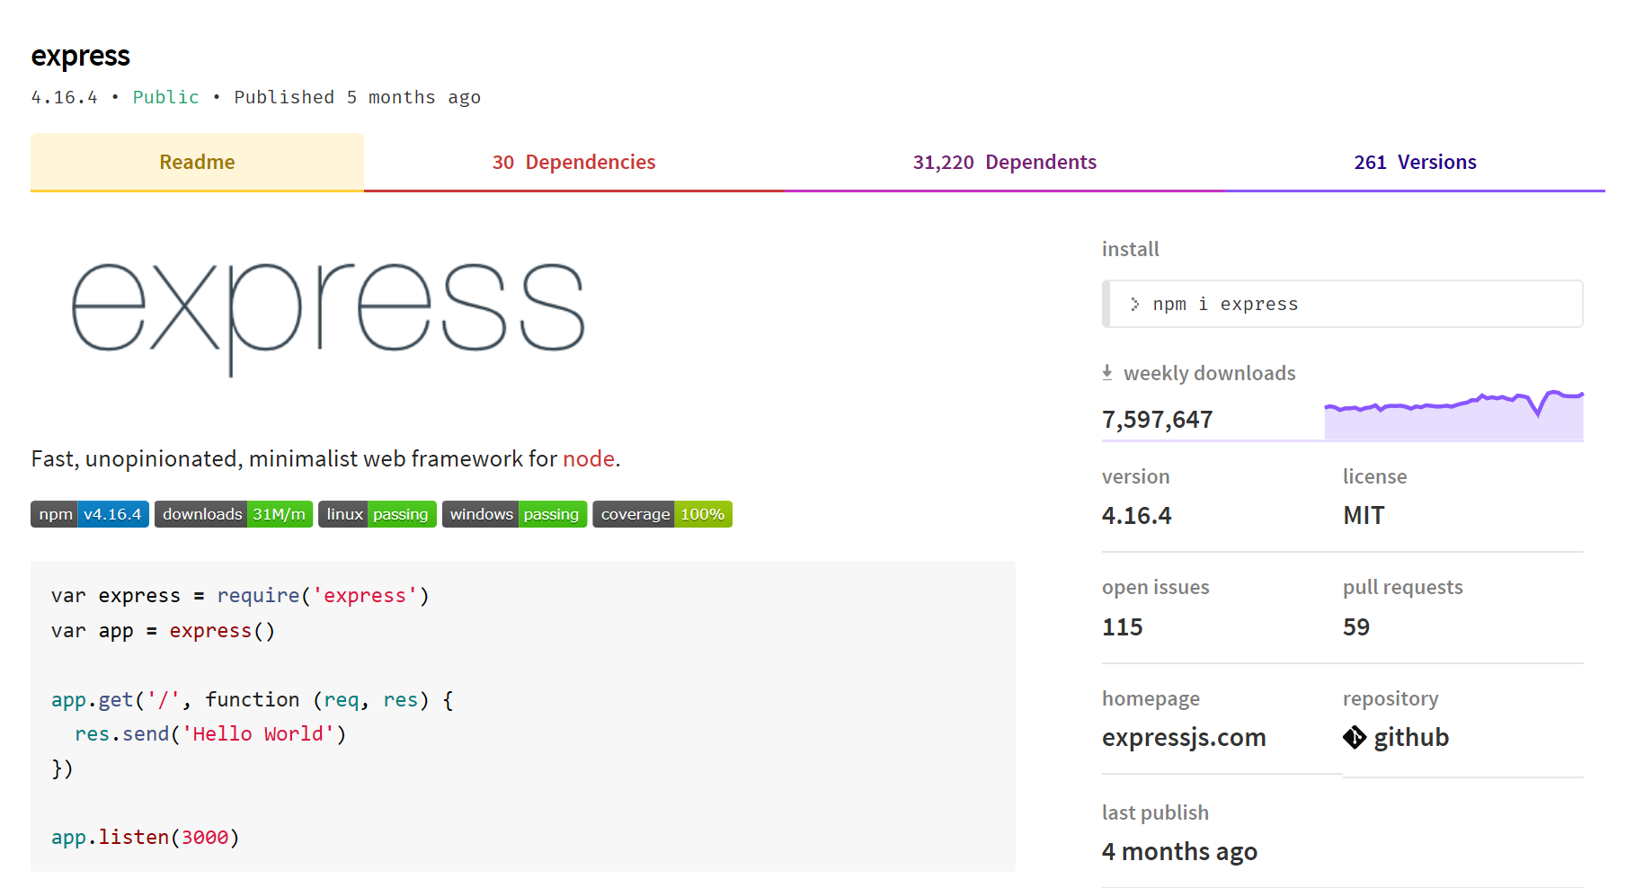
What is Express?
Notes:
Web application framework for Node
Built on the Connect middleware package
It's popular because it‘s
Minimalist,
Fast
Simple

Slide 29
What Express Gives Us...
Parses arguments and headers
Easy Routing
Route a URL to a callback function
Sessions
File Uploads
Middleware…

Slide 30
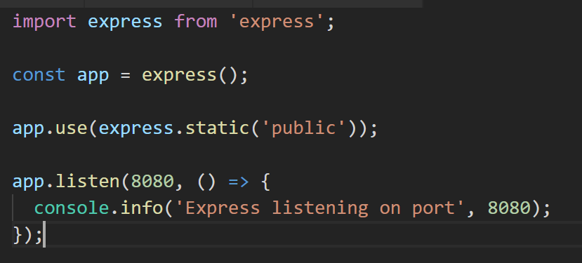
Simple Express App (index.js)
Loads Express module
Instantiates Express server
Define static content for HTTP GET

Slide 31
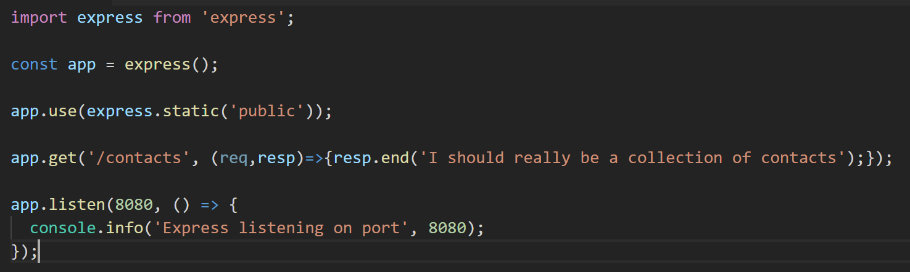
(/*)?
Routing Examples
Syntax follows the pattern:
App.[verb](path, (req,res)=>{});
HTTP POST request
// Other Route examples
app.post(‘/contacts’, createContact);
app.get(‘/contacts/:id’, contactsRouter);
//Catch-all
app.all(‘/private(/*)?', requiresLogin);
Parametised URL. Accepts :app route argument
Catch-all – works for all HTTP verbs
Notes:
DEMO!

