Slide 1


The “Joi” of Validation
And some other stuff

Slide 2
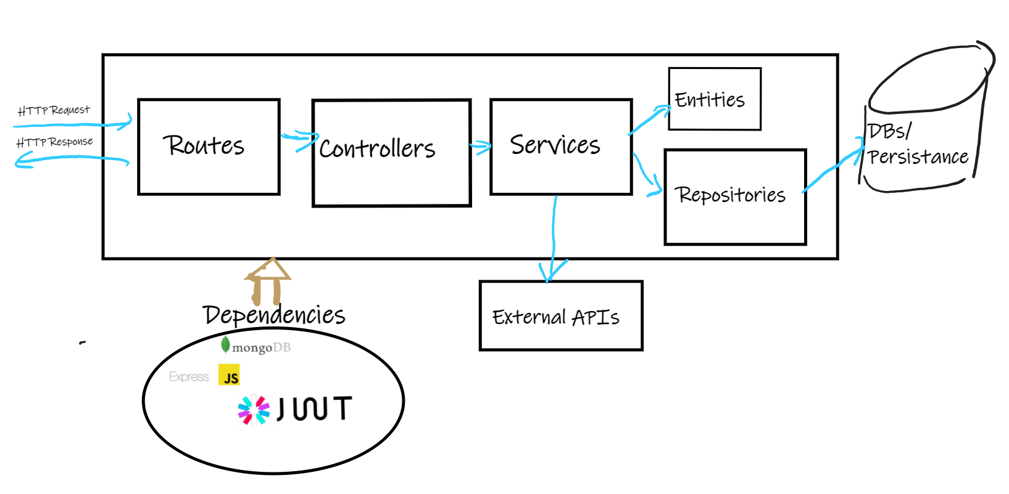
But first: Recap on Clean Architecture
Architecture we’re following in the lab…
Notes:
HTTP logic layer
Routers:
handle the HTTP requests that hits the API and route them to appropriate controller
Controllers:
Processes request object, pull out data from request, validate, then send to service(s)
Business logic Layer
Services: derived from use cases/business requirements
Data Access: Repository/data store access
I think of controllers as "orchestrators". They call the services, which contain more "pure" business logic. But by themselves,controllers don't really contain any logic other than handling the request and calling services. The services do most of the work, while the controllers orchestrate the service calls and decide what to do with the data returned.
Services should contain the majority of your business logic: - logic that encapsulates your business requirements, calls your data access layer or models, calls API's external to the Node application. And in general, contains most of your algorithmic code.
Repositories: Store and Retrieve data

Slide 3
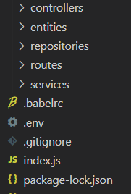
Last Weeks Example/Demo
Extend last weeks example to use in-memory DB
Add User Entity
Add User Repository
Implement as In-Memory DB
Add User Controller
Add User Service
See https://github.com/fxwalsh/ewd-week9-example

Slide 4
Validation with Joi
“joi lets you describe your data using a simple, intuitive, and readable language.”

Slide 5
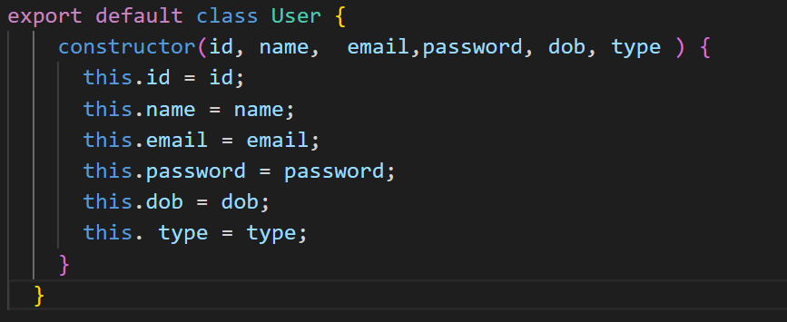


Example User Entity
Add a few extra properties in addition to last week

Slide 6
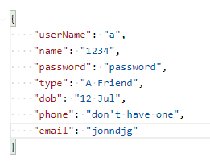
Context
When creating a User you don’t want this…
Prevent bad data making its way into your app: Use Data Validation
Bad Data:
Name should be alphanumeric at least
Password is weak
Type should be FRIEND,FAMILY, or OTHER
DOB has no year
Phone is not a phone number
Email is not formatted properly

Slide 7
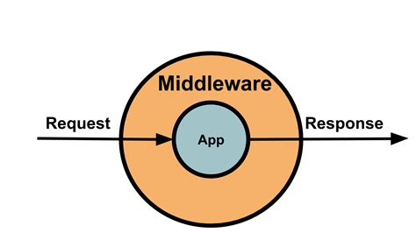
Aside: Object Relational Mapping
Mongoose, Sequelize, Knex provide for specification of validation constraints:
Handled in the application before persisting to DB
Good for enforcing Data layer rules (primary keys, no duplicate values)
Tightly coupled to the ORM implementation (what if I want to change DB?)
In an API, data arriving via HTTP to endpoints
Good idea Validate at request level, using validation middleware/controller
In Express we can use middleware on the route.

Slide 8
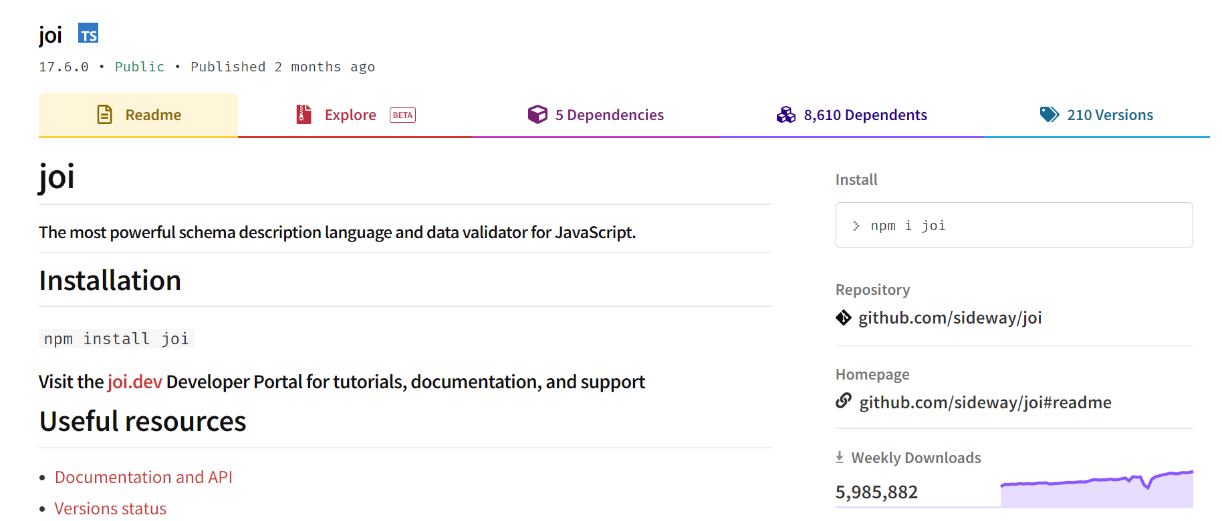
Joi
Use this module to validate data at the request level.

Slide 9
Plan to introduce Validation
Define a Joi Schema for User
Include in our app dependencies
Create a User Validation Controller
Add the Validation controller to the User Routes.
Use Dependency injection
Create in Validators folder.
Uses the User Schema to validate request body
Import Validation Controller and “chain” with other controllers.

Slide 10
Using Joi: Define Schema
email is a String, formatted as email, lowercase, and must be present(required)
import Joi from 'joi';
const userSchema = Joi.object({
email: Joi.string().email().lowercase().required(),
password: Joi.string().min(5).required(),
name: Joi.string().min(1).required(),
dob: Joi.string(),
type: Joi.string()
});
export default userSchema;
Password is a String, length of 4 or longer, and must be present
name is a String at least one character long
Note: This is not a good schema! We will improve later…

Slide 11
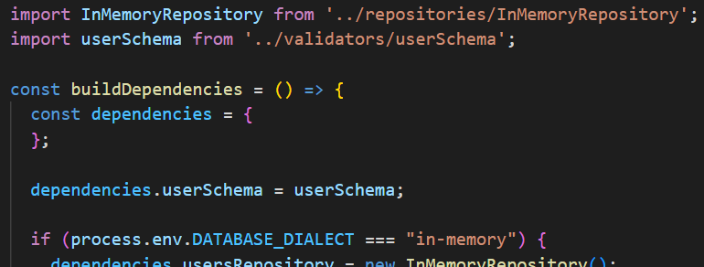

Using Joi: Include in Dependencies
Include Schema as dependencies passed to Route
In keeping with clean architecture approach, Validator schema introduced using dependency injection.
Extract from dependencies.js

Slide 12
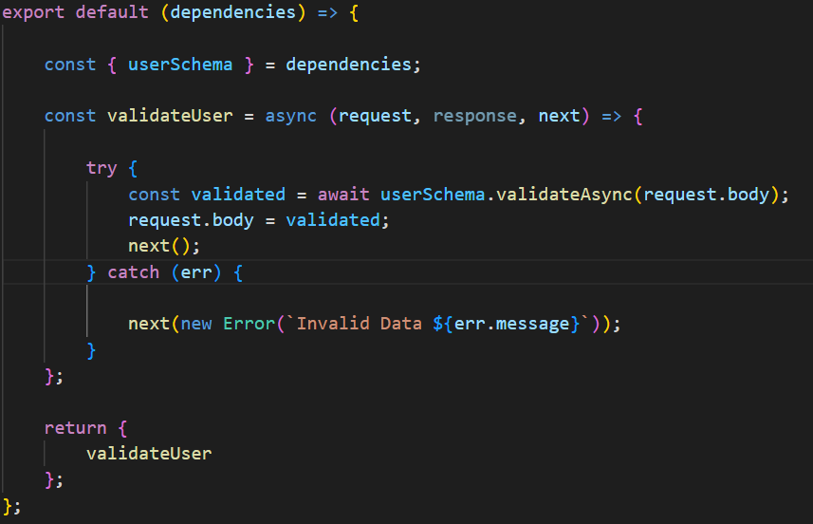
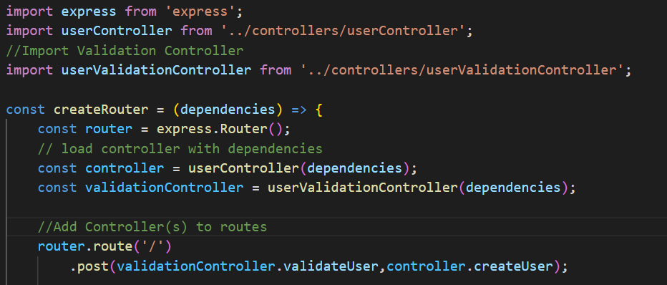


User Validation Controller, Routing Middleware
Validation Controller introduced onto route
Request Response cycle stops if Validation fails .
userRouterController.js
userValidationController.js

Slide 13
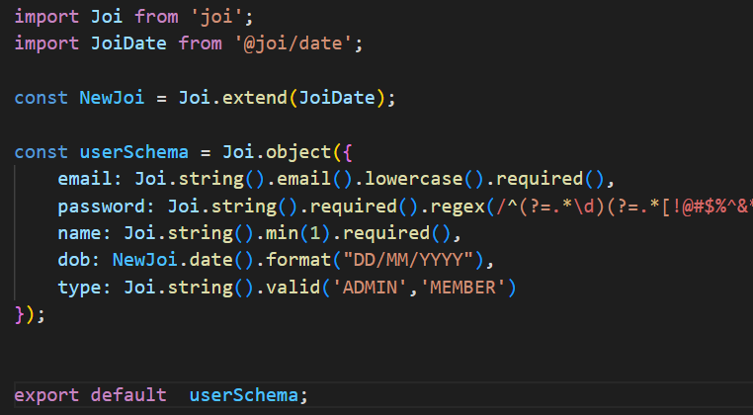
Joi Validation: Dates
Do ‘npm install @joi/date’ to install date format extension
Adds Date extension to Joi
Checks date conforms to DD/MM/YYYY format

Slide 14
Joi Validation: Enumerations
Specify list of valid values:
Type must be in list of values

Slide 15
Joi Validation: Regular Expressions
Use Regular expressions to validate password/phone properties
Ensures Password has length >7 and had letter, number and special char
Phone number has length >9 and only contains numbers, spaces and ‘-’. Can begin with ‘+’

