Slide 1
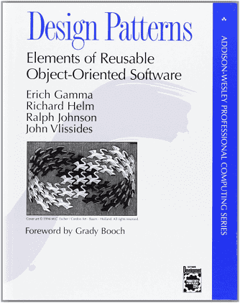
Design Patterns
In software engineering, a design pattern is a general repeatable solution to a commonly occurring problem in software design

Slide 2
Reusability & Separation of Concerns.
The DRY principle – Don’t Repeat Yourself.
Techniques to improve DRY(ness) (increase reusability):
Inheritance ( is-a relationships, e.g. Car is an automabile)
Composition ( has-a relationships, e.g. Car has an Engine)
React favours composition.
Core React composition Patterns:
Container.
Render Props.
Higher Order Components.

Slide 3
Composition - Children
HTML is composable
<div>
<h2>Some Heading</h2>
<ul>
<li> . . . . . </li>
<li> . . . . . </li>
<li> . . . . . </li>
</ul>
</div>
<div> has two children; <ul> has three children
<div>
<p>……….</p>
<img …………. />
<a href …………/>
<</div>
<div> has three children.

Slide 4
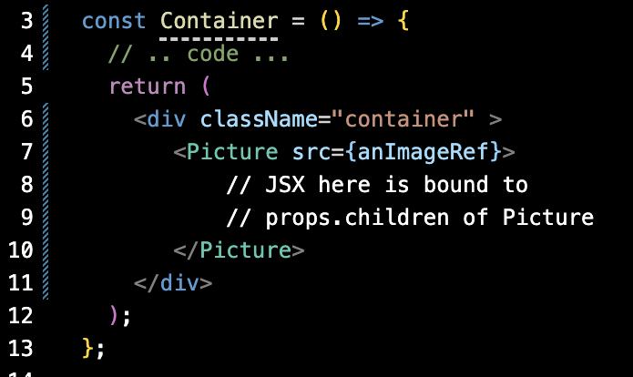
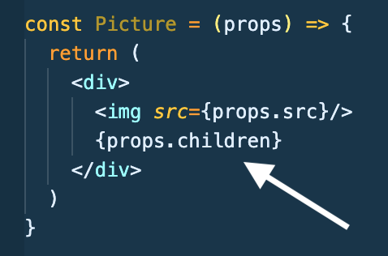
The Container pattern.
All React components have a special children prop. It allows a consumer (container) to pass other components to it by nesting them inside the tsx.
The container determines what Picture renders,
This de-couples the Picture component from its content and makes it reusable.

Slide 5
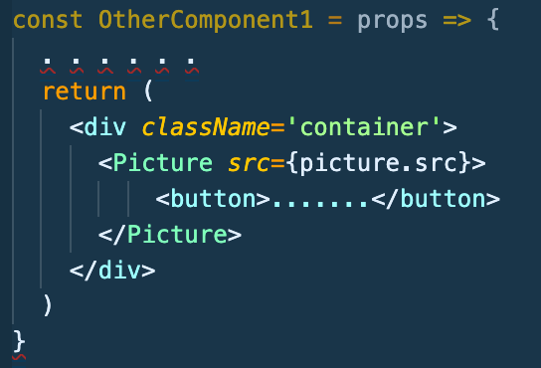
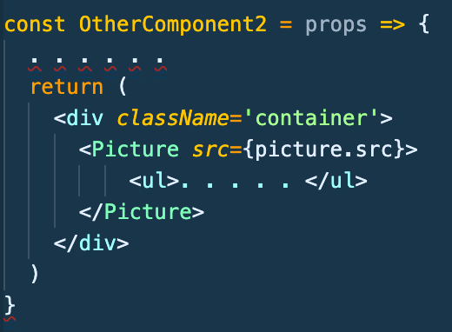

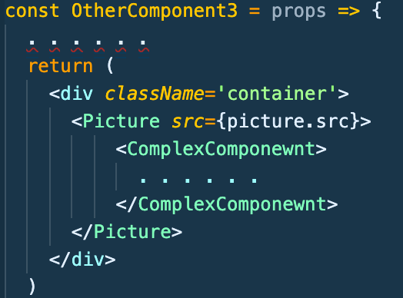
Image
Button
Image
Picture is composed with other elements / components
List
Image
Complex Component

Slide 6
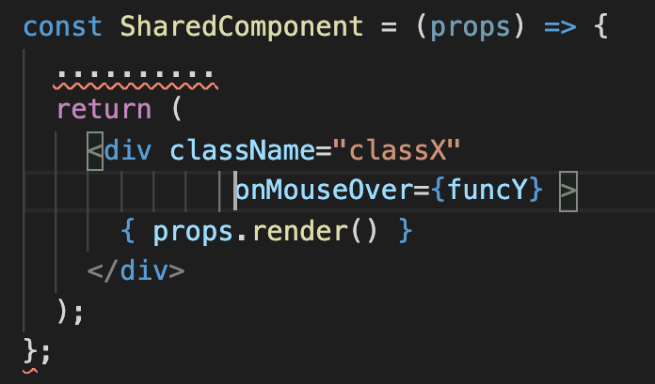
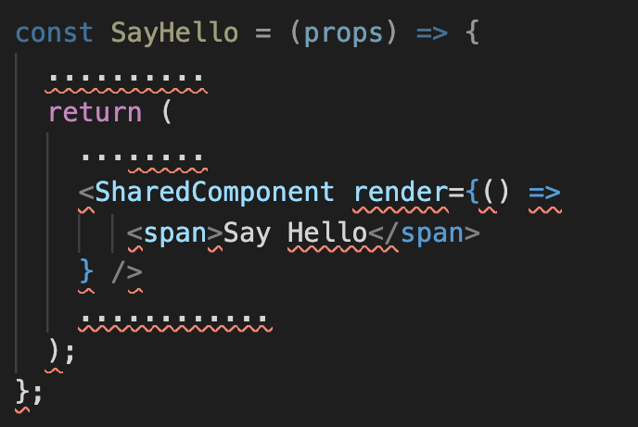
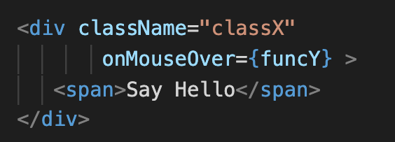
The Render Prop pattern
Use the pattern to share logic between components.
Dfn: A render prop is a function prop that a component uses to generate part of its rendered output.
SharedComponent receives its render logic from the consumer, i.e. SayHello.
Prop name is arbitrary.
Notes:
The map method is often used in React for rendering lists of components

Slide 7
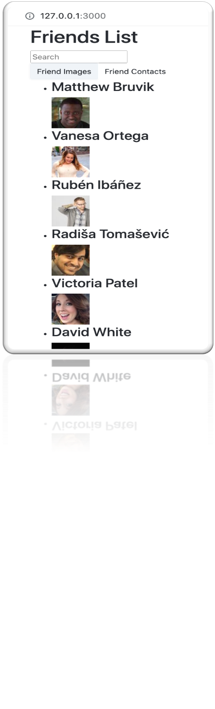
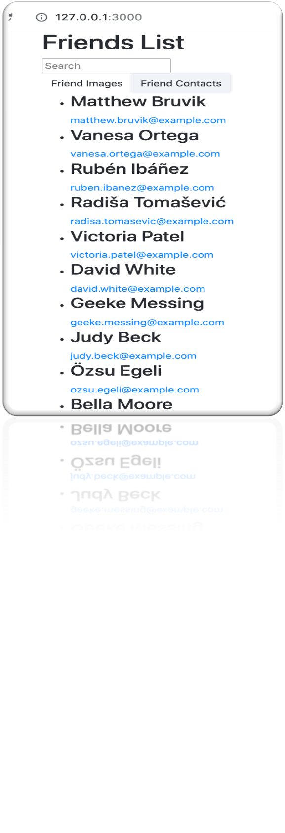
The Render Prop - Sample App.

Slide 8
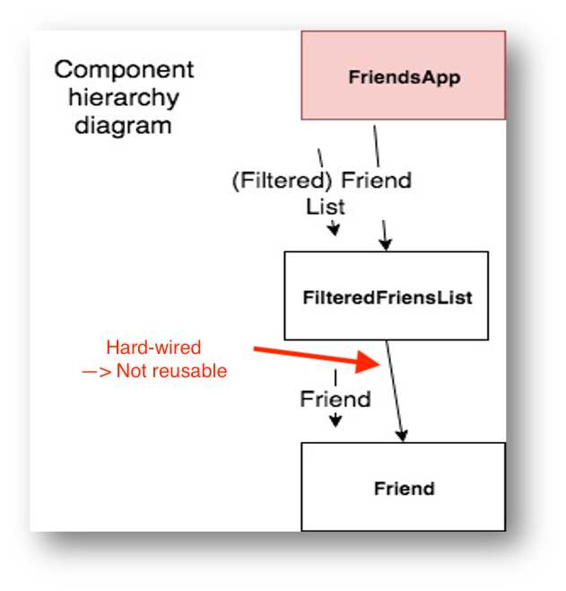
The Render Props - Sample App.
Updates to design:
FriendsApp passes a render-prop to FilteredFriendList, indicating how Friends should be rendered.
Remove static import of Friend component type from FilteredFriendList.

Slide 9
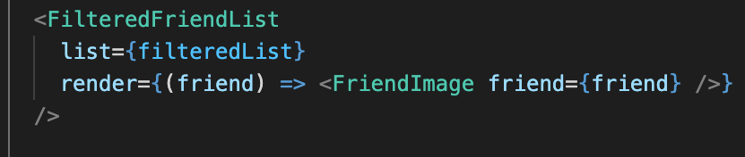
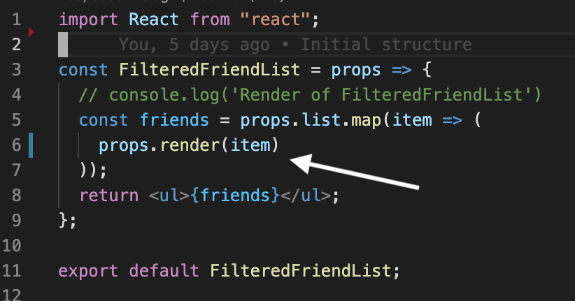
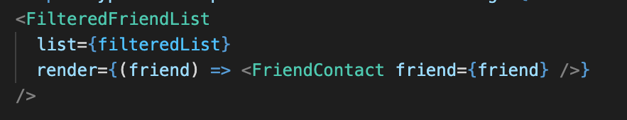
Without this pattern we would need a FilteredFriendList component for each use case, thus violating the DRY principle.
The prop name is arbitrary; render is a convention.

Slide 10

Custom Hooks

Slide 11
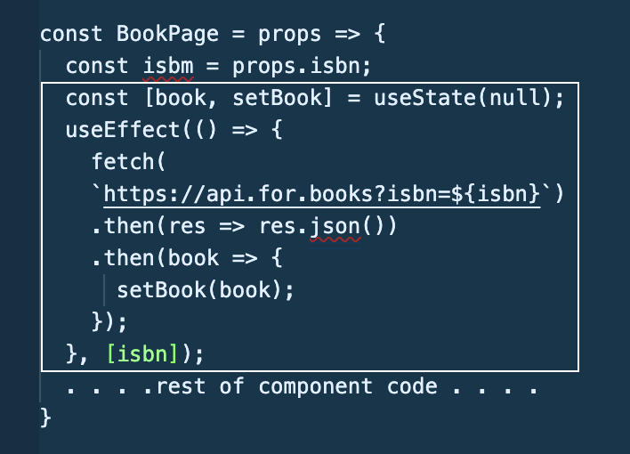
Custom Hooks.
Custom Hooks let you extract component logic into reusable functions.
Improves code readability and modularity.
Example:
Objective – Extract the book-related state code into a custom hook.

Slide 12
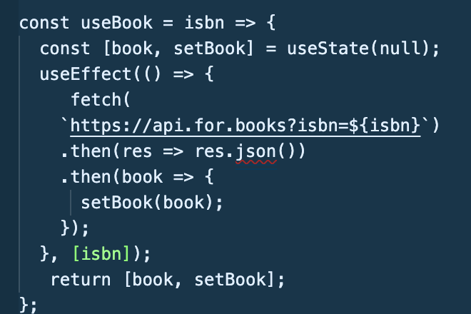
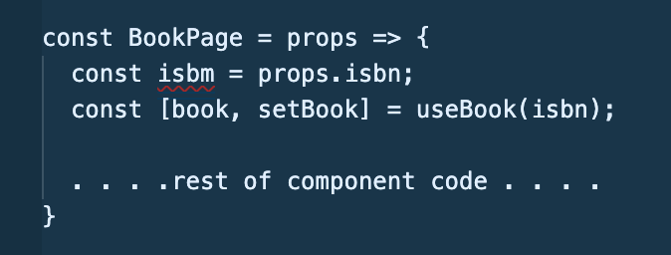
Custom Hook Example.
Solution:
Custom Hook is an ordinary function BUT should only be called from a React component function.
Prefix hook function name with use to leverage linting support.
Function can return any collection type (array, object), with any number of entries.

