Slide 1

Navigation
(Continued)

Slide 2
Agenda.
Navigation / Routing (Contd.)
Design Patterns – The Provider Pattern
Protected/Private Routes.
  A use case in the Provider pattern and
Notes:
Standard web pages. Persistent elements.

Slide 3
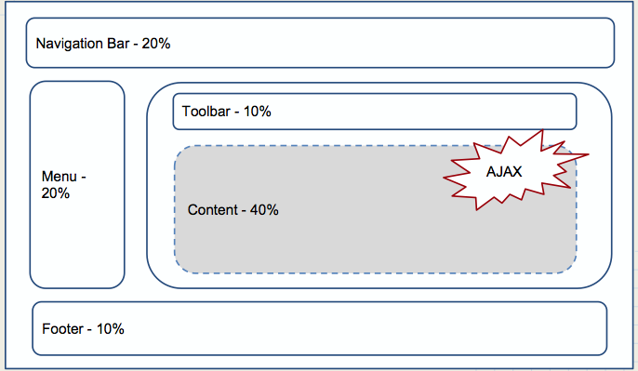

Typical Web app layout
Determined by URL
Notes:
Example, the course website

Slide 4
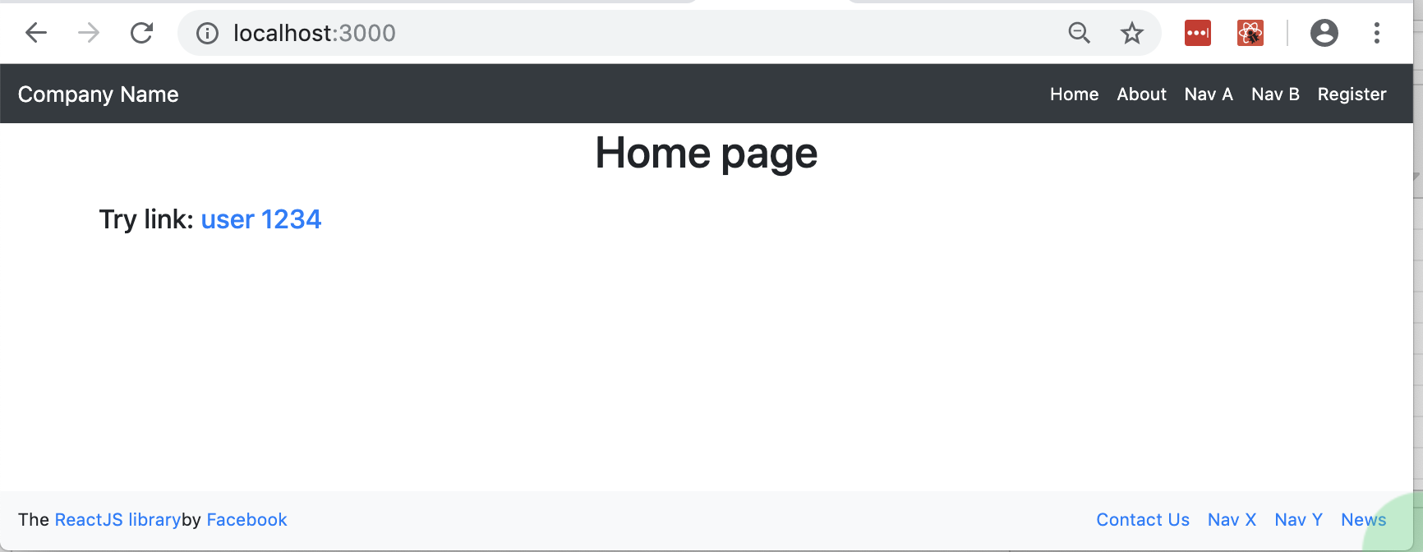
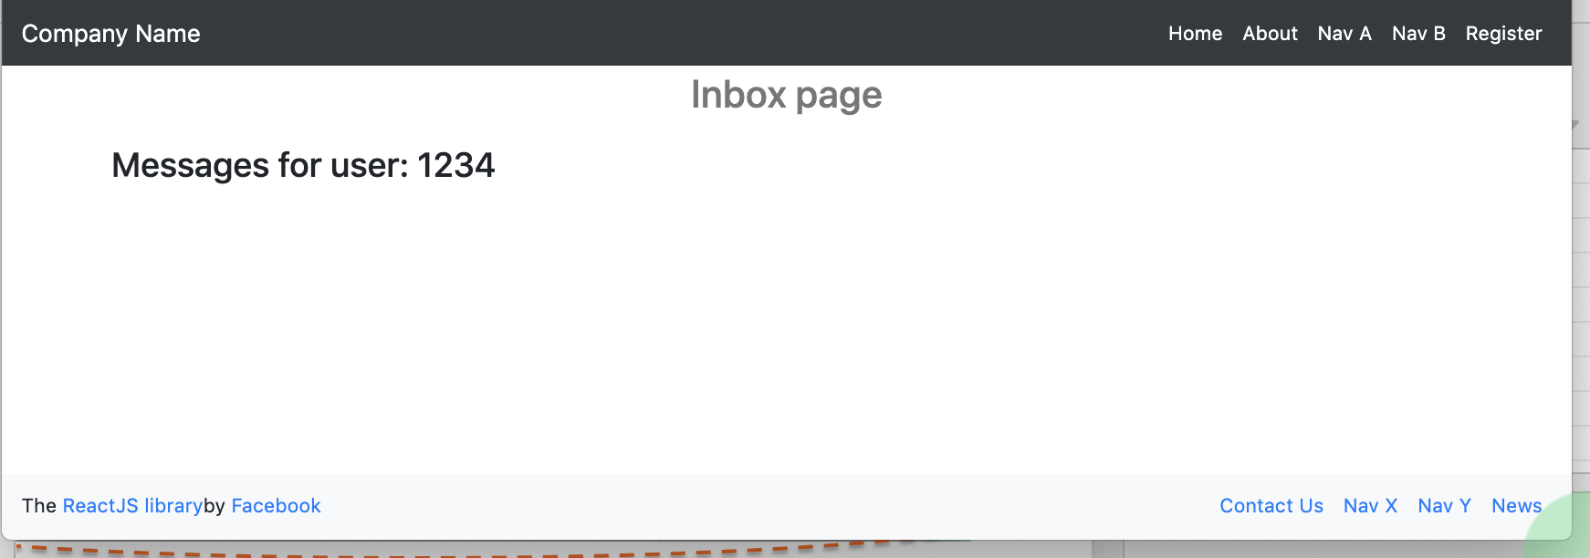
Persistent elements/components
Use cases: Site-wide Headers. Footers. Side menus.
Notes:
Usecase: using the same user inbox usecase as last time.
We wnt to inclide a persistent header and footer.

Slide 5
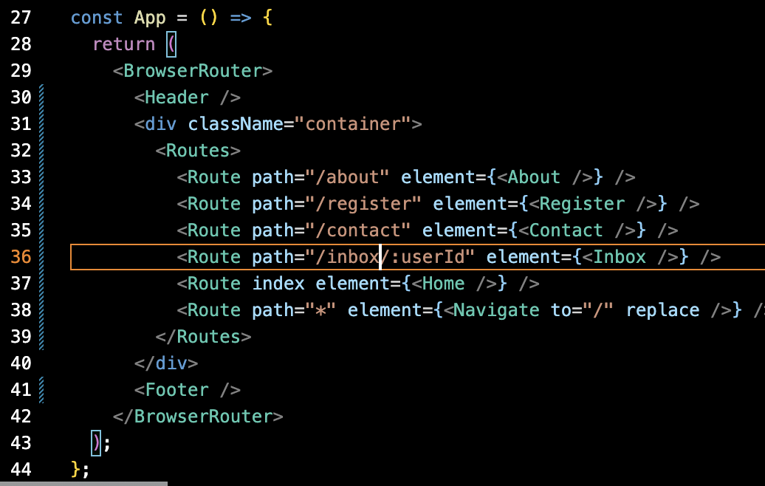
Persistent elements/components
Ref. src/sample6
Notes:
BrowserRouter provides the core routing functionality for React Router applications. It keeps your UI in sync with the URL. It creates a browser history object that uses the HTML5 history API. It lets you manipulate the browser history inside your React components, such as navigating to a new page or popping back to the previous page.
Route allows you to set up routes in your application. When the current location matches the path prop of the Route, the Route will render the UI defined in its element prop.
Link component is used to create links in your application that integrate with the router. When a Link is clicked, it updates the URL and the displayed component changes based on the new URL,
NavLink component is a special type of Link that can be styled differently when it matches the current URL. This is useful for indicating the current page in a navigation menu, for example.

Slide 6
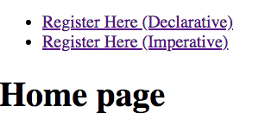
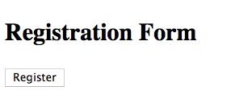
Programmatic Navigation.
Perform navigation a component’s JS logic.
Two options:
  Declarative –custom state variable and <Navigate />
  Imperative – the useNavigate hook
EX.: See /src/sample7/.
Notes:
useNavigate: Returns an imperative method for changing the location. Used by <Link>s, but may also be used by other elements to change the location.

Slide 7
Routing Summary
React Router package adheres to React principles:
  Declarative.
  Component composition.
  The event → state change → re-render
Package’s main components - <BrowserRouter>, <Route>, <Navigate>, <Link>, <NavLink>
Special hooks to allow us access routing data/methods, e.g. useParams, useNavigate, useLocation.

