Slide 1
Design Patterns
(Contd.).
The Provider pattern - React Context
Notes:
Context API, a feature in React for passing data through the component tree without having to pass props down manually at every level.
The Provider Pattern is a way of encapsulating state or services and making them accessible throughout an application in a controlled and reusable way. It allows you to “provide” a resource (e.g. a service, data model, or configuration) to parts of your application that need it.

Slide 2
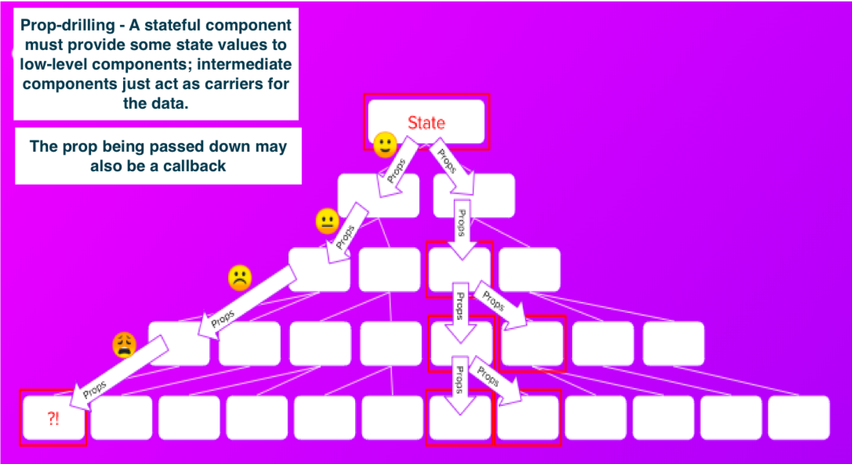
The Provider pattern – When?
Use cases:
  Sharing data/state with multiple components, i.e. global data, e.g. favourite movies.
  To avoid prop-drilling.
Notes:
What’s wrong:
Maintenance Challenges: Prop drilling makes it harder to maintain and refactor code
Component Reusability: It reduces the reusability of components. Components become tightly coupled to their specific data structure and the context in which they are used, making it harder to use them in different parts of an application without passing the same props down the component tree.

Slide 3
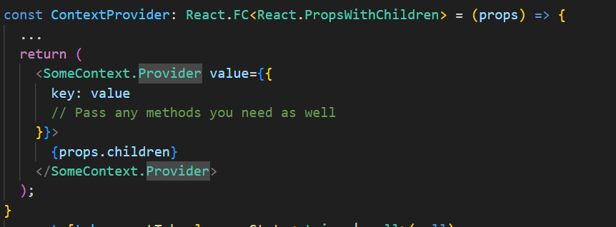
The Provider pattern – How?
React Implementation steps:
  Create a Context object using the createContext function from React library
  Implement a Provider Component that uses the Provider component from the context object.
Notes:
Context API, a feature in React for passing data through the component tree without having to pass props down manually at every level.

Slide 4
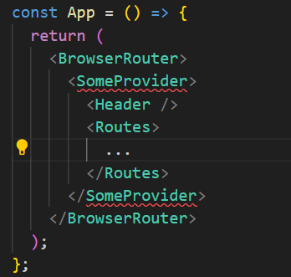
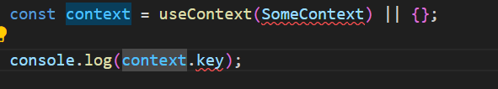
The Provider pattern – How?
Consume the Context Data: Any component wrapped by MyProvider can now access the context data. You can use the useContext hook in functional components or the Context.Consumer component in class components.
Consume the Context Data: Any component wrapped by MyProvider can now access the context data. You can use the useContext hook in functional components or the Context.Consumer component in class components.
  Wrap Your Components with the Provider. Use the provider component to wrap any components that need access to the context data.
  Use the Context Data: Any component wrapped by <SomeProvider> can now access the context data using the useContext hook.

Slide 5
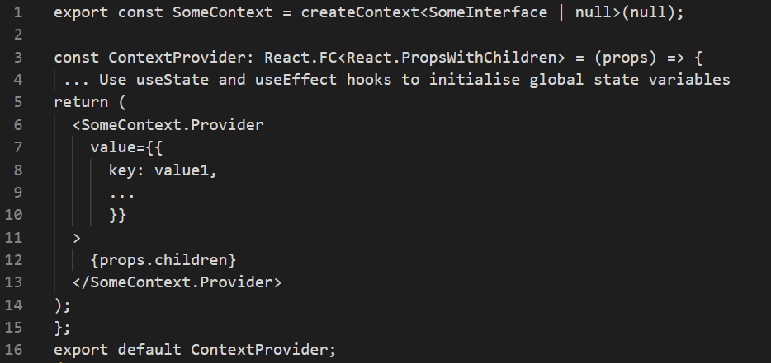
The Provider pattern – Implementation
Create the context object and Declare the Provider component:
We link the Context Object to the Provider component using <contextName.Provider>.
The values object declares the context’s content. .
  Can be functions (behaviour) as well as data (state).
Notes:
The Provider component allows consuming components to subscribe to context changes.
props.children: This is a special prop, automatically passed to every component, that contains the content passed between the opening and closing tags of a component. In this case, props.children represents any child components that will be wrapped by the AuthContext.Provider. This allows any child (or nested child) component to have access to the AuthContext without the need to pass props deeply through the component tree.
This is a generic type provided by React's type definitions.

Slide 6
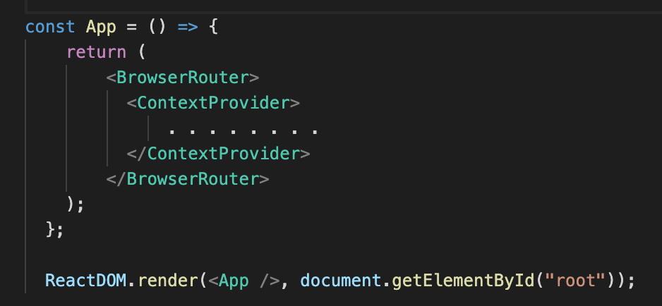
The Provider pattern – Implementation.
Integrate (Compose) the Provider with the rest of the app, using the Container pattern.
All the app’s pages can now access the context.

Slide 7
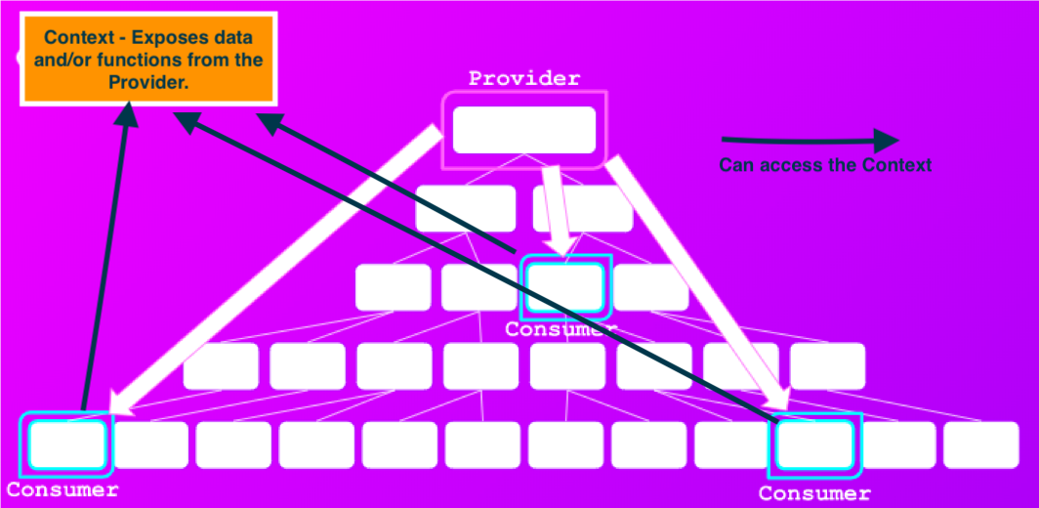
The Provider pattern – React Context.

Slide 8
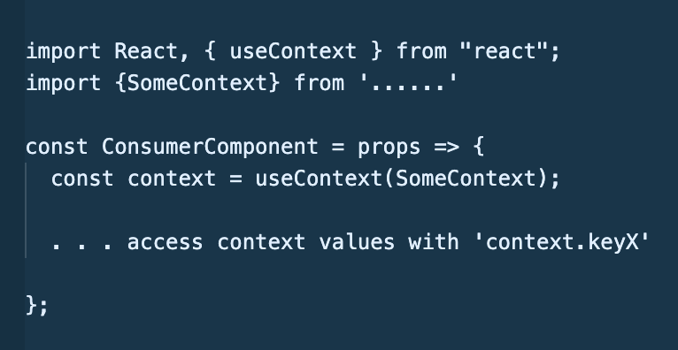
The Provider pattern – Implementation.
useContext hook – gives a component access to a context:
    const contextRef = useContext(ContextName)
    // contextRef points at context’s values object.

Slide 9
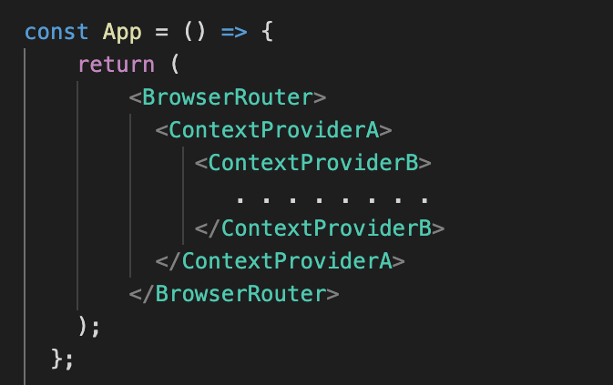
The Provider pattern – Implementation.
For improved separation of concerns, use multiple context instead of a ‘catch all’ context.

Slide 10
The Provider pattern.
When NOT to use a Context:
  To avoid ‘shallow’ prop drilling.
    Prop drilling is faster for ‘shallow’ cases.
  For state that should be kept local to a component, e.g. web form inputs.
  For large object - monitor performance and refactor as necessary.

