Slide 1
Data Fetching &
Caching

Slide 2
SPA State (Data) - Client
Client state (aka App State).
e.g. Menu selection, UI theme, Text input, logged-in user id.
Characteristics:
Client-owned; Not shared; Not persisted (across sessions); Always up-to-date.
Accessed synchronously.
useState() hook
Management - Private to a component or Global state (Context).

Slide 3
SPA State (Data) - Server
Server state (The M in MVC).
e.g. list of ‘discover’ movies, movie details, friends.
Characteristics:
Persisted remotely. Shared ownership.
Accessed asynchronously → Impacts user experience.
Can change without client’s knowledge → Client can be ‘out of date’.
useState + useEffect hooks.

Slide 4


SPA Server State.
Server state characteristics (contd.).
Management options:
Spread across many component.
Good separation of concerns.
Unnecessary re-fetching.
Global state (Context).
No unnecessary re-fetching.
Fetching data before its required.
Poor separation of concerns.
3rd party library – e.g. Redux
Same as 2 above.
We want the best of 1 and 2, if possible.

Slide 5
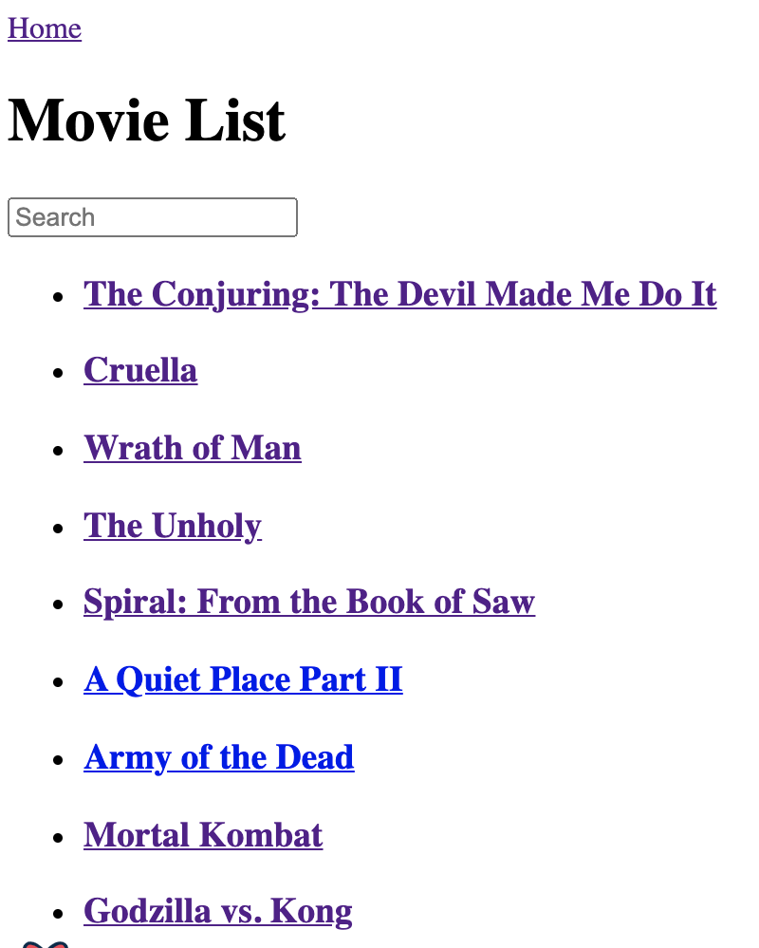
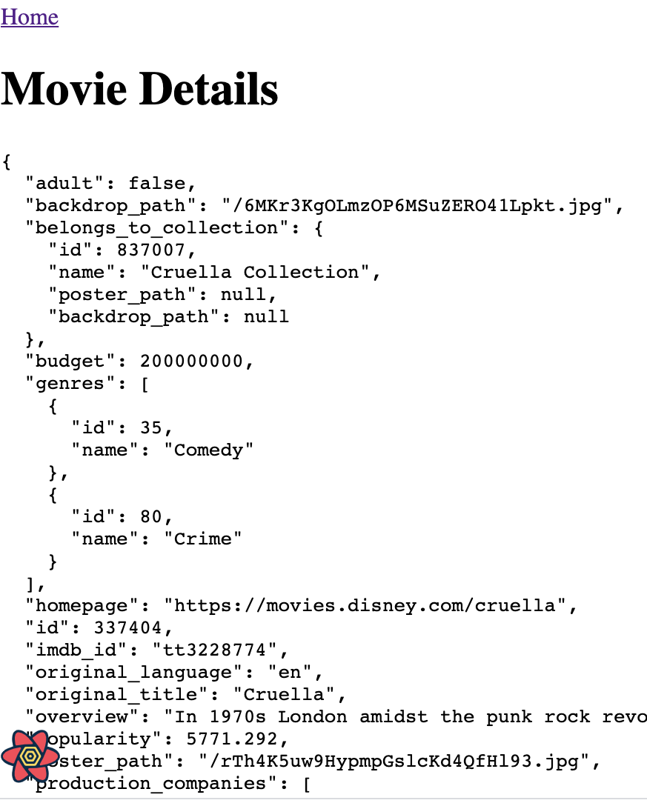
Sample App.
Both pages make a HTTP Request to a web API (TMDB)

Slide 6
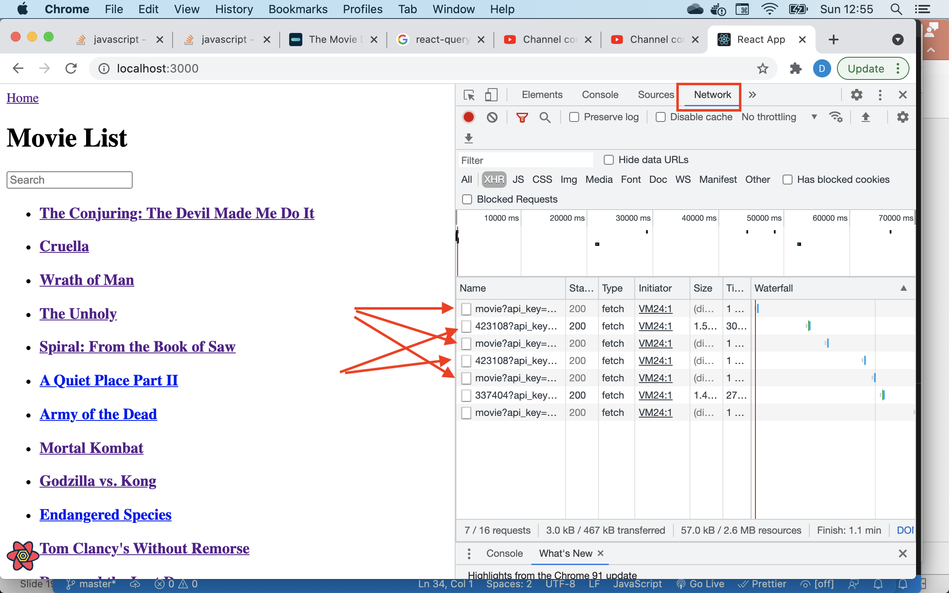
Sample App – The Problem.
Every navigation to the Home page triggers an HTTP request to TMDB.
Similarly for the Detail page.
Both pages use useEffect and useState hooks.

Slide 7
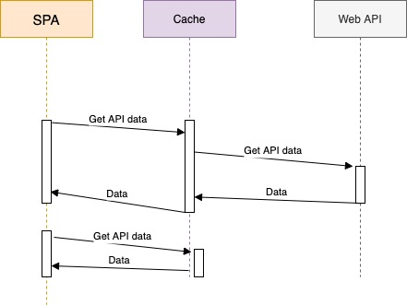
Sample App – The Solution. .
Cache (store temporarily) the API data locally in the browser.
Reduces the workload on the backend for read intensive apps.
Speeds up the rendering time for revisited pages.

Slide 8
Caching (General).
Caches are in-memory datastores with high performance and low latency.
Simple key-value datastores structure.
Keys must be unique.
Value can be any serialisable data type – Object, Array, Primitive.
Cache hit – The requested data is in the cache.
Cache miss - The requested data is not in the cache.
Caches have a simple interface:
serializedValue = cache.get(key)
cache.delete(key)
cache.purge()
Cache entries have a time-to-live (TTL).

Slide 9

The react-query library
3rd party JavaScript (React) caching library.
Provides a set of hooks.
e.g. const { data, error, isLoading, isError } = useQuery(key, queryFunction);
data – from the cache (hit) or returned by the API (miss).
error – error response from API.
isLoading(boolean) – true while waiting for API response.
isError (boolean) – true when API response is an error status.
Causes a component to re-render on query completion.
Replaces your useState and useEffect hooks.

Slide 10
The query key.
“Query keys can be as simple as a string, or as complex as an array of many strings and nested objects. As long as the query key is serializable, and unique to the query's data …..”
const { id } = useParams();
const {…} = useQuery<MovieT, Error>(["movie", id],
() => getMovie(id || ""));
// The query function.
export const getMovie = (id: string) => {
…. Do HTTP GET using a movie id of 1234

Slide 11
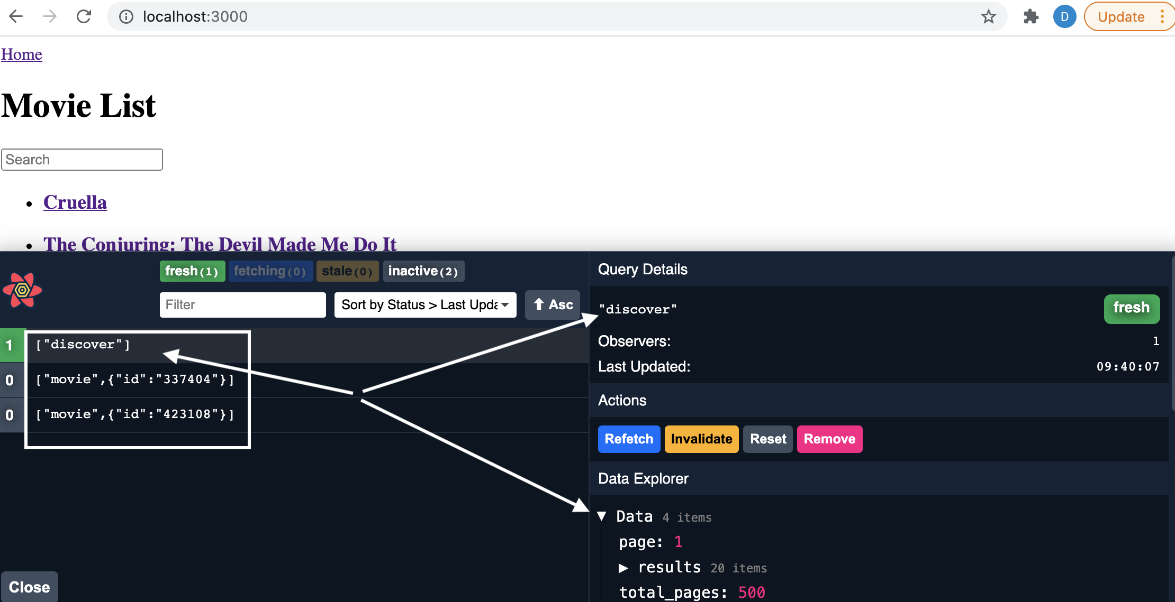
react-query DevTools.
Allows us to observe the current state of the cache datastore – great for debugging.

Slide 12
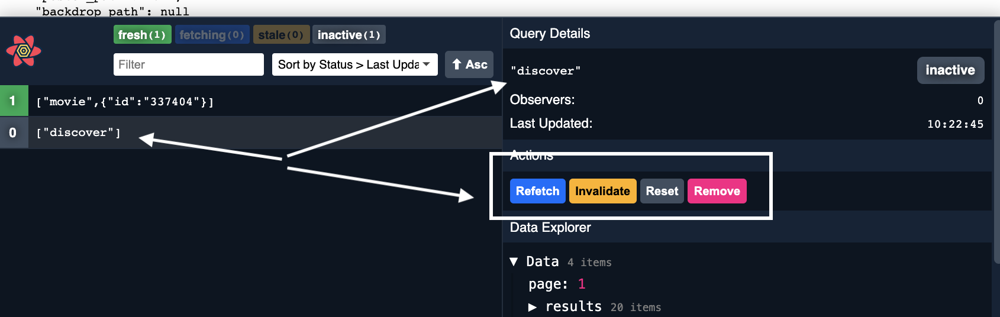
react-query DevTools.
Allows us to manipulate cache entries.
Refresh – force an immediate re-request of data from theAPI.
Invalidate – set entry as ‘stale’. Cache will request update from web API when next required by the SPA.
Reset – only applies when app can mutate the API’s data.
Remove – remove entry from cache immediately.

Slide 13
Summary
State Management - The M in MVC
State:
Client/App state.
Server state.
Cache server state locally in the browser.
Avoid unnecessary HTTP traffic → Reduce page load time
Be aware of cache entry staleness → Use TTL to minimize staleness.
The react-query library
A set of hooks for cache interaction.

