Slide 1

Introduction

Slide 2
Agenda
Background.
The V in MVC
TSX (Typescript Extension Syntax).
Developer tools..
React Component basics.
Material Design.
Notes:
TSX in React refers to TypeScript XML. It is a syntax extension for JavaScript, similar to JSX (JavaScript XML),

Slide 3


React
A Javascript framework for building dynamic Web User Interfaces.
A Single Page Apps technology.
Open-sourced in 2012.
Client-side framework.
More a library than a framework.

Slide 4
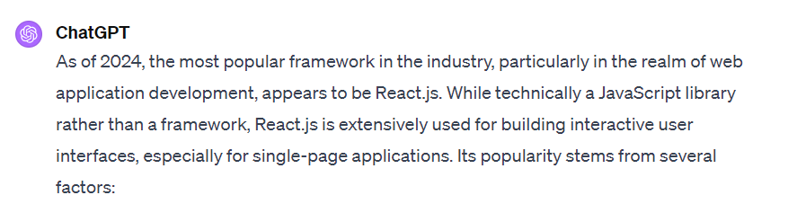
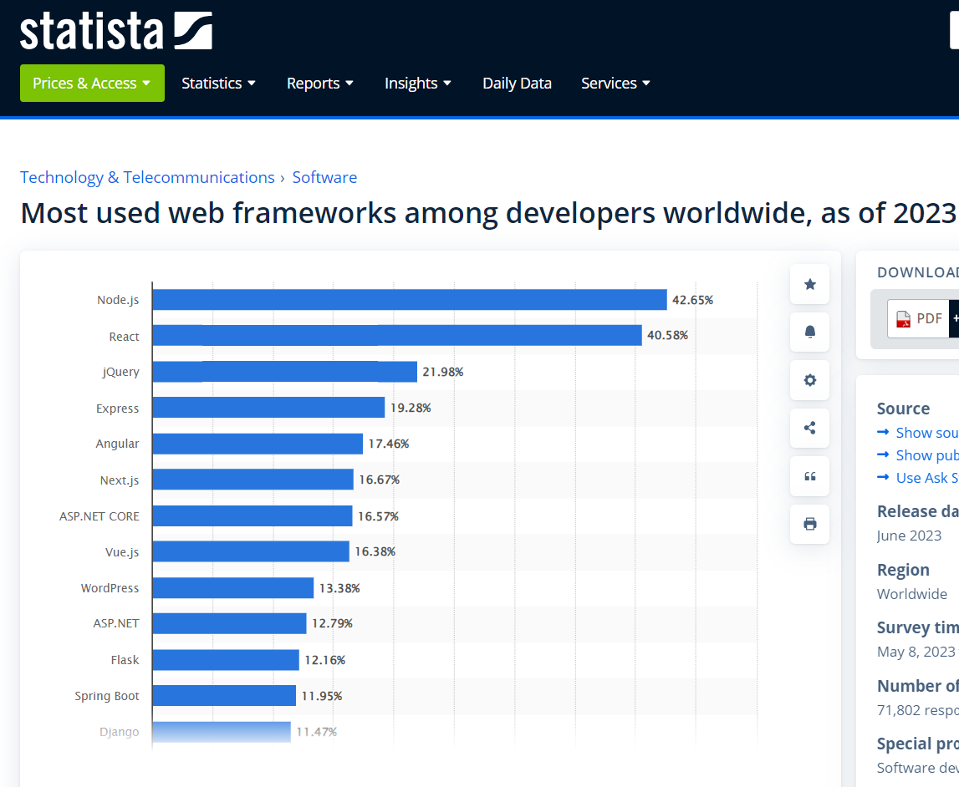
Why React?

Slide 5
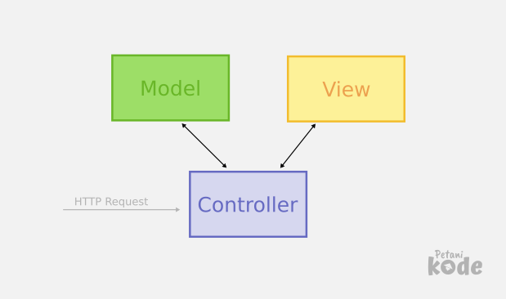
Before React
MVC pattern – The convention for app design. Promoted by market leaders, e.g. AngularJS (1.x), EmberJS, BackboneJS.
React is not MVC, just V.
It challenged established best practice (MVC).
Templating widespread use in the V layer.
React based on “components”.
This Photo by Unknown Author is licensed under CC BY
Notes:
MVC: Model: The model in AngularJS represents the data and business logic
View: The view is the presentation layer of the application
Controller: processes user input, interacts with the model, and determines what data should be displayed by the view.
Templating: Handlebars, Angular has its own built-in templating syntax that allows developers to easily define dynamic and interactive user interfaces.

Slide 6

React Components
Philosophy: Build components, not templates.
All about the User Interface (UI).
Not focused on business logic or the data model (MVC)
Component - A unit comprised of:
UI description (HTML) + UI behaviour (JS)
Two aspects are tightly coupled and co-located.
Pre-React frameworks decoupled them.
Benefits:
Improved Composition.
Greater Reusability.
This Photo by Unknown Author is licensed under CC BY-NC-ND
Notes:
Where is business logic – in the functional components and Contexts Functional Components: functional components can now manage state and side effects, which allows embedding business logic directly within the component. Hooks like useState, useEffect, and custom hooks enable components to handle data fetching, state management, and more. Middleware???

Slide 7

Used to add type definitions to JavaScript codebases.
TypeScript supports JSX (=>TSX)
Include in your React project using @types/react and @types/react-dom
Needs to be Transpiled/Compiled to Javascript to run in Browser/Client.
This Photo b Unknown Author is licensed under CC BY
Notes:
Why bother? . Type Safety
TypeScript provides static typing, allowing you to catch errors early in the development process, such as type mismatches or incorrect function arguments, leading to fewer runtime errors and bugs.
2. Improved Developer Experience
Auto-completion, code navigation, and refactoring are significantly enhanced in TypeScript, thanks to its understanding of the shapes of objects. This makes the development process faster and more efficient.
3. Better Code Quality and Maintainability
TypeScript's type system encourages more explicit contracts for component APIs, making the code easier to read and maintain. It also enforces type checking at compile time, ensuring that components are used correctly.
4. Easy Integration with React
TypeScript integrates seamlessly with React. TypeScript's JSX support allows you to use it directly within your TypeScript files (.tsx), and the React TypeScript definitions are robust and well-maintained.

Slide 8
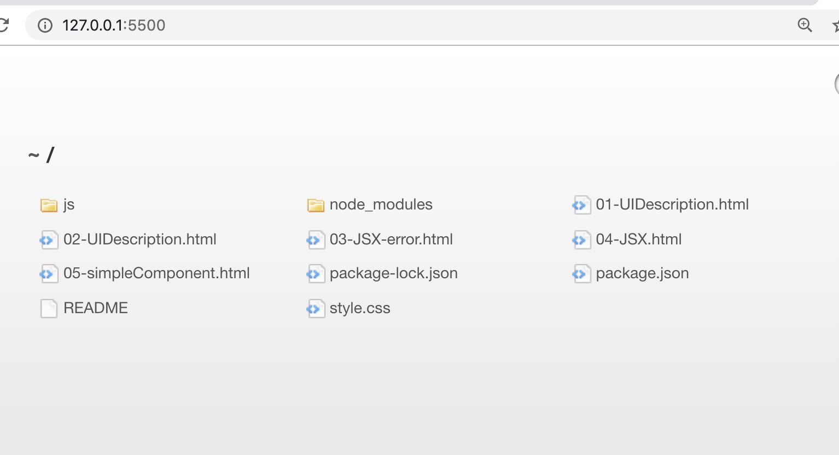
In-Class Code Demos. (See lecture archive)
See Archive accompanying these slides.
Run code using VS Code Live Server extension.

Slide 9
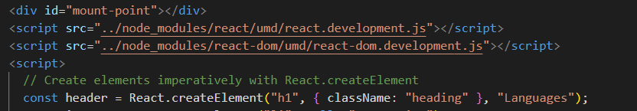
Creating the UI Description. (Vanilla React)
React.createElement() – creates a HTML element.
ReactDOM.createRoot() – used to attach the created element to existing DOM node.
React.createElement() takes three or more arguments:
We don’t use createElement() directly - too cumbersome. More later…
ReactDOM.createRoot () has 1 argument:
Type (e.g. h1, div, …)
Properties (style, event handler…)
Children(0 to many child elements)
DOM element on which to render your React Root Element
Notes:
In React, React.createElement() is a method that creates a new React element of a given type.
The 'type' argument can be either a tag name string (such as 'div' or 'span'), a React component type (a class or a function).
However, in modern React development, JSX (JavaScript XML) is more commonly used instead of React.createElement(). JSX allows you to write HTML-like syntax directly in your JavaScript code, which is often more readable and easier to write.
What’s the DOM: The DOM, or Document Object Model, is a programming interface for web documents. It represents the page so that programs
This is where your React application will be attached or "mounted" in the DOM.

Slide 10
UI Description Implementation (the imperative way)
See the demos:
Ref. 01-UIDescription.html.
Nesting createElement() calls (Ref. 02-UIDescription.html)
----------------------------------------------------------------------
Imperative programming is a programming paradigm that uses statements that change a program's state.
focuses on describing how a program operates, step by step.
Declarative programming is a programming paradigm … that expresses the logic of a computation without describing its control flow.
focuses on what the result should be without specifying how it should achieve the results
Notes:
What’s the DOM: The DOM, or Document Object Model, is a programming interface for web documents. It represents the page so that programs
Imperative programming means explicitly telling the system how to do something step by step.
You manually manipulate the DOM or state.
You focus on the sequence of steps to achieve a result.
Example: Using document.getElementById or useRef to manually update the DOM.
Declarative programming means describing what you want the UI to look like, and React handles updating the DOM for you.
You describe the final state rather than how to achieve it.
You focus on state and data flow instead of direct DOM manipulation.
Example: Using React’s useState to control UI changes.

Slide 11
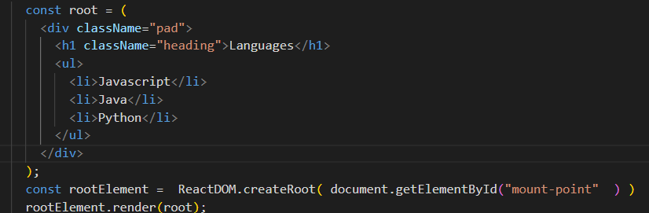
UI description implementation (the declarative way)
TSX – TypeScript XML.
Declarative syntax for coding UI descriptions.
Retains the full power of Typescript.
Allows tight coupling between UI behavior and UI description.
However, must be transpiled before being sent to browser.
Reference 03-JSX-error.html and 04-JSX.html
Notes:
It allows you to write HTML tags in TypeScript files. TypeScript supports JSX and provides type-checking for JSX code, enabling developers to use JSX syntax within TypeScript files (.tsx extension) for building user interfaces in a more expressive and HTML-like syntax.

Slide 12
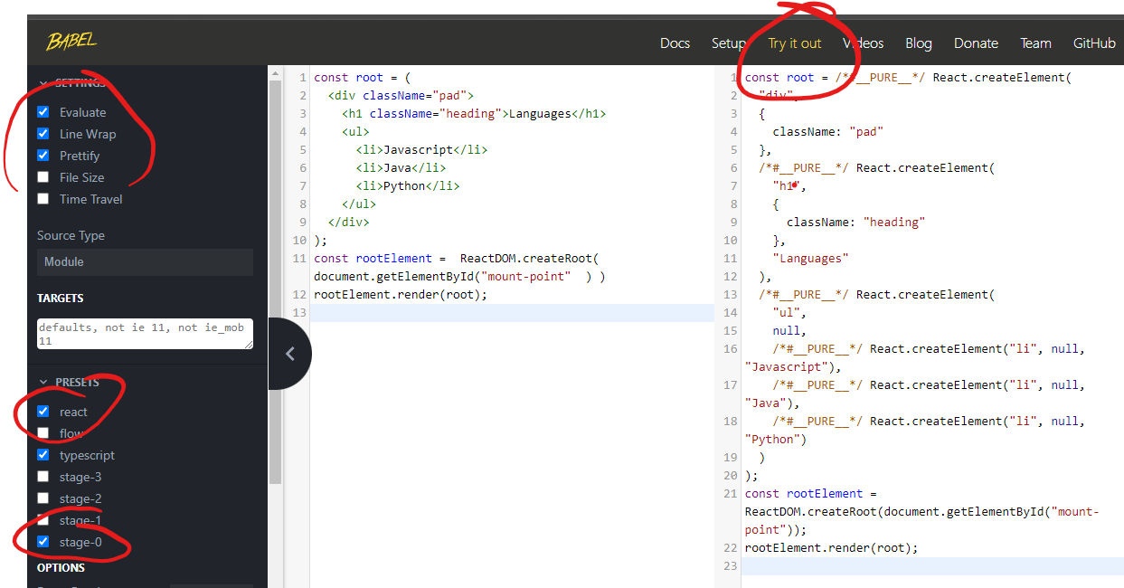
REPL (Read-Evaluate-Print-Loop) transpiler.
Reference
04-JSX.html

Slide 13

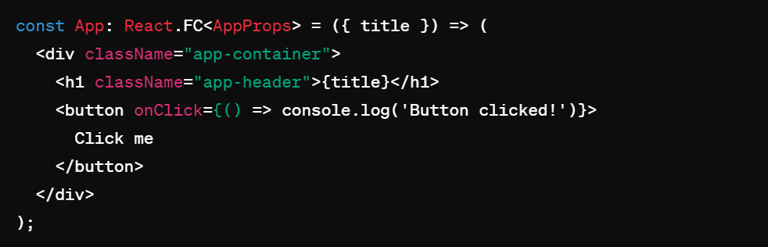
TSX(TypeScript XML)
JSX(Javascript XML) is a file syntax extension used by React. JSX resembles HTML, allowing developers to write UI components with an HTML-like (it is actually XML).
TSX is the TypeScript version of JSX, TypeScript is a superset that adds static typing in JavaScript.
Typescript files containing TSX use the .tsx extension.
Some minor HTML tag attributes differences, e.g. className (class), htmlFor (for).
Allows UI description to be coded in a declarative style and be in-lined in TypeScript.
Combines templating with the power of TS.

Slide 14
TSX Transpiling
So browsers don’t do Typescript!
Needs to be Transpiled to Javascript
What can we use to Transpile?
The Babel platform.
The Vite library.
How?
Manually, via REPL environment or command line.
When experimenting only.
Using an instrumented web server – Vite library instrumentation.
Ideal for development.
Using bundler tools as part of the build process – Vite again.
Production standard.
Notes:
REPL stands for "Read-Eval-Print Loop".

Slide 15
React Components.
We develop COMPONENTS.
A TS function that returns a UI description, i.e. TSX.
We reference a component like a HTML tag.
e.g.
const rootElement =
ReactDOM.createRoot(document.getElementById("mount-point"));
rootElement.render( <DynamicLanguages/> );
Reference 05-simpleComponent.html

