Slide 1


Developer Tools
Introduction to

Slide 2
React Developer Tools - Vite
Features:
Scaffolding/Generator.
Development web server: auto-transpilation on file change + live reloading (HMR – Hot Module Replacement).
Builder: build production standard version of app, i.e. minification, bundling.

Slide 3

React Developer Tools - Storybook
Features:
A development environment for React components.
Allows components be developed in isolation.
Promotes more reusable, testable components.
Quicker development – ignore app-specific dependencies.

Slide 4

Installation:
$ npm install @storybook/react
The tool has two aspects:
A web server.
$ ./node_modules/.bin/start-storybook -p 6006 -c ./.storybook
Performs live re-transpilation and re-loading.
Web browser user interface.
Start up using package.json script

Slide 5

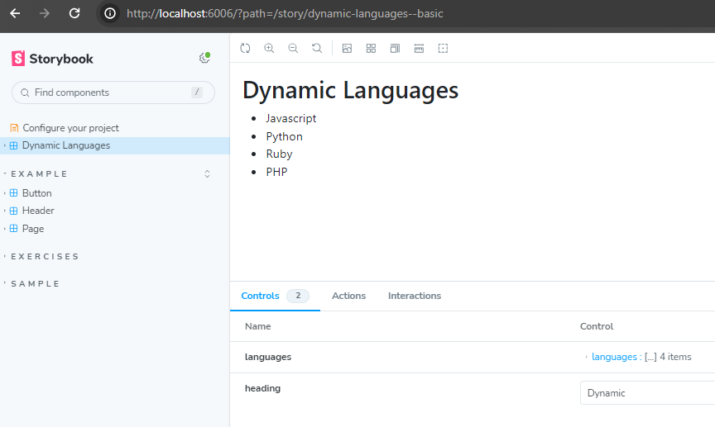
Storybook User interface.
Component
Rendering.
Component arguments and actions (callbacks)
Component catalogue
Notes:
Storybook Controls gives you a graphical UI to interact with a component's arguments dynamically without needing to code. It creates an addon panel next to your component examples ("stories"), so you can edit them live.

Slide 6
What is a Story?
A component may have several STATES
State affects how it renders.
Each state case termed a “STORY”
Example: DynamicLanguages component.
States might be:
Default – 5 or less languages → Render full list
Boundary – empty list → Render ‘No languages’ message
Exceptional – More than 5 languages → Render first 5 and a ‘See More…’ link to display next 5.
Stories are a design consideration written in Component Story Format (CSF)
They are functions that describes how to render components

Slide 7
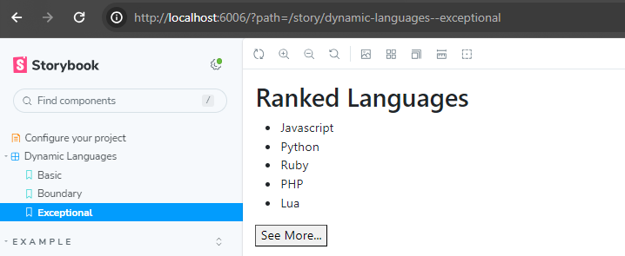
List a component’s states/stories under its name:
Set of Component Stories: (i.e. Basic, Boundary, Exceptional)

Slide 8
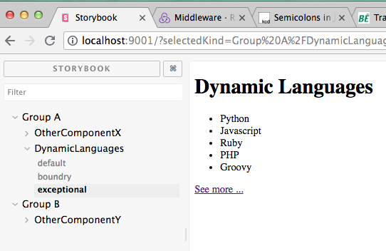
Define component groups when component catalogue is large.
helps others team members with searching.

Slide 9
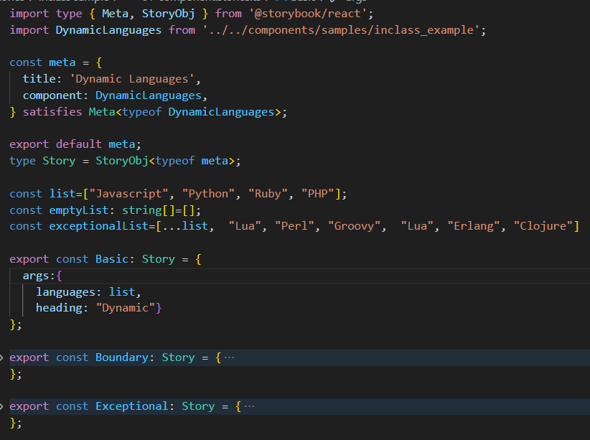
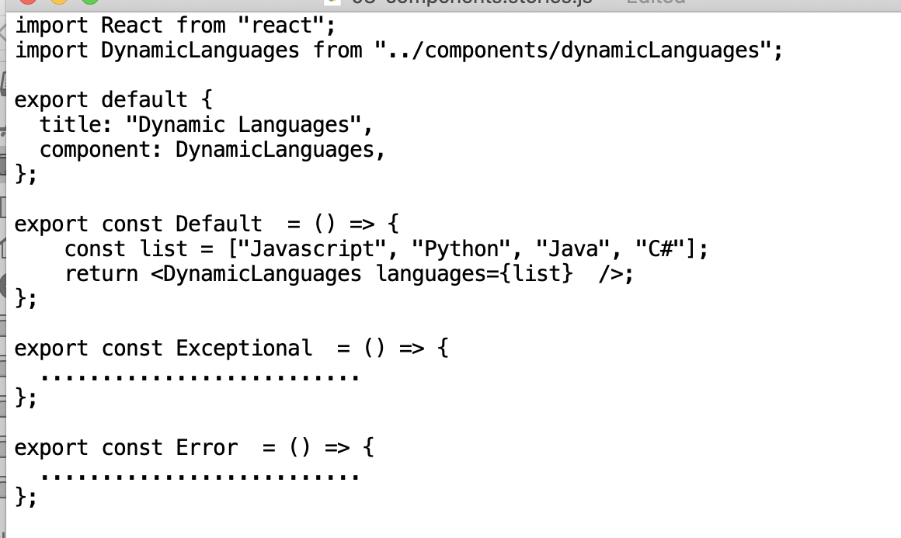
Writing stories
.stories.ts file extension (convention)
1 Stories file per component
default export; Metadata; How Storybook lists components.
Story implemented as a function.
Named exports.
UpperCamelCase
3 stories for this component
Notes:
Meta and StoryObj are types from @storybook/react used to define metadata and story objects.
StaticComponent is the React component being documented and tested with Storybook.
meta is an object that contains metadata about the story, including the title and the component being documented.
title specifies the name under which the story will appear in the Storybook UI.
component specifies the React component that this story is for.
export default meta; exports this metadata as the default export of the module.
Story is a type alias for a story object based on the meta type.
Basic is a story that currently does not have any arguments (args) defined. It represents a basic state of the StaticComponent without any props.
Meta<typeof Button>: This type annotation specifies that meta should conform to the Meta type. . The Meta type is generic, meaning it can operate on different types of inputs. In this case, it's being used with our Component, making it specific to the Dynamic Languages component.

Slide 10
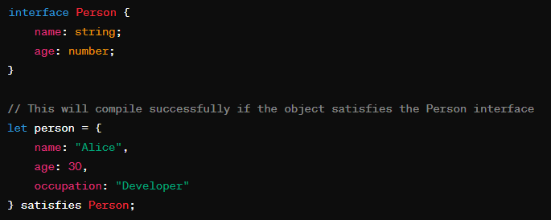

Aside: The satisfies Operator
TypeScript 4.9 introduces a new operator, satisfies
Allows you to check that an expression matches a particular type.
Used in Stories to ensure an object conforms to a type without casting
Would cause a compile error if age was missing

Slide 11
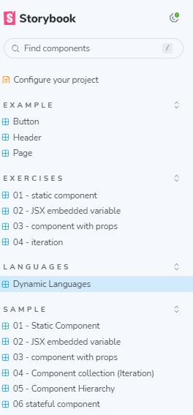


Grouping stories.
Use directory pathname symbol ( / ) to indicate component grouping (i.e. group/subgroup/….).

