Slide 1

… back to components . . .
This Photo by Unknown Author is licensed under CC BY-NC-ND

Slide 2
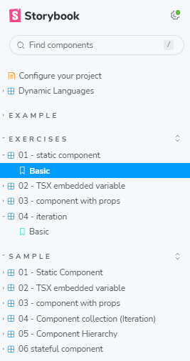
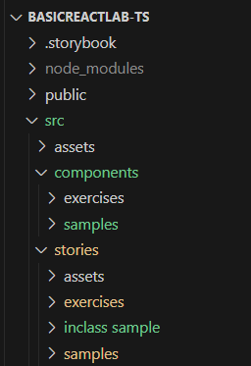
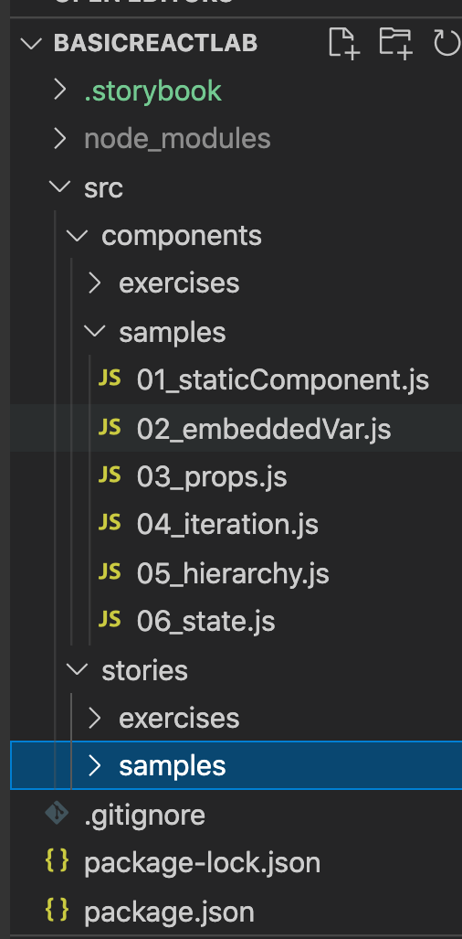
Demo Samples (See lab exercise)
Configuration – boilerplate
Lab exercise
Sample
Components
Stories

Slide 3
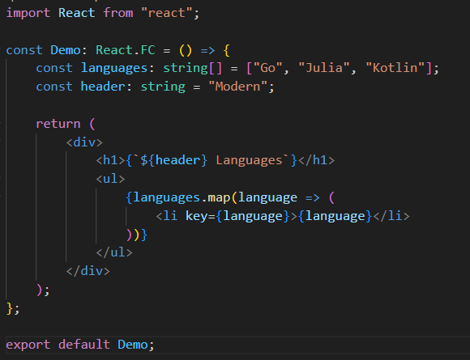
TSX - embedded variables.
Use { } to reference variable embedded in TSX.
Curly braces can contain any valid TS expression.
Reference src/components/samples/02_embeddedVariables.tsx
Notes:
defining a functional component in React using TypeScript. Here's a breakdown of what's happening:
const Demo: This is declaring a constant named Demo. In React, it's conventional to start component names with a capital letter.
React.FC: This is a TypeScript type that stands for "React Function Component". It's a type provided by the @types/react package, which provides TypeScript definitions for React. By typing Demo as React.FC, you're telling TypeScript that Demo is a functional component.

Slide 4
Reusability.
We achieve reusability through parameterisation.
props – Component properties / attribute / parameters.
Passing props to a component:
<CompName prop1Name={value} prop2Name={value} . . . . />
Access inside component via props object:
const ComponentName React.FC<PropInterface> = (props) => {
const p1 = props.prop1Name
. . . . . . . .
Props are Immutable.
Part of a component’s design.
Reference src/components/samples/03_props.tsx (and related story).

Slide 5

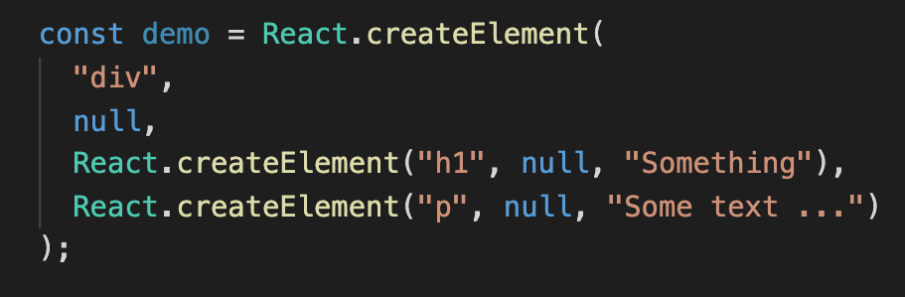
Aside.
We can assign a single TSX element to a variable.
Why?

Slide 6
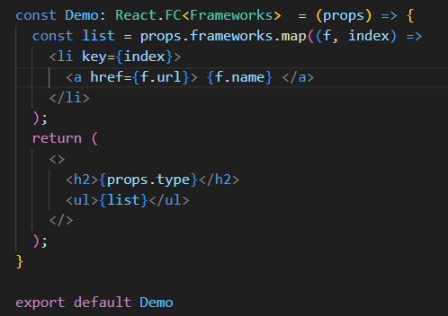
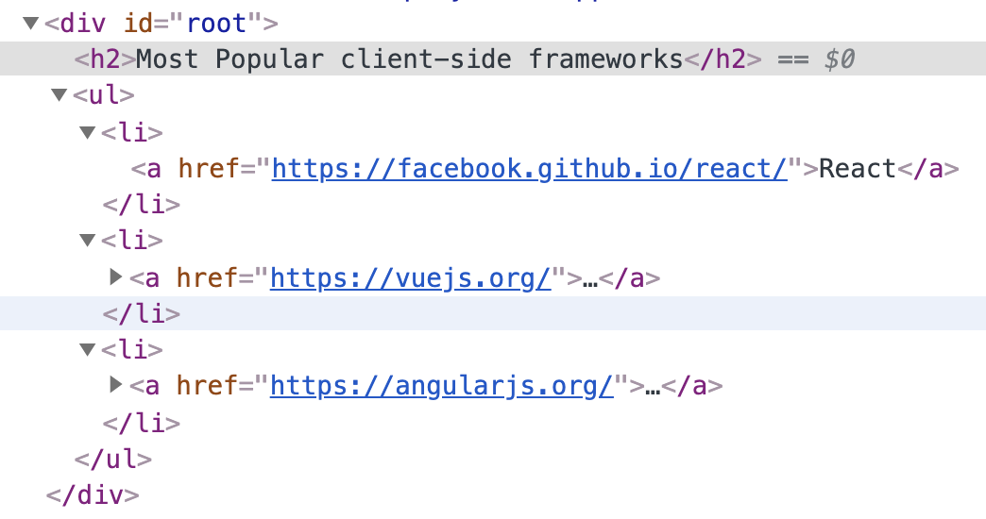
Component collection - Iteration
Use case: Generate an array of (similar) component from a data array.
Reference: src/components/samples/04_iteration.tsx
map used to to create a new array based on the frameworks array passed in through the `props` object.
Required HTML produced by component.
(From Chrome Dev Tools)
Notes:
his is calling the map method on the frameworks array. map is a built-in JavaScript method that creates a new array by applying a function to every elem

Slide 7
Component return value.
Examples:;
return <MyComponent prop1={…..} prop2={……} /> ;
return (
<div>
<h1>{this.props.type}</h1>
<MyComponent prop1={…..} prop2={……} />
<p>
. . . . . .
</p>
</div>
) ;
Must enclose in ( ) when multiline.

Slide 8
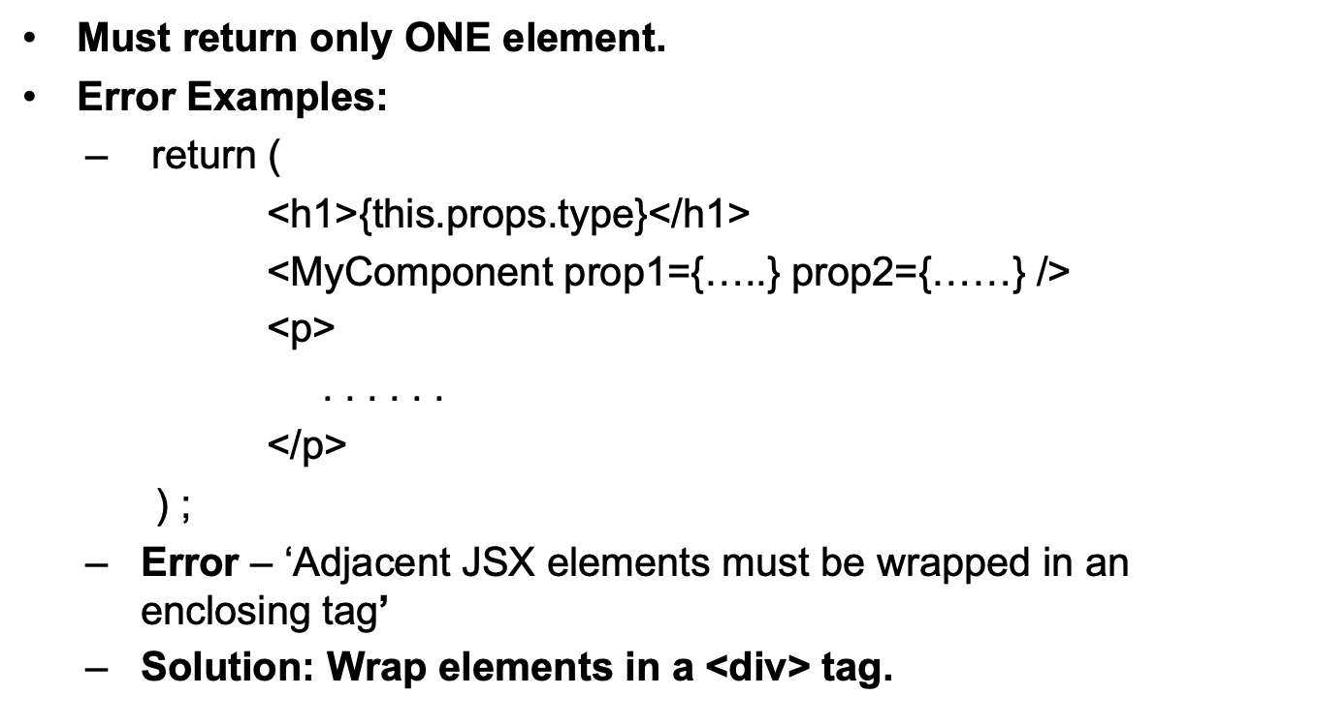
Component return value.

Slide 9
Component return value.
Old solution:
return (
<div>
<h1> ……</h1>
<MyComponent …… />
<p> …….. </p>
</div>
) ;
Adds unnecessary depth to DOM → affects performance.
Alternative solution:
return (
<>
<h1> ……</h1>
<MyComponent …… />
<p> …….. </p>
</>
) ;
<> </> – special React element, termed Fragment.
No DOM presence.

Slide 10
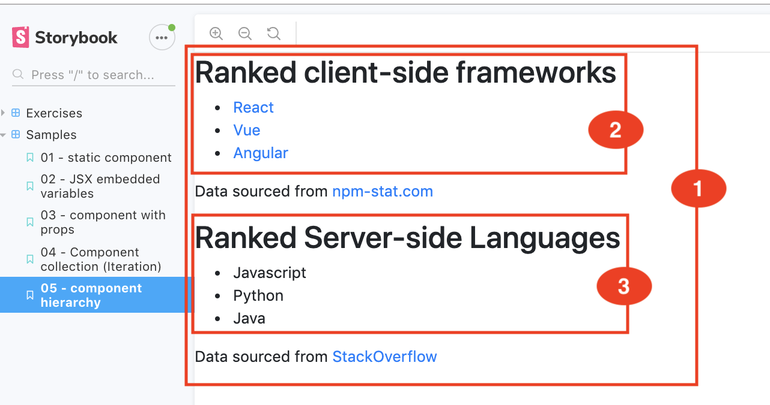
Component Hierarchy.
All React application are designed as a hierarchy of components.
Components have children – nesting.
Ref. src/components/samples/05_hierarchy.ts.

Slide 11
Summary.
TSX.
UI description and behaviour tightly coupled.
Can embed variables/expressions with braces.
All about components.
A function that takes a props argument and returns a single TSX element .
Components can be nested.
Storybook tool.
Develop components in isolation.
Story – the state (data values) of a component can affect its rendering (and behaviour).

