Slide 1

Material UI.
A 3rd party component library to build high quality digital UIs

Slide 2
Material Design.
Material (Design) is a design system created by Google to help teams build high-quality digital experiences for Android, iOS, and web.
A visual language that synthesizes classic principles of good design with the innovation and possibility of technology and science.
Inspired by:
the physical world and its textures, including how they reflect light and cast shadows.
the study of paper and ink.
Material is a metaphor.
Material surfaces reimagine the mediums of paper and ink.

Slide 3
Material Components.
Material Components are interactive building blocks for creating a digital user interface.
They cover a range of interface needs, including:
Display: Placing and organising content using components like cards, lists, and grids.
Navigation: Allowing users to move through an application using components like navigation drawers and tabs.
Actions: Allowing users to perform tasks using components such as the floating action button.
Input: Enter information or make selections using components like text fields and selection controls.
Communication: Alerting users to key information and messages using snackbars, banners and dialogues.

Slide 4
Theming.
Material Design does not mean copy Google design.
Material Theming makes it easy to customize Material Design to match the look and feel of your brand, with built-in support and guidance for customizing colors, typography styles, and corner shape.
Colour - Material’s colour system is an organised approach to applying colour to a UI. Global colour styles have semantic names and defined usage in components – primary, secondary.
Typography - The Material type system provides 13 typography styles for everything from headlines to body text and captions.
Each style has a clear meaning and intended application within an interface.

Slide 5
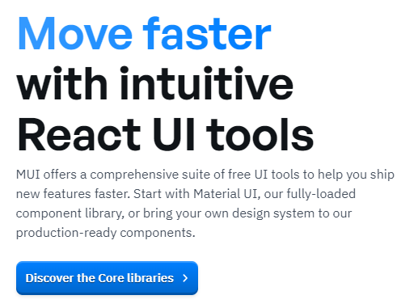
Material UI
MUI is a React component library based on the Material Design system.
Its React components include: <Card />, <Box />, <Grid />, <Menu />, <Button />, <Icon />, <Snackbar />, <Typography /> ……
Build your own design system or start with Material Design.
The CSS-in-JS model.

Slide 6
CSS-in-JS
Plain CSS
.my-header {
background-color: lightblue;
padding: 10px;
}
-------------------
import ‘app.css’
<header
className=”my-header">
………..
</header>
CSS-in-JS
const myHeader = {
backgroundColor: "lightblue",
padding: "10px”
};
. . . . . . . . .
<header style={myHeader}>
……….. </header>
Must be CamelCase

Slide 7
Many Alternatives
Libraries:
Tailwind
Chakera
React-Bootstrap
Design Systems:
ANT
CSS models:
CSS modules
BEM

