Slide 1

Navigation
(Continued)

Slide 2
Agenda.
Navigation / Routing (Contd.)
Design Patterns – The Provider Pattern
Protected/Private Routes.
  A use case in the Provider pattern and

Slide 3
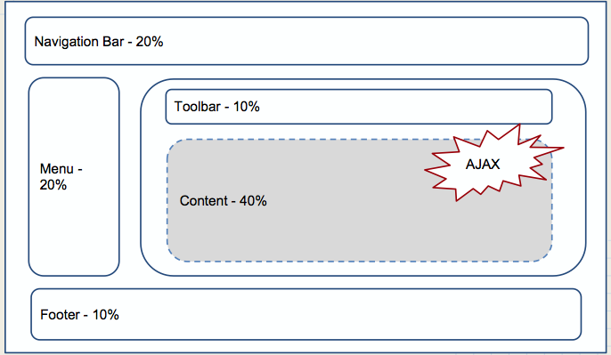

Typical Web app layout
Determined by URL

Slide 4
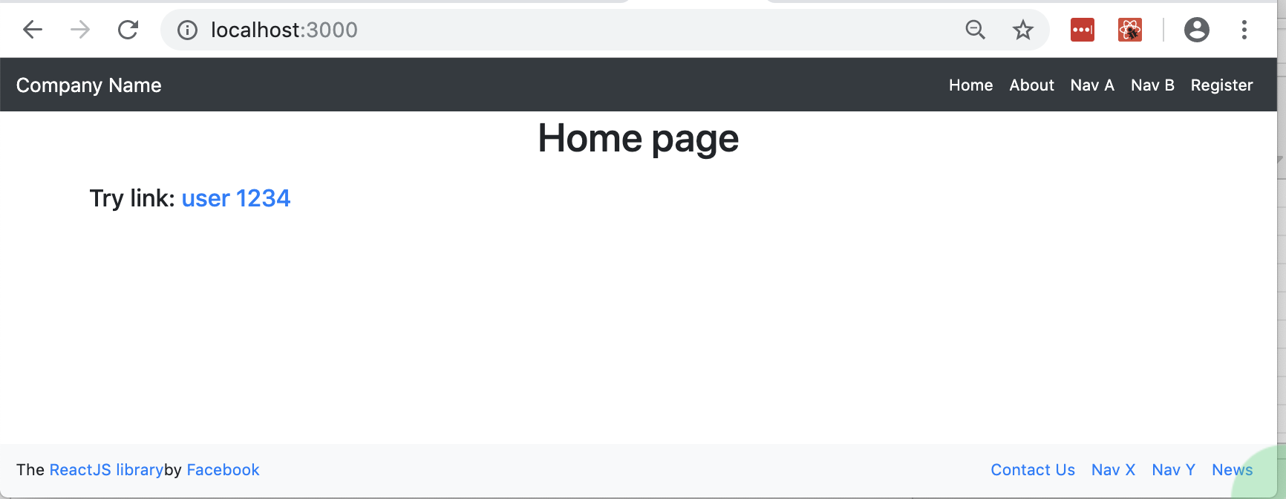
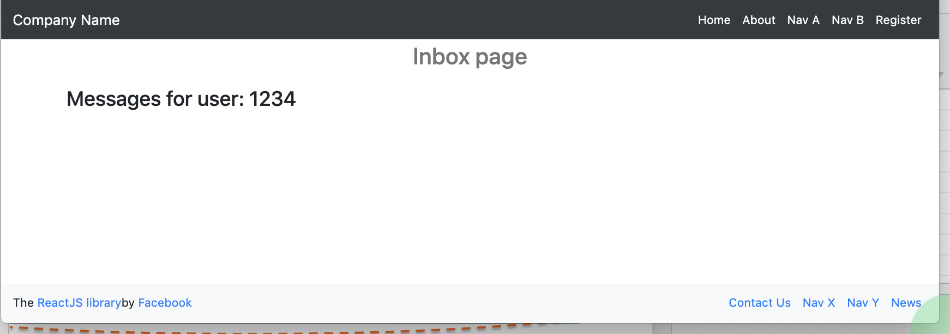
Persistent elements/components
Use cases: Site-wide Headers. Footers. Side menus.

Slide 5
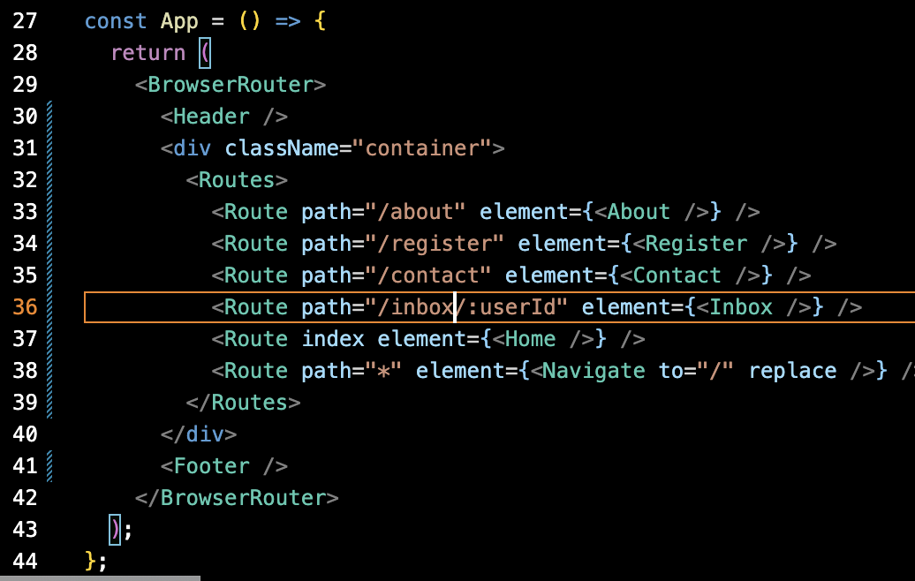
Persistent elements/components
Ref. src/sample6

Slide 6
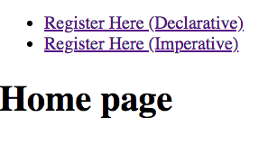

Programmatic Navigation.
Perform navigation a component’s JS logic.
Two options:
  Declarative –custom state variable and <Navigate />.
  Imperative – the useNavigate hook
EX.: See /src/sample7/.

Slide 7
Routing Summary
React Router package adheres to React principles:
  Declarative.
  Component composition.
  The event → state change → re-render
Package’s main components - <BrowserRouter>, <Route>, <Navigate>, <Link>.
Special hooks to allow us access routing data/methods, e.g. useParams, useNavigate, useLocation.

Slide 8
Design Patterns
(Contd.).
The Provider pattern - React Context

Slide 9
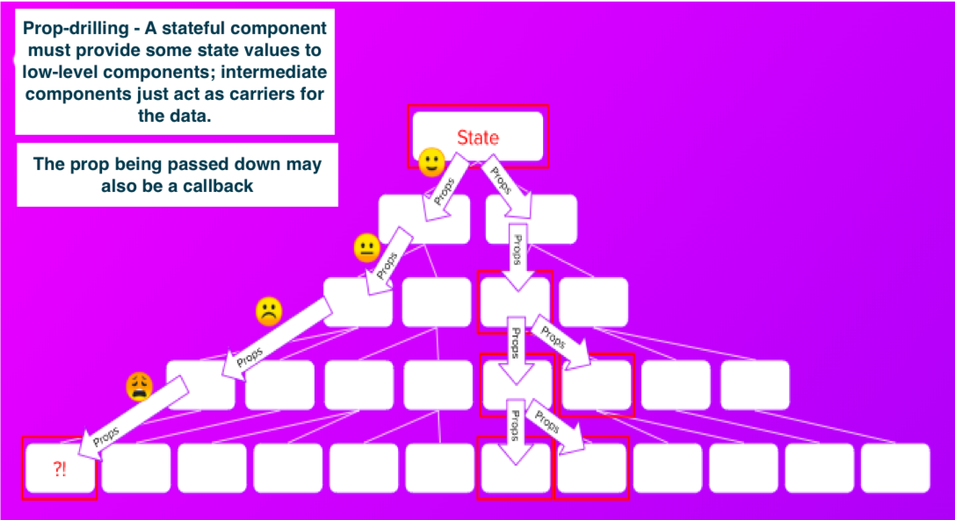
The Provider pattern – When?
Use cases:
  Sharing data/state with multiple components, i.e. global data, e.g. favourite movies.
  To avoid prop-drilling.

Slide 10
The Provider pattern – How?
React Implementation steps:
  Declare a component to manage the shared data – the Provider component.
  Create a context construct and link it to the Provider.
  Wrap the shared data in the context.
  Compose the Provider with other components to allow them access the context.
Context – the glue for the Provider pattern in React.
  Avoids prop drilling.
  Provider component manages the context.
  Consumer’s access the context with the useContext hook

Slide 11
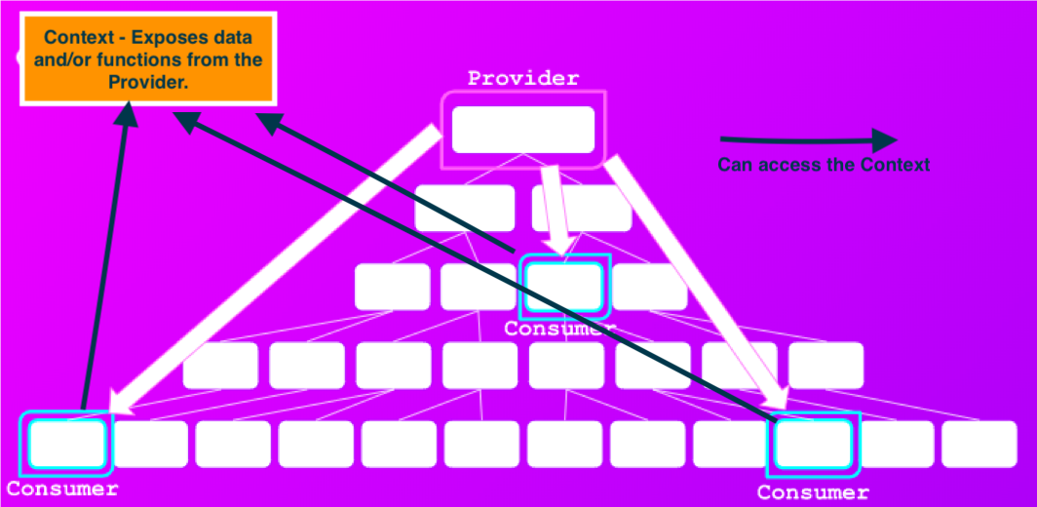
The Provider pattern – React Context.

Slide 12
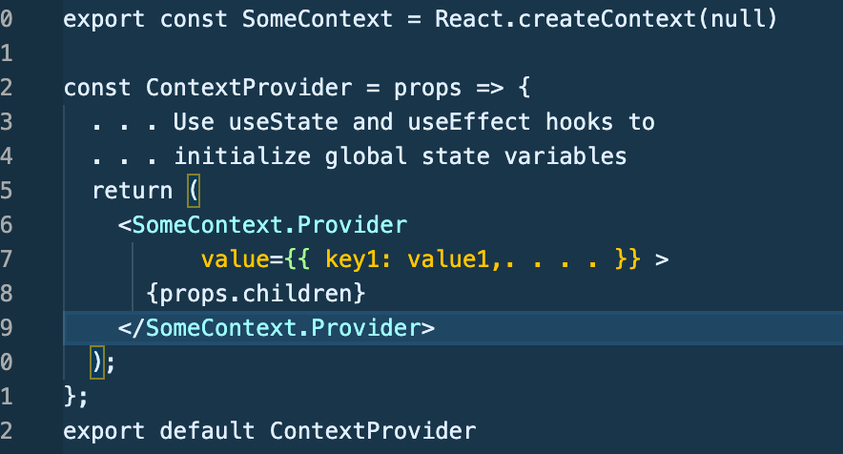
The Provider pattern – Implementation
Declare the Provider component:
We link the Context to the Provider component using <contextName.Provider>.
The values object declares the context’s content. .
  Can be functions (behaviour) as well as data (state).

Slide 13
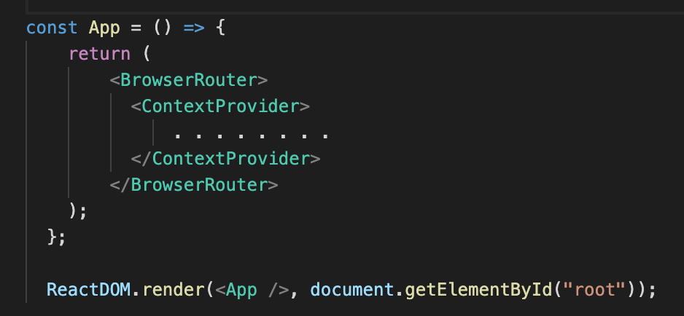
The Provider pattern – Implementation.
Integrate (Compose) the Provider with the rest of the app, using the Container pattern.
All the app’s pages can now access the context.

Slide 14
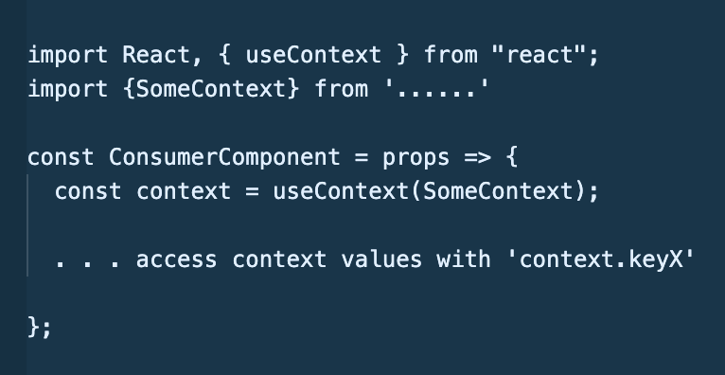
The Provider pattern – Implementation.
useContext hook – givss a component access to a context:
    const contextRef = useContext(ContextName)
    // contextRef points at context’s values object.

Slide 15
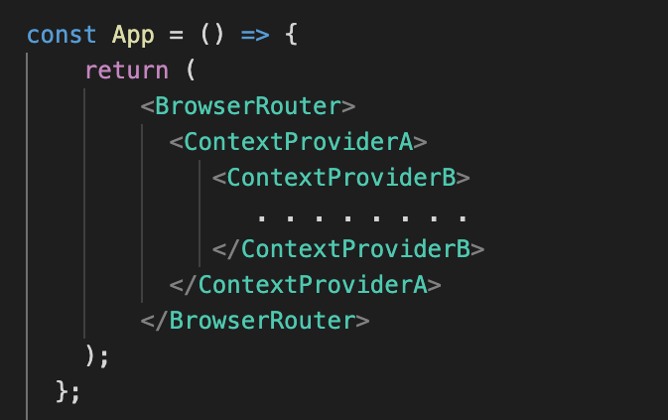
The Provider pattern – Implementation.
For improved separation of concerns, use multiple context instead of a ‘catch all’ context.

Slide 16
The Provider pattern.
When NOT to use a Context:
  To avoid ‘shallow’ prop drilling.
    Prop drilling is faster for ‘shallow’ cases.
  For state that should be kept local to a component, e.g. web form inputs.
  For large object - monitor performance and refactor as necessary.

Slide 17
Authentication and Protected/Private Routes
(See Routing samples Archive)

Slide 18
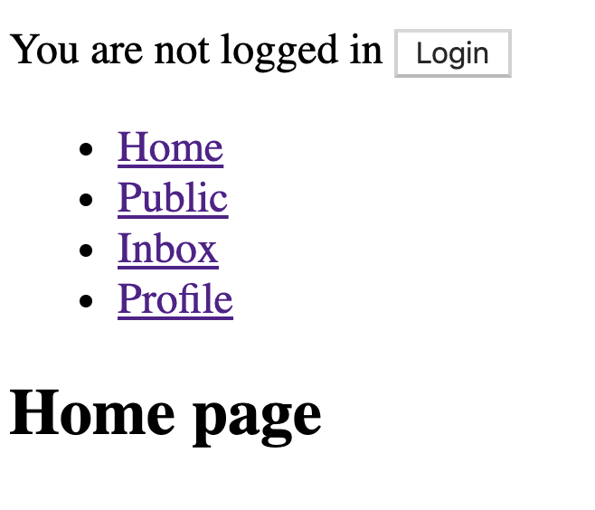
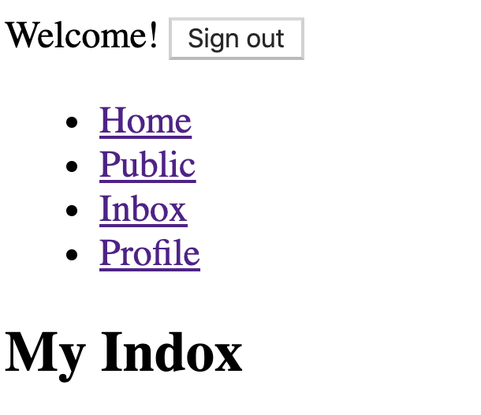

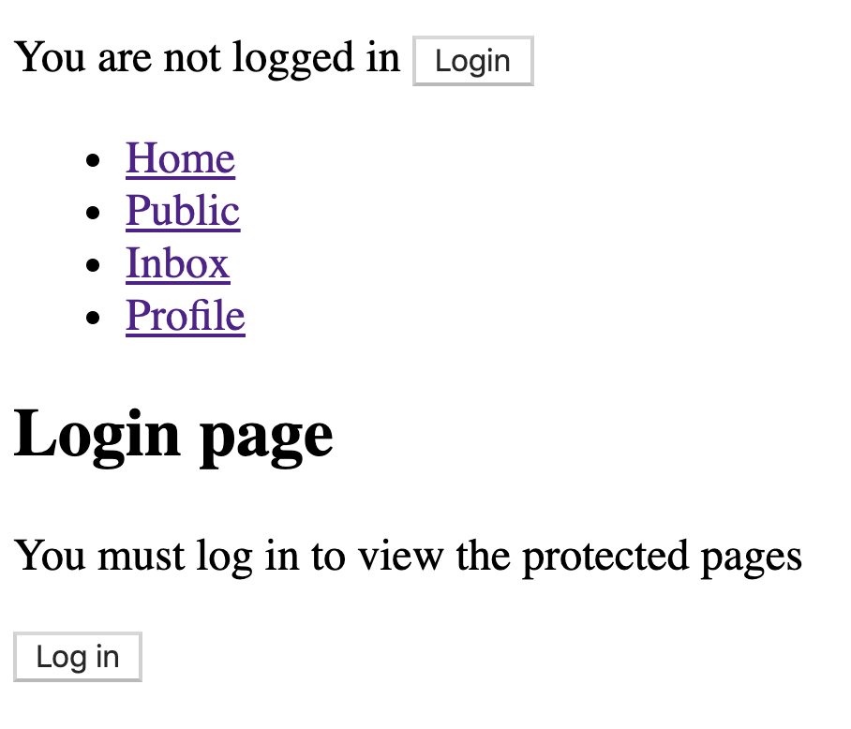

Objective

Slide 19
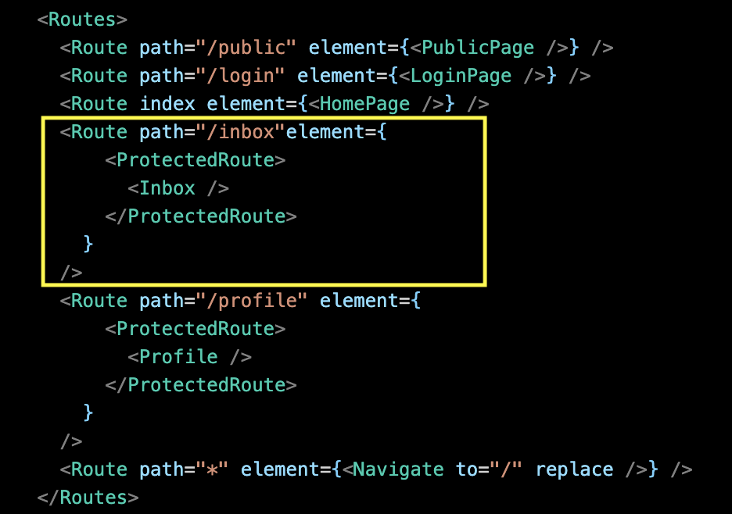
Protected Routes - Solution outline.
Not native to React Router.
We need a custom solution.
Solution outline: A clear, declarative style for declare the views/pages that require authentication.

Slide 20
Solution elements.
Solution features:
  A React Context to store the current authenticated user’s token.
  Programmatic navigation - to redirect unauthenticated user to login page.
  Remember user’s intent prior to the forced authentication step.

Slide 21
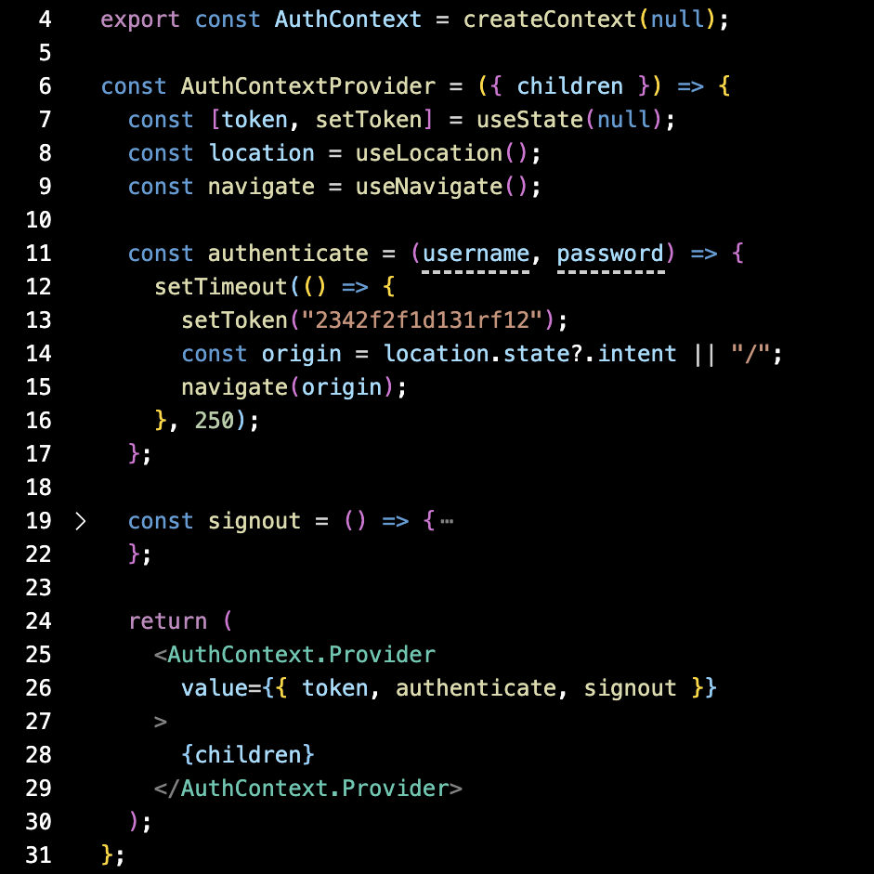
Implementation
Solution elements: The AuthContext.

Slide 22
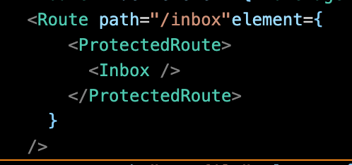
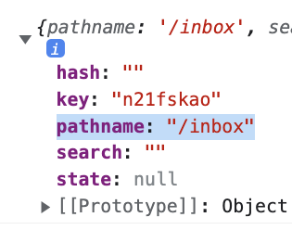
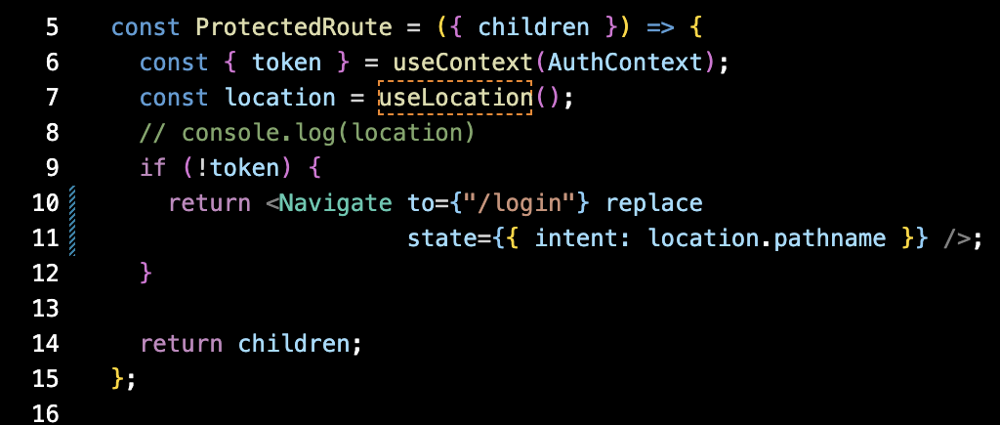
Implementation
Solution elements (Contd.): <ProtectedRoute />

Slide 23
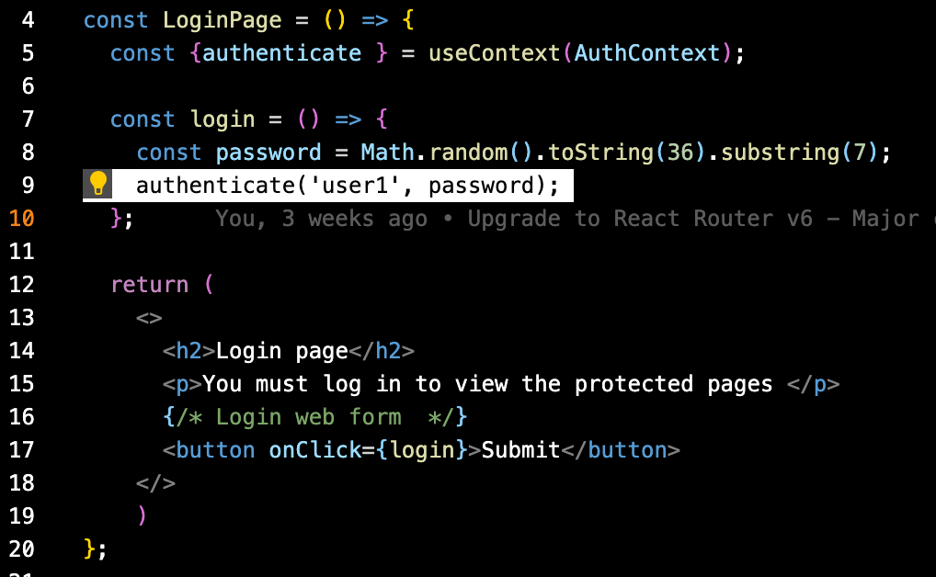
Implementation
Solution elements (Contd.): The Login Page.

Slide 24
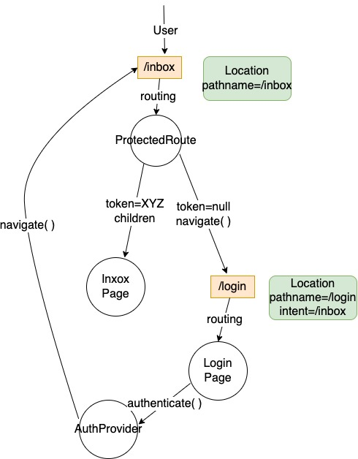
Implementation - Flow of control.
When an unauthenticated user tries to access /inbox

Slide 25
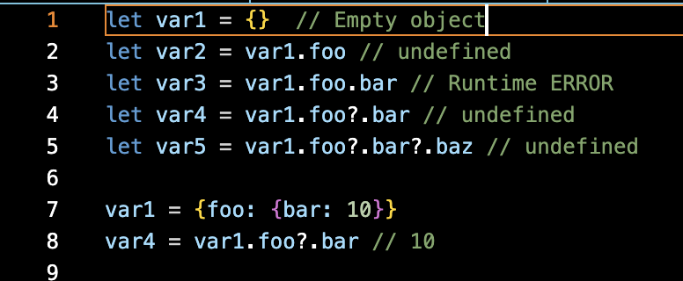
The optional chaining operator (?.)
The optional chaining operator (?.) accesses an object's property. If the property is undefined or null, the expression short circuts and evaluates to undefined instead.

Slide 26
The code archive.
Two implementations:
Version 1 - AuthContext and login page only; No ProtectedRoute or Remember intent.
Version 2 – Full implementation.
The fakeAuth() function and the async/await model for asynchronous programming.

