Slide 1

ReactJS.
The Component model

Slide 2
Topics
Component State.
Basis for dynamic, interactive UI.
Data Flow patterns.
Hooks.

Slide 3
Component Data
A component has two sources of data:
Props - Passed in to a component; Immutable; the props object.
State - Internal to the component; Causes the component to re-render when changed / mutated.
Both can be any data type - primitive, object, array.
Props-related features:
Default values.
Type-checking.
State-related features:
Initialisation.
Mutation – using a setter method.
Automatically causes component to re-render. ***
Performs an overwrite operation, not a merge.

Slide 4
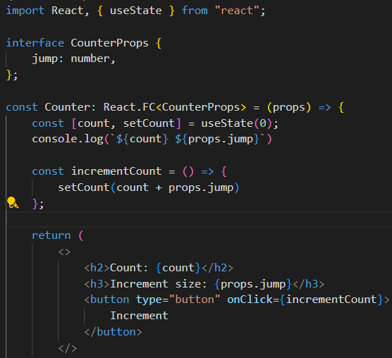
Stateful Component Example
jump (number)
The Counter component.
Ref. basicReactLab samples – sample 06.
The useState() function:
Declares a state variable.
Returns a Setter / Mutator method.
Termed a React hook.
Counter
count = 0
Increment
Notes:
Functional Component:
Interface: useState Hook: The useState Hook allows you to add React state to function components. In the example above, useState is called with the initial state. In this case, the initial state is 0 because our counter starts from zero. The useState Hook returns a pair: the current state value (count in our example) and a function that lets you update it (setCount).

Slide 5
React’s event system.
Cross-browser support.
Event handlers receive a React Event Object – a cross-browser wrapper for the browser's native event.
React event naming convention slightly different to native:
See https://react.dev/learn/responding-to-events and https://react.dev/reference/react-dom/components/common#react-event-object
for full details
React | Native
onClick | onclick
onChange | onchange
onSubmit | onsubmit

Slide 6
Automatic Re-rendering.
EX.: The Counter component.
User clicks button
→ onClick event handler executes (incrementCounter)
→ handler changes component’s state (setCount())
→ component function re- executed (re-rendering)

Slide 7
Topics
Component State. ✔
Data Flow patterns.
Hooks.

Slide 8
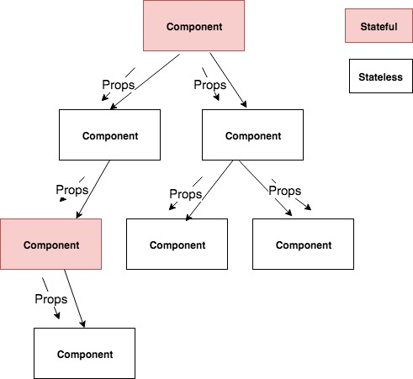
Unidirectional data flow
Notes:
In React, data flow is unidirectional ONLY.
Other SPA frameworks use two-way data binding.
Typical React app pattern: A small subset of the components are stateful; the majority are stateless.
Stateful component execution flow:
User interaction causes a component state change.
Component re-renders (re-executes).
Component recomputes the props for its subordinate components.
Subordinate components re-render, and recomputes props for its subordinates.
etc.
Stateful Components
Stateful components are those that maintain their own state. They are responsible for managing the state of the application and reacting to user input, server responses, or other events that change the state. These components are function components that use hooks like useState and useEffect.
Stateless Components
Stateless components, on the other hand, do not manage their own state. They receive data and functions as props from their parent components and render the UI based on these props. Stateless components are usually function components that simply return JSX.

Slide 9
Unidirectional data flow
In React, data flow is unidirectional ONLY.
Other SPA frameworks use two-way data binding.
Typical React app pattern: A small subset of the components are stateful; the majority are stateless.
Stateful component execution flow:
User interaction causes a component state change.
Component re-renders (re-executes).
Component recomputes the props for its subordinate components.
Subordinate components re-render, and recomputes props for its subordinates.
etc.
Notes:
Stateful Components
Stateful components are those that maintain their own state. They are responsible for managing the state of the application and reacting to user input, server responses, or other events that change the state. These components are typically class components (in older React versions) or function components that use hooks like useState and useEffect.
Stateless Components
Stateless components, on the other hand, do not manage their own state. They receive data and functions as props from their parent components and render the UI based on these props. Stateless components are usually function components that simply return JSX.
Why the Majority are Stateless
Simplicity and Reusability: Stateless components are simpler to write and understand. They are easier to reuse since they do not maintain their own state and rely solely on the data passed to them via props.
Separation of Concerns: By keeping most components stateless, React applications can maintain a clear separation of concerns. Stateful components handle the logic and state management, while stateless components focus solely on rendering the UI.
Performance: Stateless components tend to be more performant because they do not need to manage state and thus have less overhead. They are also easier for React to optimize, especially with the introduction of hooks and React.memo for memoization.
Testability: Stateless components are easier to test because they simply render UI based on props. This makes unit testing more straightforward since there is no internal state to manage.
Maintainability: Applications with a small number of stateful components are generally easier to maintain. State management can become complex, so limiting the number of stateful components helps in keeping the application architecture clean and manageable.

Slide 10
Topics
Component State. ✔
Data Flow patterns. ✔ (more later)
Hooks

Slide 11
React Hooks
Introduced in version 16.8.0 (February 2019)
React Hooks are:
Functions (some are HOFs).
That performs component state manipulation and lifecycle management.
Examples: useState, useEffect, useContext, useRef, etc
‘use’ prefix is necessary for linting tools.
Usage Rule:
Can only call hooks at the ‘top level’ in a component.
i.e. Don’t call hooks inside loops or condition statements.

Slide 12
useEffect Hook
Used when a component needs to perform side effects.
Side Effect example:
fetching data from a web API.
Subscribe to a browser events, e.g. window resize.
Signature: useEffect(callback, dependency array)
The callback contains the side effect code.
Dependencies determine when a hook is executed.
useEffect is executed:
On component mounting.
On every rendering that coincides with a dependency entry update.
An empty dependency array restricts execution to mount-time only.

Slide 13
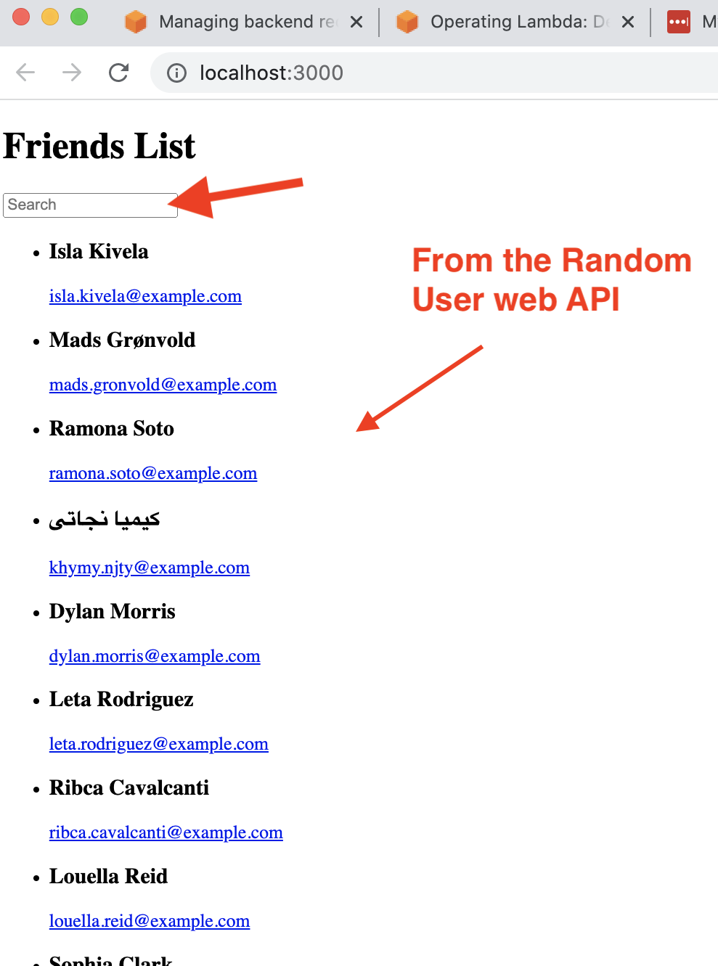
Sample App

Slide 14
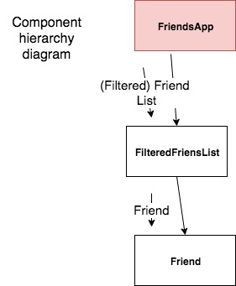
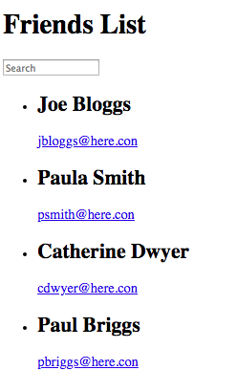
Sample App 1 (see lecture archive)
FriendsApp component:
Manages state (i.e. text box, full list of friends).
Fetches data from a web API – side effect.
Computes matching friends.
Controls list rendering.

Slide 15
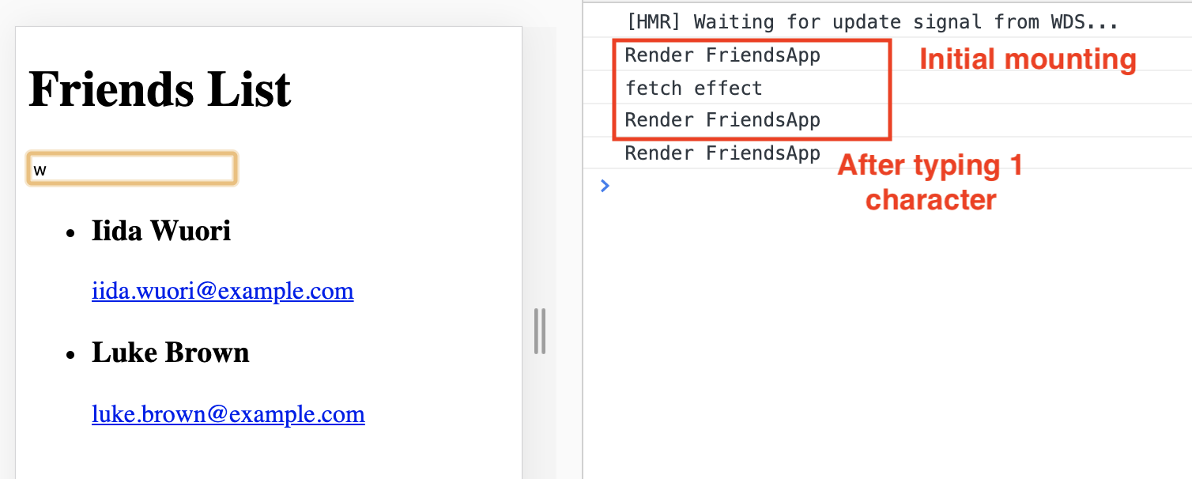
Sample App - useEffect Hook
useEffect runs AT THE END of a component’s mount process.
i.e. First rendering occurs BEFORE the API data is available.
We must accommodate this in the implementation.

Slide 16
Sample App - useEffect Hook
You must allow for asynchronous nature of API calls:
UI must remain interactive while waiting for API data.
Components should render without errors before API data is available.
Correct approach:
const [friends, setFriends] = useState( [ ] ) ; // Store API data
Incorrect approach:
const [friends, setFriends] = useState(null);
Resulting error
TypeError: Cannot read property 'filter' of null

Slide 17
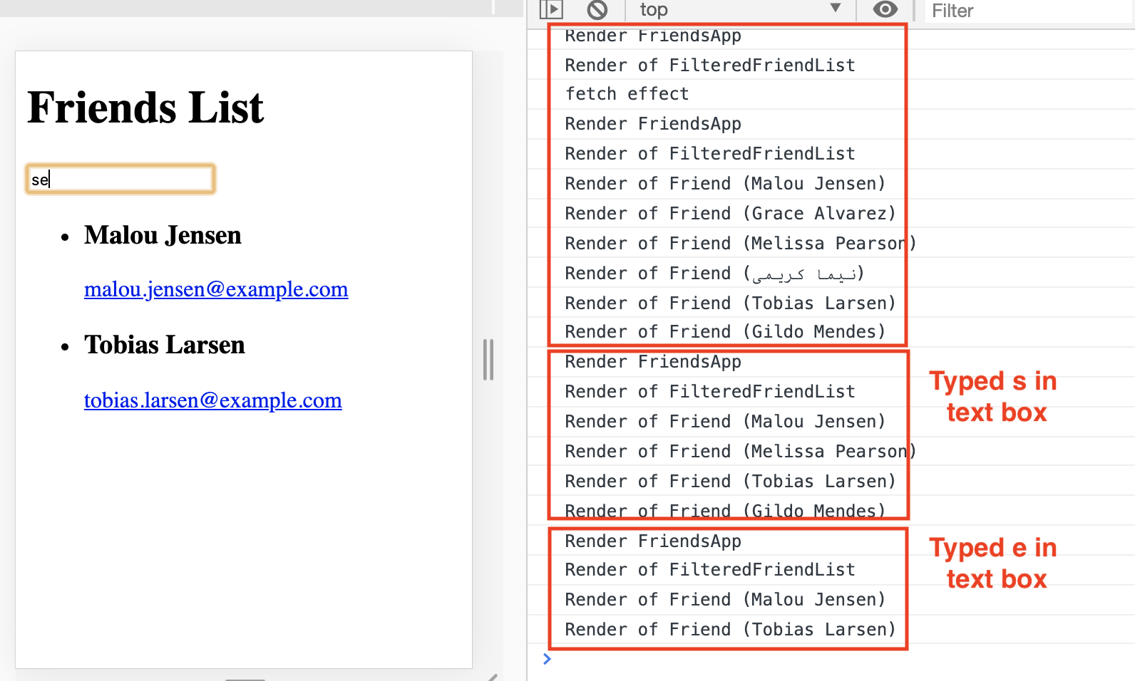
Unidirectional data flow & Re-rendering (Assume we request 6 friends from web API)

Slide 18
More to come ….

