Slide 1

ReactJS.
The Component model (Contd)

Slide 2
Topics
More Hooks and Component Lifecycle.
Data Flow patterns – Data Down, Action Up pattern.
The Virtual DOM

Slide 3
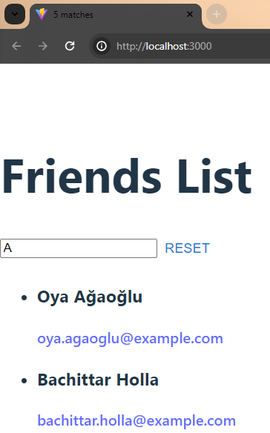
Sample App 1 – Version 2
App UI changes:
A ‘Reset’ button – loads a new list of friends (overwriting the current list).
Combine Reset button and search text into a new component, SearchBox.
Browser tab title - shows # of matching friends (side effect).
Ref. lecture archive for source code

Slide 4
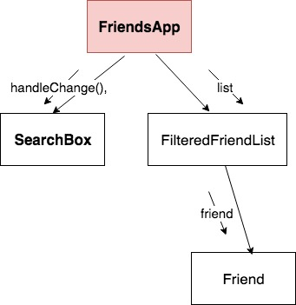
Sample App 1 (v2) - Design
3 state variables:
List of friends from API.
Text box content.
Reset button toggle.
2 side effects, both with dependency arrays:
‘Fetch API data’ - reset button toggle dependency.
‘Set browser tab title’ - matching list length dependency.

Slide 5
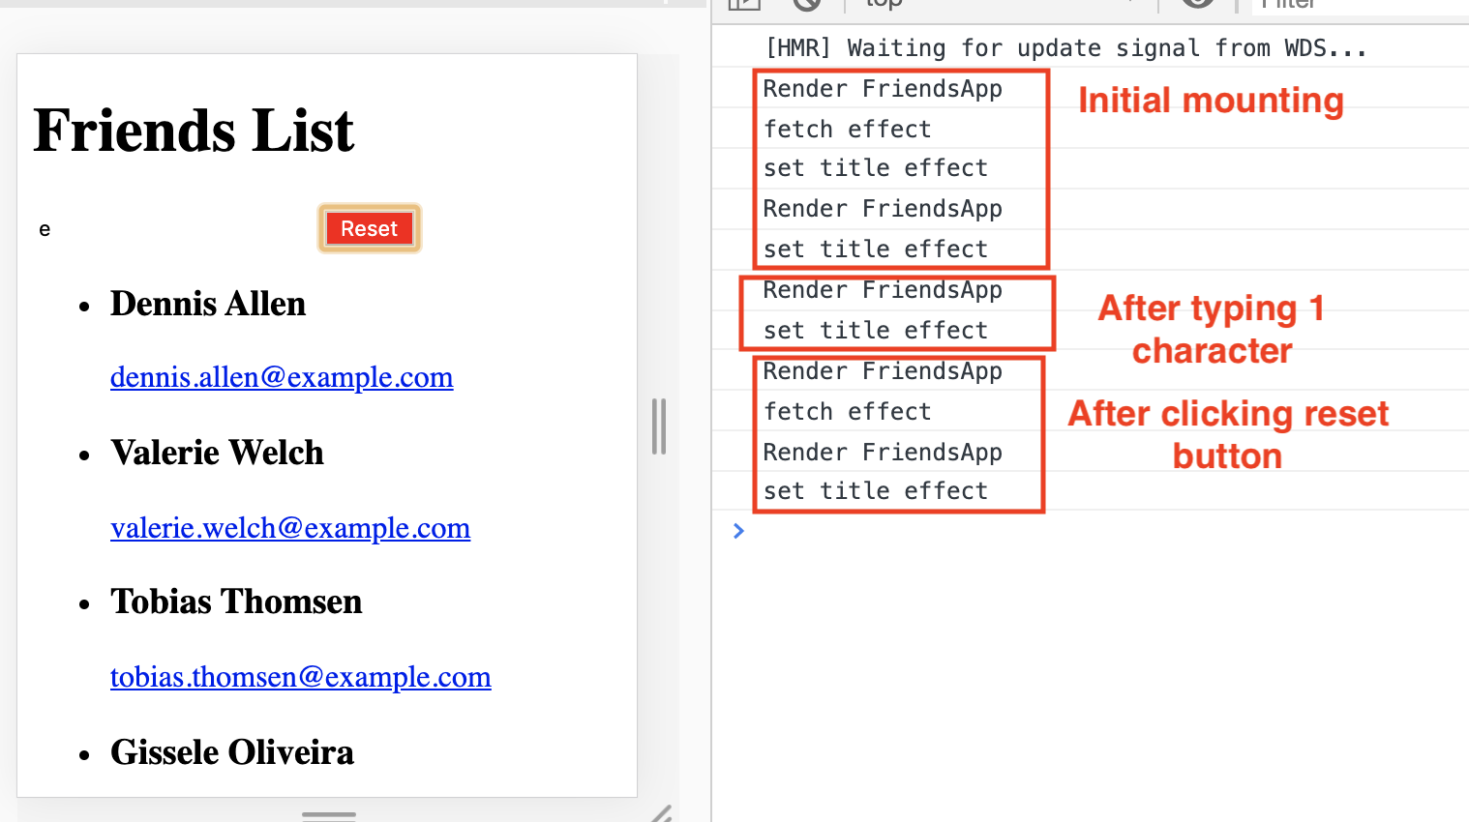
Sample App 1 (v2) - Events.
On mounting of FriendsApp component:
Both effects execute (Set browser tab to ’0 matches’).
‘Fetch data’ effect initializes ‘friends list’ state.
Component re-renders → ‘Set browser tab’ effect executes.
On typing a character in the text box:
‘Text box’ state changes.
FriendsApp rerenders + recomputes matching friends list
‘Set browser title’ effect executes.
On clicking Reset button:
‘Reset toggle’ state changes.
FriendsApp re-renders.
‘Fetch data’ effect executes.
‘Friends list’ state changes.
FriendsApp re-renders + recomputes matching list
‘Set browser title’ effect executes.

Slide 6
Topics
Hooks and Component Lifecycle.
Data Flow patterns – Data Down, Action Up pattern.
The Virtual DOM

Slide 7
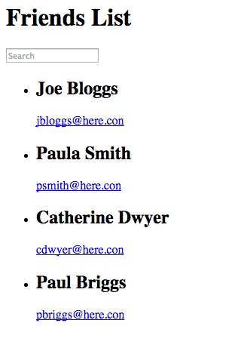
Sample App 2 (Data down, actions up pattern or Inverse data flow pattern )
Often a component’s state change is caused by an event in a subordinate component.
Solution: Use the data down, action up pattern.

Slide 8
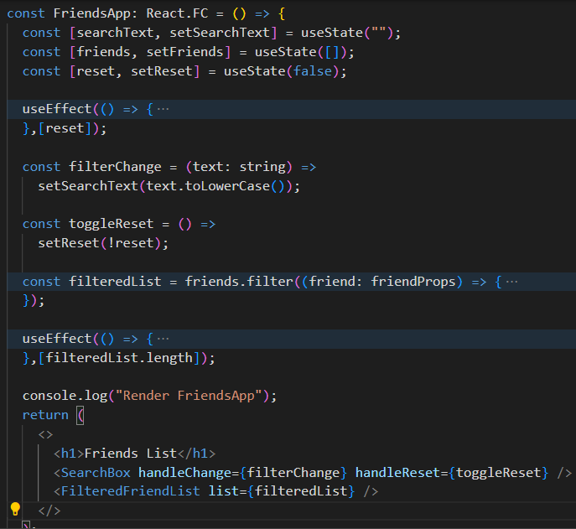
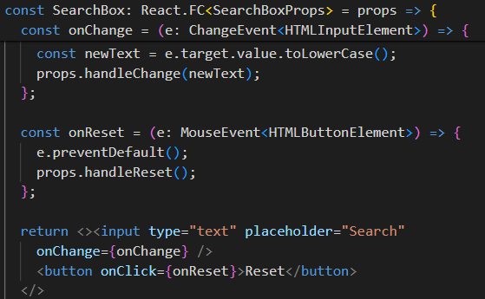
Data down, Action up.
Pattern:
Stateful component provides a callback to the subordinate.
Subordinate invokes callback when the event occurs.

Slide 9
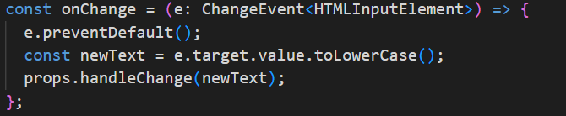
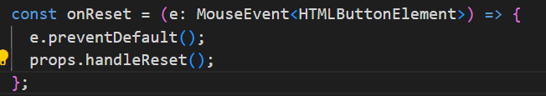
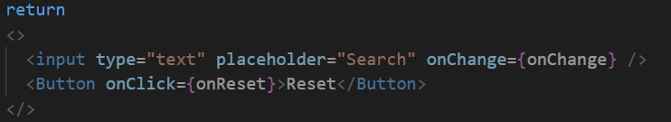
Handling Events in Code: React Event Handlers in Typescript
Event handlers designed for value changes/mouse events atc.
Event handler signature:
one argument, e, which has a corresponding generic type supplied by React Typescript libraries
event object that contains information about a change event on an HTML input element (e.g. textbox).
event object that contains information about a mouse event on an HTML button element.
Notes:
MouseEvent is a built-in interface in TypeScript that represents events that occur due to the user interacting with a pointing device (usually a mouse). This includes actions such as moving the mouse, clicking on an element, scrolling in or out, etc.
<HTMLButtonElement> is a generic parameter passed to MouseEvent. It specifies the type of the target element that the event is attached to. In this case, it's an HTML button element. This means the event is expected to be fired on an HTML button.

Slide 10
Topics
Hooks and Component Lifecycle.
Data Flow patterns – Data Down, Action Up pattern.
The Virtual DOM

Slide 11
Modifying the DOM
DOM – an internal data structure representing the browser’s current ‘display area’ ; DOM always in sync with the display.
Traditional performance best practice:
Minimize direct accessing of the DOM.
Avoid ‘expensive’ DOM operations.
Update elements offline, then replace in the DOM.
Avoid changing layouts in Javascript.
. . . etc.
Should the developer be responsible for low-level DOM optimization? Probably not.
React provides a Virtual DOM to shield developers from these concerns.

Slide 12
The Virtual DOM
How React works:
At app startup it create a lightweight, efficient form of the DOM, termed the Virtual DOM.
The app changes the V. DOM whenever a component re-renders.
When the re-rendering cycle is complete, the React engine:
Performs a diff operation between the current and previous V. DOM instance.
Computes the set of changes to apply to real DOM.
Batch update the real DOM.
Benefits:
Cleaner, more descriptive programming model.
Optimized DOM updates and reflows.

Slide 13
Automatic Re-rendering (detail)
EX.: The Counter component.
User clicks button
→ onClick event handler executed
→ component state is changed
→ component re-executed (re-renders)
→ The Virtual DOM has changed
→ React diffs the changes between the current and previous Virtual DOM
→ React batch updates the Real DOM

Slide 14

Re-rendering & the real DOM
What happens when the user types in the text box?
User types a character in text box
→ onChange event handler executes
Handler changes a state variable
React re-renders FriendsApp component
React re-renders children (FilteredFriendList) with new prop values.
React re-renders children of FilteredFriendList.
(Re-rendering completed)
(Pre-commit phase) React computes the updates required to the browser’s DOM
(Commit phase) React batch updates the DOM.
Browser repaints screen

Slide 15
Summary
A state variable change always causes a component to re-render.
State change logic is usually part of an event handler function.
Event hadler may be in a subordinate component.
Side effects:
Always execute at mount time.
The dependency array will either reference a state variable, a value computed from a state variable, or a prop.
Can be multiple entries
Callback performs the side-effect, and may also cause a state change.
Data flows downward, actions flow upward.

