Slide 1

ReactJS.
The Component model

Slide 2
Topics
Component State.
  Basis for dynamic, interactive UI.
Data Flow patterns.
Hooks.

Slide 3
Component DATA
A component has two sources of data:
  Props - Passed in to a component; Immutable; the props object.
  State - Internal to the component; Causes the component to re-render when changed / mutated.
  Both can be any data type - primitive, object, array.
Props-related features:
  Default values.
  Type-checking.
State-related features:
  Initialization.
  Mutation – using a setter method.
    Automatically causes component to re-render. ***
    Performs an overwrite operation, not a merge.

Slide 4
Stateful Component Example
The Counter component.
Ref. basicReactLab samples – sample 06.
The useState() function:
  Declares a state variable.
  Returns a Setter / Mutator method.
  Termed a React hook.
jump (Int)
Counter
count (int) = 0
Increment
Notes:
Searching for relevant definitions...The code you've shared is defining a functional component in React using TypeScript. Here's a breakdown of what's happening:- `interface CounterProps`: This is a TypeScript interface named [`CounterProps`](command:_github.copilot.openSymbolInFile?%5B%22src%2Fcomponents%2Fsamples%2F06-state.tsx%22%2C%22CounterProps%22%5D "src/components/samples/06-state.tsx"). Interfaces in TypeScript are a way of defining a contract for a certain structure of an object. In this case, [`CounterProps`](command:_github.copilot.openSymbolInFile?%5B%22src%2Fcomponents%2Fsamples%2F06-state.tsx%22%2C%22CounterProps%22%5D "src/components/samples/06-state.tsx") is defining the shape of the props that the [`Counter`](command:_github.copilot.openSymbolInFile?%5B%22src%2Fcomponents%2Fsamples%2F06-state.tsx%22%2C%22Counter%22%5D "src/components/samples/06-state.tsx") component expects to receive. It specifies that there should be a [`jump`](command:_github.copilot.openSymbolInFile?%5B%22src%2Fcomponents%2Fsamples%2F06-state.tsx%22%2C%22jump%22%5D "src/components/samples/06-state.tsx") property, and that the value of [`jump`](command:_github.copilot.openSymbolInFile?%5B%22src%2Fcomponents%2Fsamples%2F06-state.tsx%22%2C%22jump%22%5D "src/components/samples/06-state.tsx") should be a number.- `const Counter: React.FC<CounterProps>`: This is declaring a constant named [`Counter`](command:_github.copilot.openSymbolInFile?%5B%22src%2Fcomponents%2Fsamples%2F06-state.tsx%22%2C%22Counter%22%5D "src/components/samples/06-state.tsx") and specifying its type as `React.FC<CounterProps>`. `React.FC` stands for "React Function Component", and it's a type provided by the `@types/react` package, which provides TypeScript definitions for React. By using `React.FC<CounterProps>`, you're telling TypeScript that [`Counter`](command:_github.copilot.openSymbolInFile?%5B%22src%2Fcomponents%2Fsamples%2F06-state.tsx%22%2C%22Counter%22%5D "src/components/samples/06-state.tsx") is a functional component that expects to receive props of the shape defined by [`CounterProps`](command:_github.copilot.openSymbolInFile?%5B%22src%2Fcomponents%2Fsamples%2F06-state.tsx%22%2C%22CounterProps%22%5D "src/components/samples/06-state.tsx").- `= (props) => {`: This is the start of an arrow function that defines the component. The `props` parameter represents the props that are passed to the component. In this case, `props` is expected to be an object with a [`jump`](command:_github.copilot.openSymbolInFile?%5B%22src%2Fcomponents%2Fsamples%2F06-state.tsx%22%2C%22jump%22%5D "src/components/samples/06-state.tsx") property, as defined by [`CounterProps`](command:_github.copilot.openSymbolInFile?%5B%22src%2Fcomponents%2Fsamples%2F06-state.tsx%22%2C%22CounterProps%22%5D "src/components/samples/06-state.tsx").So, in summary, this code is defining a new functional component named [`Counter`](command:_github.copilot.openSymbolInFile?%5B%22src%2Fcomponents%2Fsamples%2F06-state.tsx%22%2C%22Counter%22%5D "src/components/samples/06-state.tsx") that expects to receive a single prop named [`jump`](command:_github.copilot.openSymbolInFile?%5B%22src%2Fcomponents%2Fsamples%2F06-state.tsx%22%2C%22jump%22%5D "src/components/samples/06-state.tsx") of type number. The actual implementation of the component (i.e., what it renders) would come after the `=>`.

Slide 5
React’s event system.
Cross-browser support.
Event handlers receive a React Event Object – a cross-browser wrapper for the browser's native event.
React event naming convention slightly different to native:
See https://react.dev/learn/responding-to-events and
https://react.dev/reference/react-dom/components/common#react-event-object
for full details,
React | Native
onClick | onclick
onChange | onchange
onSubmit | onsubmit

Slide 6
Automatic Re-rendering.
EX.: The Counter component.
  User clicks button
  → onClick event handler executes (incrementCounter)
    → handler changes component’s state (setCount())
  → component function re- executed (re-rendering)

Slide 7
Topics
Component State. ✔
Data Flow patterns.
Hooks.

Slide 8
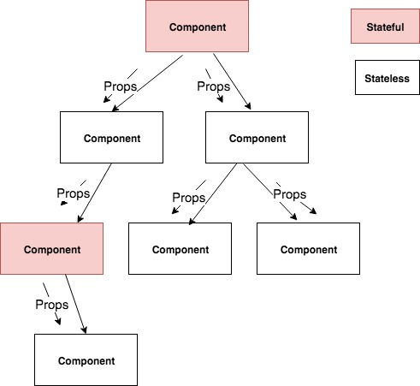
Unidirectional data flow

Slide 9
Unidirectional data flow
In React, data flow is unidirectional ONLY.
  Other SPA frameworks use two-way data binding.
Typical React app pattern: A small subset of the components are stateful; the majority are stateless.
Stateful component execution flow:
  User interaction causes a component state change.
  Component re-renders (re-executes).
  Component recomputes the props for its subordinate components.
  Subordinate components re-render, and recomputes props for its subordinates.
  etc.
Notes:
Stateful Components
Stateful components are those that maintain their own state. They are responsible for managing the state of the application and reacting to user input, server responses, or other events that change the state. These components are typically class components (in older React versions) or function components that use hooks like useState and useEffect.
Stateless Components
Stateless components, on the other hand, do not manage their own state. They receive data and functions as props from their parent components and render the UI based on these props. Stateless components are usually function components that simply return JSX.
Why the Majority are Stateless
Simplicity and Reusability: Stateless components are simpler to write and understand. They are easier to reuse since they do not maintain their own state and rely solely on the data passed to them via props.
Separation of Concerns: By keeping most components stateless, React applications can maintain a clear separation of concerns. Stateful components handle the logic and state management, while stateless components focus solely on rendering the UI.
Performance: Stateless components tend to be more performant because they do not need to manage state and thus have less overhead. They are also easier for React to optimize, especially with the introduction of hooks and React.memo for memoization.
Testability: Stateless components are easier to test because they simply render UI based on props. This makes unit testing more straightforward since there is no internal state to manage.
Maintainability: Applications with a small number of stateful components are generally easier to maintain. State management can become complex, so limiting the number of stateful components helps in keeping the application architecture clean and manageable.

Slide 10
Topics
Component State. ✔
Data Flow patterns.        ✔
Hooks

Slide 11
React Hooks
Introduced in version 16.8.0 (February 2019)
React Hooks are:
  Functions (some are HOFs).
  That performs component state manipulation and lifecycle management.
Examples: useState, useEffect, useContext, useRef, etc
  ‘use’ prefix is necessary for linting tools.
Usage Rule:
  Can only call hooks at the ‘top level’ in a component.
    i.e. Don’t call hooks inside loops or condition statements.

Slide 12
useEffect Hook
Used when a component needs to perform side effects.
Side Effect example:
  fetching data from a web API.
  Subscribe to a browser events, e.g. window resize.
Signature: useEffect(callback, dependency array)
  The callback contains the side effect code.
  Dependencies determine when a hook is executed.
useEffect is executed:
  On component mounting.
  On every rendering that coincides with a dependency entry update.
  An empty dependency array restricts execution to mount-time only.

Slide 13
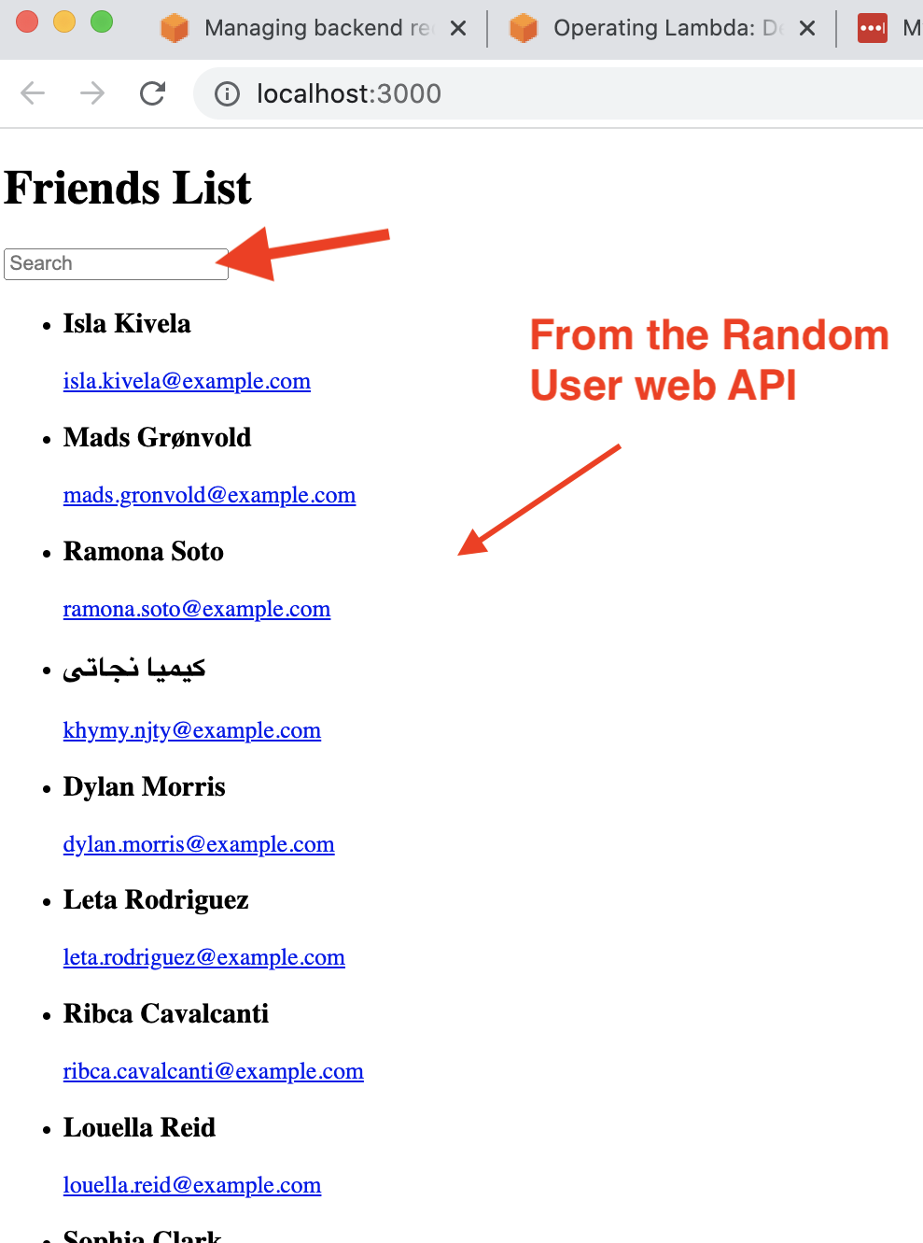
Sample App

Slide 14
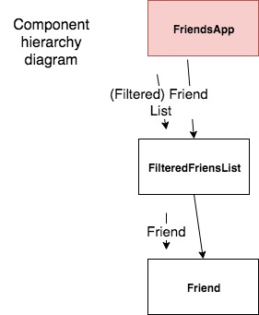
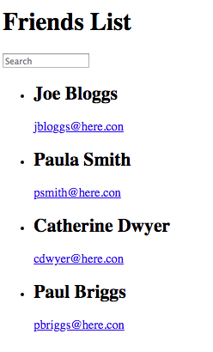
Sample App 1
(see lecture archive)
FriendsApp component:
Manages state (i.e. text box, full list of friends).
Fetches data from a web API – side effect.
Computes matching friends.
Controls list rendering.

Slide 15
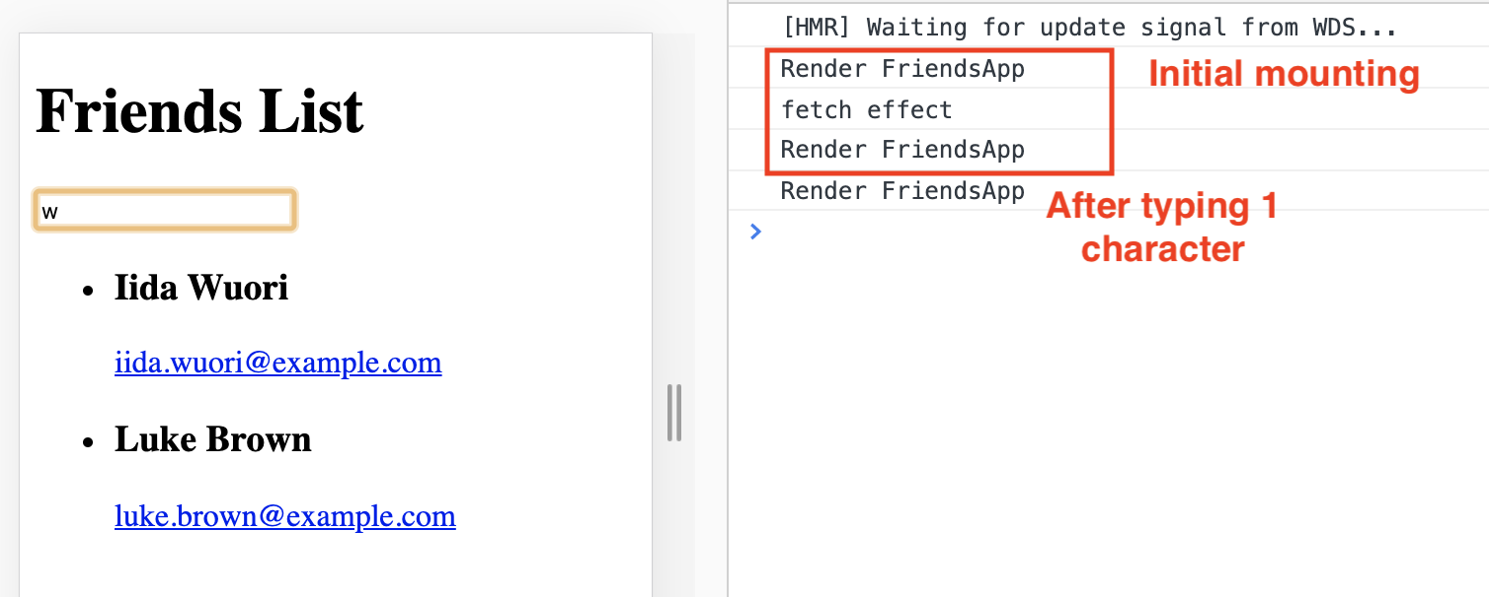
Sample App - useEffect Hook
useEffect runs AT THE END of a component’s mount process.
  i.e. First rendering occurs BEFORE the API data is available.
  We must accommodate this in the implementation.

Slide 16
Sample App - useEffect Hook
You must allow for asynchronous nature of API calls:
  UI must remain interactive while waiting for API data.
  Components should render without errors before API data is available.
Correct approach:
    const [friends, setFriends] = useState( [ ] ) ; // Store API data
Incorrect approach:
    const [friends, setFriends] = useState(null);
  Resulting error
    TypeError: Cannot read property 'filter' of null

Slide 17

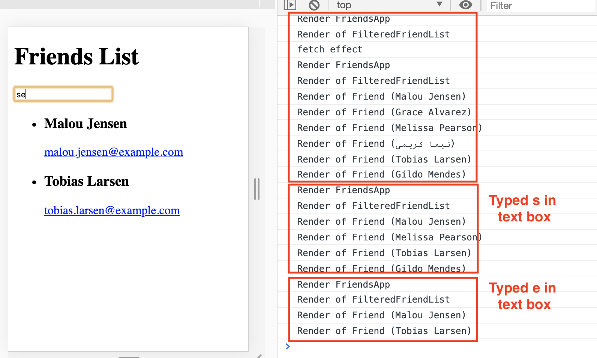
Unidirectional data flow & Re-rendering
(Assume we request 6 friends from web API)

Slide 18
More to come ….

