Slide 1
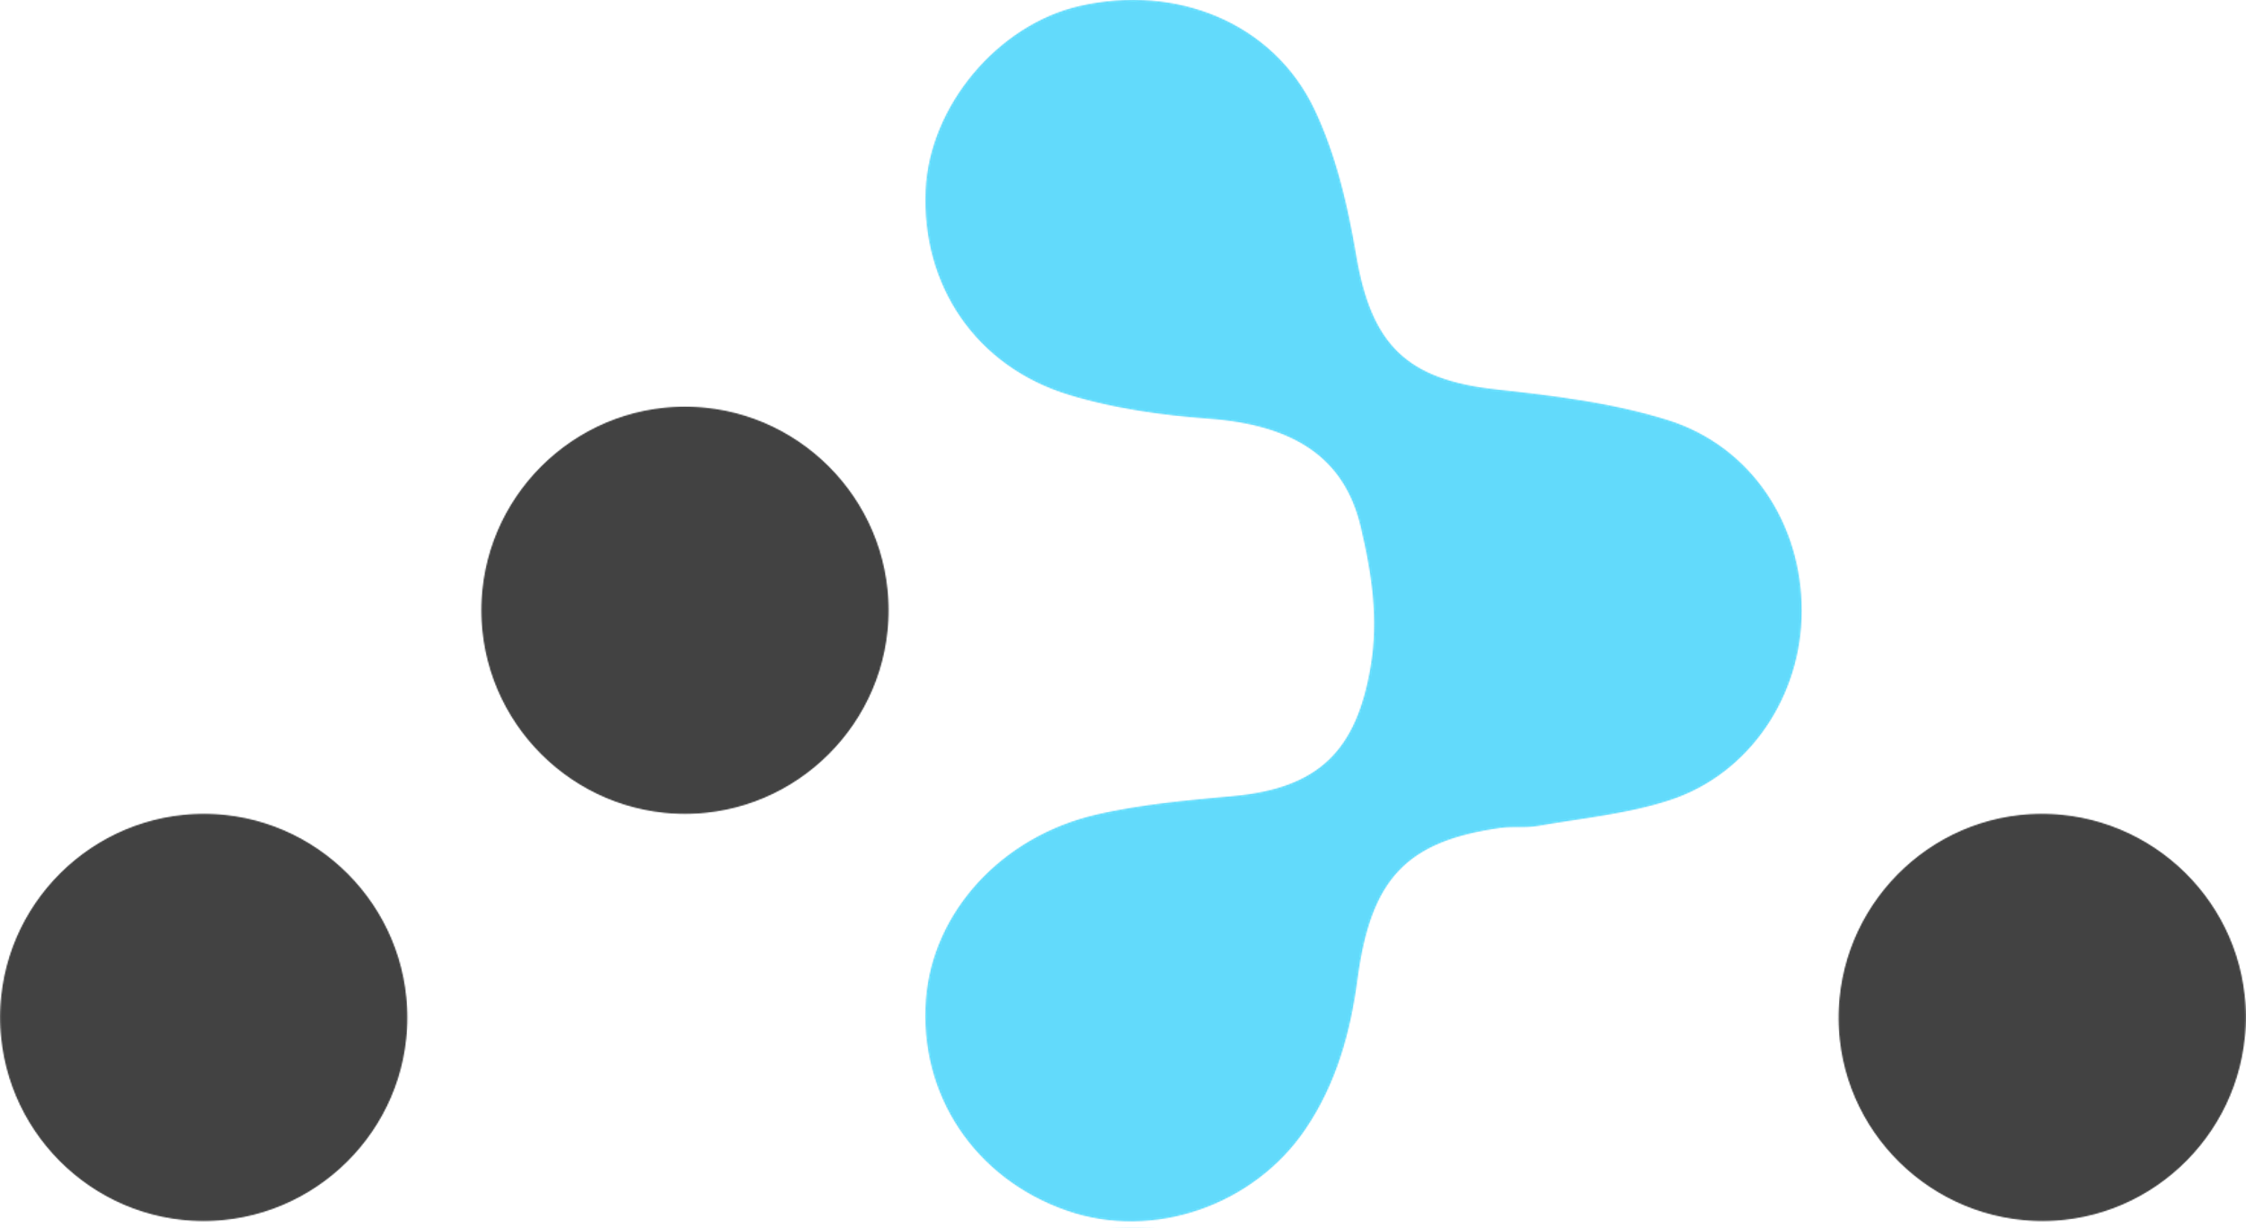
Navigation
The React Router library

Slide 2
Routing - Introduction
Allows multiple views in an app.
But there’s only one page (.html) → Single Page App (SPA)
Keeps the browser’s URL in sync with the UI.
Adheres to traditional web principles:
Addressability.
Information sharing.
Deep linking.
Not supported by the React framework.
A separate library is required: React Router.
Notes:
multiple views @:This means that the application can display different views (or components) based on user interactions or navigation. In the context of React, these views are typically components that are rendered conditionally.
there is only one HTML file (index.html). The application dynamically updates this page as the user interacts with it, rather than loading new pages from the server.
the browser can still reflect the current state/page of the application. This is crucial for usability and bookmarking. if a user navigates to /profile within the app, the URL changes to yourapp.com/profile, and the corresponding view is displayed.
Addressability
Each state or view in the application has a unique URL, making it possible to bookmark and share specific parts of the app.
Information sharing
Since each view can have its own URL, users can share links to specific parts of the app, facilitating easier information sharing.
Deep linking
Deep linking refers to the ability to link directly to a specific piece of content or a specific state within the app, bypassing the need to navigate from the homepage.

Slide 3
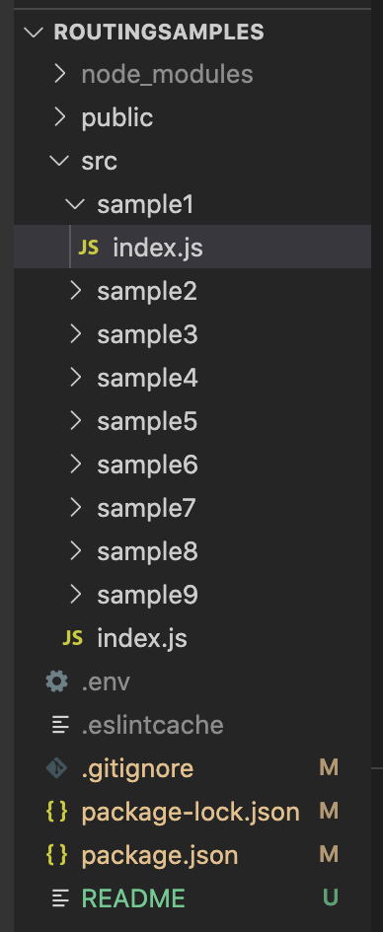
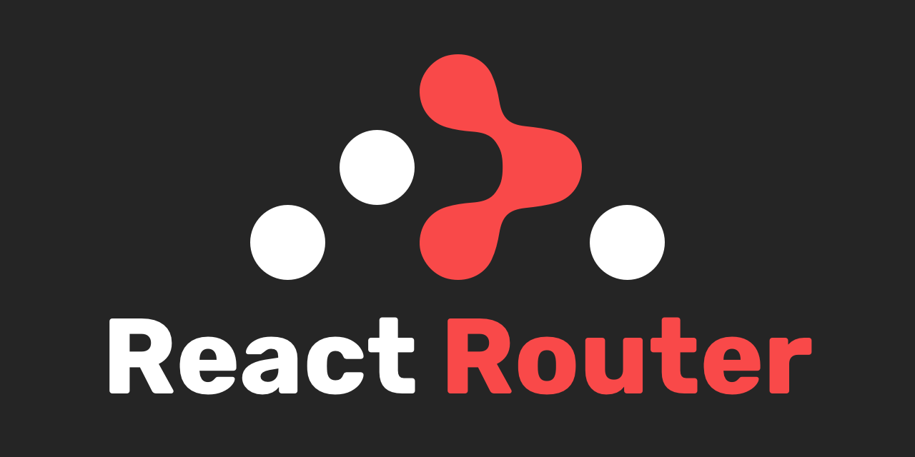
Demos
See lecture archive.
Each sample demos a routing feature.
<Link>

Slide 4
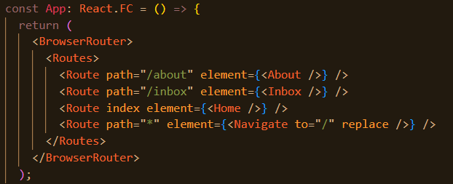
Basic routing configuration
 | URL | Components
1 | / | Home
2 | /about | About
3 | /inbox | Inbox
Declarative style.
<BrowserRouter> - matches browser’s URL to a <Route> path.
Matching Route’s element is mounted on the DOM.
element can take any arbitrary TSX.
Use index for root path case (/).
Use * path for 404 case.
<Navigate> changes browser’s URL address.
App component termed the Router component.
Ref. src/sample1
Notes:
The replace prop, when set to true, means that navigating to this new route will replace the current entry in the history stack instead of adding a new one. This means that if the user clicks the browser's back button, they won't go back to the previous route before the redirection.

Slide 5
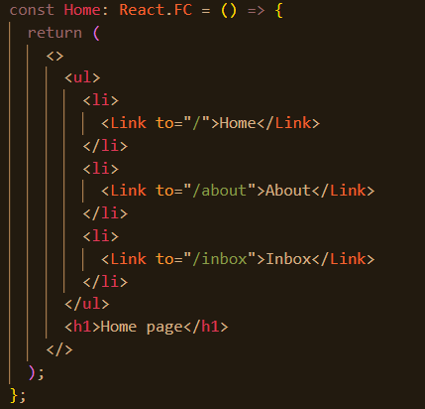
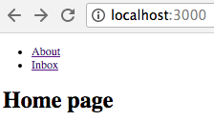
Hyperlinks
Use the <Link> component for internal links.
Use anchor tag for external links - <a href . . . . . >
Ref. src/sample2/
<Link> changes browser’s URL address (event)
→ React Router handles event by consulting its routing configuration
→ Selected Route’s elements mounted on DOM → Browser repaints the screen.

Slide 6
Dynamic segments.
Parameterised URLs, e.g. /users/22, /users/12/purchases
How to declare a parameterised path in the routing configuration?
How does a component access the parameter value?
Ex: Suppose the Inbox component shows messages for a specific user, where the user’s id is part of the browser URL
e.g /inbox/123, where 123 is the user’s id.
Solution: <Route path='/inbox/:userId’ element={ <Inbox/> } />
The colon (:) prefixes a parameter in the path.
Parameter name is arbitrary.
Ref src/sample3

Slide 7
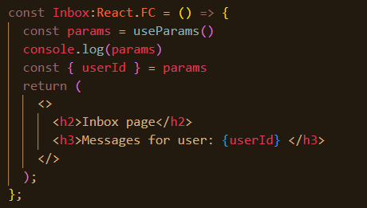
Dynamic segments.
useParams hook (React Router library).
Returns an object containing the parameter value.
Other useful hooks also provided (see later)
More than one parameter allowed.
e.g. /users/:userId/categories/:categoryName
Notes:
efers to a URL segment that can change based on the data or user input.

Slide 8
Nested Routes
Objective: A component’s child is dynamically determined from the browser’s URL (Addressability).
EX.: (See src/sample4) Given the route:
<Route path='/inbox/:userId’ element={ <Inbox /> } />,
use the following rules to determine a nested component hierarchy:
/inbox/XYZ/statistics /inbox/XYZ/draft
<Inbox> <Inbox>
<Stats/> <Drafts/>
</Inbox> </Inbox>

Slide 9
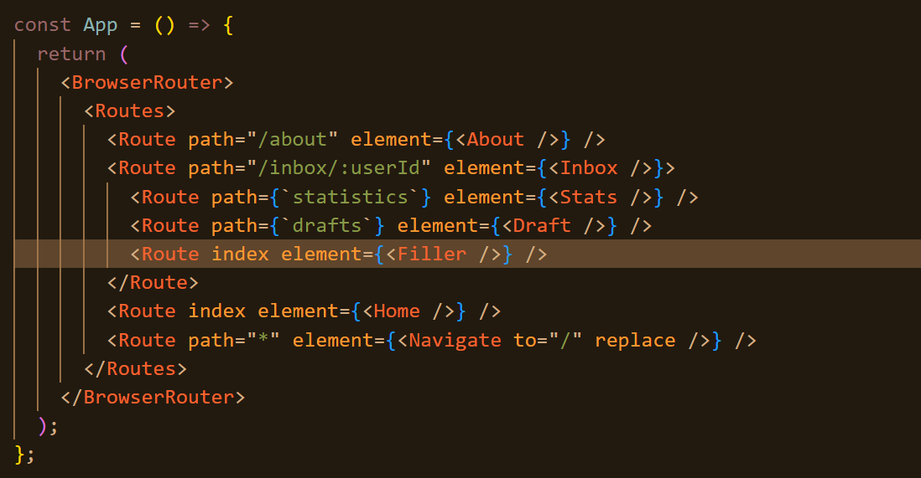
Nested Routes
Use RELATIVE path strings in the nested <Route> entries.
The index <Route> is optional.
For the default case.
Avoids a ‘blank’ section on screen.
Use <Outlet/> as a placeholder in the container component

Slide 10
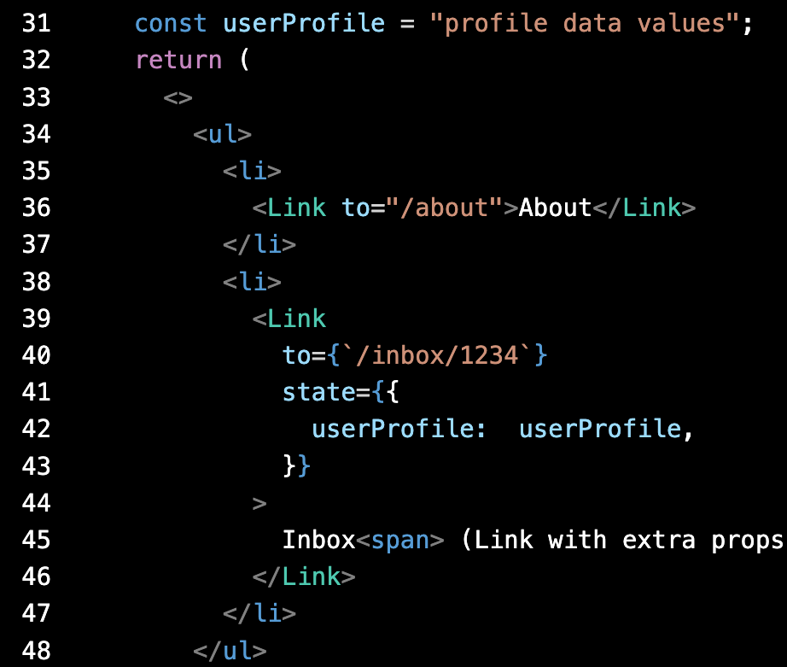
Extended <Link>
Objective: Supply data to the component mounted by a <Link>.
EX.: See /src/sample5/.
How does Inbox access the userProfile data included in the hyperlink?
A.: The useLocation hook

Slide 11
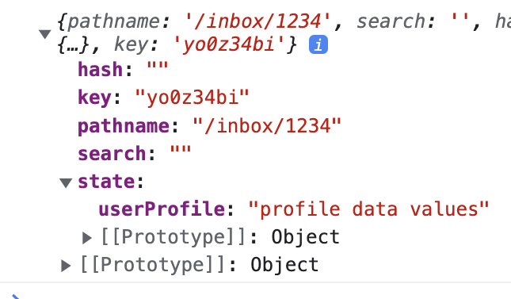
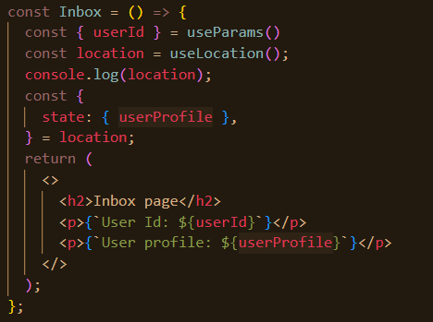
Extended <Link>
React Router creates a location object each time the URL changes.

Slide 12
Routing
More later

