Slide 1
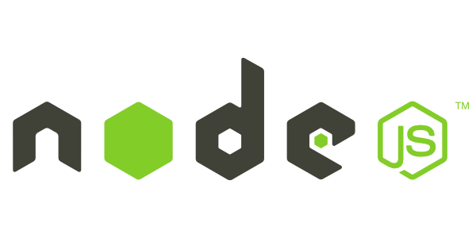
Introduction to Node.js
Frank Walsh
Diarmuid O'Connor

Slide 2
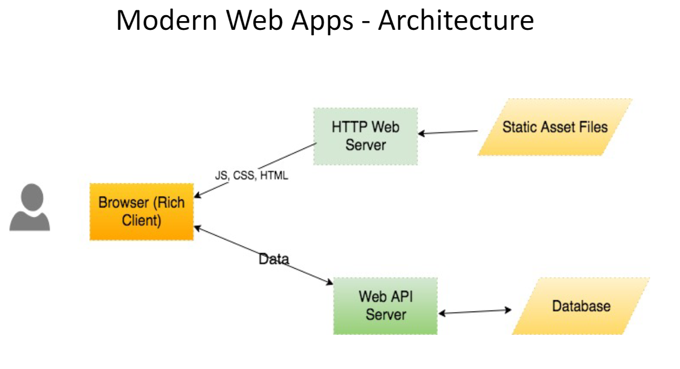

Context

Slide 3
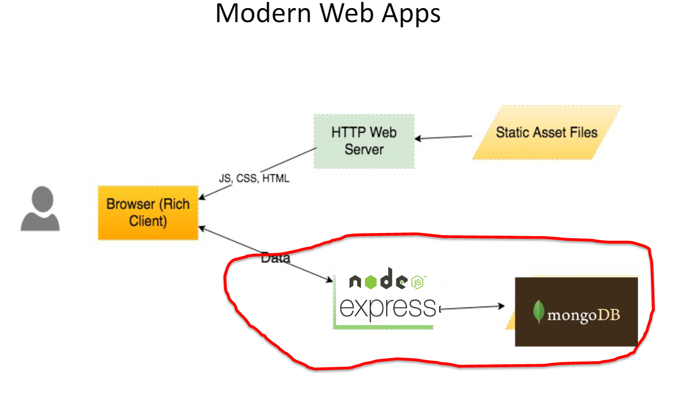

Context - Technologies

Slide 4

Agenda
What is node.js
Non Blocking and Blocking
Event-based processes
Callbacks in node
Node Package Manager(NPM)
Creating a node app

Slide 5

What's Node.js: Basics
A Javascript runtime. “Server side JS”
The “.js” doesn’t mean that it’s written completely in JavaScript.
approx. 40% JS and 60% C++
Ecosystem of packages (NPM)
Official site: “Node's goal is to provide an easy way to build scalable network programs”.
Single Threaded, Event based
Supports concurrency using events and callbacks…

Slide 6
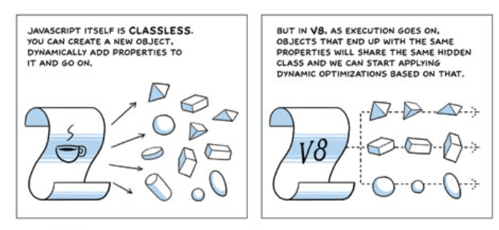

What’s Node: V8.
Embedded C++ component
Javascript virtual machine.
Very fast and platform independent
Find out a bit about it's history here:
http://www.google.com/googlebooks/chrome/big_12.html
Notes:
Same javascript engine used in chrome
Just in time compiler – compile a little, run a little
Speculative optimisations

Slide 7


What is Node.js: Event-based
Input/Output (io) is slow.
Reading/writing to database or file
network access.
Read 4K from Solid State Disk 150,000 nanoseconds ~1GB/sec
Round trip over network within same datacentre 500,000 nanoseconds
Send IP packet US->Netherlands->US 150,000,000 ns
This Photo by Unknown Author is licensed under CC BY-NC
I/O operations detrimental to highly concurrent apps (e.g. web applications)
Solutions to deal with this are:
Blocking code combined with multiple threads of execution (e.g. Apache, IIS)
Non-blocking, event-based code in single thread (e.g. NGINX, Node.js)
CPU operations are fast.
L1 cache reference 0.5 ns
L2 cache reference 7 ns
Source: https://gist.github.com/jboner/2841832
1nanoseconds = 10⁻⁹ s (0.000000001s)
Notes:
So input output is relatively slow. What I’m talking about here is reading/writing to a data store, any kind of access to resources over a network, even within your organisation. And I mean relative in relation to CPU operations. For example, referencing L1 and L2 cache takes a couple of nano seconds (extremely fast). Accessing 4K from an SSD takes about 150,000 ns. However, sending a packet from the US to the Netherlands and back could take 150 million ns (.15 of a second).
So IO operations can be detrimental to highly concurrent apps yet we do need them (for example, I’ll probably need to access a DB.

Slide 8
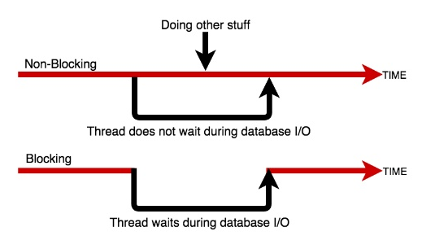

Blocking/Non-blocking
Database Read Example
Blocking
Read from file and set equal to contents
Print Contents
Do other stuff...
Non-blocking
Read from File
Whenever read is complete, print contents
Do other stuff...

Slide 9
Blocking/Non-blocking: JS
Blocking
import fs from 'fs';
const contents = fs.readFileSync('./readme.md’, ‘utf8’);
console.log(contents);
console.log('Doing something else');
Console output
Hello World……
Doing something else
Non-blocking
import fs from 'fs’;
fs.readFile('./text.txt’,’uft8’, (err, contents) => {
console.log(contents);
});
console.log('Doing something else');
Console output
Doing something else
Hello World ……

Slide 10
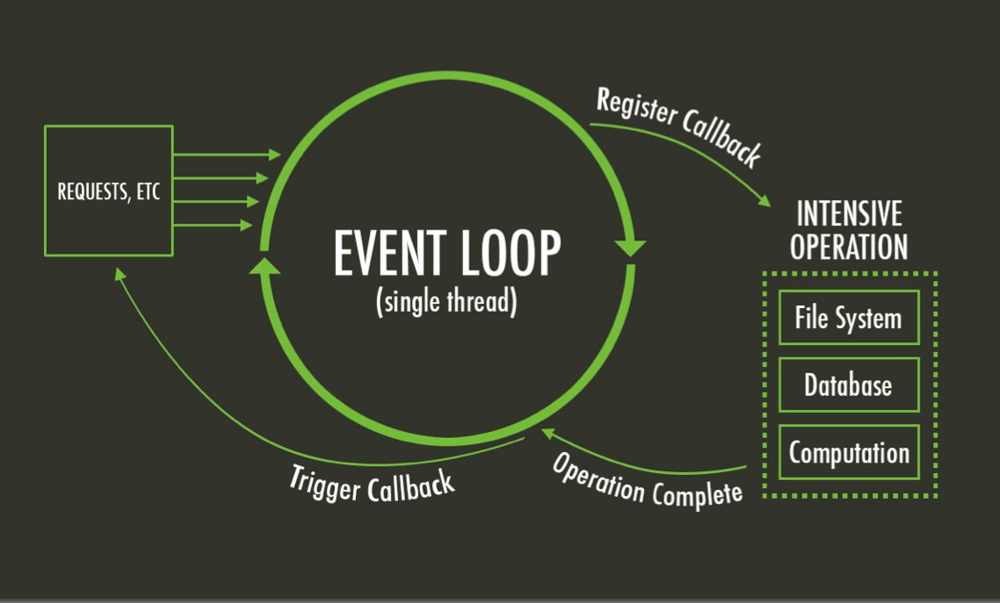
The Node Event Loop and Callbacks
A Callback is a function called at the completion of a given task. This prevents any blocking, and allows other code to be run in the meantime
The Event Loop checks for known events, registers Callbacks and, triggers callback on completion of operation
This Photo by Unknown Author is licensed under CC BY-SA

Slide 11
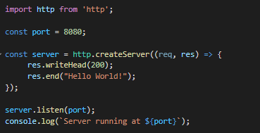
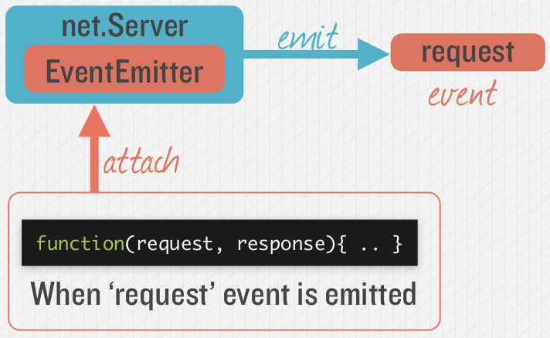

Node.js - Simple HTTP Server
Event Queue
Known Events
request
request
Event Loop
Notes:
Most node applications are waiting for “events” to occur. The event loop waits for events to occur, and then triggers the associated callback function when that event is detected. Many objects in a Node emit events, for example, a net.Server emits an event each time a peer connects to it, an fs.readStream emits an event when the file is opened. All objects which emit events are the instances of events.EventEmitter.

Slide 12
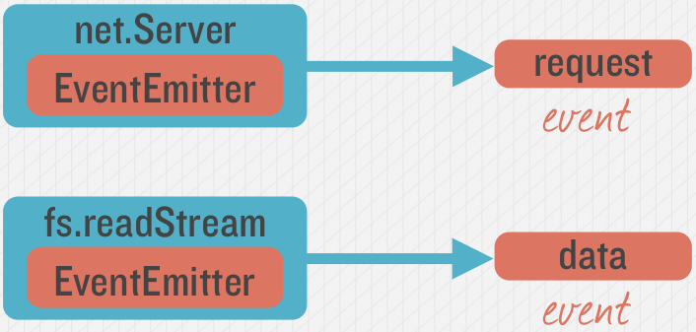
Emitting Event in Node
Many objects can emit events in node.

Slide 13
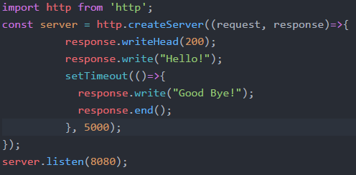
Example – Hello/Goodbye Callback
“Request” Callback
“Timeout” Callback

Slide 14
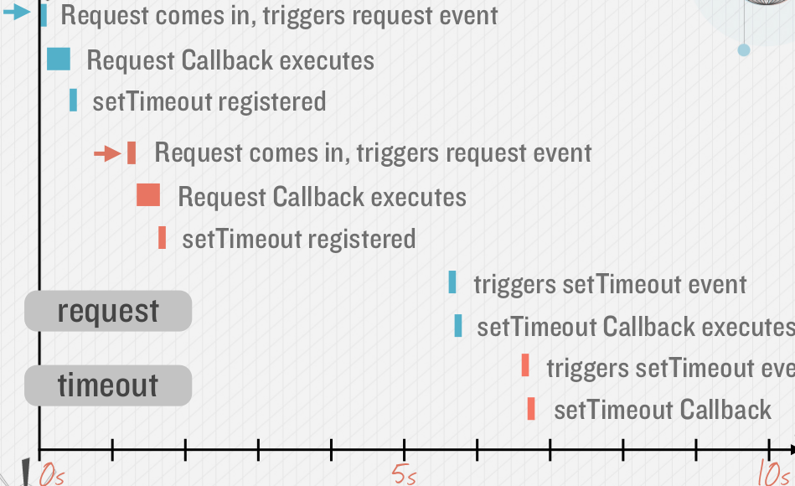
Callback Timeline, Non Blocking
Timing example: 2 requests to web application (indicated by red and blue in diagram)

Slide 15
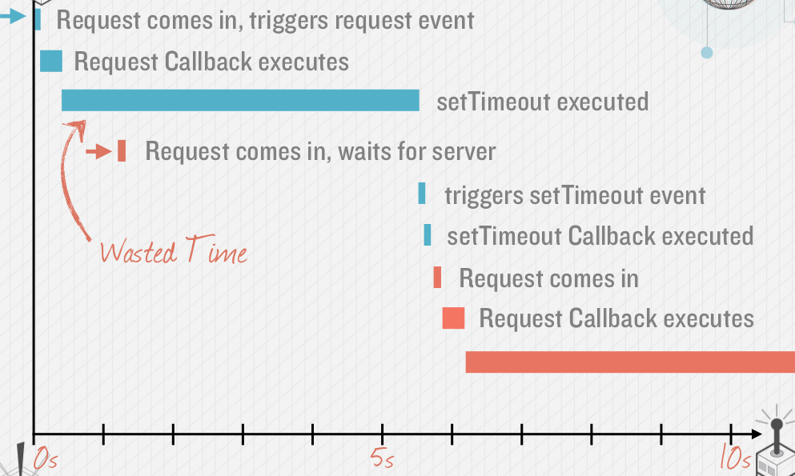
Avoid Blocking Calls in Node.js apps
What if setTimeout() blocked…
setTimeout in previous slide is an example of an asynchronous, non-blocking call.
Avoid potential blocking/ synchronous calls
Activity likely to be blocking should be called asynchronously.
Examples:
Calls to 3rd party Web Services
Database queries
Computationally expensive operations (image file processing)

Slide 16
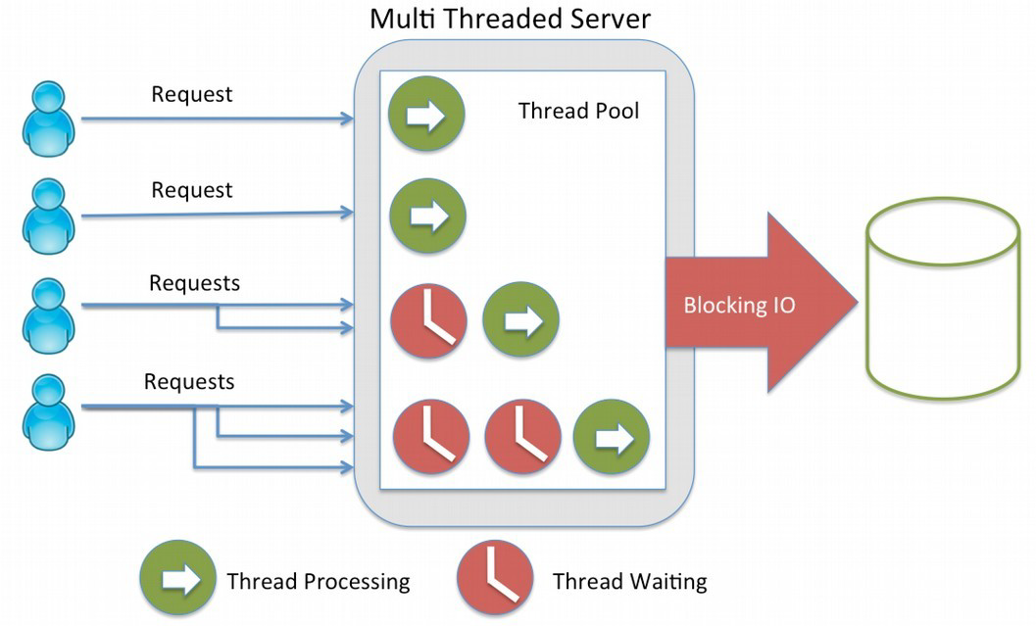
Blocking vs. Non-blocking: Web Servers
Threads consume resources
Memory on stack
Processing time for context switching etc.
No thread management on single threaded apps
Just execute “callbacks” when event occurs

Slide 17
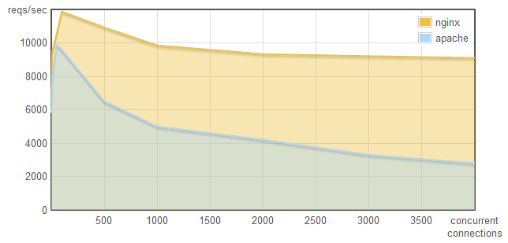
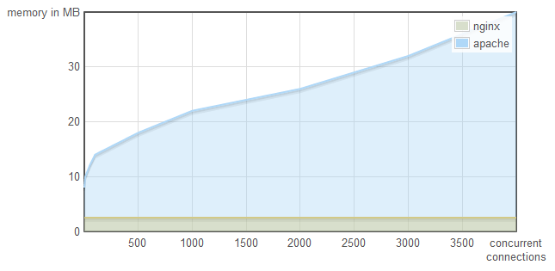
Why does it matter...
This is why:
http://blog.webfaction.com/a-little-holiday-present

Slide 18
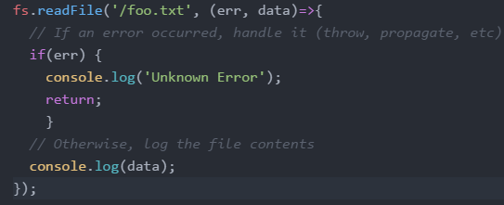
Node “Error First” Callbacks
Error object
The “error-first” callback (or “node-style callback”) is a standard convention for many Node.js callbacks.
Successful response data
If no error, err will be set to null

Slide 19
Node Modules

Slide 20
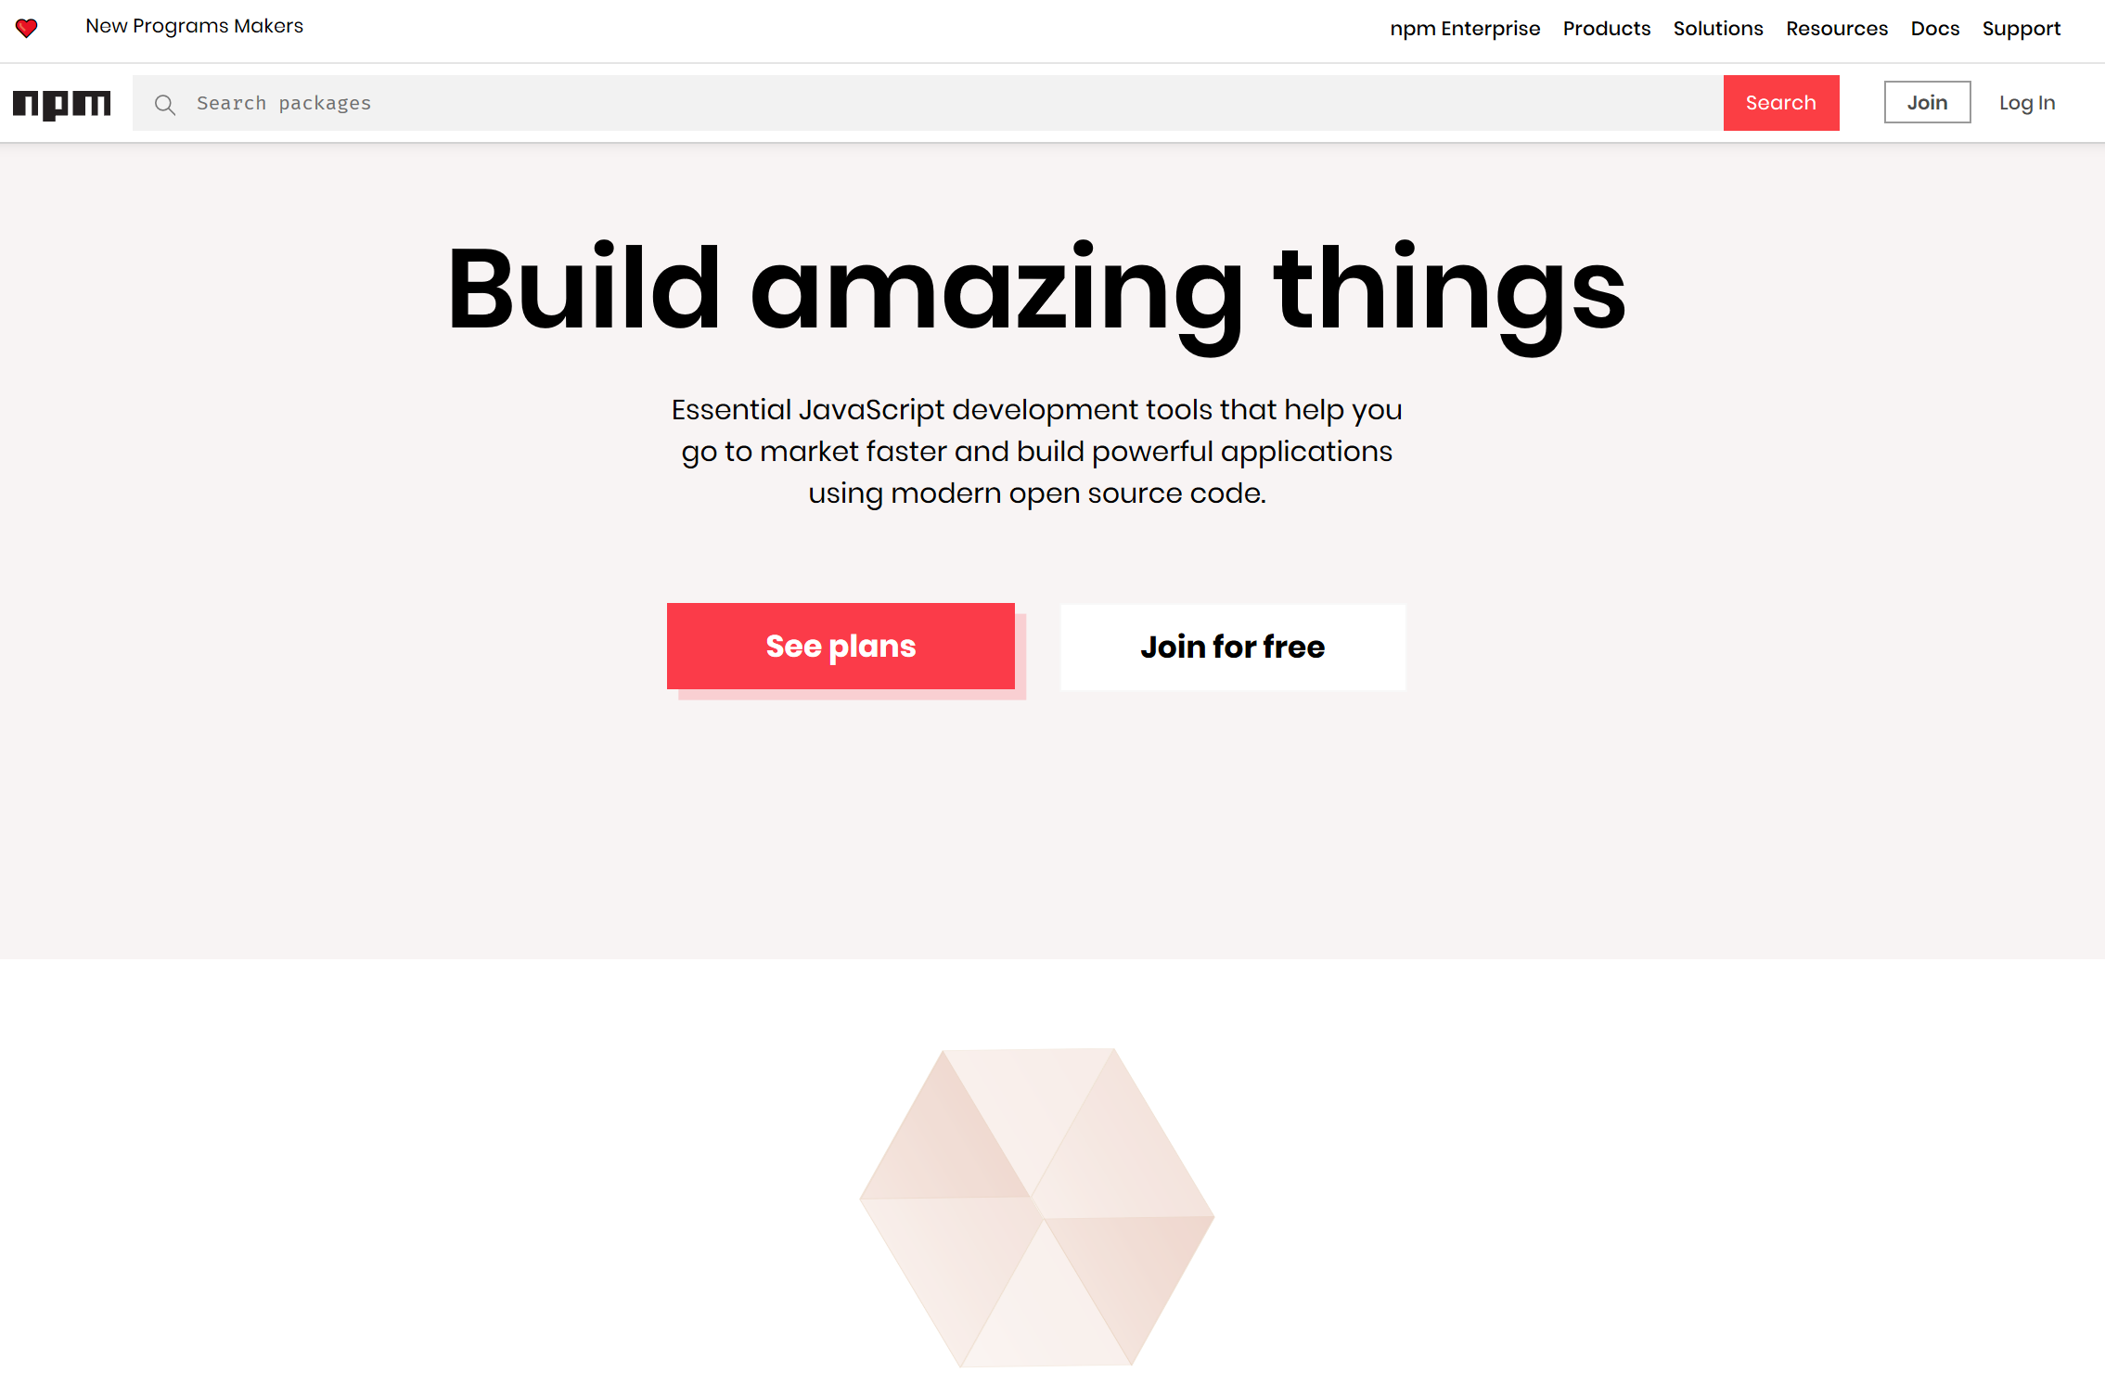

Slide 21


Node Modules
Node has a small core API
Most applications depend on third party modules
Curated in online registry called the Node Package Manager system (NPM)
NPM downloads and installs modules, placing them into a node_modules folder in your current folder.

Slide 22
NPM init
You can use NPM to manage your node projects
Run the following in the root folder of your app/project:
npm init
This will ask you a bunch of questions, and then create a package.json for you.
It attempts to make reasonable guesses about what you want things to be set to, and then writes a package.json file with the options you've selected.

Slide 23
Node Modules
To install NPM modules, navigate to the application folder and run “npm install”. For example :
npm install express --save
This installs into a “node_module” folder in the current folder.
The --save bit updates your package.json with the dependency
To use the module in your code, use:
import express from 'express';
This loads express from local node_modules folder.

Slide 24
Global Node Modules
Sometimes you may want to access modules from the shell/command line.
You can install modules that will execute globally by including the '-g'.
Example, Grunt is a Node-based software management/build tool for Javascript.
npm install -g grunt-cli
This puts the “grunt” command in the system path, allowing it to be run from any directory.

Slide 25
NPM Common Commands
Common npm commands:
– npm init initialize a package.json file
– npm install <package name> -g install a package, if –
g option is given package will be installed globally, --save
and --save-dev will add package to your dependencies
– npm install install packages listed in package.json
– npm ls –g listed local packages (without –g) or global
packages (with –g)
– npm update <package name> update a package

Slide 26
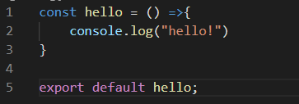

Creating your own Node Modules
We want to create the following module called greeting.js:
To access in our application, index.js:
import hello from './custom_hello'; hello();
Export defines what
import returns

Slide 27
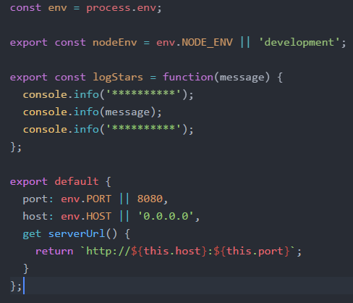
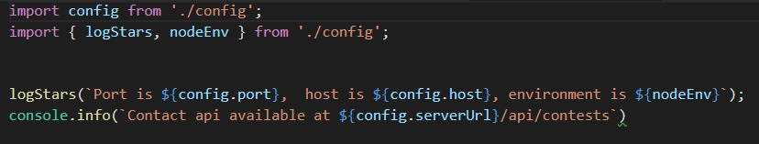
Creating your own Node Modules
Config.js
Exporting Multiple Properties
Accessing in other scripts

Slide 28


The import search
Import searches for modules based on path specified:
Just providing the module name will search in node_modules folder

Slide 29

Lecture 2: Environment/Structure for Labs
Web APIs using Express.js

Slide 30
Agenda
Development Environment
Web APIs
HTTP
URLs
Representational State Transfer (REST)
Web API Design
Express and Web APIs
Express Package
Creating an Express App
Intro to Web API Routing using Express

Slide 31






Tools and Technologies
VS Code
Postman (or equivalent)
Node v12.18.4 or closer
Express.js
Mongo
JSON Web Tokens
This Photo by Unknown Author is licensed under CC BY-SA
This Photo by Unknown Author is licensed under CC BY-SA
This Photo by Unknown Author is licensed under CC BY-SA
This Photo by Unknown Author is licensed under CC BY-SA-NC
This Photo by Unknown Author is licensed under CC BY-SA

Slide 32
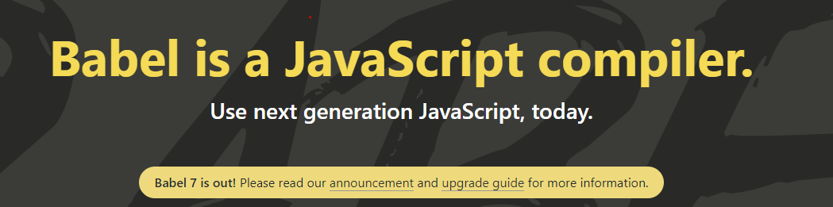
Babel is a JavaScript compiler/Transpiler
Convert the latest versions of Javascript code into a backwards compatible version of JavaScript in current and older browsers or environments(e.g. Node.js v12.18.4)
Set it up as part of our Node project: see the lab!

Slide 33
Structuring Node Apps
Node Server Code needs to be structured
Manage code base
Keeps code maintainable
Nodes packaging system supports this approach
Typical Node.js application code:
main app code
api implementation code
helper code

Slide 34
Example Approach:
Use a “project root” folder is the top level and contains the “entry point” or main server code
Always run npm in this folder to ensure just one node_modules folder
Use a public folder within the node folder for any static content

Slide 35
Basic Node App Structure
Root of your actual application
/projectroot/
package.json
readme.md
index.js
.env
.babelrc
public/
/images
/stylesheets
/scripts
index.html
node_modules/
api/
Tells Node and NPM what packages are required
The main entry point for the Express application
Environment variables
Bable Transpiler Config
Static content (if you need it)
Output directory for all NPM installations. DO NOT CHANGE OR MODIFY

Slide 36
Web APIs

Slide 37
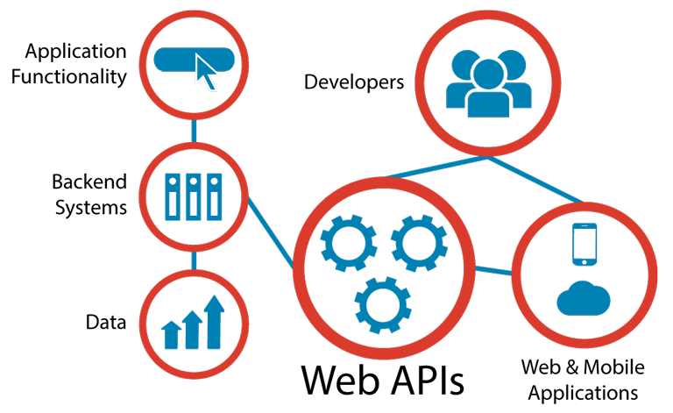
What is a Web Application Programming Interface?
Interface exposed via the Web
Usually via a URL
Accessed over the web using the HTTP
Uses open standards for data representation
JSON
XML
Typical use:
Expose application functionality via the web
Machine to machine communication
Distributed systems

Slide 38
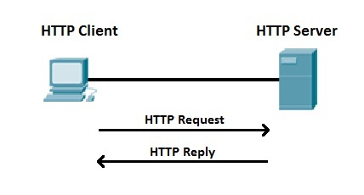
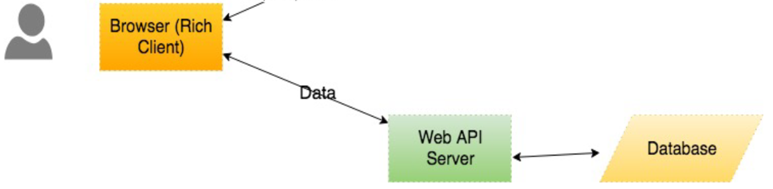
What is HTTP
HyperText Transfer Protocol
Your browser communicates using HTTP (HTTP Client)
Transfers HTML
Communicate with APIs using HTTP
Simple, ubiquitous.
We will be writing Node.js Apps that listen for and process HTTP requests
We can test using Postman, a HTTP Client

Slide 39
URL
A URL (Uniform Resource Locator) uniquely identifies a resource over the web. protocol://hostname:port/path-and-resource
There are 4 parts in a URL:
Protocol: The application-level protocol used by the client and server, e.g., HTTP, FTP, and telnet.
Hostname: The DNS domain name (e.g., www.nowhere123.com) or IP address (e.g., 192.128.1.2) of the server.
Port: The TCP port number that the server is listening for incoming requests from the clients.
Path-and-resource-name: The name and path of the requested resource
Example, for http://www.myserver.com:8080/api/movies
the communication protocol is HTTP
The host is www.myserver.com.
The port number is TCP port 8080.
The path and resource name is “api/movies".

Slide 40
HTTP Protocol (Request)
HTTP clients (e.g. a browser) translates a URL into a request message according to the specified protocol; and sends the request message to the server.
For example, a html client may translated the URL http://www.myserver.com:8080/api/movies into the following HTTP request message:
GET /api/movies/ HTTP/1.1
User-Agent: PostmanRuntime/7.26.5
Accept: application/json
Cache-Control: no-cache
Host: www.myserver.com:8080
Accept-Encoding: gzip, deflate, br
Connection: keep-alive

Slide 41
HTTP Protocol (Response)
When this request message reaches the server, the server can take either one of these actions:
The server interprets the request received, maps the request into a program kept in the server, executes the program, and returns the output of the program to the client.
The request cannot be satisfied, the server returns an error message.
An example of the HTTP response message is below:
HTTP/1.1 200 OK
Date: Sun, 18 Oct 2009 08:56:53 GMT
Server: Apache/2.2.14 (Win32)
Last-Modified: Sat, 20 Nov 2019 07:16:26 GMT
Content-Length: 22
Connection: close
Content-Type: application/json
{“result”:”It Works!”}

Slide 42
HTTP Methods
GET
Request objects without sending data
POST
Modify objects with data that you are sending
PUT
Create new objects with data that your are sending
DELETE
Delete objects without sending data

Slide 43

REST
Short for Representational State Transfer
Set of Principles for how web should be used
Coined by Roy Fielding
One of the HTTP creator
A set of principles that define how Web standards(HTTP and URIs) can be used.

Slide 44
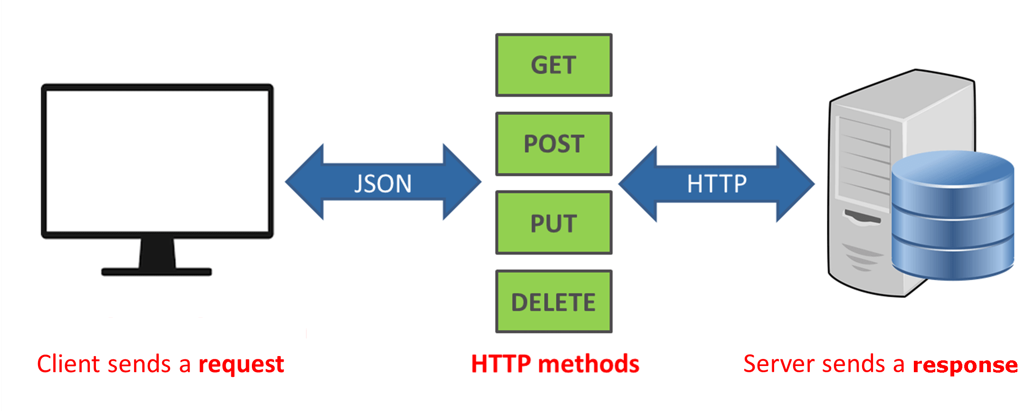
Key REST Principles
Every “thing” has an identity
URL
Link things together
Hypermedia/Hyperlinks
Use standard set of methods
HTTP GET/POST/PUT/DELETE
Manipulate resources through their representations
Resources can have multiple representations
JSON/XML/png/...
Communicate stateless
Should not depend on server state.
This Photo by Unknown Author is licensed under CC BY-SA-NC

Slide 45
API Design
Use principle of “developer-first”
put target developers’ interests ahead of other considerations
Strive for a better developer experience
Commit to RESTful APIs
Take a “grammatical” approach to the functionality
Keep interface simple and intuitive
Optional: Can use a Interface Description Language & Tools like:
RESTful API Markup Language (RAML)
Swagger

Slide 46
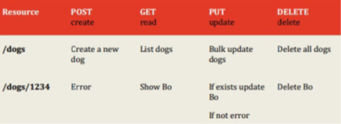
API Design
In Rest, everything is based around resources
the “things” you’re working with are modelled as resources described by URI paths--like /users, /groups, /dogs
Notice they are nouns .
Verbs in URLs are BAD
The things that you do on these things (or nouns) are characterised by the fixed set of HTTP methods
What GET,POST,PUT does is something that the designer/developer gets to put into the model.
The metadata (the adjectives) is usually encoded in HTTP headers, although sometimes in the payload.
The responses are the pre-established HTTP status codes and body. (200, 404, 500 etc.)
The representations of the resource are found inside the body of the request and response

Slide 47
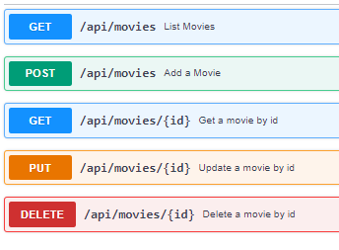
API Design Demo: Movies API

Slide 48
The Express Package

Slide 49
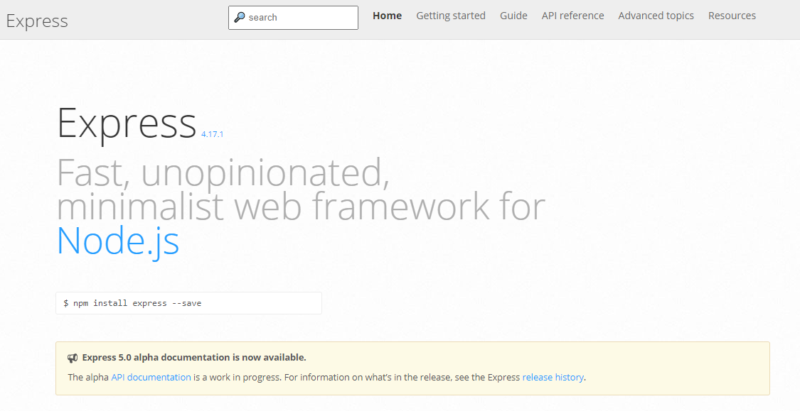
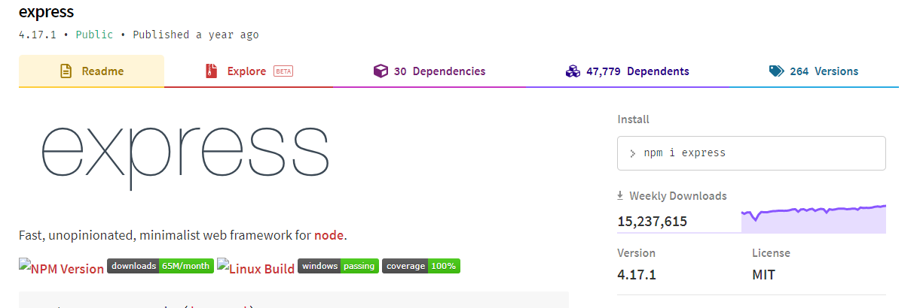
What is Express?
Notes:
Web application framework for Node
Built on the Connect middleware package
It's popular because it‘s
Minimalist,
Fast
Simple

Slide 50
What Express Gives Us...
Parses arguments and headers
Easy Routing
Route a URL to a callback function
Sessions
File Uploads
Middleware…

Slide 51
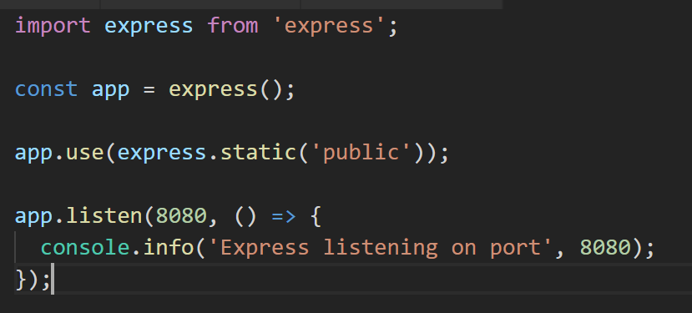
Simple Express App (index.js)
Loads Express module
Instantiates Express server
Define static content for HTTP GET

Slide 52
Getting Started with Express
Installing Express
[local install] C:\> npm install express --save
[global install] C:\> npm install express -g

Slide 53
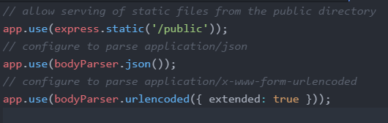
Express Configuration
Express allows you to easily configure your web app behaviour...

Slide 54
Express: Routing
Routing refers to determining how an application responds to a client request
The path and HTTP request method (e.g. GET, POST) are used to “route” the request.
Each route can have one or more handler functions, which are executed when the route is matched.

Slide 55
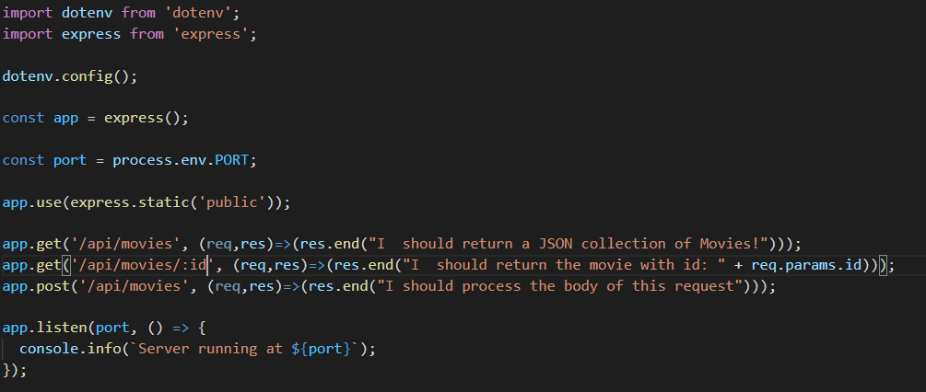



(/*)?
Routing Example
Syntax follows the pattern:
app.[http_verb](path, (req,res)=>{});
Handles HTTP POST requests on path /api/movies
app.post(‘/api/movies’, …);
app.get(‘/api/movie/:id’, …)
Parametised URL. Accepts :id route argument. Access using req.id

