Slide 1

MongoDB, Mongoose and Cloud Storage
Frank Walsh, Diarmuid O’Connor

Slide 2

Agenda
NoSQL Databases
MongoDB
Mongoose
Mongo in the cloud

Slide 3
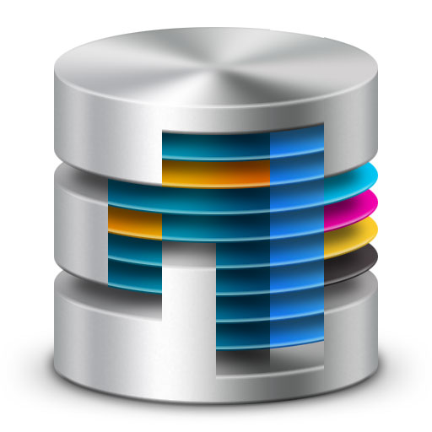
Databases in Enterprise Apps
Most data driven enterprise applications need a database
Persistence: storage of data
Concurrency: many applications sharing the data at once.
Integration: multiple systems using the same DB
Enterprise Application DBs require backups, fail over, maintenance, capacity provisioning.
Traditionally handled by a Database Administrator (the DBA).
This Photo by Unknown Author is licensed under CC BY
Notes:
- As of last year, still most common means fo system integration.

Slide 4
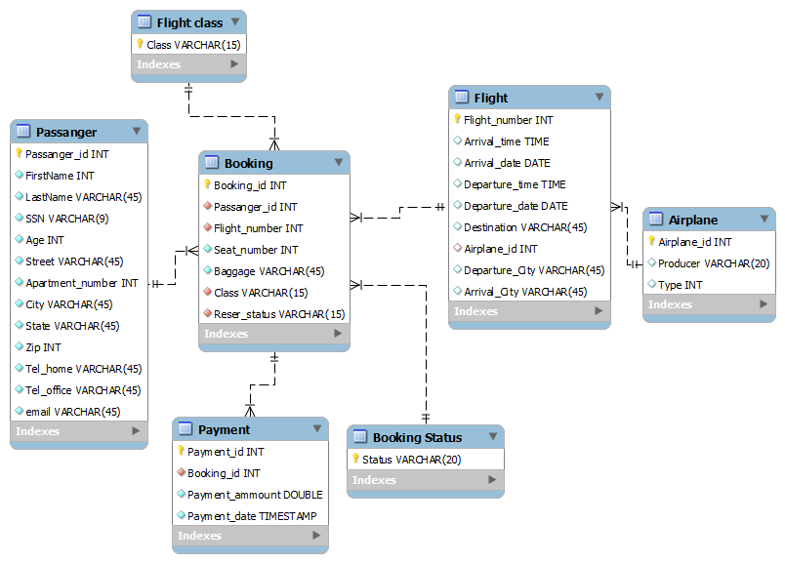
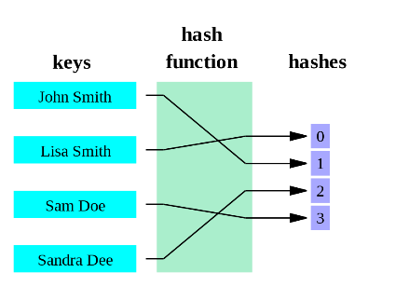
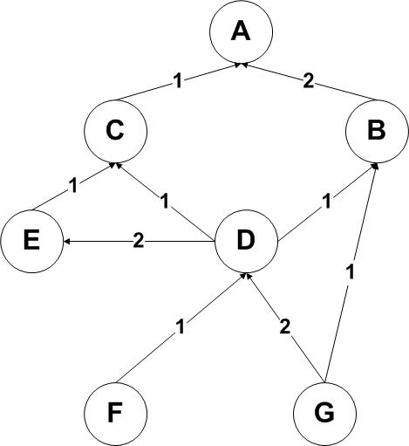
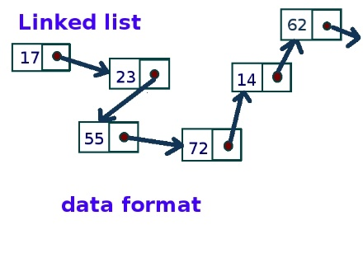
Structured & Unstructured Data
Relational Database
Relational Databases:
Organise data into structured tables and rows
Relations have to be simple, they cannot contain any structure such as a nested record or a list
In memory data structures
Much more varied structure
Lists, Queues, Stacks, Graphs, Hashing
In Memory Data Structures
This Photo by Unknown Author is licensed under CC BY-SA
This Photo by Unknown Author is licensed under CC BY-SA
This Photo by Unknown Author is licensed under CC BY-SA
This Photo by Unknown Author is licensed under CC BY-SA
Notes:
There is a divide between the relational model and the in-memory data structures.
Use relational algebra to conduct operations using SQL on those relations.
In memory data structures Are a better match for certain types of problems

Slide 5
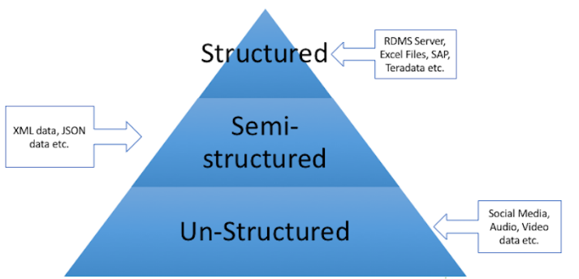
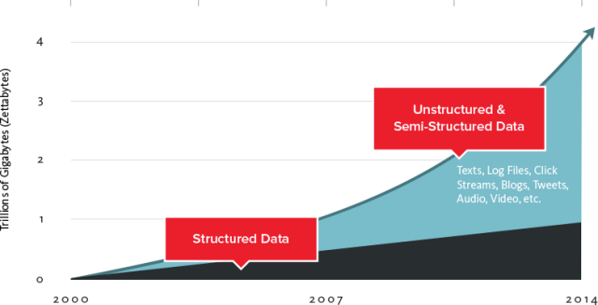
Time

Slide 6
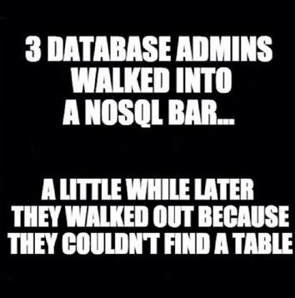
NoSQL Databases
Non-tabular(no tables) databases and store data differently than relational tables.
Variety of types based on their data model
Document based, key-value, graph
NoSQL databases allow developers to work with semi-structured/unstructured data, giving them a lot of flexibility
No need to define exact schema(i.e. structure) for data

Slide 7

Databases in the Cloud
For some apps, a traditional relational database may not be the best fit
Organisations are capturing more data and processing it quicker – can be expensive/difficult on traditional DB
Traditionally, relational database is designed to run on a single machine in predicable environment
Hard to estimate scaling requirements, particularly if it’s a web app?
Are you going to do Data mining?
One approach is to use the Cloud for you DB
Designed for scale
Can be outsourced so you don’t have to deal with infrastructure requirements.
This Photo by Unknown Author is licensed under CC BY-SA
Notes:
Do you need db schema definition?
Many NoSQL databases are designed explicitly to run on clusters, so they make a better ﬁt for big data scenarios.

Slide 8
NoSQL Cloud DB Advantages
Removes Management costs
Inherently scalable
No need to define schemas(if NoSQL) etc.
Lots of Cloud DB offerings out there
SQL based
NoSQL based
If organisation policy/standards do not allow outsourcing:
- Can host yourself, most NoSQL DBs are free.

Slide 9
NoSQL Cloud Database Practices
Drop Consistency(if you can)
this makes distributed systems much easier to build
Drop SQL and the relational model
simpler structures are easier to distribute:
key/value pairs
structured documents
pseudo-tables
tend to be schema-free, accepting data as-is
Offer HTTP interfaces using XML or JSON
Web APIs!!!

Slide 10

Mongodb
This Photo by Unknown Author is licensed under CC BY-NC-ND

Slide 11
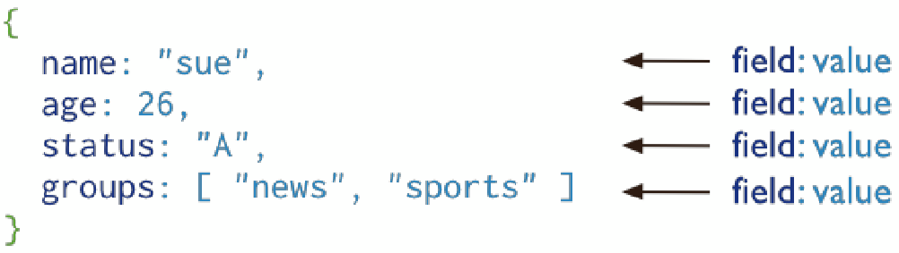
Introduction
Document-oriented database
A record in MongoDB is a document, which is a data structure composed of ﬁeld and value pairs.
MongoDB documents are similar to JSON objects
Field Values can be other documents, arrays, arrays of other documents.
Reduces need for “Joins”
Community support - popular choice
Notes:
Uses JSON natively – nice fit for Node.js

Slide 12
Mongo Terminology
Each database contains a set of "Collections"
Collections contain a set of JSON documents
there is no schema (in the DB…)
The documents can all be different
means you have rapid development
adding a property is easy - just starting using in your code
Makes deployment easier and faster
roll-back and roll-forward are safe - unused properties are just ignored
Collections can be indexed and queries
Operations on individual documents are atomic
MongoDB Server
Database
Collection
Document
{“_id”:” 5c92448b…”,
“name”:”Frank”,
“gender”:”male”}
Document
{“_id”:” 3a92c48b…”,
“name”:”Frank”,
“gender”:”male”,
“status”:”active”}
Document
{“_id”:” 7292b48b…”,
“name”:”Frank”,
“status”:”active”,
“upvotes”:0}

Slide 13
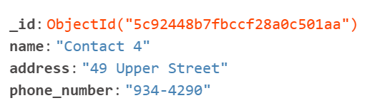
Mongo Documents
MongoDB stores data records as BSON documents(Binary JSON.
BSON is a binary representation of JSON documents.
Each document stored in a collection requires a unique _id field and is reserved for use as a primary key.
If an inserted document omits the _id field, the MongoDB driver automatically generates an ObjectId for the _id field.
ObjectId values consist of 12 bytes.

Slide 14
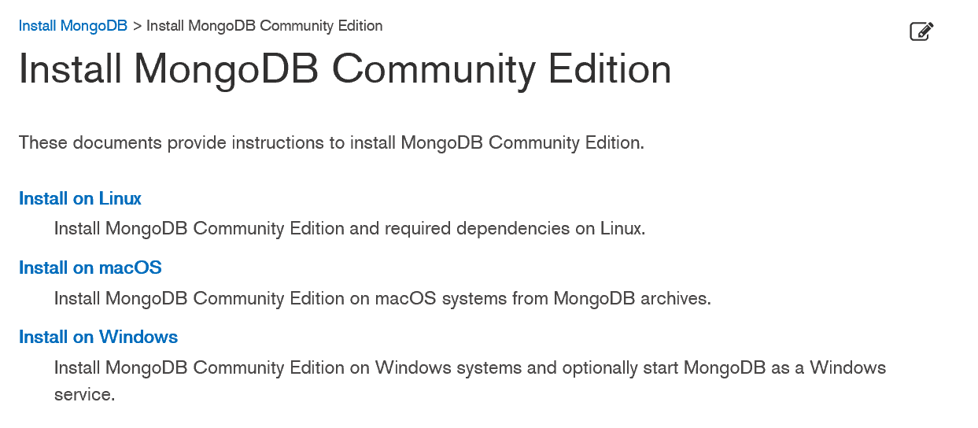


Getting Started (locally)
Install Mongo community edition for your OS:
Specify a directory for your db files and start Mongodb server.

Slide 15
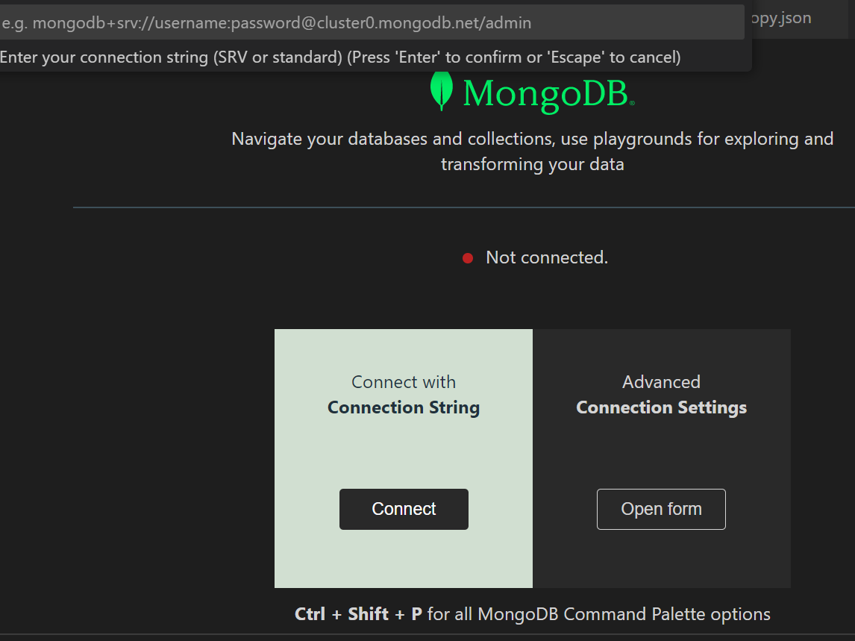
Getting Started (locally)
Install Mongo DB Extension for VS Code
Never have to leave your VS Code environment!!!
Navigate your DBs and Collections

Slide 16
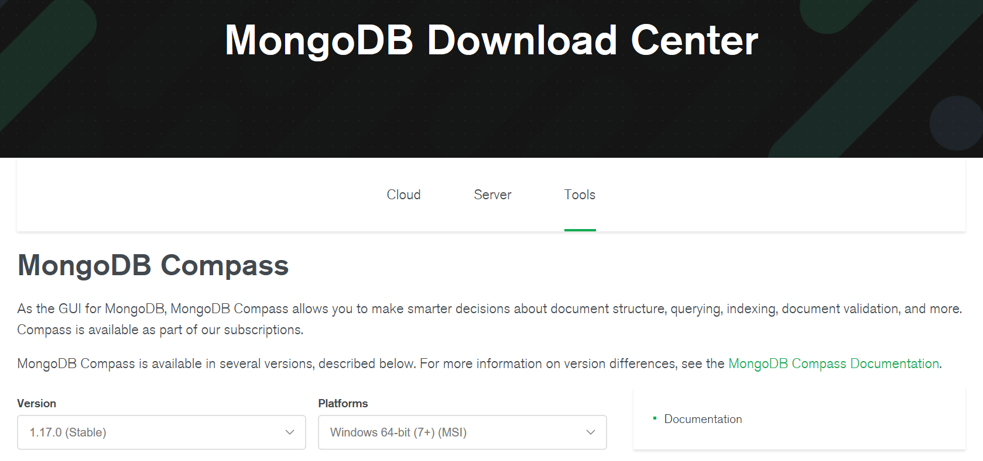
Getting Started (locally)
Install Mongo Compass, Graphical User Interface for managing MongoDB.
For windows, comes as part of mongodb install
Other platforms can get it here:

Slide 17
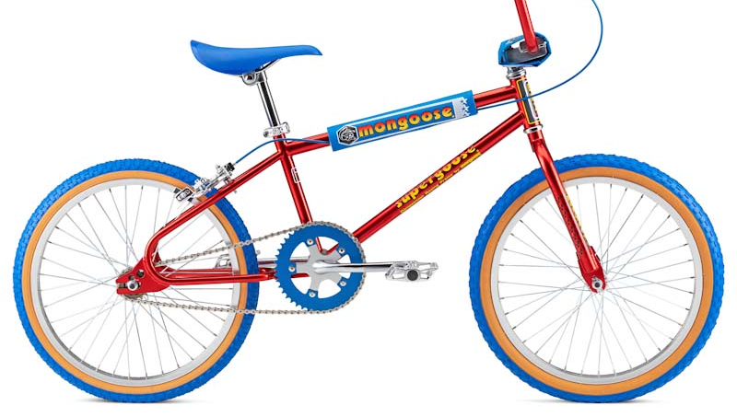

Mongoose
Mongo with Node.js
This Photo by Unknown Author is licensed under CC BY-SA

Slide 18
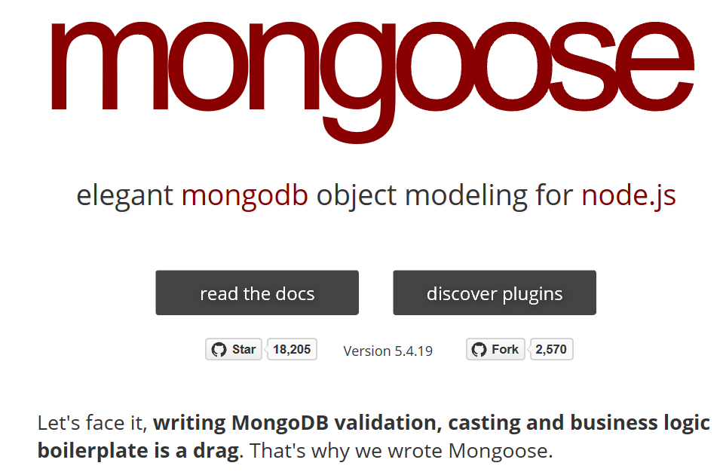
Mongoose Overview
Mongoose is a object-document model module in Node.js for MongoDB
Wraps the functionality of the native MongoDB driver
Exposes models to control the records in a doc
Supports validation on save
Extends the native queries

Slide 19

Mongoose first?
????
Shortcut to understanding the basics
Similar to Object Relational Mapping libraries like JPA/Hibernate
Easier concept if coming from relational DB background.
This Photo by Unknown Author is licensed under CC BY-NC

Slide 20
Installing & Using Mongoose
Run the following from the CMD/Terminal
Import the module
Connect to the database

Slide 21
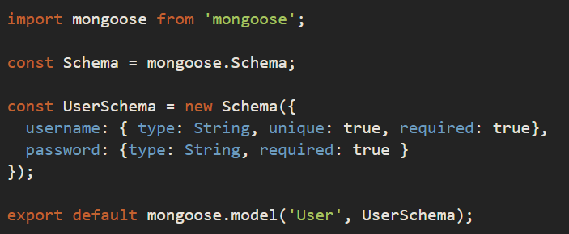
Mongoose Schemas and Models
A Mongoose schema defines the structure of the document
Properties, default values, validation etc.
A Mongoose model is a “wrapper” on the Mongoose schema.
provides an interface to the database for creating, querying, updating, deleting records, etc
Notes:
A Mongoose model is a wrapper on the Mongoose schema. A Mongoose schema defines the structure of the document, default values, validators, etc., whereas a Mongoose model provides an interface to the database for creating, querying, updating, deleting records, etc.

Slide 22
Demo
Contacts API: Manage contact details…
Contacts Schema:
name: String
address: String
age: Number
email: String
updated: Date
Solution in Code Examples…

Slide 23
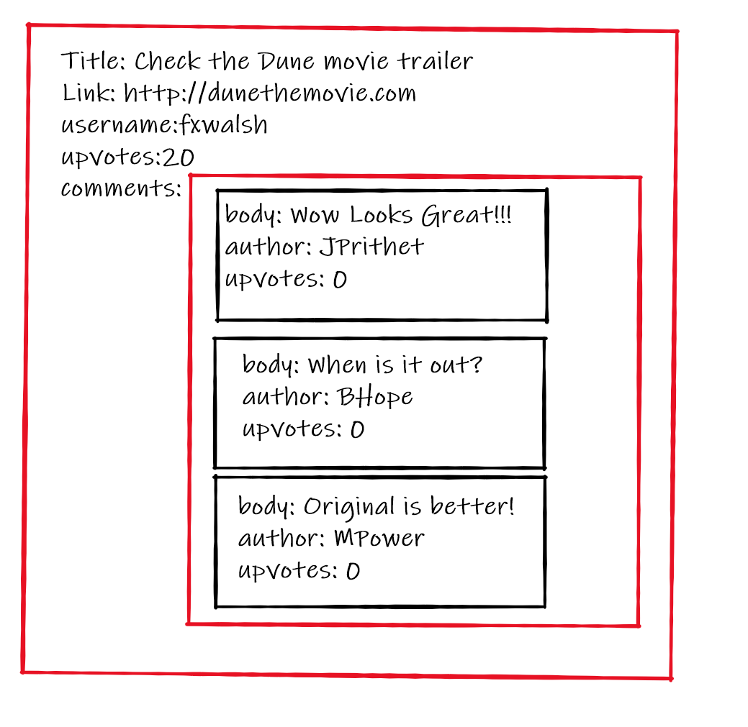
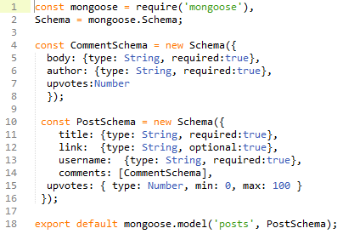
Mongoose Schemas – Arrays & sub-documents
Example: Data Model for supports user Posts on a web site:
Comments property is an Array of CommentSchemas

Slide 24
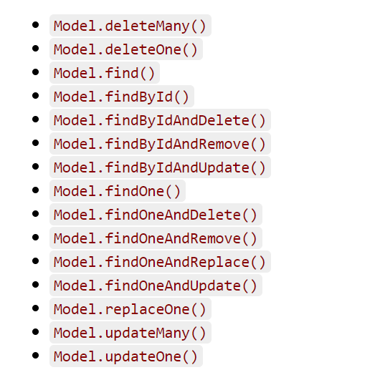
Mongoose Queries
Mongoose supports many queries:
For equality/non-equality
Selection of some properties
Sorting
Limit & skip
Mongoose models provide several static helper functions for CRUD operations.
Model.findOne() returns a single document, the first match
Model.find() returns all
Model.findById() queries on the _id field.

Slide 25

Mongoose Queries
Can build complex queries and execute them later
The above finds all contacts where age >17 and <66 and living in either Waterford, Kilkenny or Wexford

Slide 26
Lecture 2
Sub Documents
Validators
Queries
Object Refs.

Slide 27
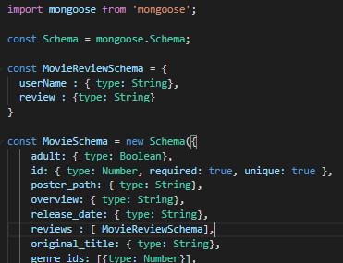
Mongoose Schemas - Arrays
Review property is an Array of MovieReviewSchema

Slide 28
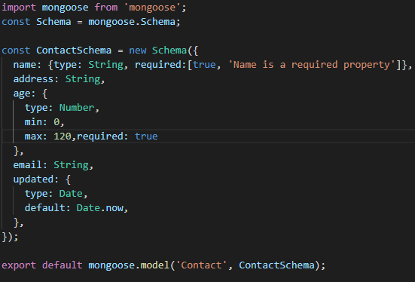
Mongoose Schema – Built-in Validation
constraints on properties :
https://mongoosejs.com/docs/validation.html

Slide 29
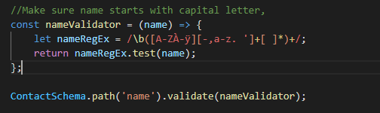
Mongoose Custom Validation
Developers can define custom validation on their properties (e.g. validate name field is correct format)
Using Regular Expression (regex) to test for a valid name format, for example begins with a capital letter. If you’ve not come across them before check out https://www.w3schools.com/jsref/jsref_obj_regexp.asp
https://mongoosejs.com/docs/validation.html

Slide 30
Data Manipulation Mongoose
Mongoose supports all the CRUD operations:
Create –> Model.create(docs) or new Model(doc).save()
Read –> Model.find(conditions)
Update –> Model.update(conditions, props)
Remove –> Model.remove(conditions)
Can operate with "error first" callbacks, promises, or async-await

Slide 31
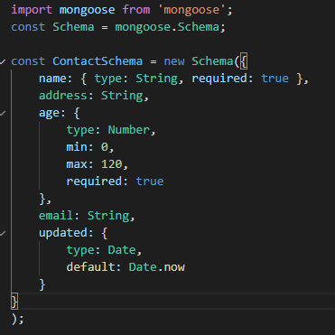

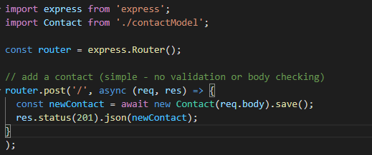


Create with Mongoose (async-await)

Slide 32
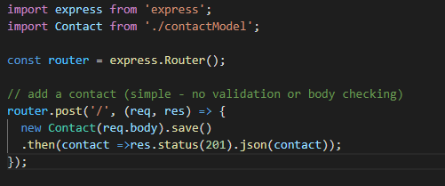
Create with Mongoose (promise)

Slide 33
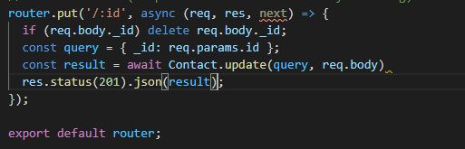
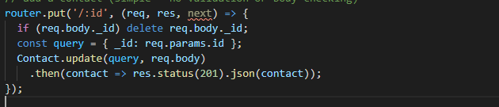
Update with Mongoose
Async-Await Syntax
Promise Syntax

Slide 34
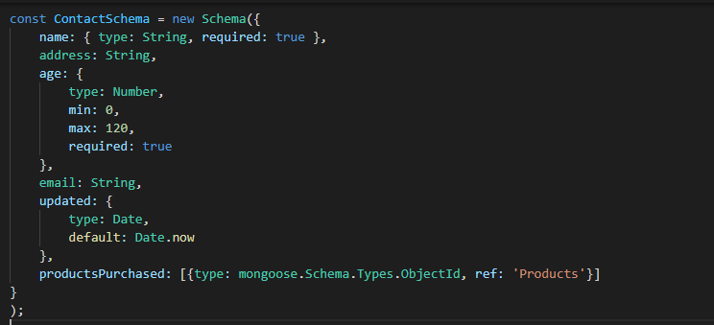
Object Referencing
Using Object ID to reference a document in Products
Can use Object Id to reference documents in other collections
Similar to ‘foreign keys’ in SQL databases

Slide 35
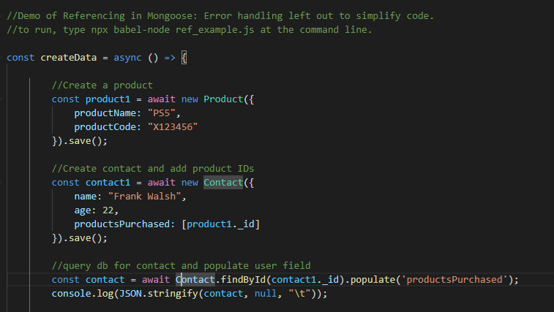
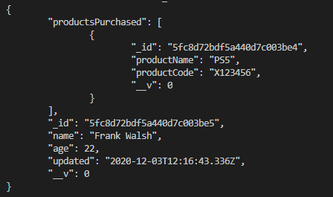
Query Population using Refs
https://github.com/fxwalsh/ewd-examples-2020.git
Allows you to automatically replace the speciﬁed paths in the document with document(s) from other collection(s).
output

Slide 36
Schema Methods

Slide 37
Example: Using Schema Methods for Simple Authentication
Restrict access to API (require authentication):
Create users schema with methods for
Finding users
Checking password
Use express-session middleware to create and manage user session (using cookies)
Create an authentication route to set up “session”
Create your own authentication middleware and place it on /api/movies route

Slide 38
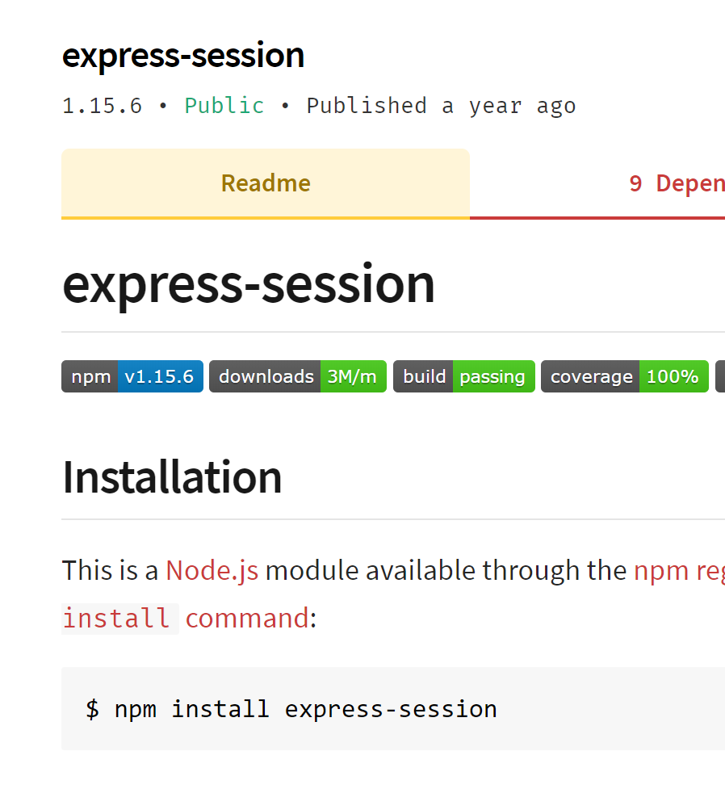
Aside: Sessions
Requests to Express apps are stand-alone by default
no request can be linked to another.
By default, no way to know if this request comes from a client that already performed a request previously.
Sessions are a mechanism that makes it possible to “know” who sent the request and to associate requests.
Using Sessions, every user of you API is assigned a unique session:
Allows you to store state.
The express-session module is middleware that provides sessions for Express apps.

Slide 39
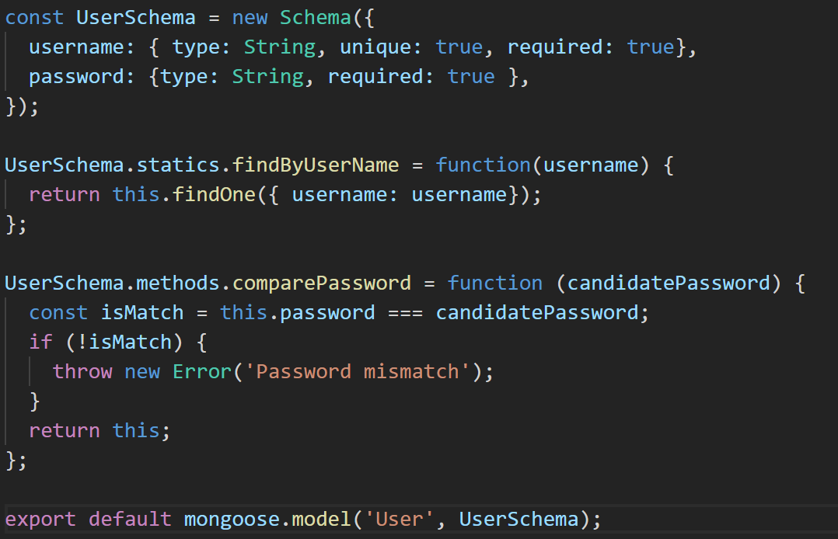
1. User Schema with Static & Instance Methods
Static Method: belongs to schema. Independent of any document instance
Instance Method: belongs to a specific document instance.

Slide 40
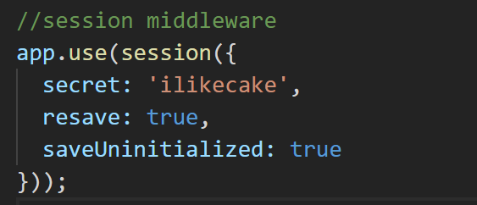
2. express-session middleware
Session middleware that stores session data on server-side
Puts a unique ID on client
Add to Express App middleware stack:

Slide 41
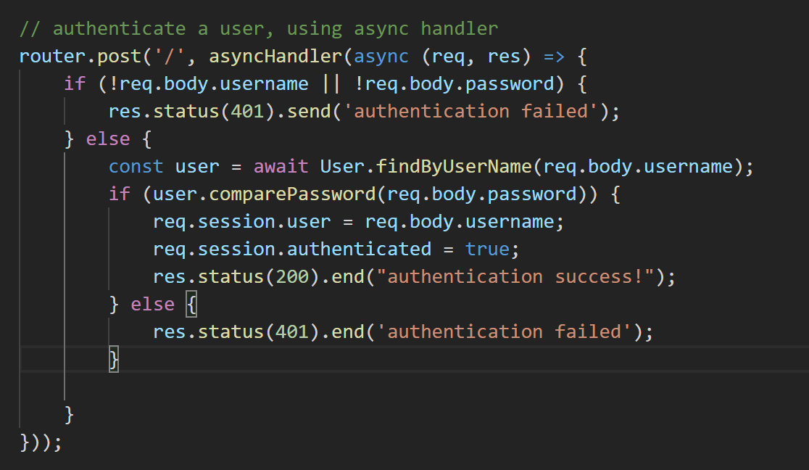
3. Use User Route to authenticate
Use /api/user to authenticate, passing username and password in HTTP body
/api/users/index.js
Using static method to find User document
Using instance method to check password
/index.js

Slide 42
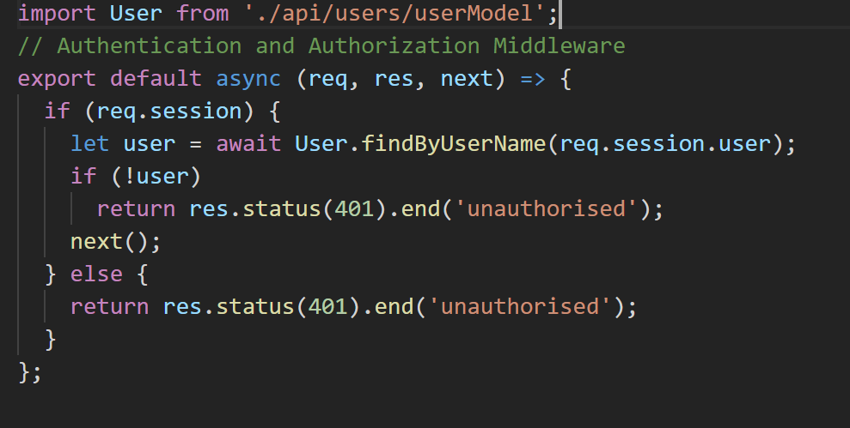
4. Add Authentication Middleware
authenticate.js
Checks for user ID in session object. If exists, called next middleware function, otherwise end req/res cycle with 401
index.js
Authentication middleware applied on /api/movies route.

