Slide 1

MongoDB, Mongoose and Cloud Storage
Frank Walsh, Diarmuid O’Connor

Slide 2

Agenda
Cloud Databases
MongoDB
Mongoose
Mongo in the cloud

Slide 3
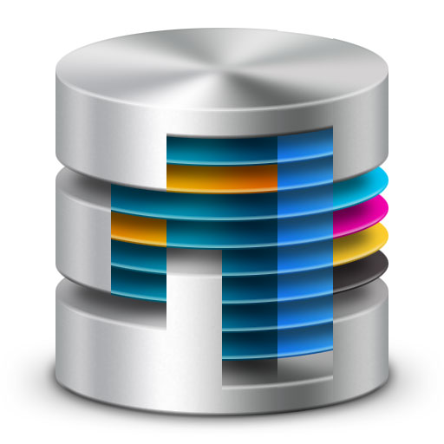
Databases in Enterprise Apps
Most data driven enterprise applications need a database
Persistence: storage of data
Concurrency: many applications sharing the data at once.
Integration: multiple systems using the same DB
Enterprise Application DBs require backups, fail over, maintenance, capacity provisioning.
Traditionally handled by a Database Administrator (the DBA).
This Photo by Unknown Author is licensed under CC BY

Slide 4
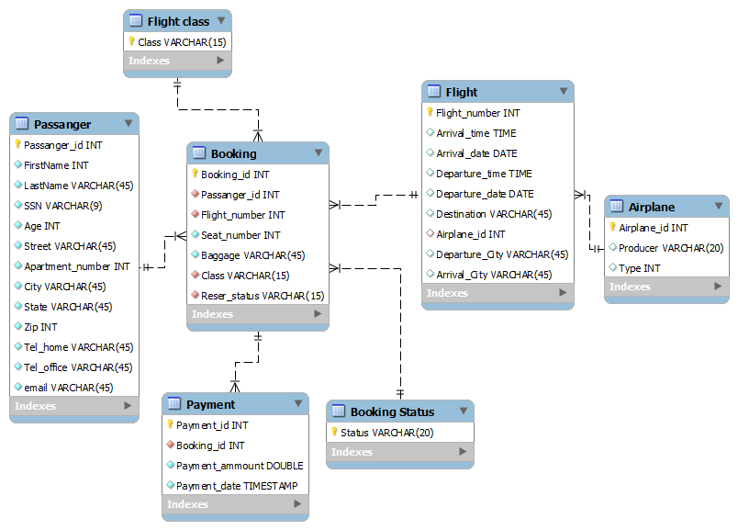
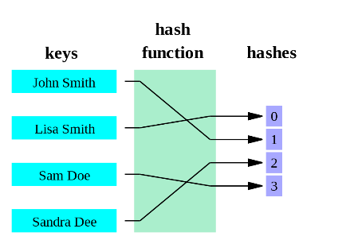
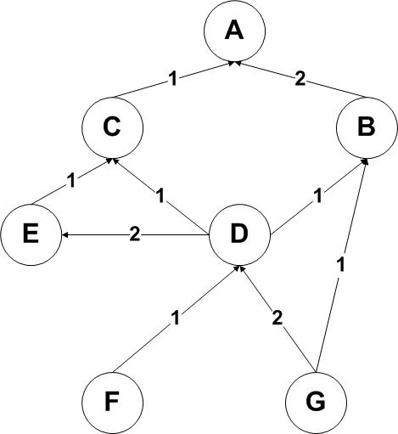
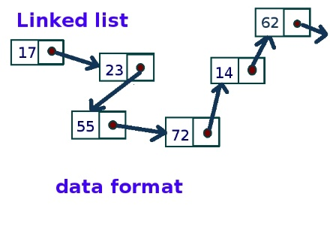
Structured & Unstructured Data
Relational Database
Relational Databases:
Organise data into structured tables and rows
Relations have to be simple, they cannot contain any structure such as a nested record or a list
In memory data structures
Much more varied structure
Lists, Queues, Stacks, Graphs, Hashing
In Memory Data Structures
This Photo by Unknown Author is licensed under CC BY-SA
This Photo by Unknown Author is licensed under CC BY-SA
This Photo by Unknown Author is licensed under CC BY-SA
This Photo by Unknown Author is licensed under CC BY-SA
Notes:
There is a divide between the relational model and the in-memory data structures.
Use relational algebra to conduct operations using SQL on those relations.
In memory data structures Are a better match for certain types of problems

Slide 5
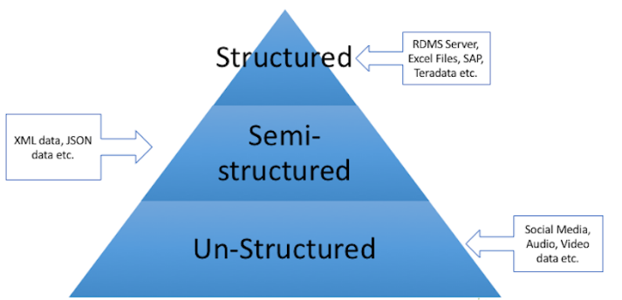
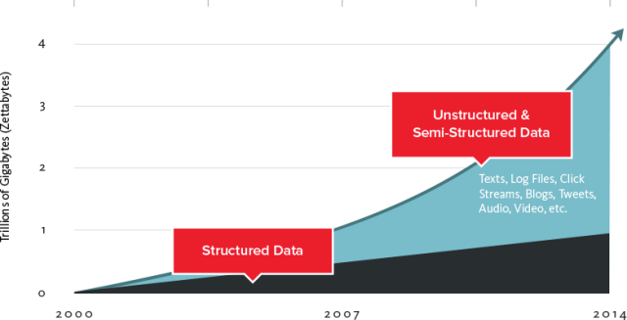

Slide 6

Databases in the Cloud
For some apps, a traditional relational database may not be the best fit
Organisations are capturing more data and processing it quicker – can be expensive/difficult on traditional DB
Traditionally, relational database is designed to run on a single machine in predicable environment
May be economic to run large data and computing loads on clusters.
Hard to estimate scaling requirements, particularly if it’s a web app?
Are you going to do Data mining?
One approach is to use the Cloud for you DB
Designed for scale
Can be outsourced so you don’t have to deal with infrastructure requirements.
This Photo by Unknown Author is licensed under CC BY-SA
Notes:
Do you need db schema definition?
Many NoSQL databases are designed explicitly to run on clusters, so they make a better ﬁt for big data scenarios.

Slide 7
Cloud DB Advantages
Removes Management costs
Inherently scalable
Latency is predictable and constant
No need to define schemas(if NoSQL) etc.
Lots of Cloud DB offerings out there
SQL based
NoSQL based
If organisation policy/standards do not allow outsourcing:
- Can host yourself, most NoSQL DBs are free.

Slide 8
Cloud Database Practices
Drop Consistency
this makes distributed systems much easier to build
Drop SQL and the relational model
simpler structures are easier to distribute:
key/value pairs
structured documents
pseudo-tables
tend to be schema-free, accepting data as-is
Offer HTTP interfaces using XML or JSON
Web APIs!!!

Slide 9
Designing Distributed Data
App data is not homogeneous
some kinds of data will be much larger
consider using different databases for different requirements.
user details,billing - needs consistency
require traditional database
user data,content - needs partition tolerance
replicate to keep safe
analytics,sessions - needs availability
"eventually consistent" is good enough

Slide 10

Mongodb
This Photo by Unknown Author is licensed under CC BY-NC-ND

Slide 11
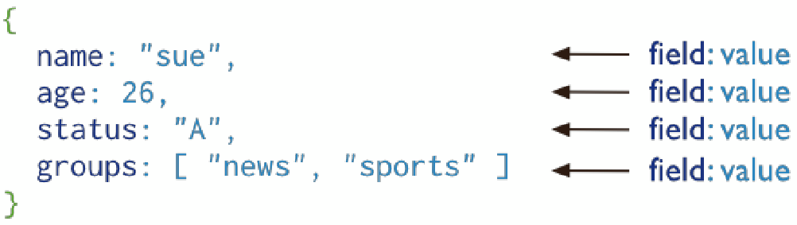
Introduction
Document-oriented database
A record in MongoDB is a document, which is a data structure composed of ﬁeld and value pairs.
MongoDB documents are similar to JSON objects
Field Values can be other documents, arrays, arrays of other documents.
Reduces need for “Joins”
Community support - popular choice
Notes:
Uses JSON natively – nice fit for Node.js

Slide 12
Mongo Terminology
Each database contains a set of "Collections"
Collections contain a set of JSON documents
there is no schema (in the DB…)
The documents can all be different
means you have rapid development
adding a property is easy - just starting using in your code
Makes deployment easier and faster
roll-back and roll-forward are safe - unused properties are just ignored
Collections can be indexed and queries
Operations on individual documents are atomic
MongoDB Server
Database
Collection
Document
{“_id”:” 5c92448b…”,
“name”:”Frank”,
“gender”:”male”}
Document
{“_id”:” 3a92c48b…”,
“name”:”Frank”,
“gender”:”male”,
“status”:”active”}
Document
{“_id”:” 7292b48b…”,
“name”:”Frank”,
“status”:”active”,
“upvotes”:0}

Slide 13
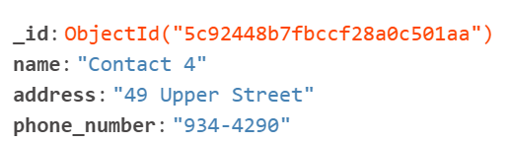
Mongo Documents
MongoDB stores data records as BSON documents.
BSON is a binary representation of JSON documents.
Each document stored in a collection requires a unique _id field and is reserved for use as a primary key.
If an inserted document omits the _id field, the MongoDB driver automatically generates an ObjectId for the _id field.
ObjectId values consist of 12 bytes.

Slide 14
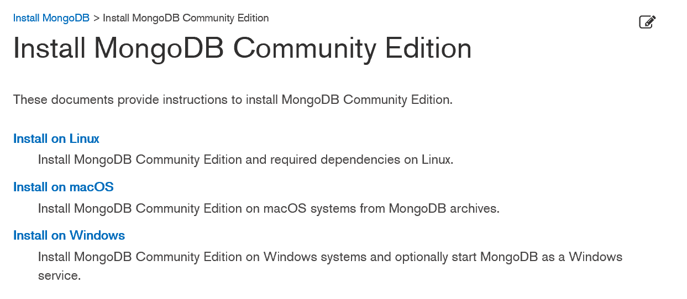


Getting Started (locally)
Install Mongo community edition for your OS:
Specify a directory for your db files and start Mongodb server.

Slide 15
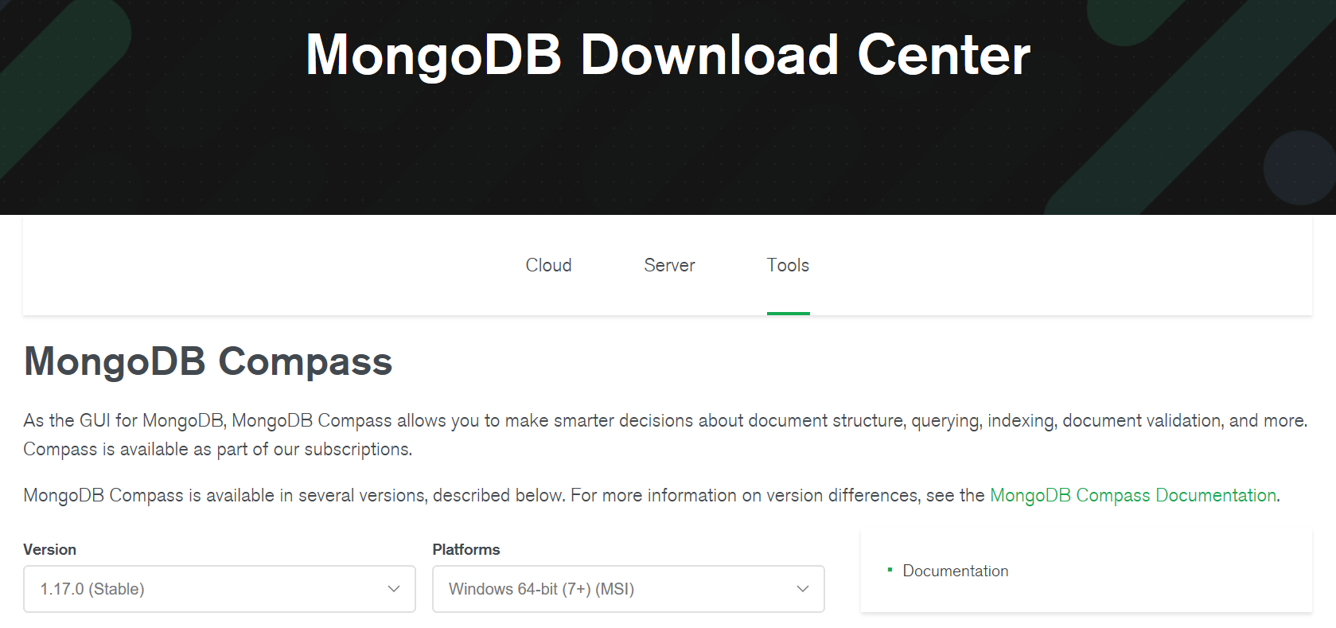
Getting Started (locally)
Install Mongo Compass, Graphical User Interface for managing MongoDB.
For windows, comes as part of mongodb install
Other platforms can get it here:

Slide 16

Mongoose
Mongo with Node.js
This Photo by Unknown Author is licensed under CC BY-SA

Slide 17
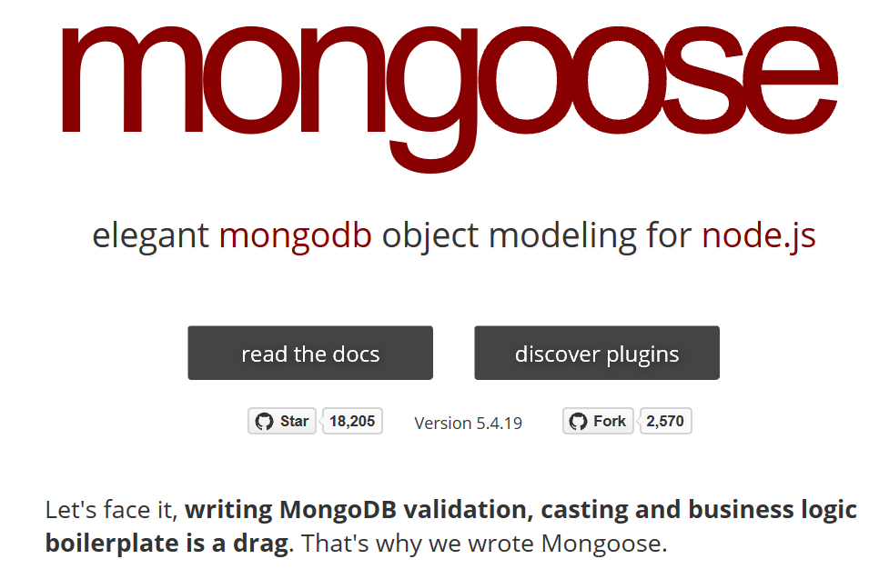
Mongoose Overview
Mongoose is a object-document model module in Node.js for MongoDB
Wraps the functionality of the native MongoDB driver
Exposes models to control the records in a doc
Supports validation on save
Extends the native queries

Slide 18

Mongoose first?
????
Shortcut to understanding the basics
Similar to Object Relational Mapping libraries like JPA/Hibernate
Easier concept if coming from relational DB background.
This Photo by Unknown Author is licensed under CC BY-NC

Slide 19
Installing & Using Mongoose
Run the following from the CMD/Terminal
Import the module
Connect to the database

Slide 20
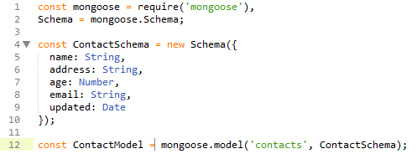
Mongoose Schemas and Models
Mongoose supports models
i.e. fixed types of documents
Compiled from a mongoose.Schema definition
Each of the properties must have a type
Number, String, Boolean, array, object
Instances of models represent documents in the Database
All document manipulation (create/read/update/delete) is handled by models

Slide 21
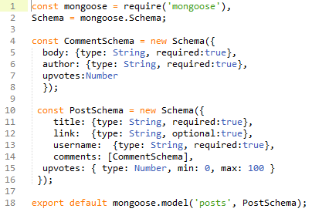
Mongoose Schemas – Arrays & sub-documents
Comments property is an Array of CommentSchemas

Slide 22
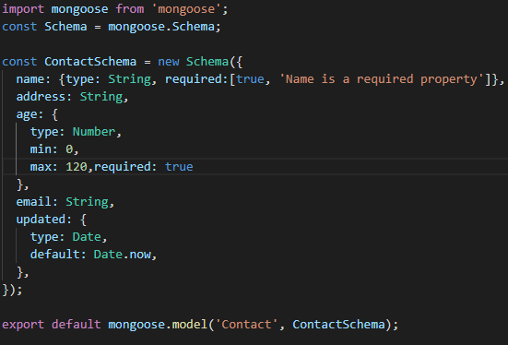
Mongoose Schema – Built-in Validation
constraints on properties :

Slide 23

Mongoose Custom Validation
Developers can define custom validation on their properties (e.g. validate email field is correct format)
Using Regular Expression (regex) to test for a valid email. If you’ve not come across them before check out https://www.w3schools.com/jsref/jsref_obj_regexp.asp

Slide 24
Data Manipulation Mongoose
Mongoose supports all the CRUD operations:
Create –> Model.create()
Read –> Model.find()
Update –> Model.update(condition, props, cb)
Remove –> Model.remove()
Can operate with "error first" callbacks or promises.

Slide 25
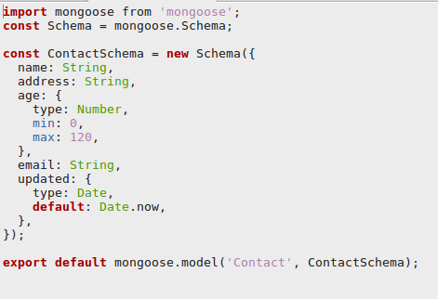
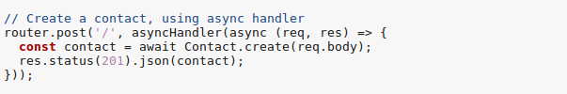
Create Contact with Mongoose

Slide 26
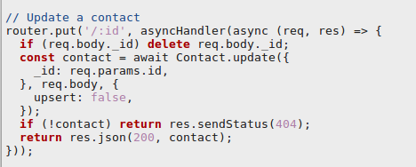
Update Contact with Mongoose

Slide 27
Mongoose Queries
Mongoose provides a more expressive version of the native MongoDB
Instead of: {$or: [{conditionOne: true}, {conditionTwo: true}]
Do:
.where({conditionOne:true}).or({conditionTwo: true})

Slide 28
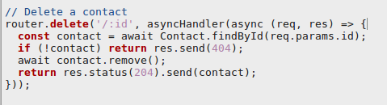
Mongoose Queries
Mongoose supports many queries:
For equality/non-equality
Selection of some properties
Sorting
Limit & skip
All queries are executed over the object returned by Model.find*()
Model.findOne() returns a single document, the first match
Model.find() returns all
Model.findById() queries on the _id field.

Slide 29

Mongoose Queries
Can build complex queries and execute them later
The above finds all contacts where age >17 and <66 and living in either Waterford, Kilkenny or Wexford

Slide 30
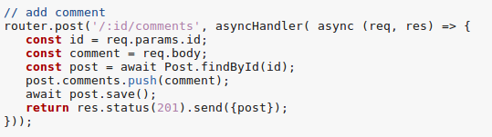
Mongoose Sub-Docs
Ex: Hacker News – Adding a comment to a post.

Slide 31
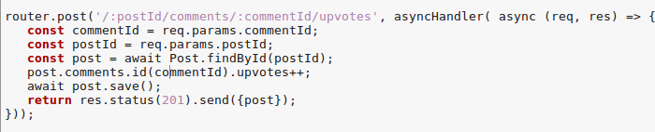
Mongoose Sub-Docs
Updating a Sub-Document(e.g. incrementing the upvotes for a comment)
Each subdocument is assigned it’s own _id from MongoDB. This is a special method to access sub documents

Slide 32
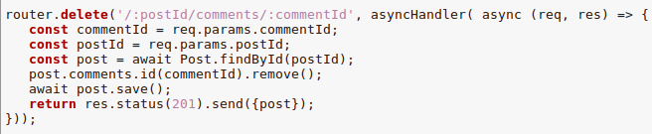
Mongo Sub docs
Removing a sub document

Slide 33
Schema Methods

Slide 34
Example: Using Schema Methods for Simple Authentication
Restrict access to Posts API (require authentication):
Create users schema with methods for
Finding users
Checking password
Use express-session middleware to create and manage user session (using cookies)
Create an authentication route to set up “session”
Create your own authentication middleware and place it on /api/posts route

Slide 35
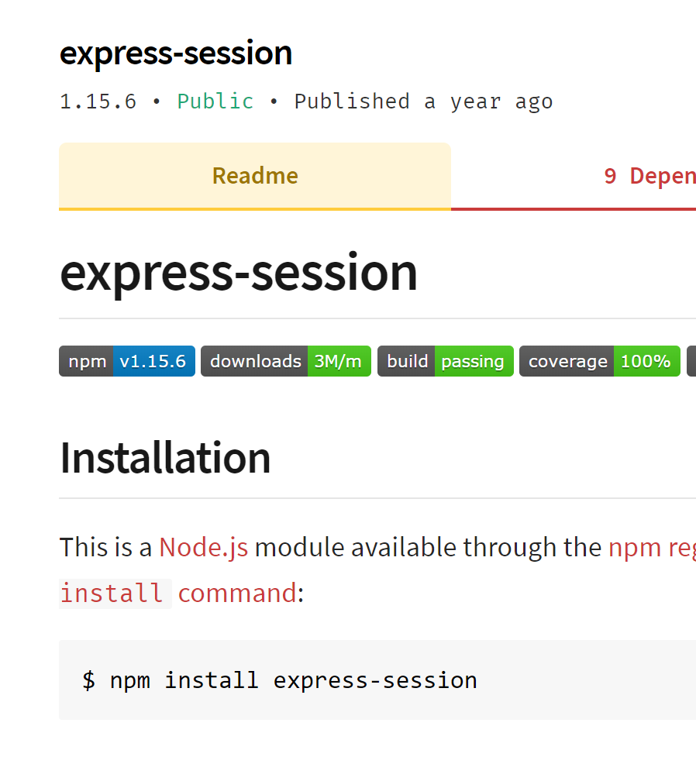
Aside: Sessions
Requests to Express apps are stand-alone by default
no request can be linked to another.
By default, no way to know if this request comes from a client that already performed a request previously.
Sessions are a mechanism that makes it possible to “know” who sent the request and to associate requests.
Using Sessions, every user of you API is assigned a unique session:
Allows you to store state.
The express-session module is middleware that provides sessions for Express apps.

Slide 36
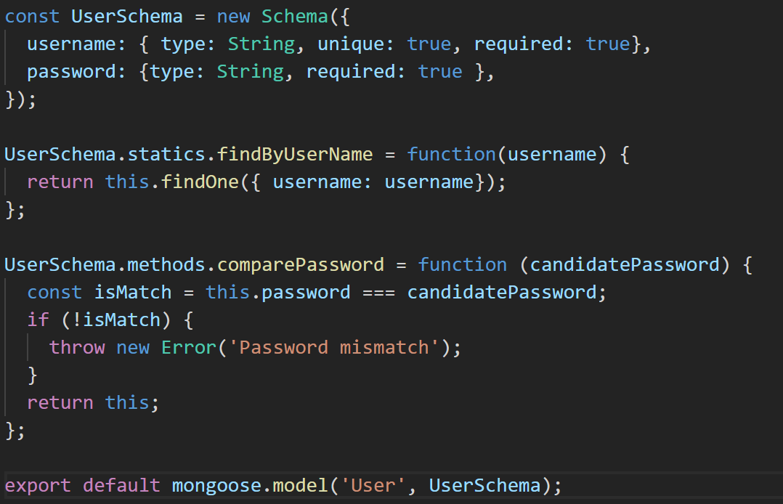
User Schema with Static & Instance Methods
Static Method: belongs to schema. Independent of any document instance
Instance Method: belongs to a specific document instance.

Slide 37
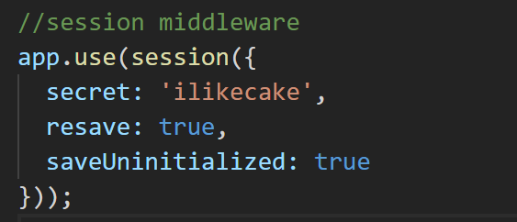
express-session middleware
Session middleware that stores session data on server-side
Puts a unique ID on client
Add to Express App middleware stack:

Slide 38
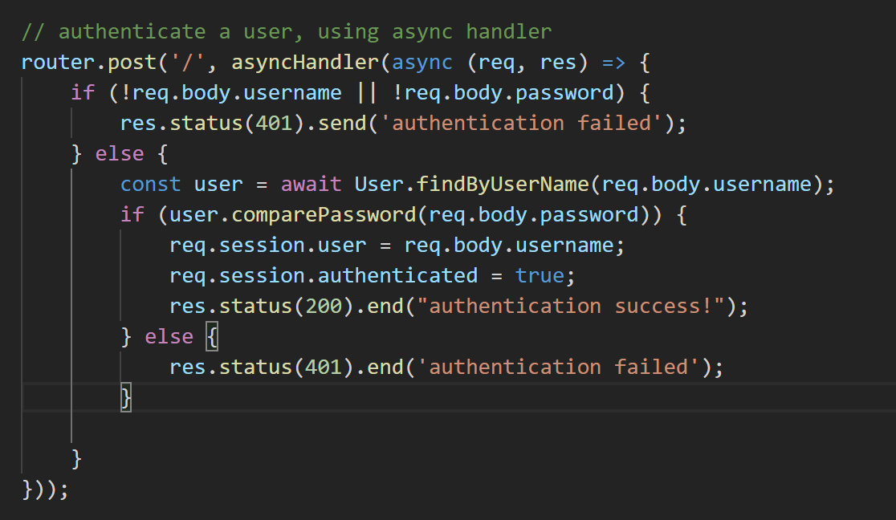
Create User Route to authenticate
Use /api/user to authenticate, passing username and password in HTTP body
/api/users/index.js
Using static method to find User document
Using instance method to check password
/index.js

Slide 39
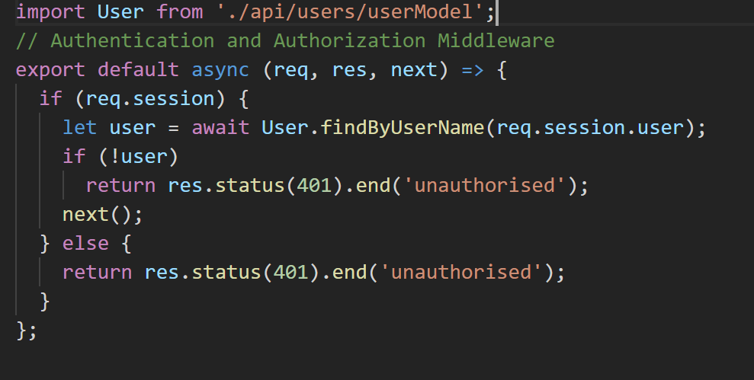
Authentication Middleware
authenticate.js
Checks for user ID in session object. If exists, called next middleware function, otherwise end req/res cycle with 401
index.js
Authentication middleware applied on /api/posts route.

Slide 40
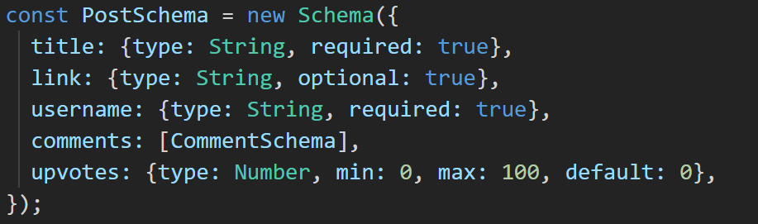
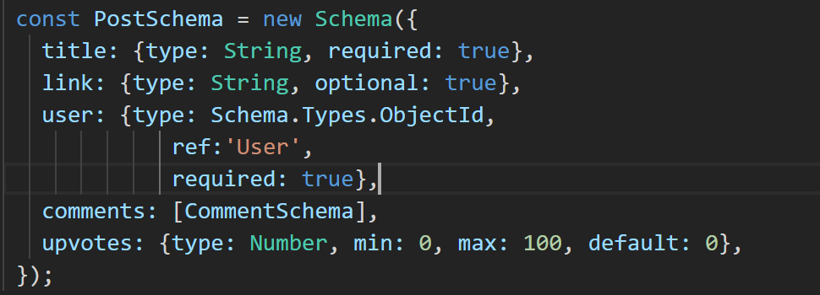
Object Referencing
Using Object ID to reference user document

Slide 41
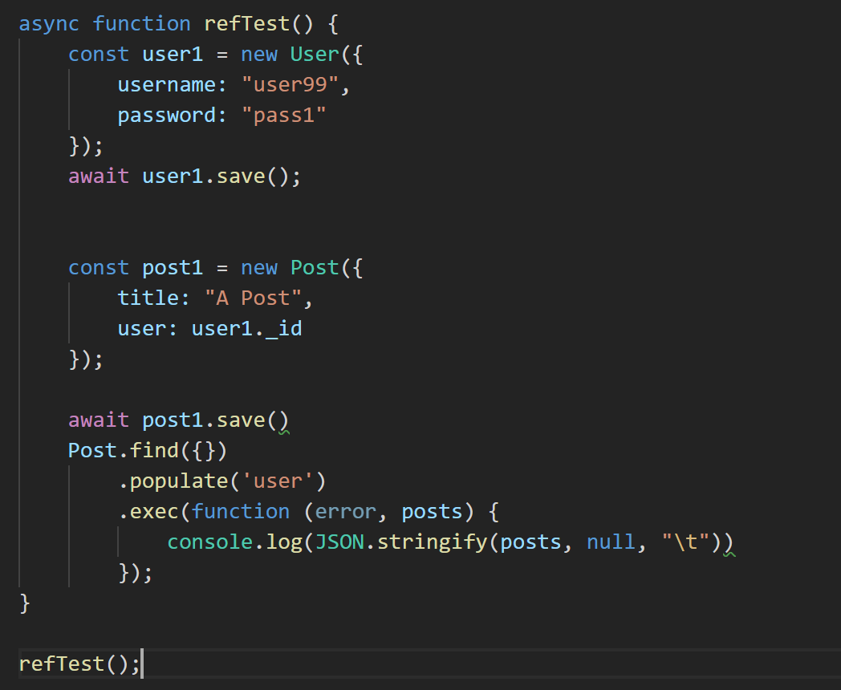
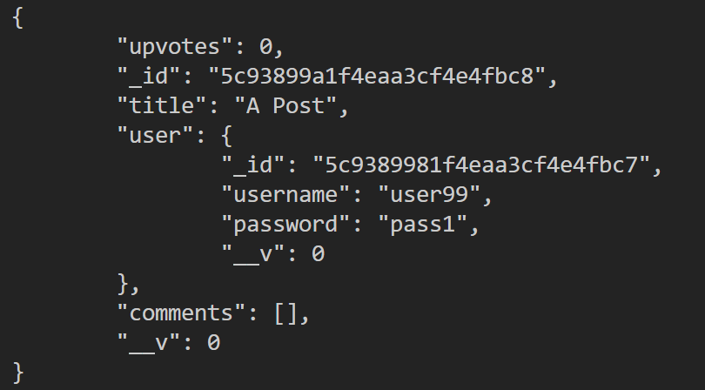
Query Population using Refs
https://github.com/fxwalsh/ewd-examples-2019.git
Allows you to automatically replace the speciﬁed paths in the document with document(s) from other collection(s).
output

Slide 42
MongoDB as a service

Slide 43
MongoDB as a Service
Best practice for initial development is to host MongDB process on your development machine
In production environments, Mongo will be hosted:
on it’s own instance or
provisioned as a service
This Photo by Unknown Author is licensed under CC BY-SA

Slide 44
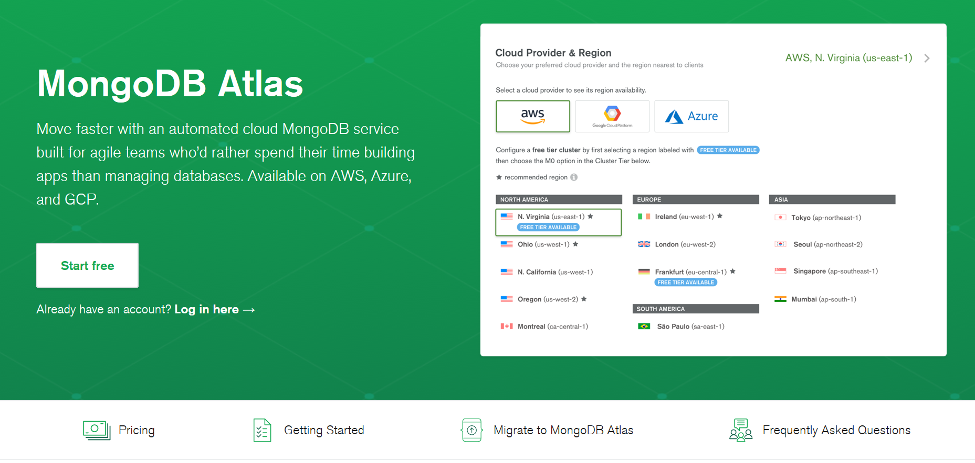
MongoDB as a Service

Slide 45
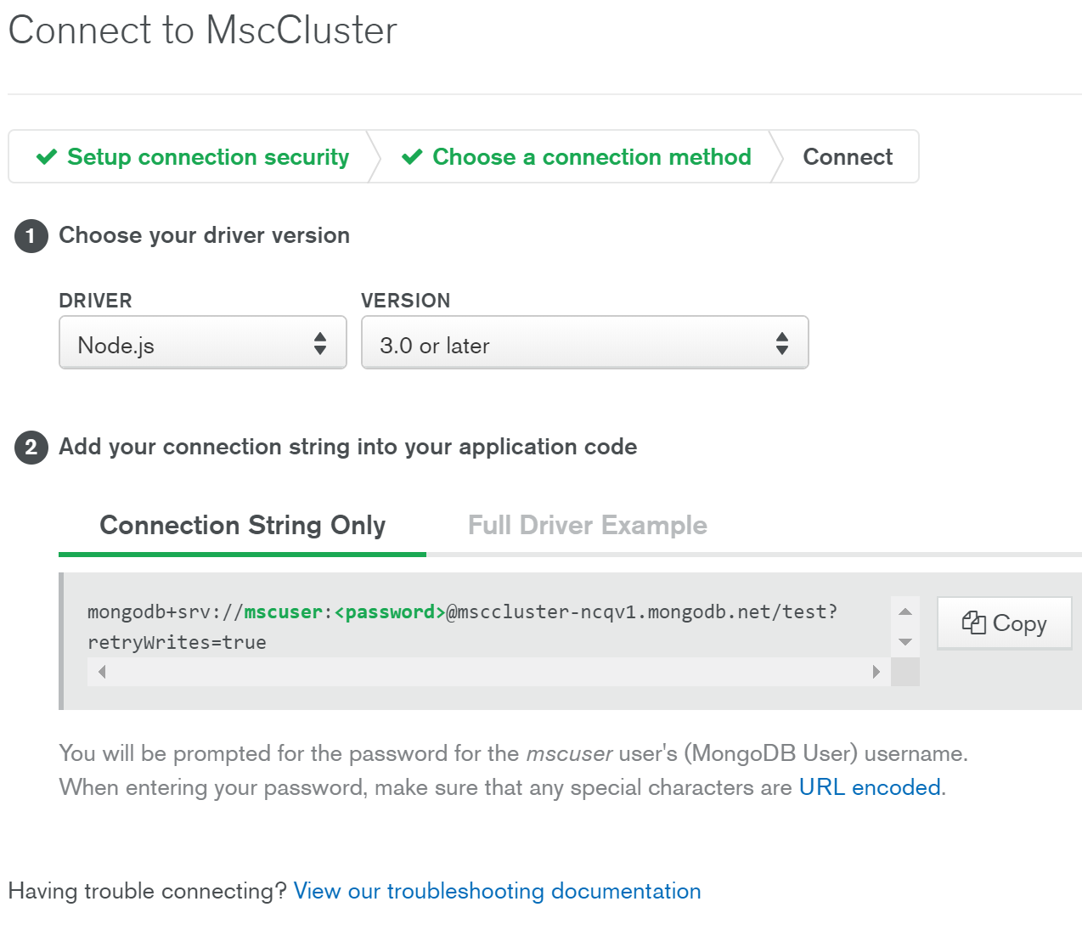
MongoDB as a Service
Some providers allow free access tier
Provide user credentials wrapped in a URL
All you need to do is update your config with the relevant URL
Again, be careful to ignore credentials when pushing to github/public repo

