Slide 1
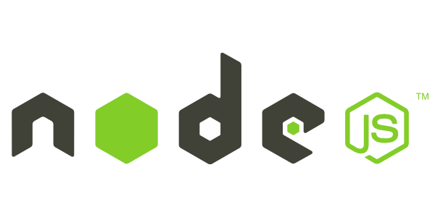
Introduction to Node.js
Frank Walsh
Diarmuid O'Connor

Slide 2
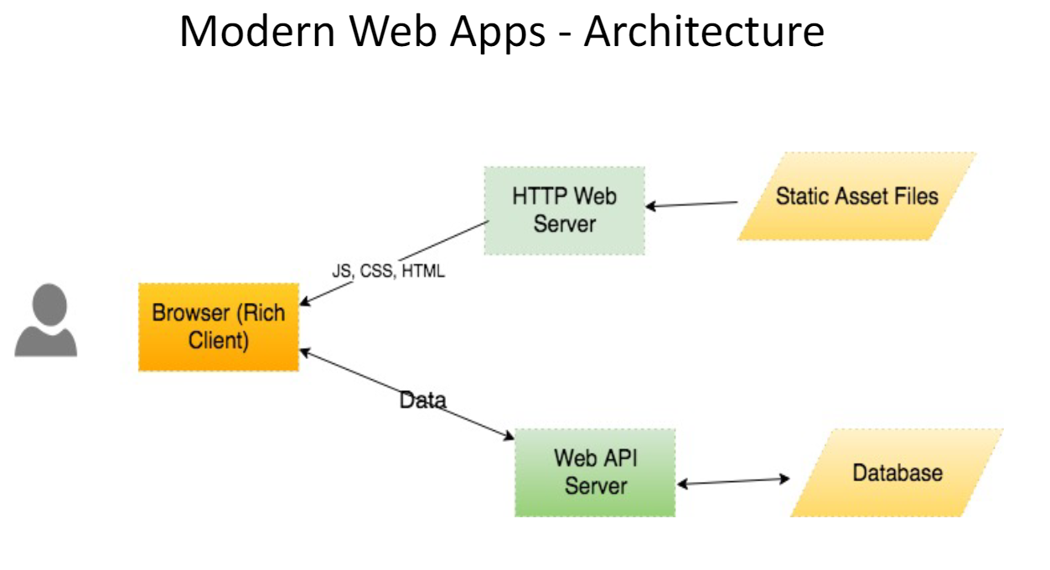
Context

Slide 3
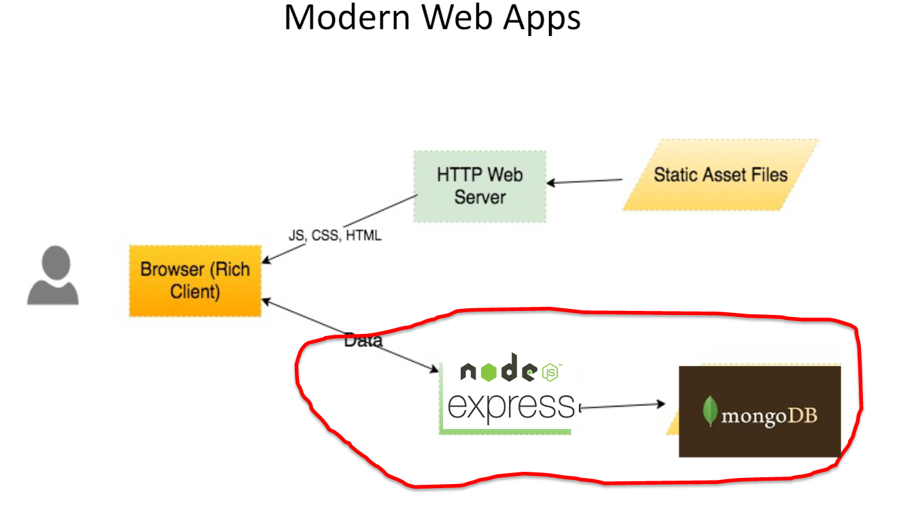
Context - Technologies

Slide 4

Agenda
What is node.js
Non Blocking and Blocking
Event-based processes
Callbacks in node
Node Package Manager(NPM)
Creating a node app

Slide 5
What's Node: Basics
A Javascript runtime. “Server side JS”
The “.js” doesn’t mean that it’s written completely in JavaScript.
approx. 40% JS and 60% C++
Ecosystem of packages (NPM)
Official site: “Node's goal is to provide an easy way to build scalable network programs”.
Single Threaded, Event based
Supports concurrency using events and callbacks…

Slide 6
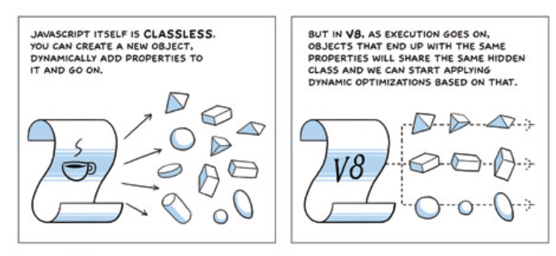
What’s Node: V8.
Embedded C++ component
Javascript virtual machine.
Very fast and platform independent
Find out a bit about it's history here:
http://www.google.com/googlebooks/chrome/big_12.html
Notes:
Same javascript engine used in chrome
Just in time compiler – compile a little, run a little
Speculative optimisations

Slide 7

What is Node.js: Event-based
Input/Output (io) is slow.
Reading/writing to data store, network access.
Read 4K randomly from SSD* 150,000 ns ~1GB/sec SSD
Round trip over network within same datacenter 500,000 ns
Send packet US->Netherlands->US 150,000,000 ns
This Photo by Unknown Author is licensed under CC BY-NC
I/O operations detrimental to highly concurrent apps (e.g. web applications)
Solutions to deal with this are:
Blocking code combined with multiple threads of execution (e.g. Apache, IIS)
Non-blocking, event-based code in single thread (e.g. NGINX, Node.js)
CPU operations are fast.
L1 cache reference 0.5 ns
L2 cache reference 7 ns
Source: https://gist.github.com/jboner/2841832
1ns = 10⁻⁹ s (0.000000001s)
Notes:
So input output is relatively slow. What I’m talking about here is reading/writing to a data store, any kind of access to resources over a network, even within your organisation. And I mean relative in relation to CPU operations. For example, referencing L1 and L2 cache takes a couple of nano seconds (extremely fast). Accessing 4K from an SSD takes about 150,000 ns. However, sending a packet from the US to the Netherlands and back could take 150 million ns (.15 of a second).
So IO operations can be detrimental to highly concurrent apps yet we do need them (for example, I’ll probably need to access a DB.

Slide 8
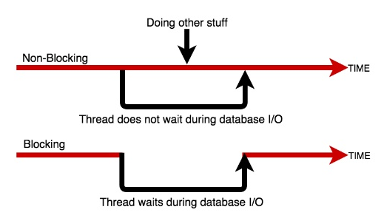
Blocking/Non-blocking Example
Blocking
Read from file and set equal to contents
Print Contents
Do other stuff...
Non-blocking
Read from File
Whenever read is complete, print contents
Do other stuff...

Slide 9
Blocking/Non-blocking: JS
Blocking
import fs from 'fs';
const contents = fs.readFileSync('./readme.md’, ‘utf8’);
console.log(contents);
console.log('Doing something else');
Console output
Hello World……
Doing something else
Non-blocking
import fs from 'fs’;
fs.readFile('./text.txt’,’uft8’, (err, contents) => {
console.log(contents);
});
console.log('Doing something else');
Console output
Doing something else
Hello World ……

Slide 10
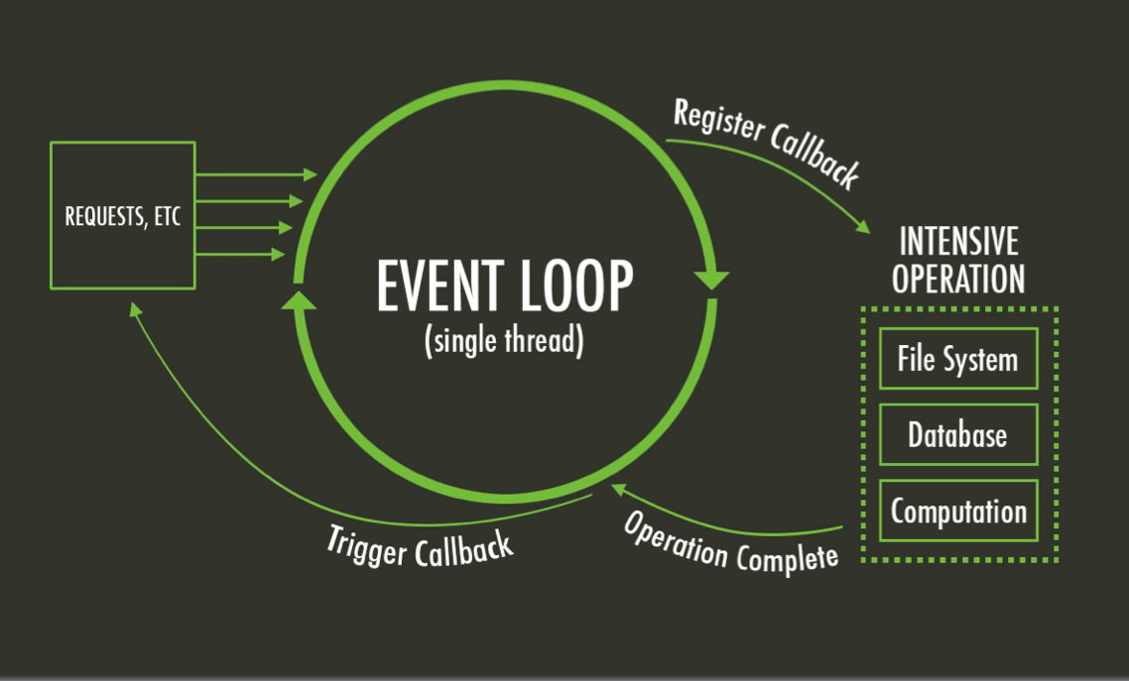
The Node Event Loop and Callbacks
A Callback is a function called at the completion of a given task. This prevents any blocking, and allows other code to be run in the meantime
The Event Loop checks for known events, registers Callbacks and, triggers callback on completion of operation
This Photo by Unknown Author is licensed under CC BY-SA

Slide 11
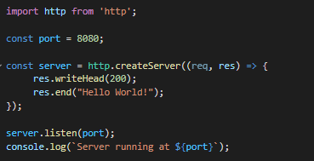
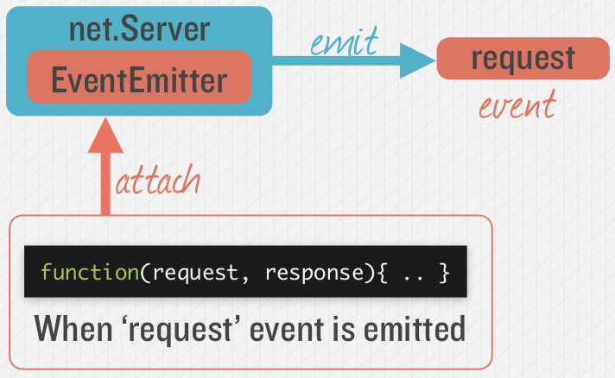

Node.js - Simple HTTP Server
Event Queue
Known Events
request
request
Event Loop
Notes:
Most node applications are waiting for “events” to occur. The event loop waits for events to occur, and then triggers the associated callback function when that event is detected. Many objects in a Node emit events, for example, a net.Server emits an event each time a peer connects to it, an fs.readStream emits an event when the file is opened. All objects which emit events are the instances of events.EventEmitter.

Slide 12
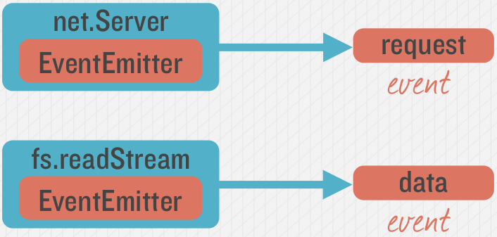
Emitting Event in Node
Many objects can emit events in node.

Slide 13
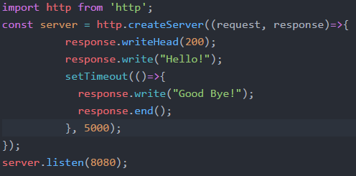
Example – Hello/Goodbye Callback
“Request” Callback
“Timeout” Callback

Slide 14
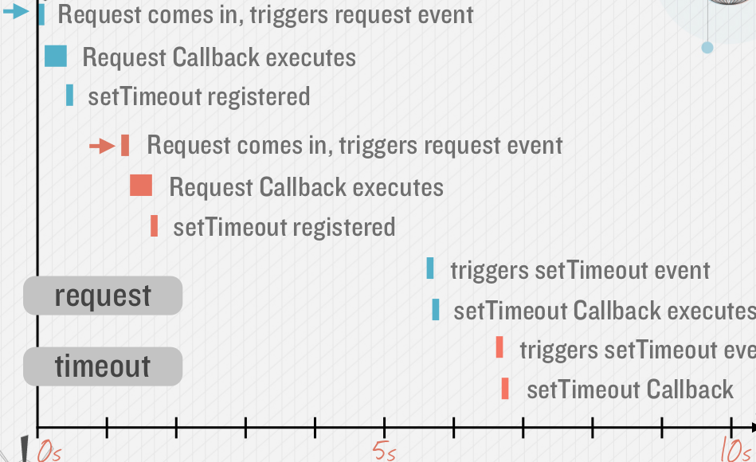
Callback Timeline, Non Blocking
Timing example: 2 requests to web application (indicated by red and blue in diagram)

Slide 15
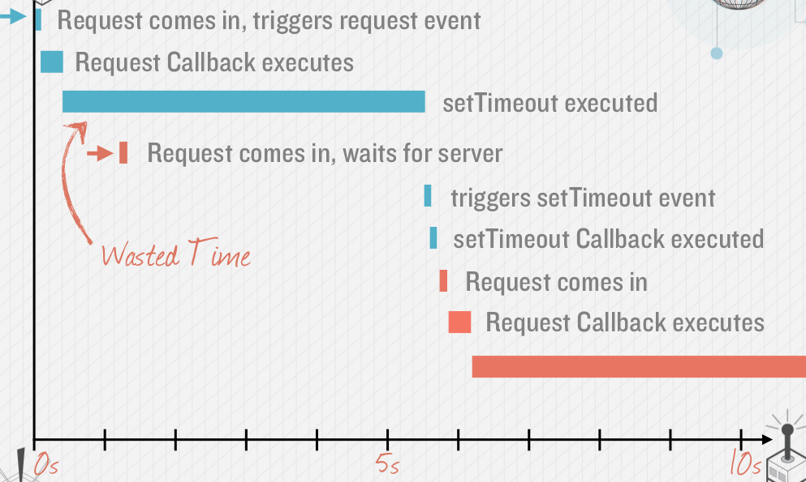
Avoid Blocking Calls in Node.js apps
What if setTimeout() blocked…
setTimeout in previous slide is an example of an asynchronous, non-blocking call.
Avoid potential blocking/ synchronous calls
Activity likely to be blocking should be called asynchronously.
Examples:
Calls to 3rd party Web Services
Database queries
Computationally expensive operations (image file processing)

Slide 16
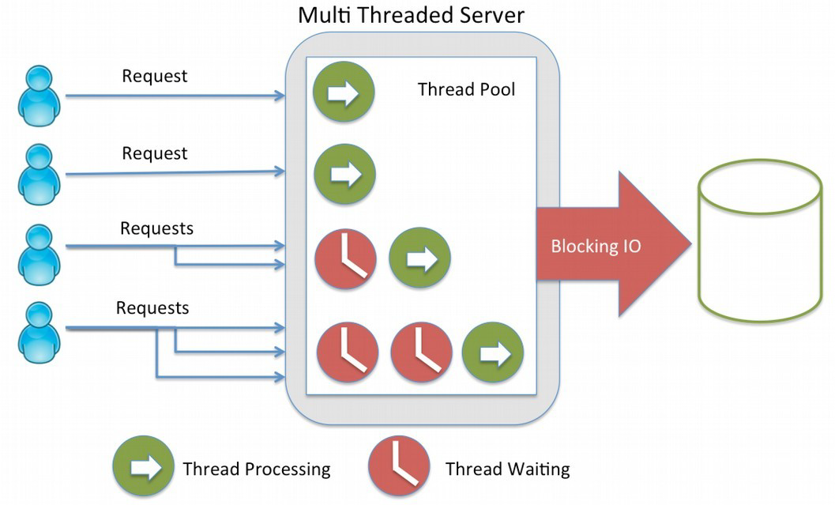
Blocking vs. Non-blocking: Web Servers
Threads consume resources
Memory on stack
Processing time for context switching etc.
No thread management on single threaded apps
Just execute “callbacks” when event occurs

Slide 17
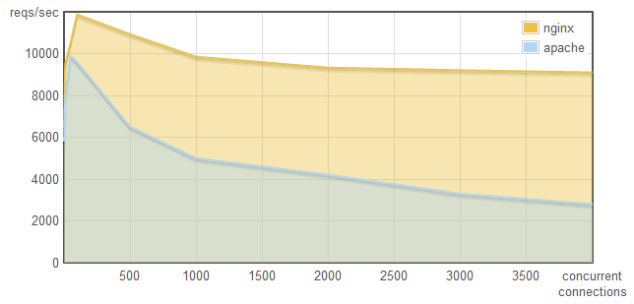
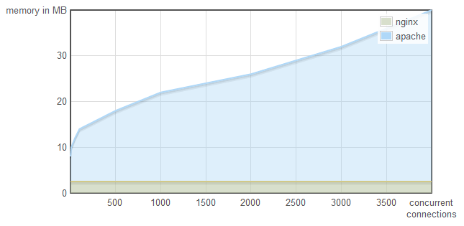
Why does it matter...
This is why:
http://blog.webfaction.com/a-little-holiday-present

Slide 18
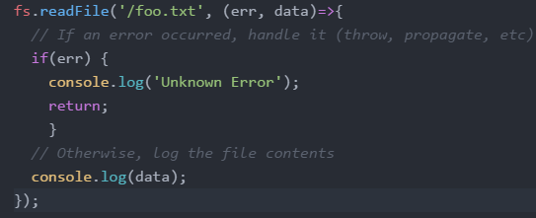
Node “Error First” Callbacks
Error object
The “error-first” callback (or “node-style callback”) is a standard convention for many Node.js callbacks.
Successful response data
If no error, err will be set to null

Slide 19
Node Modules

Slide 20
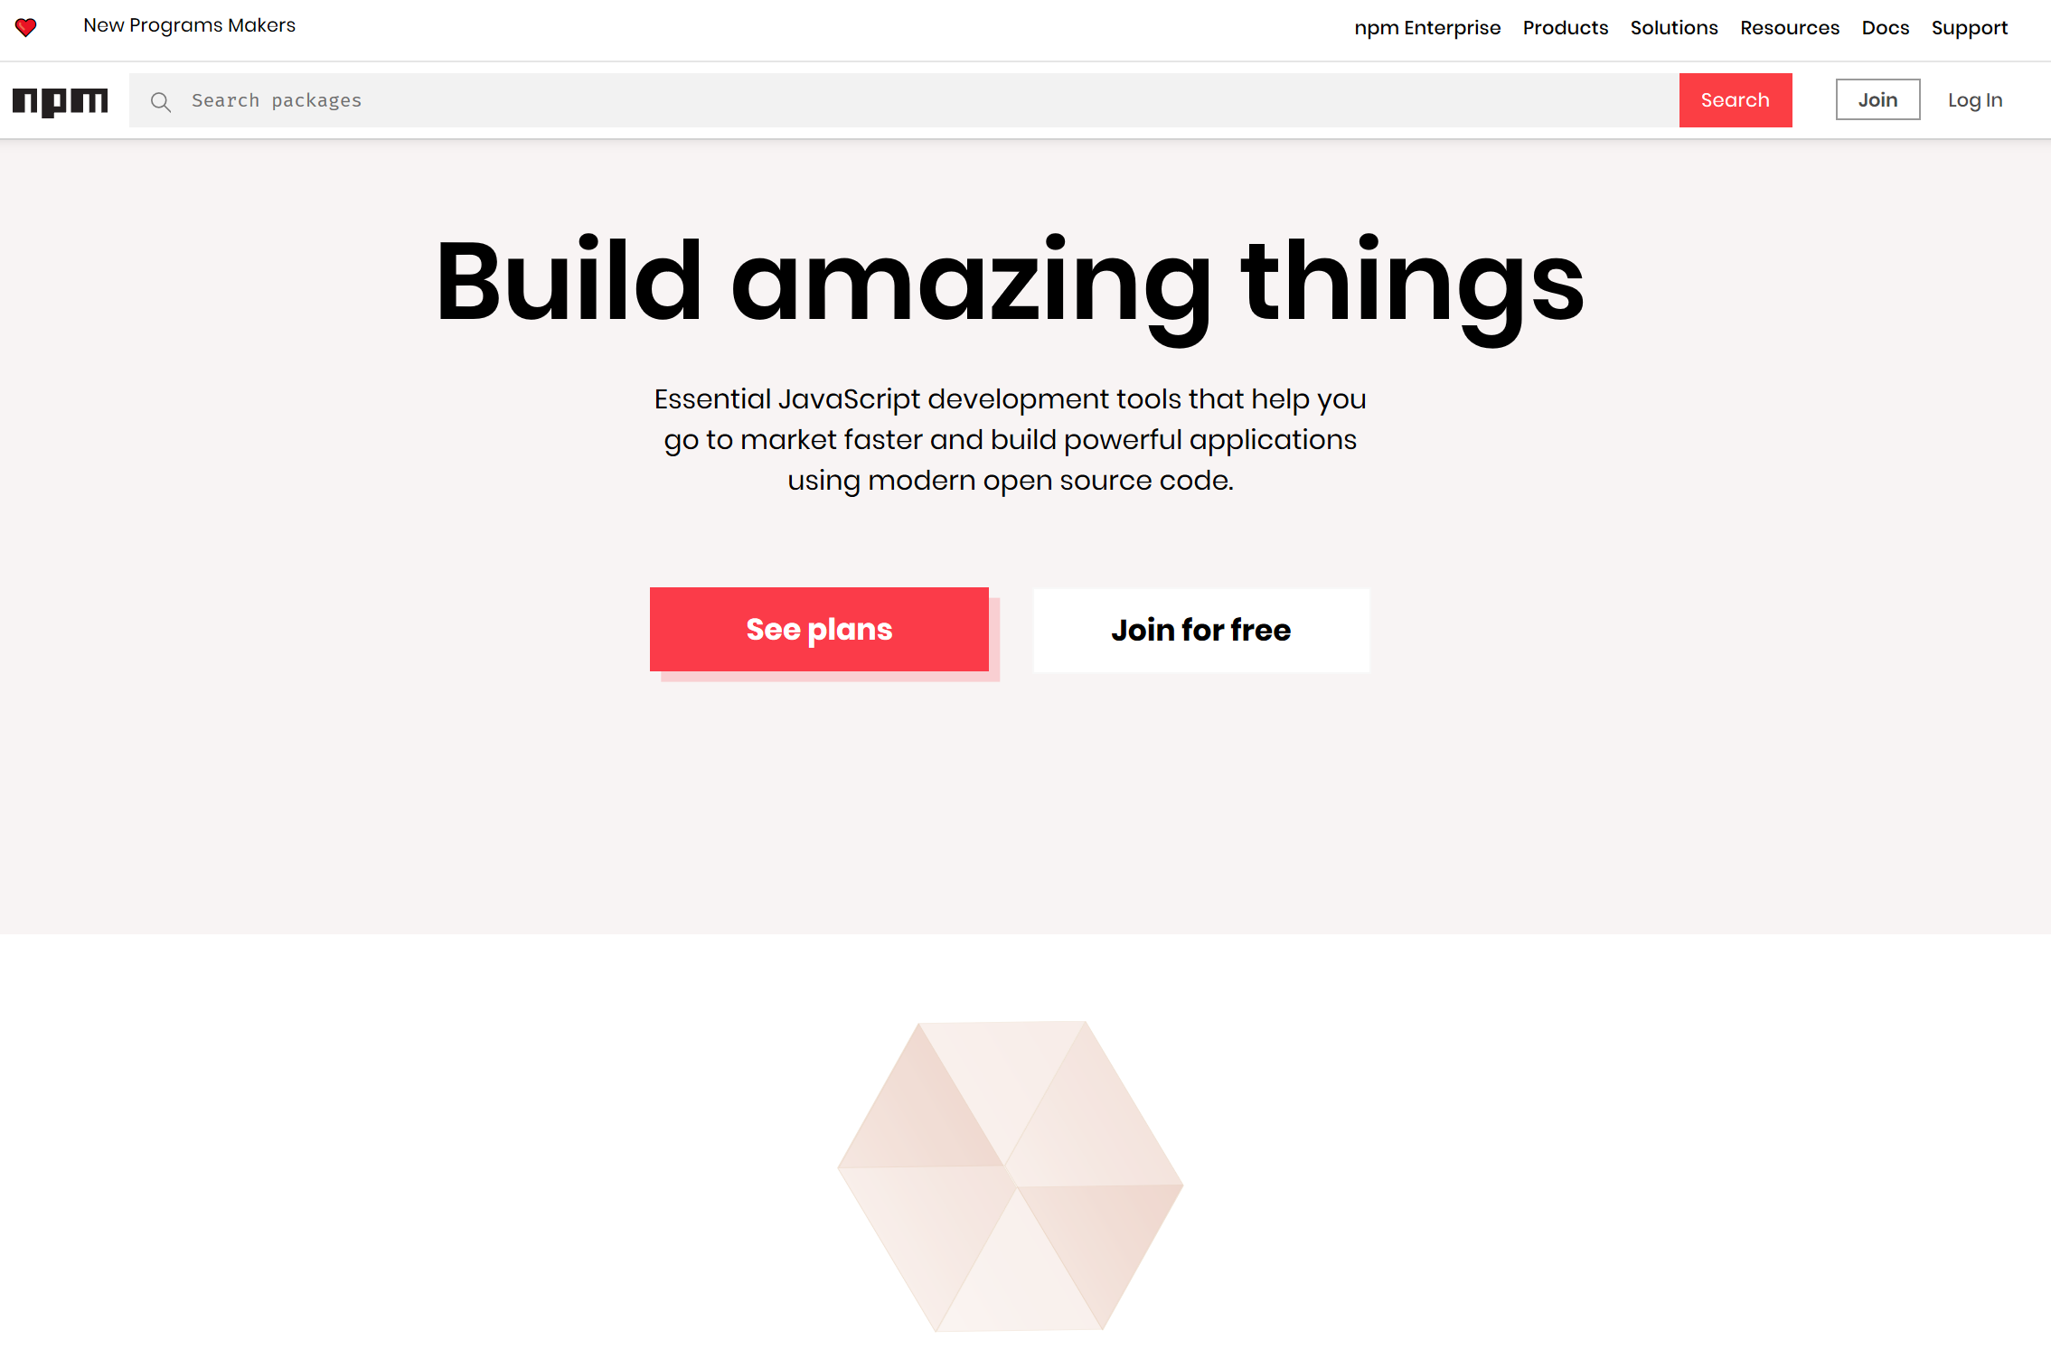

Slide 21


Node Modules
Node has a small core API
Most applications depend on third party modules
Curated in online registry called the Node Package Manager system (NPM)
NPM downloads and installs modules, placing them into a node_modules folder in your current folder.

Slide 22
NPM init
You can use NPM to manage your node projects
Run the following in the root folder of your app/project:
npm init
This will ask you a bunch of questions, and then create a package.json for you.
It attempts to make reasonable guesses about what you want things to be set to, and then writes a package.json file with the options you've selected.

Slide 23
Node Modules
To install NPM modules, navigate to the application folder and run “npm install”. For example :
npm install express --save
This installs into a “node_module” folder in the current folder.
The --save bit updates your package.json with the dependency
To use the module in your code, use:
import express from 'express';
This loads express from local node_modules folder.

Slide 24
Global Node Modules
Sometimes you may want to access modules from the shell/command line.
You can install modules that will execute globally by including the '-g'.
Example, Grunt is a Node-based software management/build tool for Javascript.
npm install -g grunt-cli
This puts the “grunt” command in the system path, allowing it to be run from any directory.

Slide 25
NPM Common Commands
Common npm commands:
– npm init initialize a package.json file
– npm install <package name> -g install a package, if –
g option is given package will be installed globally, --save
and --save-dev will add package to your dependencies
– npm install install packages listed in package.json
– npm ls –g listed local packages (without –g) or global
packages (with –g)
– npm update <package name> update a package

Slide 26
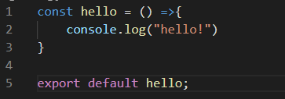

Creating your own Node Modules
We want to create the following module called greeting.js:
To access in our application, index.js:
import hello from './custom_hello'; hello();
Export defines what
import returns

Slide 27
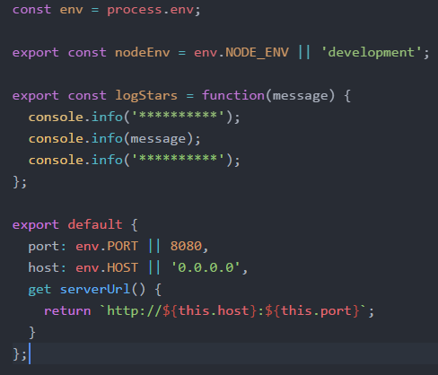
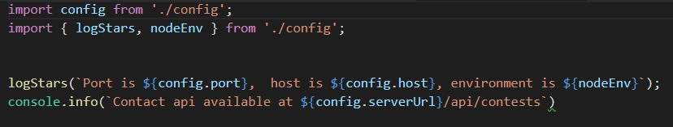
Creating your own Node Modules
Config.js
Exporting Multiple Properties
Accessing in other scripts

Slide 28


The import search
Import searches for modules based on path specified:
Just providing the module name will search in node_modules folder

Slide 29
Environment/Structure for Labs

Slide 30






Tools and Technologies
Tools:
VS Code
Postman (or equivalent)
Technologies
Node v12.18.4 or closer
Express.js
Mongo
JSON Web Tokens
This Photo by Unknown Author is licensed under CC BY-SA
This Photo by Unknown Author is licensed under CC BY-SA
This Photo by Unknown Author is licensed under CC BY-SA
This Photo by Unknown Author is licensed under CC BY-SA-NC
This Photo by Unknown Author is licensed under CC BY-SA

Slide 31
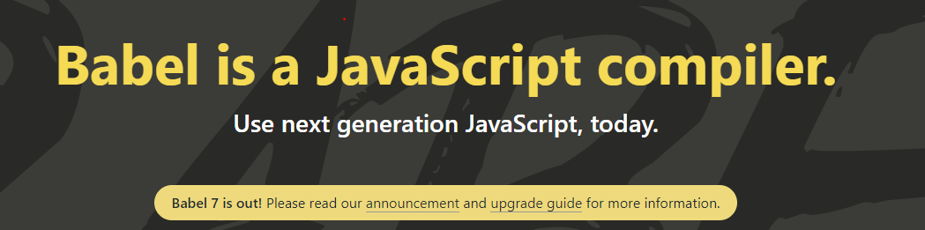
Babel
Babel is a JavaScript compiler/Transpiler
Convert the latest versions of Javascript code into a backwards compatible version of JavaScript in current and older browsers or environments(e.g. Node.js v12.18.4)
Set it up as part of our Node project: see the lab!

Slide 32
Structuring Node Apps
Node Server Code needs to be structured
Manage code base
Keeps code maintainable
Nodes packaging system supports this approach
Typical Node.js application code:
main app code
api implementation code
helper code

Slide 33
Example Approach:
Use a “project root” folder is the top level and contains the “entry point” or main server code
Always run npm in this folder to ensure just one node_modules folder
Use a public folder within the node folder for any static content

Slide 34
Basic Node App Structure
Root of your actual application
/projectroot/
package.json
readme.md
index.js
.env
.babelrc
public/
/images
/stylesheets
/scripts
index.html
node_modules/
api/
Tells Node and NPM what packages are required
The main entry point for the Express application
Environment variables
Bable Transpiler Config
Static content (if you need it)
Output directory for all NPM installations

