Slide 1

JavaScript Asynchronous Patterns
Frank Walsh

Slide 2

Agenda
Callbacks
Promises
Async Await
Further/advanced async behaviour

Slide 3

Recap -Javascript Characteristics
JavaScript is single threaded
JavaScript is event driven
Events happen – we write code to deal with them
Can use callbacks to do this
JavaScript can be Asynchronous
Order of operation results may differ from order they were called…

Slide 4
Callbacks (again)

Slide 5








Recap - The Callback
i: 5
i: 5
i: 5
i: 5
i: 5
What will be logged to the console?
Hint: the while loop will finish before the 1st callback executes.
i: 0
i: 1
i: 2
i: 3
i: 4
console.log('setTimeout')
let i=0;
while (i <5) {
setTimeout(() => {
console.log('i: ' + i)
}, 0);
i++;
}
i: 0
i: 0
i: 0
i: 0
i: 0

Slide 6
The Callback
The traditional way of handling asynchronous events
Function that is registered as the event handler for something we're fairly sure will happen in the future
componentDidMount : ()=> {
request.get('http://0.0.0.0:3000/friends')
.end( (error, response) => { . . . Callback code ...}
} ….... filterFriends : (event) => { . . . Callback . . . .}
render: ()=>{
. . . . . . . .
<input type="text” …. onChange={this.filterFriends} />

Slide 7
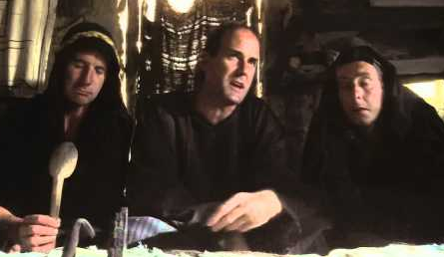
What have Callbacks ever done for us...
Great for things that can happen multiple times
Great if you don't really care about what happened before you attached the listener
Great if it's a straight-forward, stand-alone event with a quick resolution time
Great if callback is not part of sequential process.
E.g. key press event on control.
document.getElementById("demo").addEventListener("keypress", myFunction);
But...

Slide 8
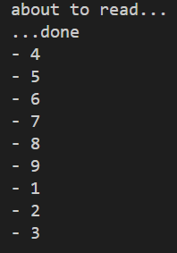
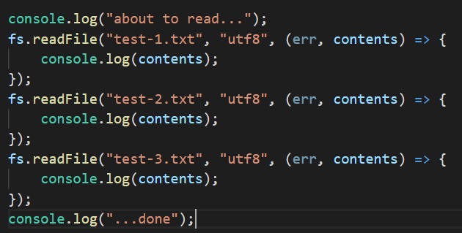
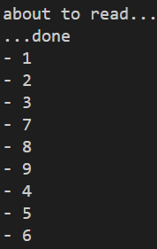
Multiple Callbacks
I want this to happen sequentially… but order of callback events is indeterminate.
Possible Result
Possible Result
Notes:
You have no idea what order the callbacks will execute. Once the callback is registered/scheduled, you’ve no idea when the underlying process (n this case the file read) will report back.

Slide 9
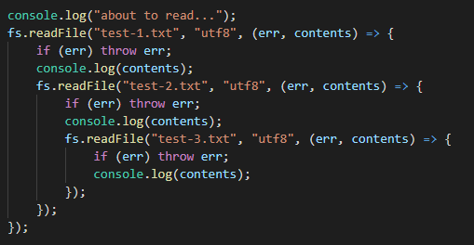
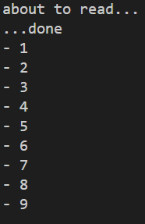
Sequential callbacks.
A callback in a callback in a callback!
Sequential callbacks are difficult to read / understand
Sequential callbacks cause many level of indentation in source code
And this is typically just the “success path”
It gets more complicated if you want to handle errors

Slide 10
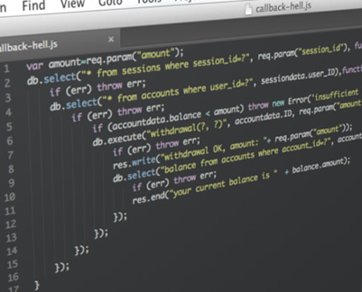
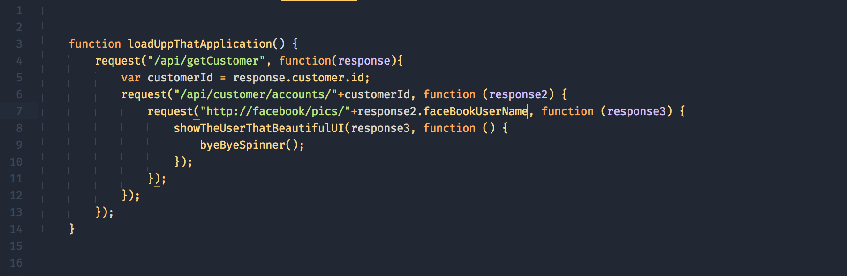
Callback Hell – Multiple sequential requests

Slide 11
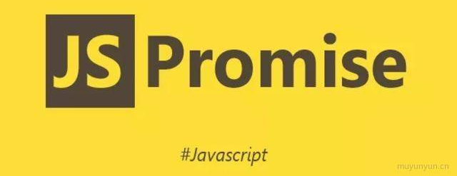
Promises
This Photo by Unknown Author is licensed under CC BY-NC-ND

Slide 12
Promises
A promise is the eventual result of an asynchronous operation or computation.
Promises are:
an abstraction useful in async programming
an associated API that allows us to use this abstraction in our programs.
A promise can be:
fulfilled - The action relating to the promise succeeded
rejected - The action relating to the promise failed
pending - Hasn't fulfilled or rejected yet
settled - Has fulfilled or rejected

Slide 13
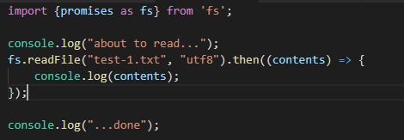
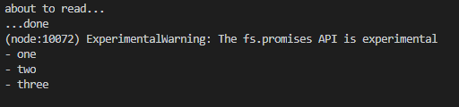
fs using promises (experimental)
output

Slide 14

If you return a value to a then(), the next then() is called with that value.
If you return a promise, the next then() waits on it, and is only called when that promise settles (i.e. either succeeds/rejects).

Slide 15
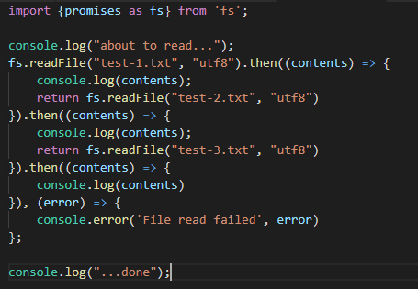
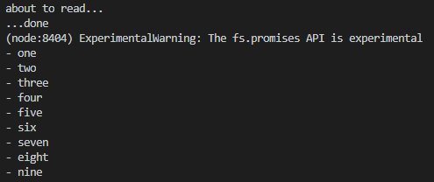
fs sequential using promises (chaining)
output

Slide 16
Async Functions
using async/await

Slide 17
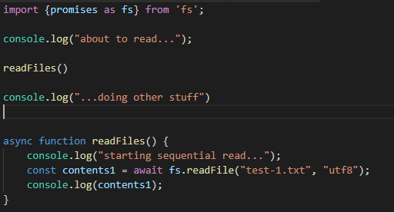
Async/Await !
async/await and promises are essentially the same under the hood
async is a keyword
Used in function declaration
await is used during the promise handling
must be used within an async function
async functions return a promise, regardless of what the return value is within the function.
Available now! in most good browsers as well as Node.js

Slide 18
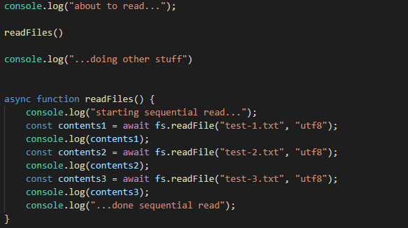
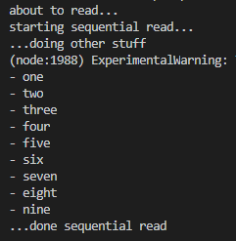
Async/Await Sequential read
output

Slide 19
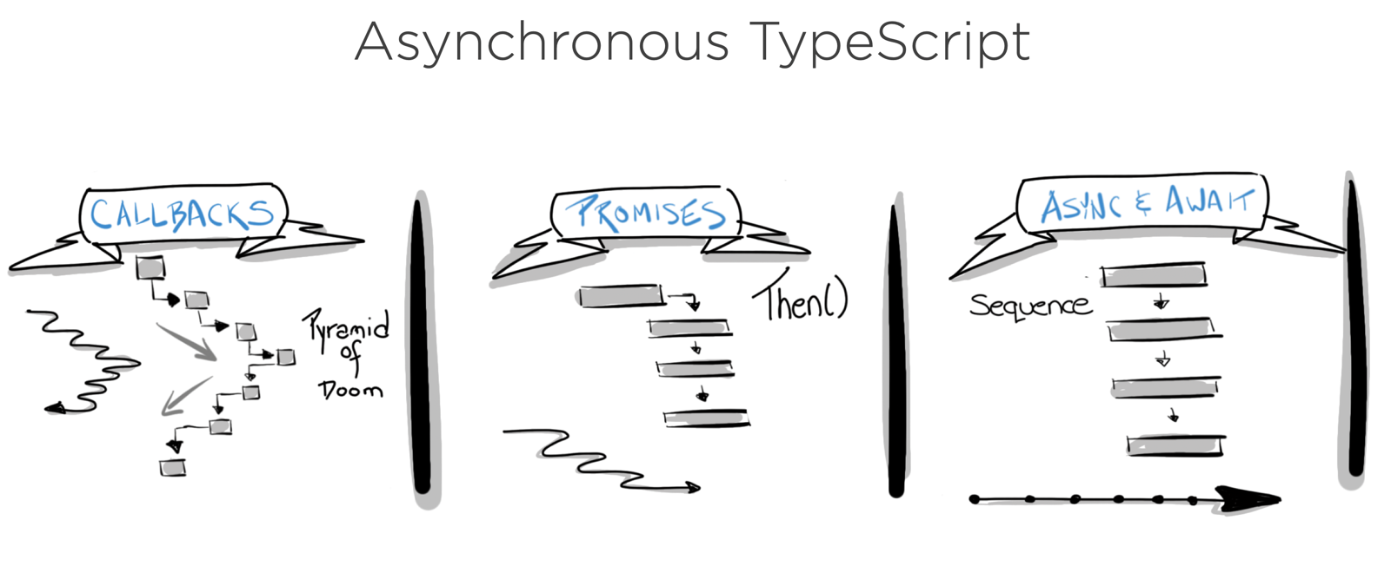
Callbacks vs Promises vs Async-Await
Asynchronous Javascript
This Photo by Unknown Author is licensed under CC BY

Slide 20
Error Handling

Slide 21

Error Handling - Promises
then() function can take 2 arguments, one for fulfillment(success), one for rejection(failure)

Slide 22
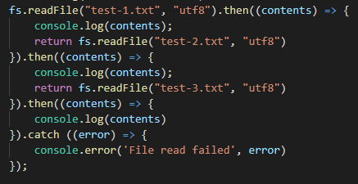
Error Handling - catch(...)
You can also use catch() to handle promise rejects:
Reacts slightly different to previous.
Useful in sequential async processes

Slide 23
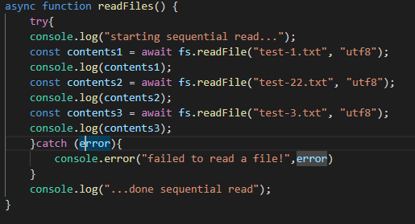
Error Handling – async await
Use try -catch

Slide 24
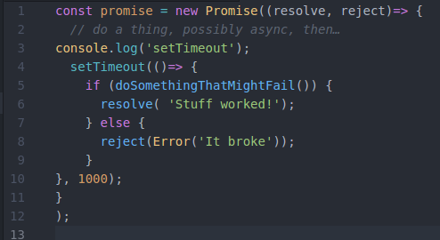
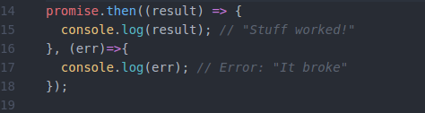

JavaScript promise dummy implementation

Slide 25
Further Asynchronous features…

Slide 26
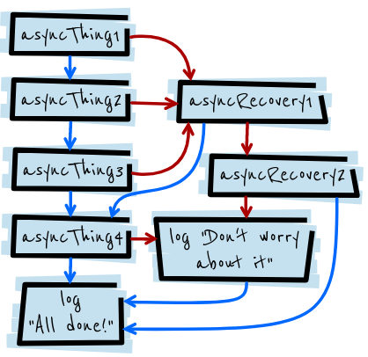
Rejection forwarding
A Promise rejection will skip forward to the next then() with a rejection callback (or catch()):
asyncThing1().then(function() { return asyncThing2(); }).then(function() { return asyncThing3(); }).catch(function(err) { return asyncRecovery1(); }).then(function() { return asyncThing4(); }, function(err) { return asyncRecovery2(); }).catch(function(err) { console.log("Don't worry about it"); }).then(function() { console.log("All done!"); })
asyncThing1().then(function() {
return asyncThing2();
}).then(function() {
return asyncThing3();
}).catch(function(err) {
return asyncRecovery1();
}).then(function() {
return asyncThing4();
}, function(err) {
return asyncRecovery2();
}).catch(function(err) {
console.log("Don't worry about it");
}).then(function() {
console.log("All done!");
})
https://developers.google.com/web/fundamentals/primers/promises#error_handlingck to add text

Slide 27
Wrapper Function
const asyncWrapper = fn => {
return Promise.resolve(fn)
.catch(err => {return err.message});
};
async function doSomethingAsync() {
const result = await asyncWrapper(promise());
console.log(result);
}
As an Async function always returns a Promise.
can wrap the async function to catch errors...
Can drop try/catch.
Makes code more readable.

Slide 28
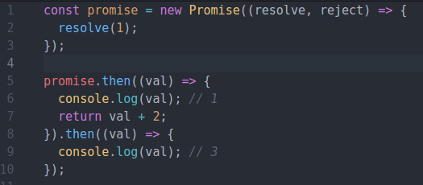
Chaining
you can chain then’s together to transform values or run additional async actions one after another.

Slide 29

Parallelism
Takes 1000ms
async function series() { await wait(500); // Wait 500ms… await wait(500); // …then wait another 500ms. return "done!"; }
Some processes need to be sequential
Eg. Had to get data back from API BEFORE getting link URL
REMEMBER: Should only be sequential if you need to be...
Takes ~500ms
async function parallel() { const wait1 = wait(500); // Start a 500ms timer asynchronously… const wait2 = wait(500); // this timer happens in parallel. await wait1; // Wait 500ms for the first timer… await wait2; // …by which time this timer has already finished. return "done!"; }

Slide 30
Sources
https://developers.google.com/web/fundamentals/primers/promises
https://stackoverflow.com/questions/2069763/difference-between-event-handlers-and-callbacks
https://medium.com/@Abazhenov/using-async-await-in-express-with-node-8-b8af872c0016

