Slide 1
Query By Image Content

Slide 2
INTRODUCTION

Slide 3
The emergence of multimedia has highly revolutionized means of animation.
An important aspect of multimedia is image.
Images play a very important role in our day-to-day life.

Slide 4
Due to introduction of Multimedia Devices like Digital- Cameras, web-cams, mobiles ,etc. we have to work with various types of images on a daily basis.
In answer to this problem, we are in the attempt to create a software that will reduce the overhead in searching for images in your hard disk.

Slide 5
Several images are stacked up in our Personal Computers.
While working with images, we encounter certain problems. The several images stacked up in our Personal Computers create an overhead in searching for the required images resulting in wastage of time.
This problem faced by almost all individuals needs a proper solution.

Slide 6
JAVA BASED QUERY BY IMAGE CONTENT

Slide 7
PROJECT DETAILS

Slide 8
Project Platform:
This project is made in Java Programming language.
Java with its versatility, efficiency, and portability, Java has become invaluable to developers by enabling them to:
Write software on one platform and run it on virtually any other platform.
It can be easily used in web.

Slide 9
Algorithm used:
The algorithm to be used is Wavelet Transformation.
Each step of the wavelet transform applies the scaling function to the data input.
If the original data set has N values, the scaling function will be applied in the wavelet transform step to calculate N/2 smoothed values.
In the ordered wavelet transform the smoothed values are stored in the lower half of the N element input vector.

Slide 10
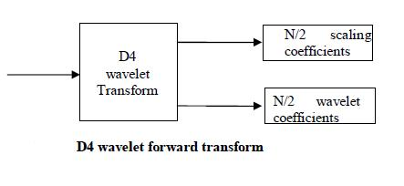

Slide 11
WORKING

Slide 12
Query By Image Content as the name goes, answers queries related to images based on image content.
QBIC aims to automatically extracting target images according to objective visual contents of the image itself.
Representation of visual features and similarity match are important issues in QBIC.
A novel QBIC method is proposed by exploit the wavelets which represent the visual feature.

Slide 13
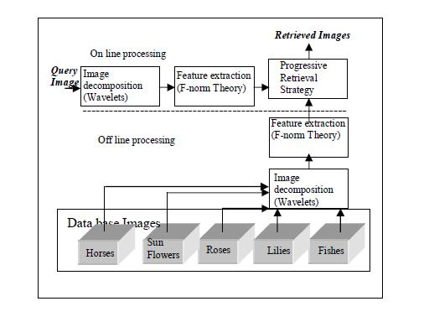
STRUCTURE OF PROPOSED QBIC SYSTEM

Slide 14
Steps:
The procedure is divided into three
Indexing-
Transformation of images as per the algorithm and storage in indexed form
2. Query Image Input-
Selection of a query image
3. Retrieval-
Retrieval and display of resultant image

Slide 15
Algorithms Used:
Feature Extraction (Wavelet Transform)
Color feature extraction
Color space selection
Quantization of color space
Color descriptor selection
Shape feature extraction

Slide 16
Clustering:
K-Means Clustering
The basic steps involved in K-means clustering is outlined as:
Select K-data points as the initial centroids.
(Re) assign all points to their closest centroids.
Recompute the centroid of each newly assembled cluster.
Repeat steps 2 and 3 until the centroids do not change.

Slide 17
Matching:
Euclidean Distance:
Step 1: Compute the Euclidean distance for one dimension. The distance between two points in one dimension is simply the absolute value of the difference between their coordinates. Mathematically, this is shown as |p1 - q1| where p1 is the first coordinate of the first point and q1 is the first coordinate of the second point. We use the absolute value of this difference since distance is normally considered to have only a non-negative value.

Slide 18
Euclidean Distance:
Step 2: Take two points P and Q in two dimensional Euclidean space. We will describe P with the coordinates (p1,p2) and Q with the coordinates (q1,q2). Now construct a line segment with the endpoints of P and Q. This line segment will form the hypotenuse of a right triangle. Extending the results obtained in Step 1, we note that the lengths of the legs of this triangle are given by |p1 - q1| and |p2 - q2|. The distance between the two points will then be given as the length of the hypotenuse.

Slide 19
Euclidean Distance:
Step 3: Use the Pythagorean theorem to determine the length of the hypotenuse in Step 2. This theorem states that c^2 = a^2 + b^2 where c is the length of a right triangle's hypotenuse and a,b are the lengths of the other two legs. This gives us c = (a^2 + b^2)^(1/2) = ((p1 - q1)^2 + (p2 - q2)^2)^(1/2). The distance between 2 points P = (p1,p2) and Q = (q1,q2) in two dimensional space is therefore ((p1 - q1)^2 + (p2 - q2)^2)^(1/2).

Slide 20
Euclidean Distance:
Step 4: Extend the results of Step 3 to three dimensional space. The distance between points P = (p1, p2, p3) and Q = (q1,q2,q3) can then be given as ((p1-q1)^2 + (p2-q2)^2 + (p3-q3)^2)^(1/2).

Slide 21
Euclidean Distance:
Step 5: Generalize the solution in Step 4 for the distance between two points P = (p1, p2, ..., pn) and Q = (q1,q2, ..., qn) in n dimensions. This general solution can be given as ((p1-q1)^2 + (p2-q2)^2 + ... + (pn-qn)^2)^(1/2).

Slide 22
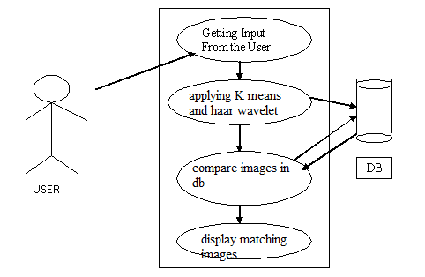
Design:
Use-Case Diagram:

Slide 23
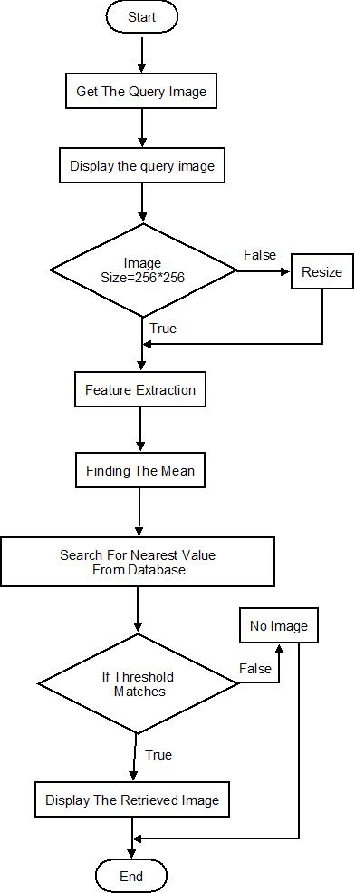
Flow-Chart:

Slide 24
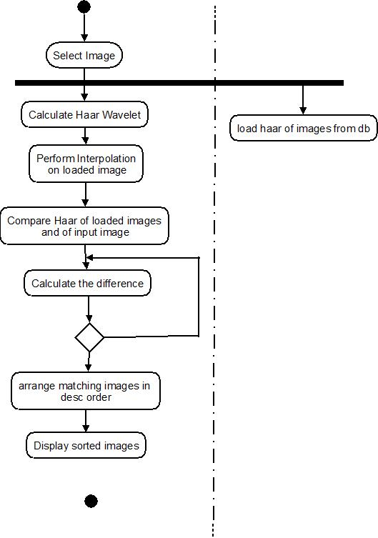
Activity Diagram:

Slide 25
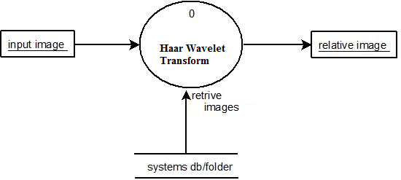
DFD:
DFD 1:

Slide 26
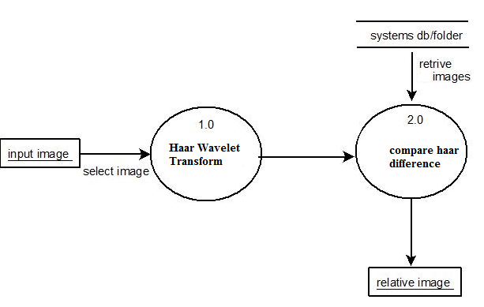
DFD-2:

Slide 27
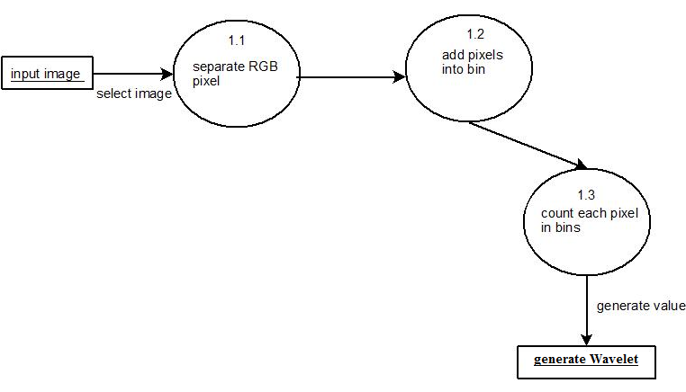
DFD-3:

Slide 28
EXAMPLES

Slide 29
WORK DONE:

Slide 30
APPLICATIONS

Slide 31
Query By Image Content allows automatically extracting target images according to objective visual contents of the image itself.
It provides a regressive image retrieval strategy to achieve flexibility.
Query results in the display of related images matching the color and texture.
Image Search Engines like GOOGLE is the best example of applications of QBIC.

Slide 32
THANK YOU !

