Slide 1

Summarising of User Reviews for Opinion Generation
Guide:
Prof.
Project by:

Slide 2
ABSTRACT
The growth of E-commerce.
Posting User Reviews.This
Project presents a semi supervised approach for mining online user reviews to generate comparative feature-based statistical summaries that can guide a user in making an online purchase.
Phases: Preprocessing,Feature extraction,Pruning,Feature based opinion summarization,Overall opinion sentiment classification.
Empirical studies indicate that the approach used in the paper can identify opinionated sentences from blog reviews with a high average precision of 91% and can classify the polarity of the reviews with a good average accuracy of 86%.

Slide 3
PROJECT OVERVIEW
1. IT IS AN APPLICATION THAT AUTOMATICALLY EXTRACTS OPINIONS EMOTIONS AND SENTIMENTS FROM THE TEXT.
2. IT ALLOWS US TO TRACK FEELINGS AND ATTITUDE OF THE WEB
3. SENTIMENTAL ANALYSIS CAN BE DONE ON BLOGSPOTS,REVIEWS,COMMENTS ETC.
4.WE CAN TRACK PRODUCTS,BRANDS ON THE BASIS WETHER THEY ARE VIEWED POSITIVELY OR NEGATIVELY.

Slide 4
Problem Statement
The growth of E-commerce has led to the invention of several websites that sell products as well as allow users to post reviews.
An online buyer refers to these reviews before making a buying decision.
Hence, user reviews have a great commercial significance. However, since the product reviews are written by non experts in an unstructured, natural language text, the task of summarizing them is challenging

Slide 5
REQUIREMENT ANALYSIS
THE REASON AND REQUIREMENT IN CREATING THE SYSTEM:
NEW PRODUCT PERCEPTION
BRAND PERCEPTION
REPUTATION MANAGEMENT
BUISNESS TRACKING
TO ALLOW USER TO GET OPINION ON A GLOBAL SCALE.

Slide 6
System
We shall generate an opinion review database by crawling some popular websites that categorically post product reviews by actual users.
2. Our product opinion summarizer has three main phases. These phases are
Preprocessing phase,
Feature extraction phase, and
Opinion summarization and classification phase.

Slide 7
1: Pre-processing Phase
Online blog reviews posted by users frequently contain spelling errors and incorrect punctuation.
So, in this phase we perform basic cleaning tasks like
→sentence boundary detection.
→spell-error correction.
→ repetitive punctuation conflation.

Slide 8
A)Sentence boundary detection
Sentences normally end with punctuations like period (.), question mark (?), or exclamation mark (!).
B) Spell error correction.
After sentence boundary detection, we perform spell-error correction using a word processor.

Slide 9
C]Repetitive punctuation conflation
Sometimes bloggers overuse the “?” and “!” symbols for emphasis.
For example, a blogger may post a review that says “It’s surprising that the ebook reader does not have a touch screen !!!!”
In such cases we conflate the repetitive punctuation symbols to a single occurrence (i.e., “!!!!” is replaced by a single “!”).

Slide 10
2. Feature Extraction Phase
In this phase we extract opinion features from the pre-processed review text obtained From the previous phase.
We treat frequently occurring nouns (N) and noun phrases (NP) as possible opinion features and associated adjectives describing them as indicators of their opinion orientation.
http://www.abisource.com/projects/link-grammar/
Is the Link Grammar Parser which we are using.

Slide 11
First, we extract all nouns (N) and noun phrases (NP) tagged by the Link Grammar Parser and identify the frequently occurring N and NP as possible opinion features.
Stemming is performed on noun features expressed in plural to convert them to singular expression in order to improve their chances of matching..
As an example of stemming the feature word “processors” is stemmed to “processor.”

Slide 12
Semantically similar features need to be clubbed together manually in order to improve the accuracy of feature-based summarization.
For example, “screen/display/touchscreen” although extracted separately actually allude to the same feature.
Thus, our final feature-set is generated

Slide 13
Opinion Summarization and Classification Phase:
In the previous phase we extracted opinion features and adjectives describing them.
In order to determine the sentiment polarity of an adjective describing an opinion feature we make use of SentiWordNet which is a lexical resource for opinion mining.
SentiWordNet assigns three normalized sentiment scores: positivity, objectivity, and negativity.

Slide 14
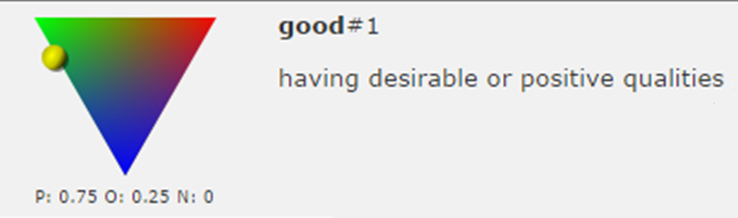
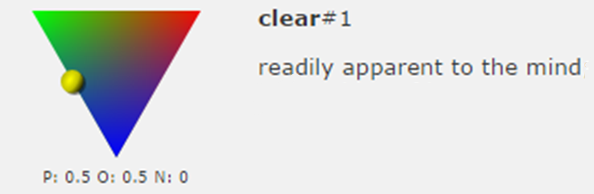

Slide 15
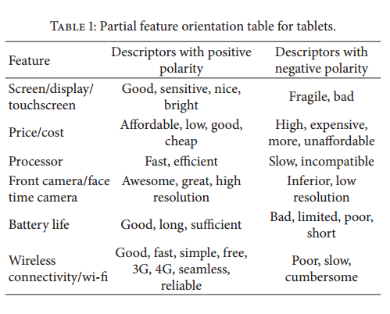

Slide 16
Intuitively it is desirable that if a user’s opinion contains more number of features with positive polarity compared to the number of features with negative polarity it should be classified as positive.
Likewise more number of negative polarity features should cause a user opinion to be classified as negative.

Slide 17
Pos_Bias
Let 𝑇 be the total number of features explicitly mentioned in a user opinion. Let 𝑃 be the number of features tagged positive using the FO table, and let 𝑁 be the number of features tagged as negative. Now, we calculate the term Pos Bias which indicates the normalized positive bias of the opinion as indicated in the following:
Pos Bias = 𝑃−𝑁/𝑇 .
The value of Pos Bias falls in the range [−1, 1].
If the value of Pos Bias is positive, the opinion is classified as positive.
If its value is negative, the opinion is classified as negative,
and if its value is zero the opinion is classified as neutral.

Slide 18
Conclusion
Classifying and summarizing opinions of bloggers has several interesting and commercially significant applications. However, this task is much more difficult than classifying regular text and requires intensive preprocessing.
The success of the opinion mining task is mainly dependent on the efficiency and sophistication of the preprocessing and feature extraction steps.
The proposed approach for product feature set extraction, that is, using frequent multi words with decomposition strategy outperforms other contemporary approaches like the Apriori-based approach and the seed-set expansion approach.
Empirical results indicate that the multistep feature based semi supervised opinion mining approach used in this project can successfully identify opinionated sentences from unstructured user reviews and classify their orientation with acceptable accuracy.
This enables reliable review opinion summarization which has several commercially important applications.

Slide 19
Thank You!

