Slide 1
Improving code quality with Roslyn Code Analyzers
https://github.com/jwooley/Analyzers

Slide 2




About Jim
Solultion Architect
Microsoft MVP
Slalom Consulting
Visual Studio Tools
03
Author
@JimWooley
LINQ in Action
https://jwooley.github.io
https://github.com/jwooley/Analyzers
http://www.thinqlinq.com
Notes:
Click the icon and navigate to your photo on your computer
Crop and position photo as desired
Go to the Arrange drop down menu > choose “send to back” to reveal text

Slide 3
Agenda
Code Analysis and Code Styles
Third party tools
Custom Analyzers
Hack

Slide 4
Code Quality
Compile
Unit Test
Static Analysis
Peer Reviews
Trend Analysis
CI/CD
Style Guide

Slide 5

“Static program analysis is the analysis of computer software that is performed without actually executing programs.”
Wikipedia
https://en.wikipedia.org/wiki/Static_program_analysis
slalom.com
Notes:
Quote Sample

Slide 6
Why use
Standardize within team
Improve maintainability
Allow code review to focus on domain/logic issues
Detect common errors not caught by compiler
Fix code smells

Slide 7
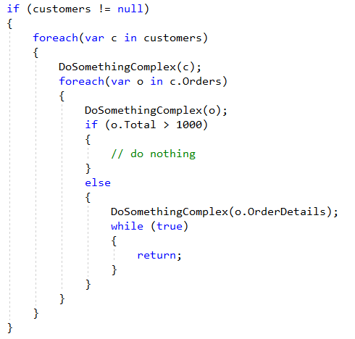
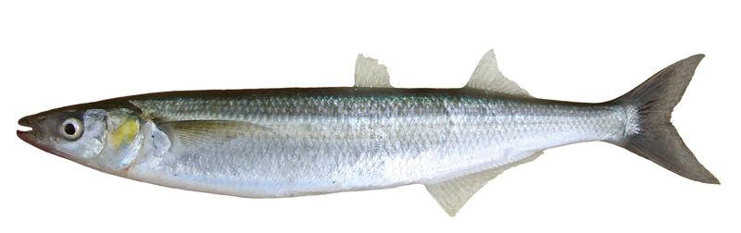
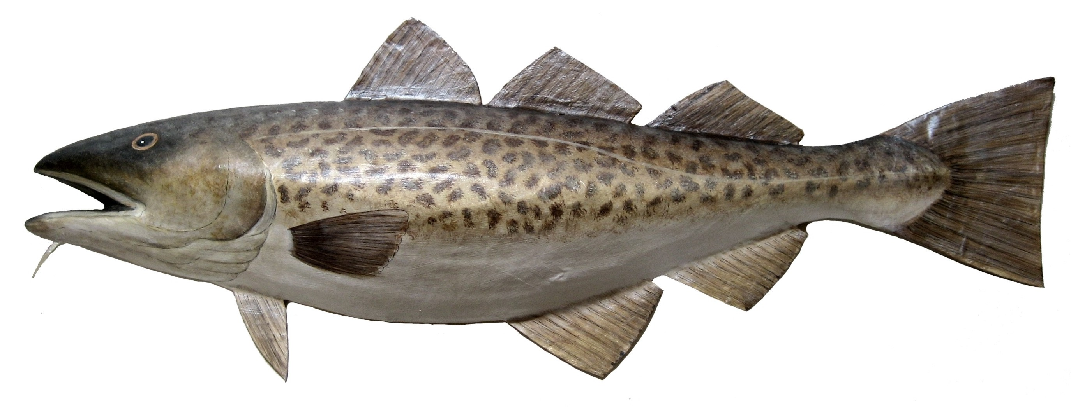

Fixing Cod Smelts
e
^
l

Slide 8
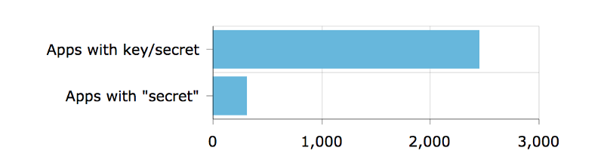
Detect security vulnerabilities
Out of 16,000 apps — apps with keys or secrets
https://hackernoon.com/we-reverse-engineered-16k-apps-heres-what-we-found-51bdf3b456bb#.eechvyizf

Slide 9
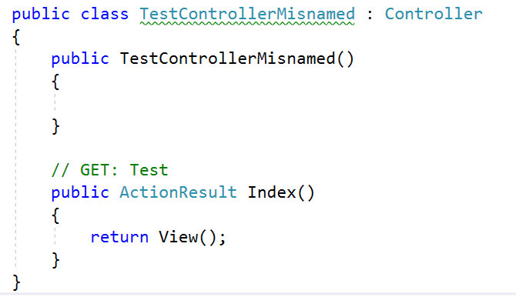
Detect domain specific errors

Slide 10

Recommend best practices

Slide 11
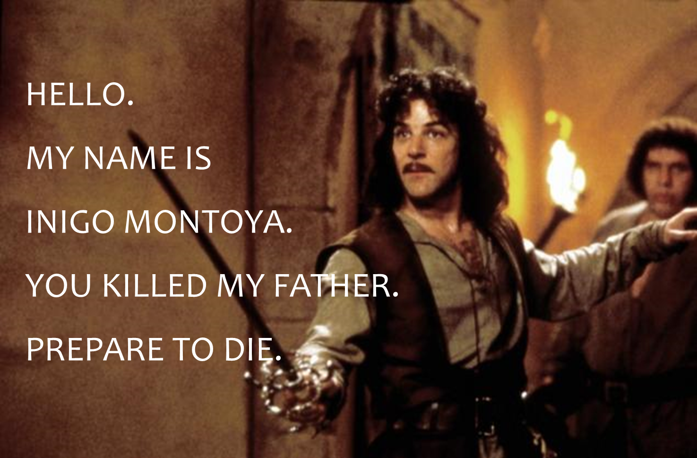
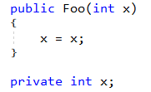
Names matter

Slide 12
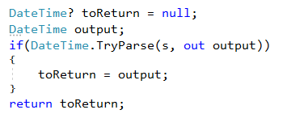
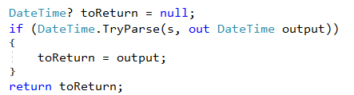
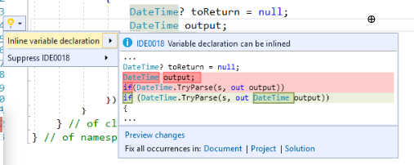
Recommend modernized syntax
Notes:
Click the icon and navigate to your photo on your computer
Crop and position photo as desired
Go to the Arrange drop down menu > choose “send to back” to reveal text

Slide 13
Demo
Running and customizing built-in analyzers

Slide 14
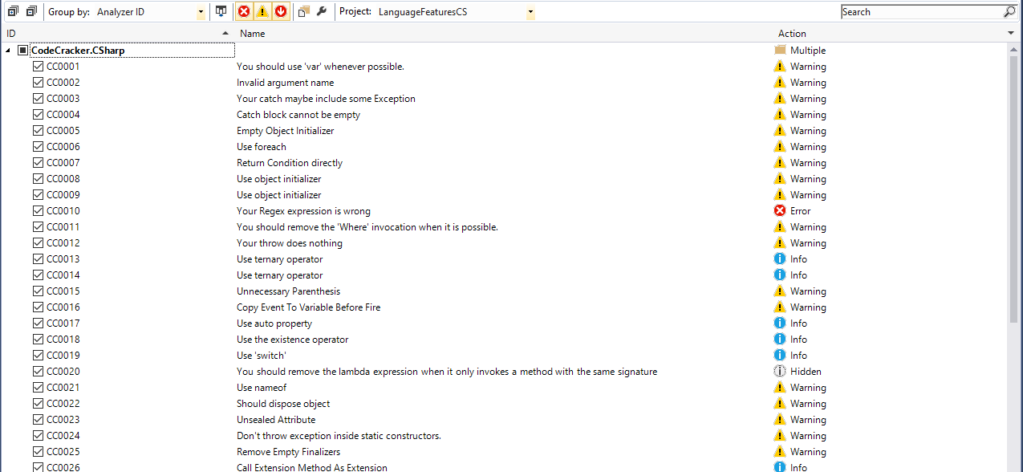
Extensible and Customizable

Slide 15
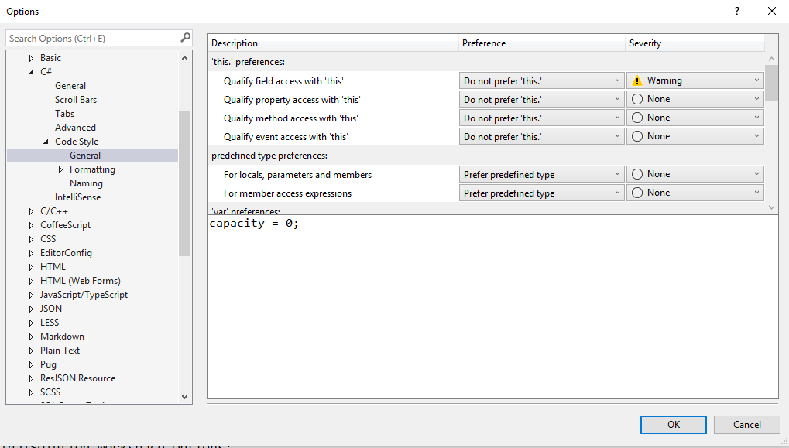
Customizing Code Style

Slide 16
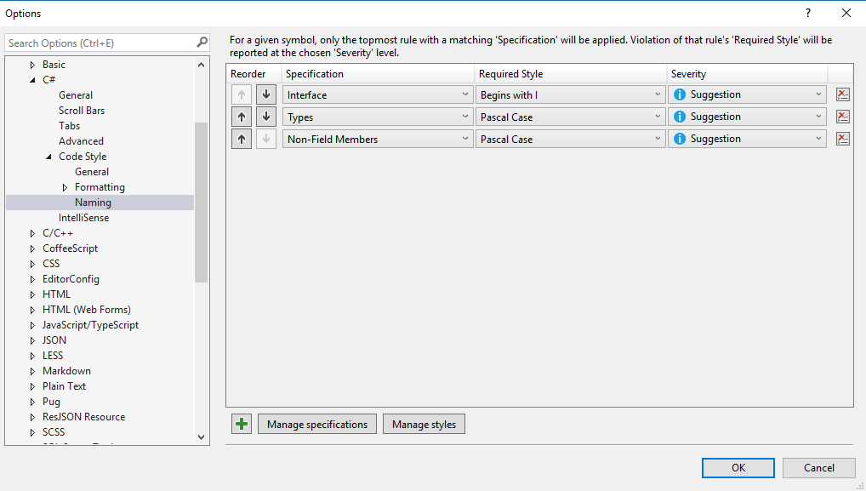
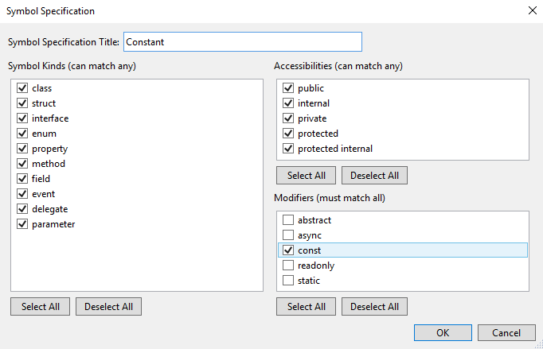
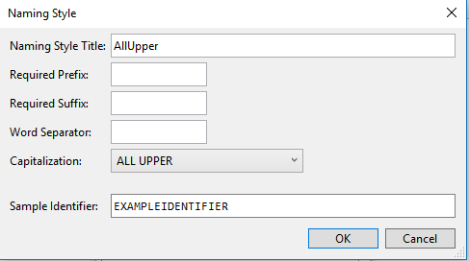
Customizing Naming styles

Slide 17
Lab – Running and customizing Analyzers

Slide 18
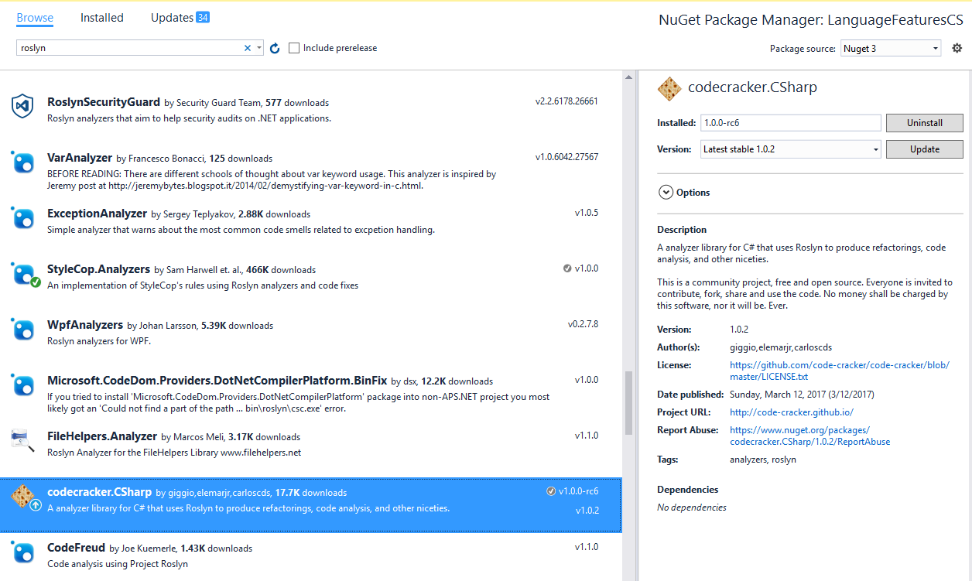
Adding Analyzer from Nuget

Slide 19
Lab - Adding community analyzers

Slide 20
Detect domain specific errors

Slide 21
Creating your own Roslyn analyzer and Code Fix
[DiagnosticAnalyzer(LanguageNames.CSharp)]
public class WebApiControllerNamingConventionAnalyzer : DiagnosticAnalyzer
{
string DiagnosticId = “WA0001";
string Description = "Controller type should end in 'Controller'";
string MessageFormat = "Type name '{0}' does not end in Controller";
internal const string Category = "Naming";
private static DiagnosticDescriptor Rule = new DiagnosticDescriptor(
DiagnosticId, Description, MessageFormat, Category,
DiagnosticSeverity.Warning, true);
// Add implementation
}
private void Analyzer(SymbolAnalysisContext context)
{
var symbol = (INamedTypeSymbol)context.Symbol;
if (symbol.BaseType == null) return;
if ((symbol.BaseType.Name == "Controller"
|| symbol.BaseType.Name == "ApiController")
&& !symbol.Name.EndsWith("Controller"))
{
var diagnostic = Diagnostic.Create(
Rule, symbol.Locations[0], symbol.Name);
context.ReportDiagnostic(diagnostic);
}
}

Slide 22
Custom Diagnostic - CodeFixProvider
private async Task<Document> MakeEndInControllerAsync(
Document document,
TypeDeclarationSyntax typeDecl,
CancellationToken cancellationToken)
{
var identifierToken = typeDecl.Identifier;
var originalName = identifierToken.Text;
var nameWithoutController = Regex.Replace(
originalName, "controller", String.Empty, RegexOptions.IgnoreCase);
var newName = nameWithoutController + "Controller";
var newIdentifier = SyntaxFactory.Identifier(newName)
.WithAdditionalAnnotations(Formatter.Annotation);
var newDeclaration = typeDecl.ReplaceToken(identifierToken, newIdentifier);
var root = await document.GetSyntaxRootAsync();
var newRoot = root.ReplaceNode(typeDecl, newDeclaration);
var newDocument = document.WithSyntaxRoot(newRoot);
return newDocument;
}
[ExportCodeFixProvider("ControllerNameCodeFixProvider", LanguageNames.CSharp)]
public class ControllerNameCodeFixProvider : CodeFixProvider
{
public override ImmutableArray<string> GetFixableDiagnosticIds()
{
return ImmutableArray.Create(DiagnosticId);
}
public override async Task ComputeFixesAsync(CodeFixContext context)
{
var root = await context.Document.GetSyntaxRootAsync(
context.CancellationToken).ConfigureAwait(false);
var diagnostic = context.Diagnostics.First();
var diagnosticSpan = diagnostic.Location.SourceSpan;
var declaration = root.FindToken(diagnosticSpan.Start)
.Parent.AncestorsAndSelf()
.OfType<TypeDeclarationSyntax>().First();
context.RegisterFix(
CodeAction.Create("Ensure type ends in 'Controller'",
c => MakeEndInControllerAsync(context.Document, declaration, c)),
diagnostic );
}

Slide 23
Lab – Create diagnostic with code fix
Labs\Lab-DiagnosticWithCodeFix.docx
slalom.com
Notes:
Click the icon and navigate to your photo on your computer
Crop and position photo as desired
Go to the Arrange drop down menu > choose “send to back” to reveal text

Slide 24

Brainstorm
Your ideas go here:

Slide 25
Lab - Hack
Sample projects
https://github.com/dotnet/roslyn
https://github.com/DotNetAnalyzers
https://github.com/code-cracker
https://github.com/dotnet/roslyn/wiki/Syntax%20Visualizer
Alternative exercises
https://msdn.microsoft.com/en-us/magazine/dn879356
https://msdn.microsoft.com/en-us/magazine/dn904670.aspx
https://github.com/dotnet/roslyn/wiki/Scripting-API-Samples
slalom.com
Notes:
Click the icon and navigate to your photo on your computer
Crop and position photo as desired
Go to the Arrange drop down menu > choose “send to back” to reveal text

Slide 26
About Jim
Solultion Architect
Microsoft MVP
Slalom Consulting
Visual Studio Tools
03
Author
@JimWooley
LINQ in Action
https://github.com/jwooley/Analyzers
http://www.thinqlinq.com
Notes:
Click the icon and navigate to your photo on your computer
Crop and position photo as desired
Go to the Arrange drop down menu > choose “send to back” to reveal text

