Slide 1
Improving code quality with Roslyn Code Analyzers
https://github.com/jwooley/RoslynLabs

Slide 2




About Jim
Solultion Architect
Microsoft MVP
Slalom Consulting
Visual Studio Tools
03
Author
@JimWooley
LINQ in Action
https://jwooley.github.io
https://github.com/jwooley/RoslynLabs
http://www.thinqlinq.com

Slide 3
Agenda
Static Analysis and Code Styles
Third party tools
Custom Analyzers
Hack

Slide 4
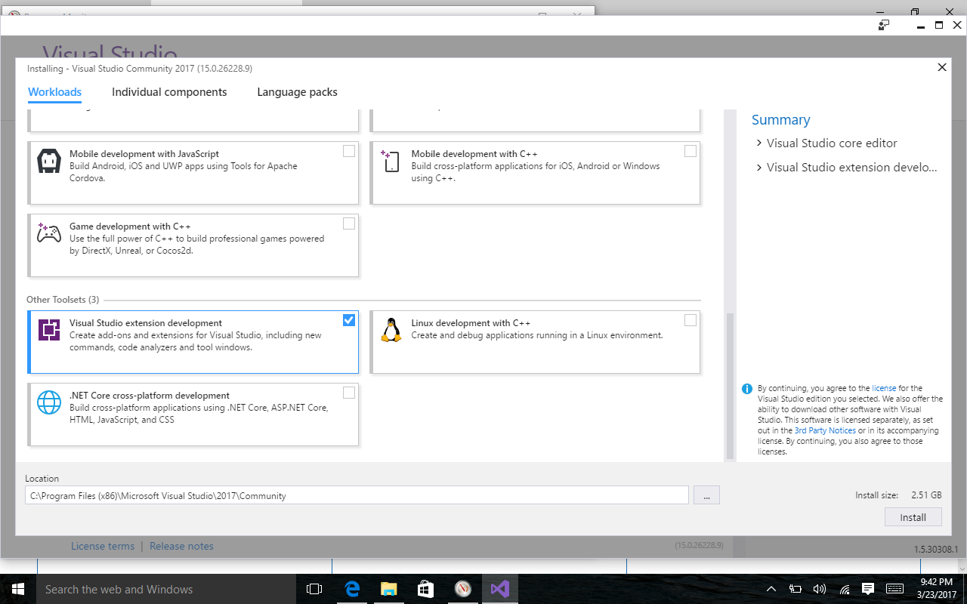
Prerequisite

Slide 5
Code Quality
Compile
Unit Test
Static Analysis
Peer Reviews
Trend Analysis
CI/CD
Style Guide

Slide 6

“Static program analysis is the analysis of computer software that is performed without actually executing programs.”
Wikipedia
https://en.wikipedia.org/wiki/Static_program_analysis
slalom.com

Slide 7
Why use
Standardize within team
Improve maintainability
Allow code review to focus on domain/logic issues
Detect common errors not caught by compiler
Fix code smells

Slide 8
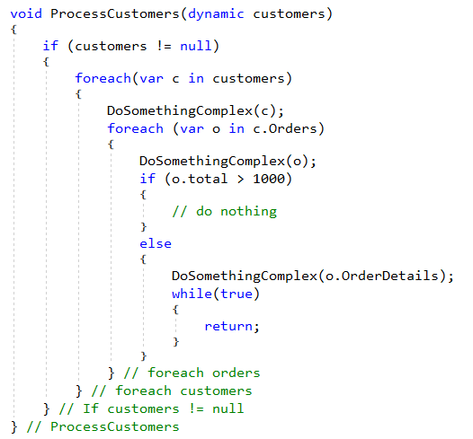
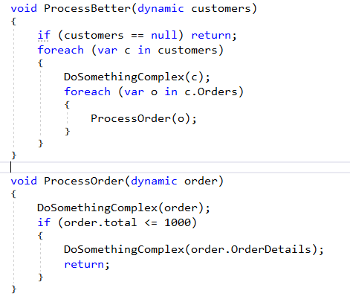
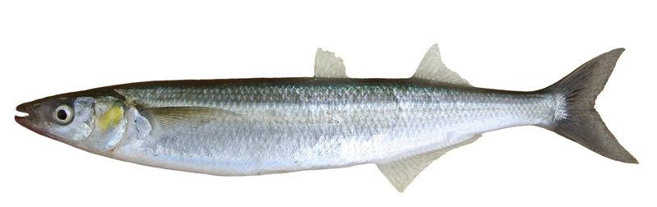
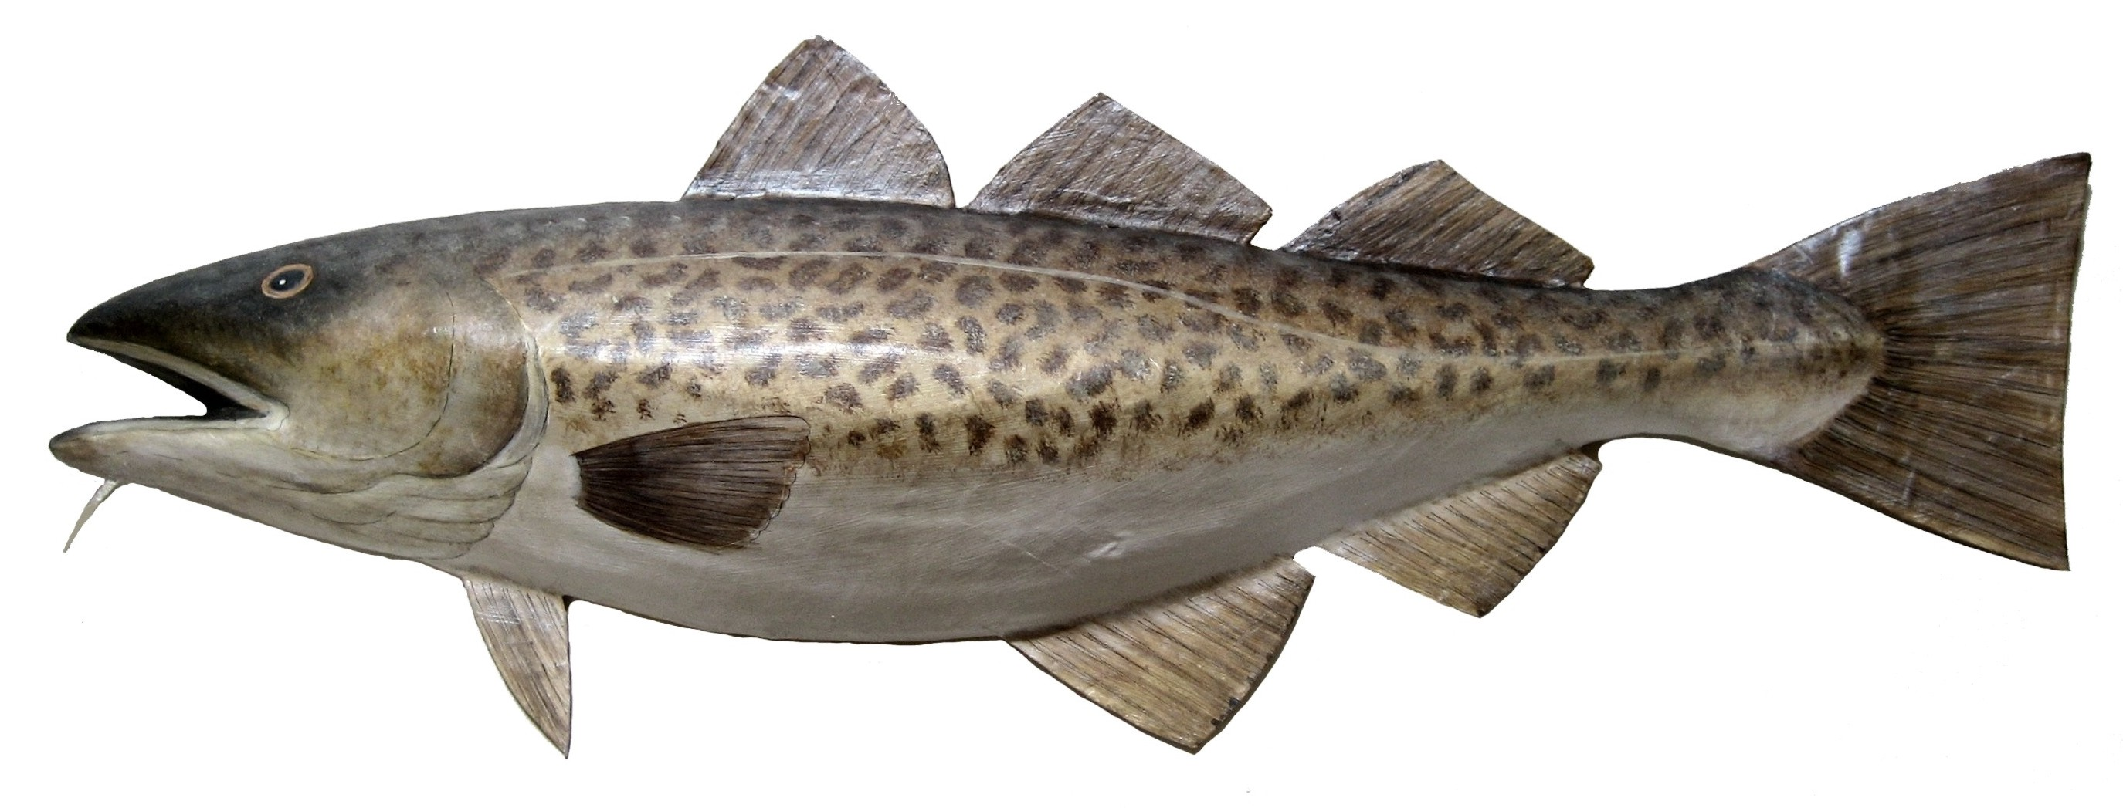

Fixing Cod Smelts
e
^
l

Slide 9
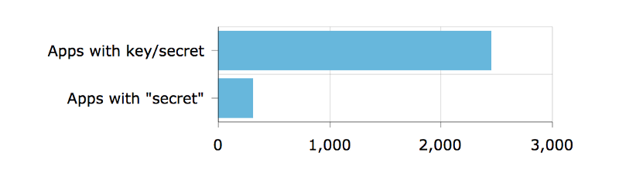
Detect security vulnerabilities
Out of 16,000 apps — apps with keys or secrets
https://hackernoon.com/we-reverse-engineered-16k-apps-heres-what-we-found-51bdf3b456bb#.eechvyizf

Slide 10
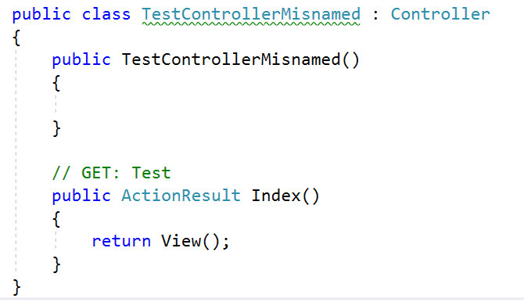
Detect domain specific errors

Slide 11

Recommend best practices

Slide 12
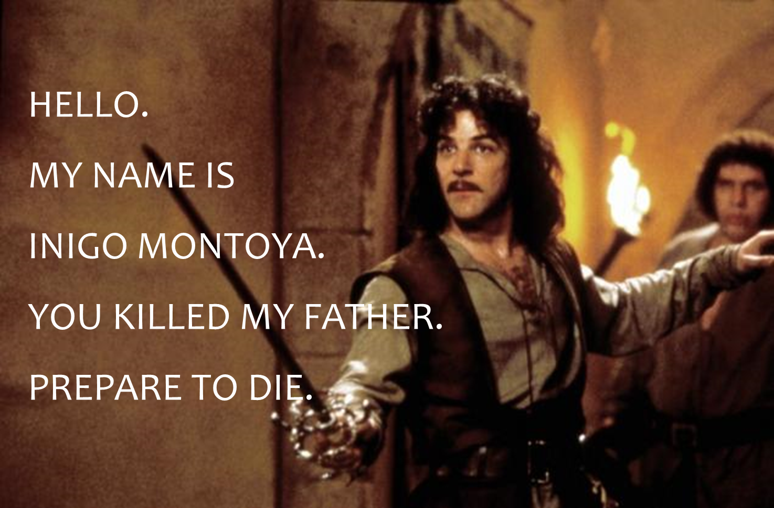
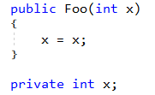
Names matter

Slide 13
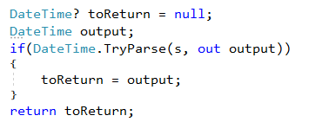
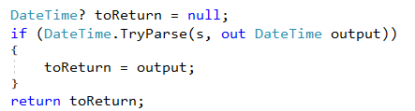
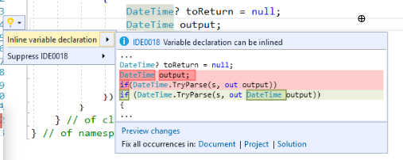
Recommend modernized syntax

Slide 14
Demo
Running built-in analyzers

Slide 15
Out of the Box Refactorings
Code Fixes (30)
Refactorings (13)
Add Await
Add Async
Change Return Type
Change To Yield
Convert To Async
Convert To Iterator
Add Missing Reference
Add Using
Fully Qualify
Generate Method
Add Constructor Parameters from members
Change Signature
Encapsulate Field
Extract Interface
Extract Method
Generate Constructor from members
Generate default constructors
Inline temporary
Introduce Variable
Invert If
Simplify Lambda

Slide 16
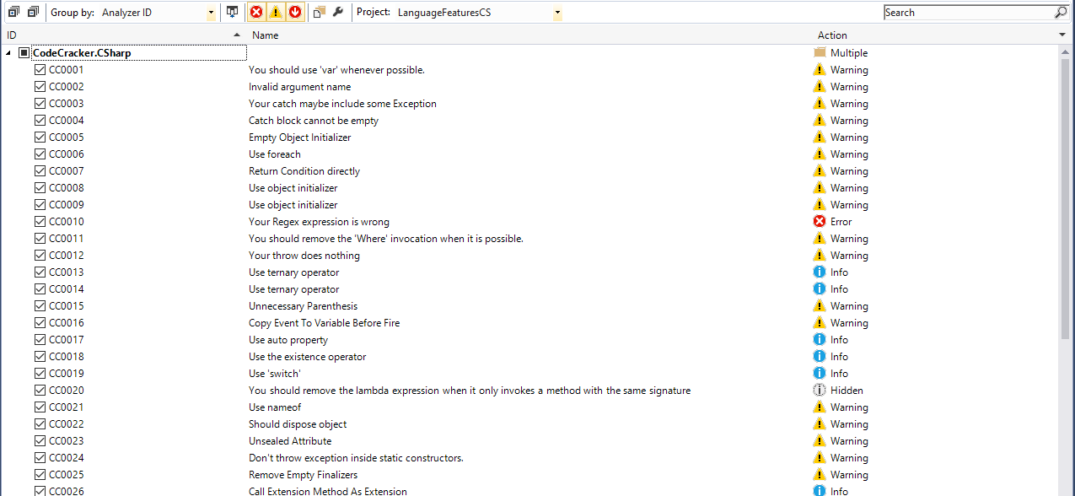
Extensible and Customizable

Slide 17
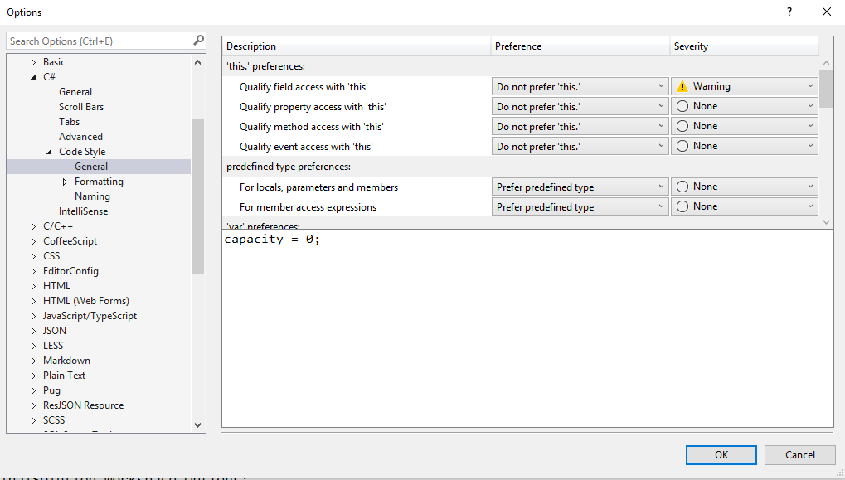
Customizing Code Style

Slide 18
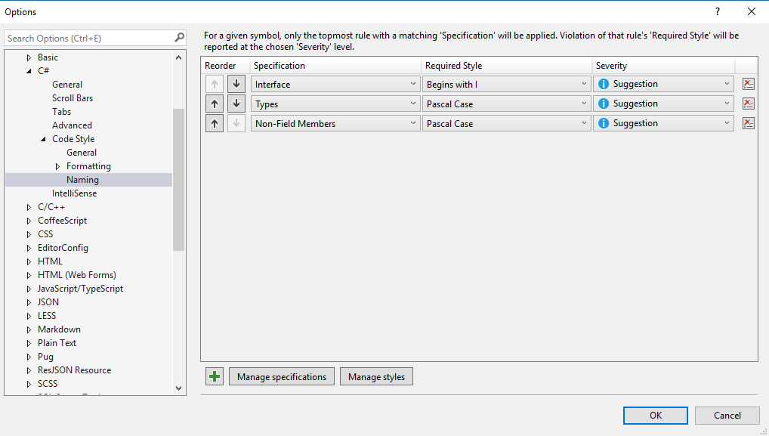
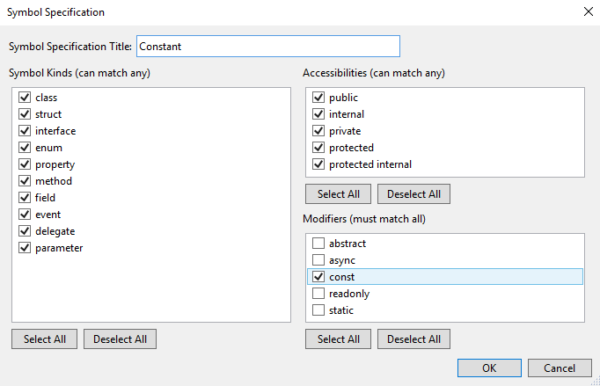
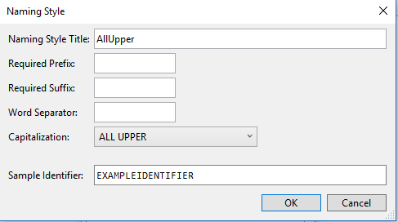
Customizing Naming styles

Slide 19
Demo
Customizing built-in analyzers

Slide 20
Lab – Running and customizing Analyzers
https://github.com/jwooley/RoslynLabs
\Labs\Lab 1-Running and customizing analyzers.docx
\Labs\Lab1-Start

Slide 21
Agenda
Code Analysis and Code Styles
Third party tools
Custom Analyzers
Hack

Slide 22
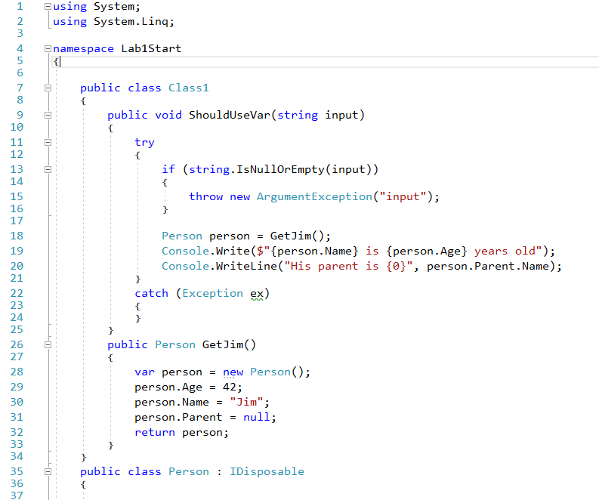
Clean Code?

Slide 23
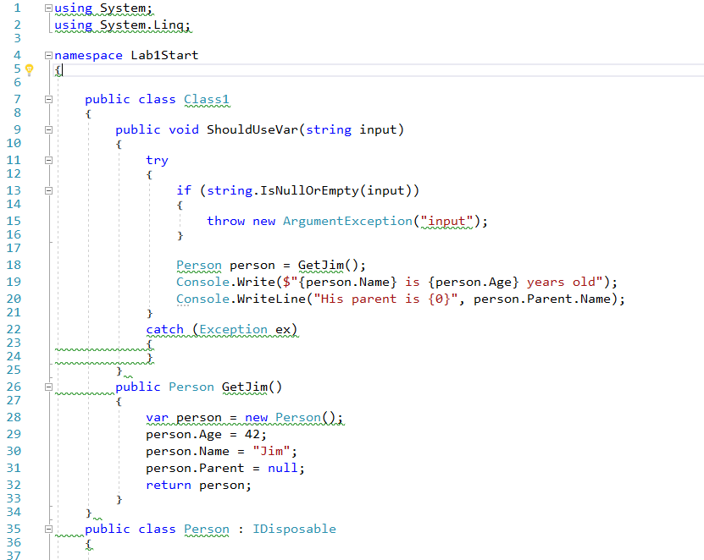
Not so clean

Slide 24
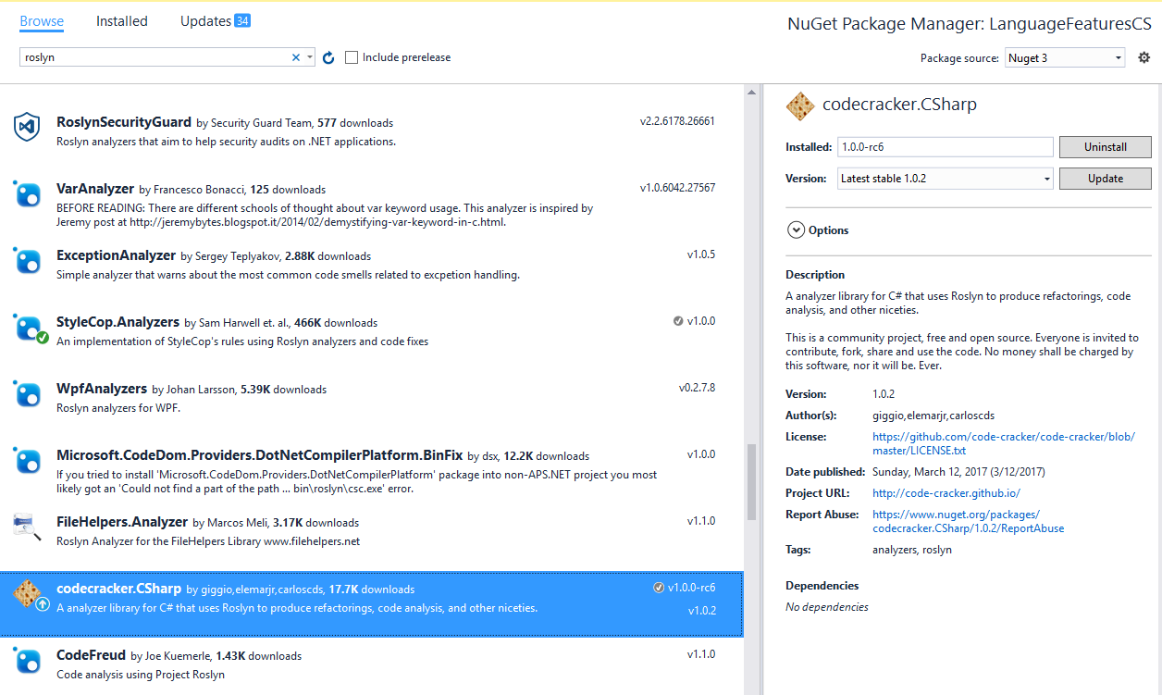
Adding Analyzer from Nuget

Slide 25
Demo
Using third party analyzers

Slide 26
Third Party Code Fixes
Roslyn Analyzers
Code Cracker
DotNetAnalyzers
StyleCop
AsyncUsageAnalyzers
TSqlAnalyzer
DotNetDoodle
RoslynDiagnostics
AzureAnalytics
Wintellect.Analyzers

Slide 27
Lab - Adding community analyzers
https://github.com/jwooley/RoslynLabs
\Labs\Lab 2-Applying OpenSource Analyzers.docx
\Labs\Lab1-Start

Slide 28
Agenda
Code Analysis and Code Styles
Third party tools
Custom Analyzers
Hack

Slide 29
Detect domain specific errors

Slide 30

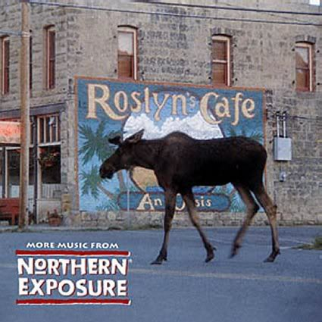
What is Roslyn?

Slide 31

Opening up the compiler
AST
AST
AST
CSC/VBC
IL

Slide 32
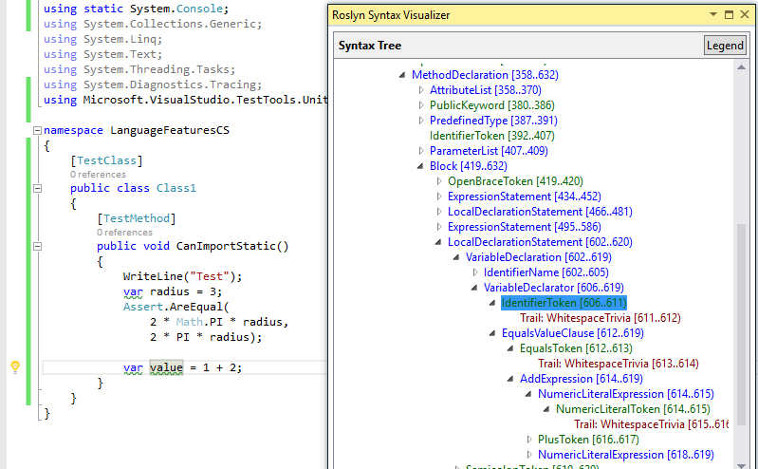
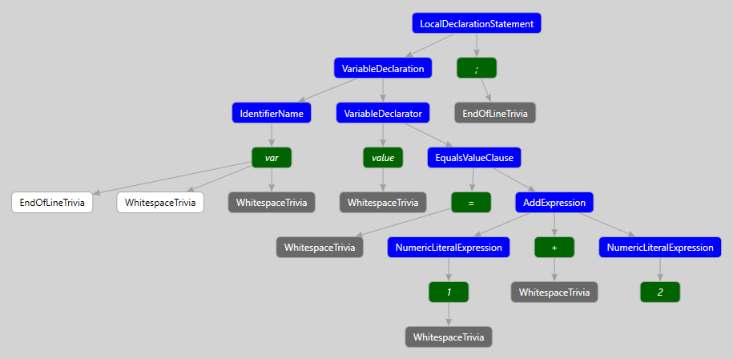
Building your own Fix
ExpressionSyntax
SyntaxToken
SyntaxTrivia
var value = 1 + 2;
var equalsValue =
SyntaxFactory.EqualsValueClause(
SyntaxFactory.BinaryExpression(
SyntaxKind.AddExpression,
SyntaxFactory.LiteralExpression(
SyntaxKind.NumericLiteralExpression, SyntaxFactory.Literal(1)),
SyntaxFactory.LiteralExpression(
SyntaxKind.NumericLiteralExpression,SyntaxFactory.Literal(2))
));
var typeSyntax =
SyntaxFactory.VariableDeclaration(
SyntaxFactory.ParseTypeName("var"),
new SeparatedSyntaxList<VariableDeclaratorSyntax>()
.Add(SyntaxFactory.VariableDeclarator(“value")
.WithInitializer(equalsValue)))
.NormalizeWhitespace(" ")
.WithAdditionalAnnotations(Formatter.Annotation);
var declaration = SyntaxFactory.LocalDeclarationStatement(typeSyntax);

Slide 33
Creating your own Roslyn analyzer and Code Fix
[DiagnosticAnalyzer(LanguageNames.CSharp)]
public class WebApiControllerNamingConventionAnalyzer : DiagnosticAnalyzer
{
string DiagnosticId = “WA0001";
string Description = "Controller type should end in 'Controller'";
string MessageFormat = "Type name '{0}' does not end in Controller";
internal const string Category = "Naming";
private static DiagnosticDescriptor Rule = new DiagnosticDescriptor(
DiagnosticId, Description, MessageFormat, Category,
DiagnosticSeverity.Warning, true);
// Add implementation
}
private void Analyzer(SymbolAnalysisContext context)
{
var symbol = (INamedTypeSymbol)context.Symbol;
if (symbol.BaseType == null) return;
if ((symbol.BaseType.Name == "Controller"
|| symbol.BaseType.Name == "ApiController")
&& !symbol.Name.EndsWith("Controller"))
{
var diagnostic = Diagnostic.Create(
Rule, symbol.Locations[0], symbol.Name);
context.ReportDiagnostic(diagnostic);
}
}

Slide 34
Custom Diagnostic - CodeFixProvider
private async Task<Document> MakeEndInControllerAsync(
Document document,
TypeDeclarationSyntax typeDecl,
CancellationToken cancellationToken)
{
var identifierToken = typeDecl.Identifier;
var originalName = identifierToken.Text;
var nameWithoutController = Regex.Replace(
originalName, "controller", String.Empty, RegexOptions.IgnoreCase);
var newName = nameWithoutController + "Controller";
var newIdentifier = SyntaxFactory.Identifier(newName)
.WithAdditionalAnnotations(Formatter.Annotation);
var newDeclaration = typeDecl.ReplaceToken(identifierToken, newIdentifier);
var root = await document.GetSyntaxRootAsync();
var newRoot = root.ReplaceNode(typeDecl, newDeclaration);
var newDocument = document.WithSyntaxRoot(newRoot);
return newDocument;
}
[ExportCodeFixProvider("ControllerNameCodeFixProvider", LanguageNames.CSharp)]
public class ControllerNameCodeFixProvider : CodeFixProvider
{
public override ImmutableArray<string> GetFixableDiagnosticIds()
{
return ImmutableArray.Create(DiagnosticId);
}
public override async Task ComputeFixesAsync(CodeFixContext context)
{
var root = await context.Document.GetSyntaxRootAsync(
context.CancellationToken).ConfigureAwait(false);
var diagnostic = context.Diagnostics.First();
var diagnosticSpan = diagnostic.Location.SourceSpan;
var declaration = root.FindToken(diagnosticSpan.Start)
.Parent.AncestorsAndSelf()
.OfType<TypeDeclarationSyntax>().First();
context.RegisterFix(
CodeAction.Create("Ensure type ends in 'Controller'",
c => MakeEndInControllerAsync(context.Document, declaration, c)),
diagnostic );
}

Slide 35
Lab – Create diagnostic with code fix
https://github.com/jwooley/RoslynLabs
Labs\Lab 3-DiagnosticWithCodeFix.docx
slalom.com

Slide 36
Agenda
Code Analysis and Code Styles
Third party tools
Custom Analyzers
Hack

Slide 37

Brainstorm
Your ideas go here:

Slide 38
Lab - Hack
Sample projects
https://github.com/dotnet/roslyn
https://github.com/DotNetAnalyzers
https://github.com/code-cracker
Alternative exercises
https://msdn.microsoft.com/en-us/magazine/dn879356
https://msdn.microsoft.com/en-us/magazine/dn904670.aspx
https://msdn.microsoft.com/en-us/magazine/dn879356.aspx
https://github.com/dotnet/roslyn/wiki/Scripting-API-Samples
https://github.com/dotnet/roslyn/wiki/Syntax%20Visualizer
slalom.com

Slide 39
About Jim
Solultion Architect
Microsoft MVP
Slalom Consulting
Visual Studio Tools
03
Author
@JimWooley
LINQ in Action
https://github.com/jwooley/RoslynLabs
http://www.thinqlinq.com

