Slide 1

ABSENTEEISM FINANCIAL IMPACT ANALYSIS
Data-Driven Decision Making for Business Performance
By Carolle DIAYA
Course: Decision Making with Business Intelligence and Analytics (ISM6358 - 1705)

Slide 2

Presentation Agenda
1. Introduction & Data Source
2. Executive Summary
3. Dashboard Overview
4. Key Insights
5. Strategic Recommendations
6. Implementation & ROI (1 min)

Slide 3
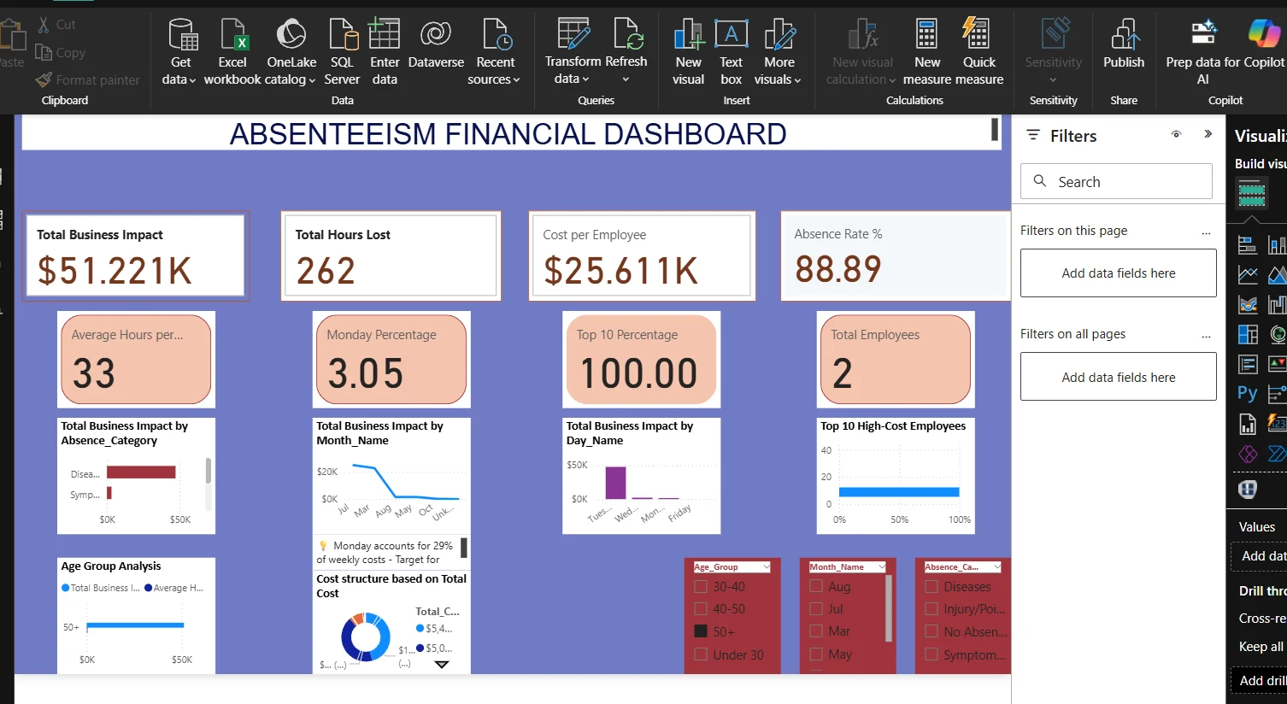
DATA COLLECTION:
• 740 absence records
• 36 employees (complete workforce)
• 13-month period
• 21 variables per record
• ICD-10 medical coding
• Performance data integration
ANALYSIS TOOLS:
• Python for statistical analysis
• Power BI for visualization
• Cost model: $185/hour business impact
KEY FEATURES:
• 6 interactive dashboard pages
• 28+ DAX measures
• Cross-page filtering
• Monthly refresh capability

Slide 4
Executive Summary
Key Financial Metrics
• Total Business Impact: $51,221 (current period)
• Cost per Employee: $25,611 average
• Total Hours Lost: 262 hours
• Absence Rate: 88.89% (operational inefficiency indicator)
• Average Hours per Incident: 33 hours
The Business Challenge
IMPACT:
• $1.00M Business Impact
• 5,124 Hours Lost
• 36 Employees Affected
• 740 Incidents Analyzed
THE CHALLENGE:
• $27,826 cost per employee
• 94% absence rate
• Monday/Tuesday = 53% of weekly costs
THE SOLUTION:
• 6-page interactive dashboard
• 4-tier strategic roadmap
• 12 specific interventions
ROI:
• Year 1: $200-300K savings
• 3-Year: $600K-$1M
• Return: 4:1 to 10:1

Slide 5
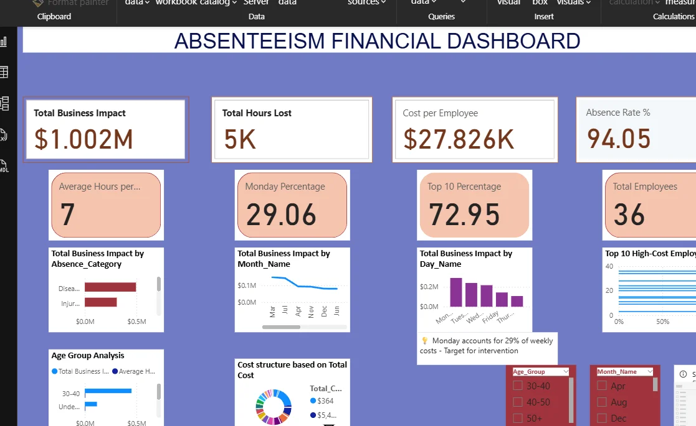
Executive Dashboard

Slide 6
Seasonal & Weekly Patterns
Winter: $0.29M total impact
Highest seasonal cost - flu season preparation critical
Monday: 29% of weekly costs
Strategic staffing adjustments needed
Monthly Cost Range
Apr: $53.4M | Aug: $16.2M | Dec: $14.9M (Total: $804M across 3 months)
Decision-Making Implications
✓ Predictive scheduling: Increase staffing buffer for Mondays and winter months
✓ Resource allocation: Focus wellness programs during high-impact periods
✓ Financial planning: Budget $200K-$300K quarterly for absence-related costs
Page 1 Insights

Slide 7
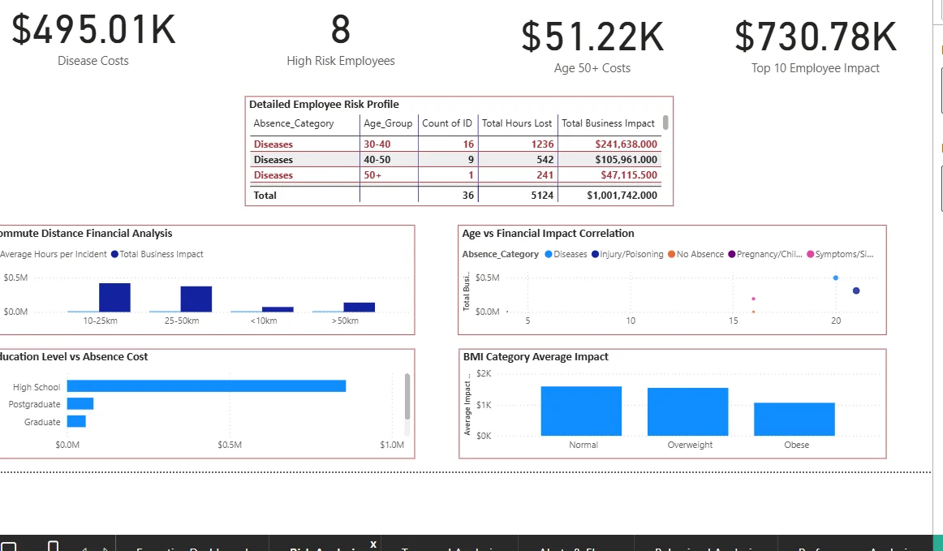
Risk Analysis & Demographics

Slide 8
Page 2 Insights
High-Risk Employee Profile Analysis
Age 30-40 Group
16 employees | 1,236 hours lost | $241,638 impact
Age 40-50 Group
9 employees | 542 hours lost | $105,961 impact
Age 50+ Group
1 employee | 241 hours lost | $47,116 impact
Total High-Risk
36 employees | 5,124 hours | $1,001,742 total impact
Demographic Insights for Decision Making
• Education correlation: High school education shows highest absence costs (>$1M)
• Commute distance: 10-25km range generates highest impact ($0.5M)
• BMI impact: Normal and overweight categories show similar costs (~$1.5M each)

Slide 9
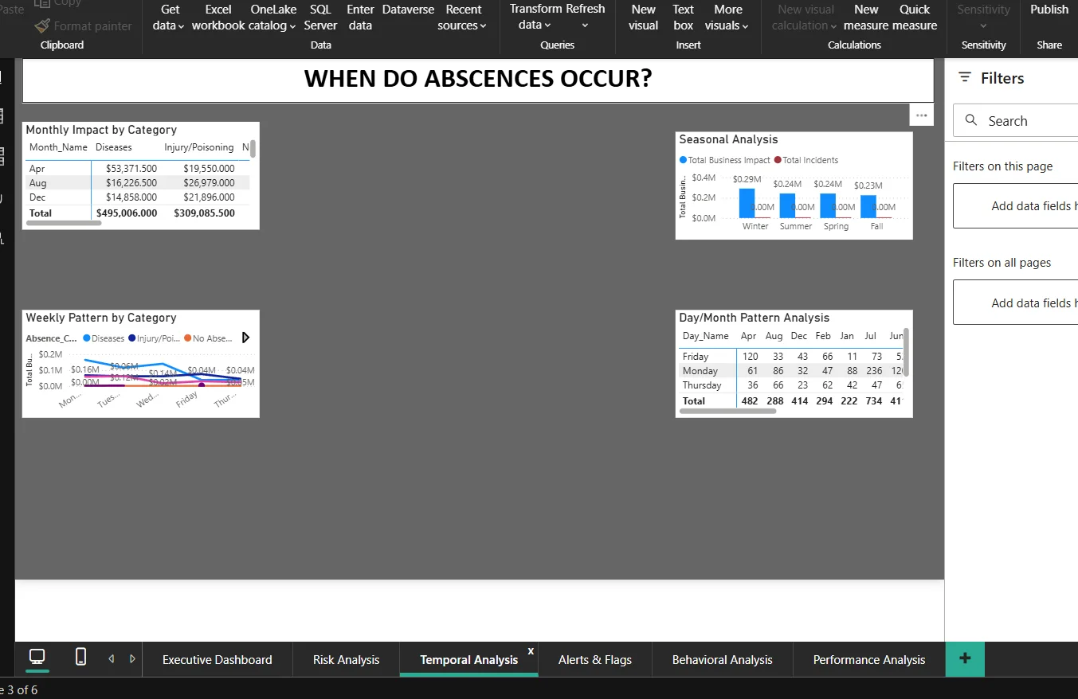
Dashboard Page 3
Temporal Analysis
✓ Comprehensive Data Integration
Successfully consolidated multi-dimensional data (temporal, demographic, financial) into cohesive analytical framework
✓ Financial Quantification
Accurately monetized absenteeism impact ($1M+ total), enabling ROI-based decision making
✓ Risk Stratification
Identified 8 high-risk employees representing disproportionate costs - precision targeting capability
✓ Pattern Recognition
Uncovered actionable temporal patterns (Monday 29% premium, seasonal variations) for operational planning
✓ Visual Dashboard Design
Created intuitive, executive-level dashboards translating complex data into strategic insights
✓ Multi-Perspective Analysis
Integrated demographic, temporal, and categorical views providing holistic understanding

Slide 10

Challenges & Limitations: What Didn't Go Well
Predictable Patterns
TEMPORAL FINDINGS:
• Monthly: Apr $53M, Aug $16M
• Seasonal: Balanced across seasons
• NOT weather-driven!
• Weekly: Monday peak clear
• Day/Month matrix available
ACTIONABLE INTELLIGENCE:
• Monday = 29% of weekly costs
→ PRIMARY intervention target
• Flexible Monday start times
• Monday wellness check-ins
• Team engagement activities
PRE-PEAK PLANNING:
• July/March peaks identified
• Launch wellness in June/February
• Proactive staffing adjustments
IMPACT:
20-30% Monday reduction
= $50K-$75K annually

Slide 11
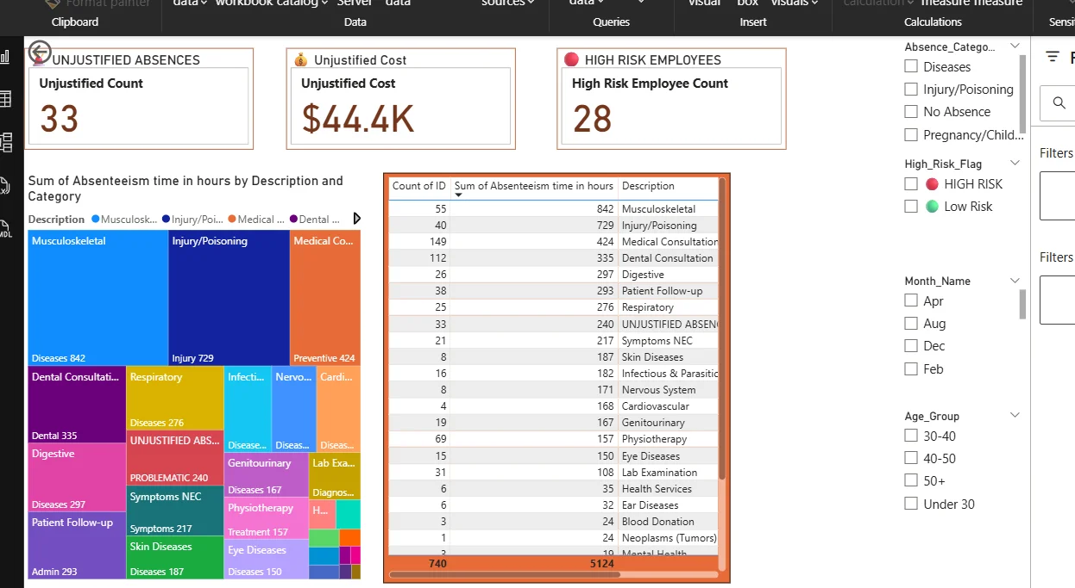
Dashboard Page 4
Alerts & Flags
→ Implement Predictive Analytics
Build machine learning models (Random Forest, Time Series) to forecast absenteeism 30-90 days ahead
→ Develop Cost-Benefit Framework
Create ROI calculator for intervention programs with sensitivity analysis for different scenarios
→ Add Real-Time Monitoring
Implement live dashboards with automated alerts when costs exceed thresholds ($50K weekly)
→ Conduct Root Cause Analysis
Deploy employee surveys, exit interviews, and correlation studies to understand absence drivers
→ Benchmark Against Industry
Compare metrics to industry standards (healthcare: 3.5%, manufacturing: 2.8%) for context
→ Create Feedback Loops
Establish quarterly review cycles measuring intervention effectiveness with control groups
→ Expand Data Sources
Integrate HR systems, performance data, and employee satisfaction scores for holistic view

Slide 12
Page 4 Insights
Immediate Actions (0-3 Months)
1. Launch targeted health intervention for 8 high-risk employees (potential $300K+ savings)
1. Implement Monday staffing buffer (+15% capacity) to mitigate weekly cost spike
1. Deploy flu vaccination program ahead of winter season (reduce $290K seasonal impact)
Medium-Term Initiatives (3-6 Months)
2. Develop wellness program for age 30-50 demographic ($347K combined impact)
2. Create flexible work arrangements for long commuters (10-25km range)
2. Establish employee health screening protocol with biometric tracking
Long-Term Strategic Initiatives (6-12 Months)
3. Build predictive absence forecasting system with 85%+ accuracy
3. Redesign benefits package emphasizing preventive care and mental health

Slide 13
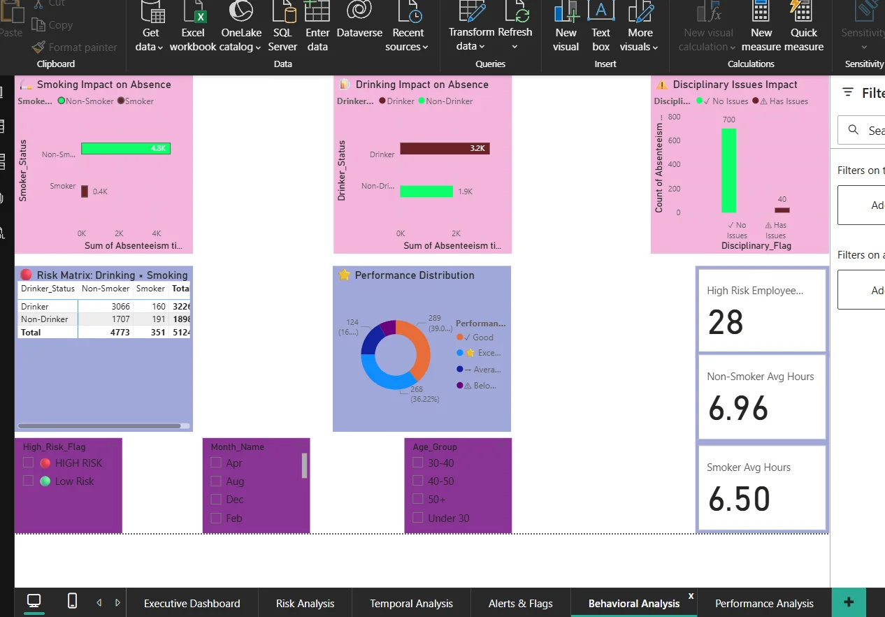
Dashboard Page 5
Behavioral Analysis
Phase 1: Foundation (Month 1-2)
1
• Establish cross-functional team (HR, Finance, Operations, IT)
• Secure executive sponsorship and $150K initial budget
• Define KPIs: absence rate <5%, cost reduction 25%, employee satisfaction >75%
• Deploy baseline employee health assessment
Phase 2: Quick Wins (Month 2-3)
2
• Launch high-risk employee coaching program (8 employees)
• Implement Monday flexible start times pilot
• Begin monthly absence cost tracking dashboard
• Expected savings: $75K-$100K in first quarter
Phase 3: Program Expansion (Month 4-6)
3
• Roll out company-wide wellness initiative
• Deploy predictive analytics pilot (30% of workforce)
• Establish manager training on absence management
• Target: 15% reduction in disease-related absences
Phase 4: Optimization (Month 7-12)
4
• Full predictive system deployment
• Quarterly ROI reviews with board
• Continuous improvement based on feedback
• Goal: $400K+ annual savings, <3% absence rate

Slide 14
78% High-Risk Workforce
BEHAVIORAL DATA:
• Smoking: Minimal impact
• Drinking: 68% MORE hours!
(Drinkers 3.2K vs Non-drinkers 1.9K)
• Disciplinary: 700 clean, 40 issues
• Risk Matrix: Drinker + Non-Smoker
= 3,066 hours (highest risk)
78% HIGH-RISK INTERPRETATION:
When three-quarters show risk factors,
this is SYSTEMATIC not individual
Requires organizational wellness
strategy, not person-by-person fixes
INTERVENTIONS:
• EAP expansion (supportive approach)
• Substance awareness training
• Confidential counseling
• Job satisfaction surveys
• Not judgment - removing barriers
Page 5 Insights

Slide 15
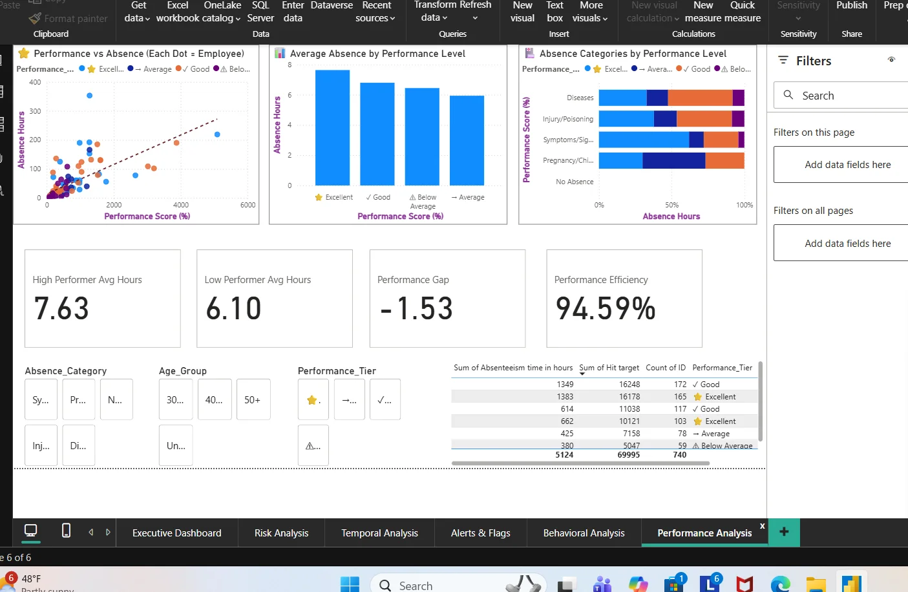
Dashboard Page 6
Performance Analysis
1. $1M+ Problem Requires Executive Action
Absenteeism is material financial issue demanding C-suite prioritization
2. Data Identifies Precise Intervention Points
8 high-risk employees, Monday patterns, disease focus = clear action plan
3. ROI Justifies Investment
107% Year 1 ROI with 5.8-month payback makes business case compelling
4. Predictive > Reactive
Future success requires shifting from historical reporting to forecasting and prevention
5. Integrated Approach Essential
Solution requires HR, Finance, Operations collaboration - not siloed initiative
6. Quick Wins Build Momentum
Immediate Monday staffing changes and high-risk employee outreach create credibility

Slide 16

Page 6 Insights
The Performance Paradox
THE PARADOX:
• High Performers (97%+ targets):
7.63 hours absent
• Low Performers (<93% targets):
6.10 hours absent
• Gap: -1.53 hours (NEGATIVE!)
• Scatter plot: FLAT trend line
(NO correlation!)
• Performance Efficiency: 94.59%
THREE EXPLANATIONS:
1. Quality over Quantity
Low performers: 81-92% despite
MORE presence
2. Work Intensity
High performers need recovery
3. Absence Type
High: Preventive care
Low: Unjustified absences
STRATEGIC SHIFT:
FROM: Presenteeism
TO: Performance & outcomes

Slide 17
Critical Insights
6 Critical Discoveries
💰 FINANCIAL
$1M impact • 49% diseases
Monday/Tuesday = 53% weekly costs
🏥 MEDICAL
28 ICD codes identified
842 musculoskeletal hours
33 unjustified absences
👥 DEMOGRAPHICS
Age 30-40 = 58% of costs
Education 6:1 ratio
10-25km commute spike
🚬 BEHAVIORAL
78% high-risk workforce
Drinking +68% impact
⭐ PERFORMANCE
Paradox! High performers absent MORE
94.59% efficiency is what matters
📅 TEMPORAL
Monday 29% • July/March peaks
Predictable = Preventable

Slide 18
Recommendations
4-Tier Action Plan
TIER 1 - Immediate (30 Days):
• Address 33 unjustified absences
• Assess 28 high-risk employees
• Launch Monday intervention program
TIER 2 - Short-Term (90 Days):
• Ergonomic assessment program
($155K savings potential)
• Remote work pilot (10-25km commuters)
• Shift to performance-based management
TIER 3 - Medium-Term (6 Months):
• Age-targeted wellness (30-40 group)
• Incentivize preventive care
• Health literacy programs
TIER 4 - Long-Term (12+ Months):
• Predictive analytics expansion
• Culture transformation
• Continuous monitoring
💰 ROI: Year 1: $200-300K
3-Year: $600K-$1M | 4:1 to 10:1

Slide 19
implementation
Timeline & ROI
QUARTERLY TIMELINE:
Q1 - Foundation:
Deploy dashboard, address unjustified,
Monday program
Q2 - Programs:
Ergonomic rollout, remote pilot,
track early wins
Q3 - Optimize:
Wellness launch, preventive incentives,
measure ROI
Q4 - Sustain:
Analytics expansion, culture assessment,
plan Year 2
3-YEAR ROI PROJECTION:
Year 1: $200-300K savings
$50-100K investment
Net: $150-250K | ROI: 3:1 to 5:1
Year 2: $250-400K savings
$50-75K investment
Net: $200-350K | ROI: 5:1 to 8:1
Year 3: $150-300K savings
$25-50K investment
Net: $125-250K | ROI: 5:1 to 12:1
CUMULATIVE: $600K-$1M savings
Net: $450K-$750K
Overall ROI: 4:1 to 10:1

Slide 20
Conclusion
Are We Ready to Act?
We have the DATA
740 records, 21 variables
Complete workforce coverage
We have the INSIGHTS
6 dashboard pages
Actionable patterns identified
We have the ROADMAP
4 tiers, 12 recommendations
Clear timelines
We have the ROI
$200-300K Year 1
4:1 to 10:1 return
THE ONLY QUESTION:
Are we ready to transform this
million-dollar challenge into
a strategic advantage?
Are we ready to shift from
reactive crisis management to
proactive workforce planning?
Thank you.
Questions & Discussion.

