Slide 1
How abundance is distributed over the range of body sizes in a community (the ISD) provides insight into community structure and function.

Slide 2
To the extent that functional traits correlate with body size, the ISD reflects the functional composition of the community
Peaks in the ISD may reflect unevenness in how resources (or ecological opportunity more broadly) are available to species of certain sizes or with certain traits
“Opportunities” might derive from fundamental biological constraints, environmental conditions, species interactions, or a mix

Slide 3
The ISD is also the key link between community-level abundance and community function (energy use)
The total energy used by an assemblage of N individuals depends on how large those individuals are
Total energy is a more direct metric of community function that total abundance, and the two metrics are not necessarily interchangeable

Slide 4
ISDs can be used to make substantive comparisons between communities that differ in species composition, total abundance, or other particulars
Comparing over two communities…
If the distribution of niche opportunities is similar, the ISDs may be consistent even when species differ (functional analogs/replacement)
Divergence between the ISDs may reflect differences in the functional composition of the communities
Divergent ISDs may decouple total energy use from total abundance
Most comparisons for terrestrial animal communities have focused on cross-community comparisons, aggregating observations over time or focusing on a single snapshot for a given locale

Slide 5
Temporal changes in the ISD allow us to explore if, and how, community structure and function are changing
If ISDs are shaped by fundamental constraints or processes, or if they are shaped by local conditions that do not change over time, they may be relatively stable
Species may replace each other within size classes – functional replacement
Changes in total energy use will be proportional to total abundance
However, case studies (e.g. Portal) demonstrate that habitat & species shifts can correspond to reorganization of the ISD and a decoupling of the trajectories of energy use and abundance
Notes:
Drift, operating over time and in the absence of processes maintaining a stable ISD, may also result in size shifts and potentially a decoupling of E and N

Slide 6
Terrestrial animals, including birds, may be experiencing widespread declines in abundance and body size
ISDs allow us to test for size shifts, decoupling of E and N, and declining energy use at the community scale
Strong ecological changes may affect the traits and size classes that can thrive in a community
If these changes systematically advantage one end of the size spectrum – e.g. size-biased exploitation – there will be a directional shift in the ISD and a decoupling of E and N
Changes may not disproportionately affect any size class, meaning the ISD is stable and the relationship between E and N is conserved
To date, size data has been scarce – but see Thibault approach!

Slide 7
Using estimated ISDs for the Breeding Bird Survey…
Have ISDs remained the same from the beginning to the most recent observations, or are the ISDs from the beginning and end detectably different from each other?
If we can’t detect differences in ISDs over time, the factors that define ISDs may transcend species-level fluctuations. These could be habitat features that are stable over time, or more fundamental biological or evolutionary constraints.
If the ISDs do differ from beginning to end, the changes may reflect changes in the functional composition of the community…

Slide 8
Using estimated ISDs for the Breeding Bird Survey…
If and where ISDs have changed, do the changes consistently favor one end of the size spectrum?
Consistent declines could be consistent with size-biased extinctions (although BBS may be on the other end of a disturbance-recovery trajectory, resulting in increases)
Changes that disproportionately impact one end of the size spectrum decouple E from N.

Slide 9
Using estimated ISDs for the Breeding Bird Survey…
What are the general trends in energy use and abundance from beginning to end of monitoring?

Slide 10
Comparing ISDs beginning-to-end:
Construct ISDs for the first and last 5 years of monitoring
Construct the pooled ISD combining the two time periods
Simulate many beginning-and-end ISDs from the pooled ISD
Calculate degree of overlap between pairs of simulated ISDs: yields expected distribution of overlap scores if the two ISDs come from the same distribution
Calculate overlap of actual ISDs: if they overlap less than 95% of pairs of simulated ISDs, consider them different

Slide 11
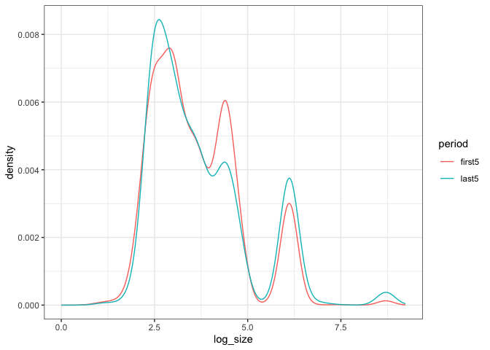
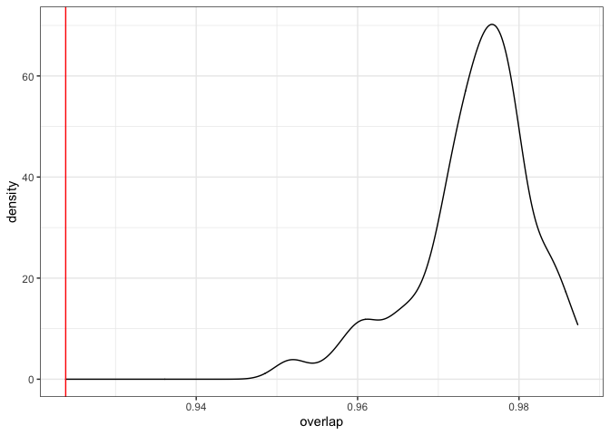
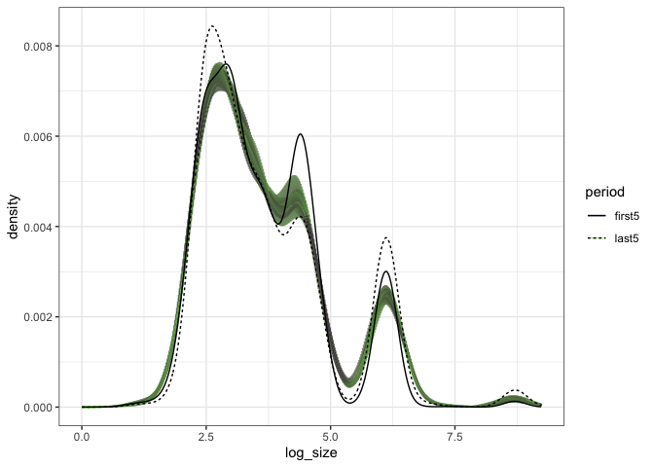
Left: Simulated ISDs from the combined ISD, and actual ISDs (dotted lines)
Upper left: ISDs for first and last 5 years
Upper right: Distribution of overlap for sims and actual overlap (red line).
Actual overlap = .92 of a max of 1.
The ISD has shifted detectably, although note that it’s a very small absolute shift!

Slide 12
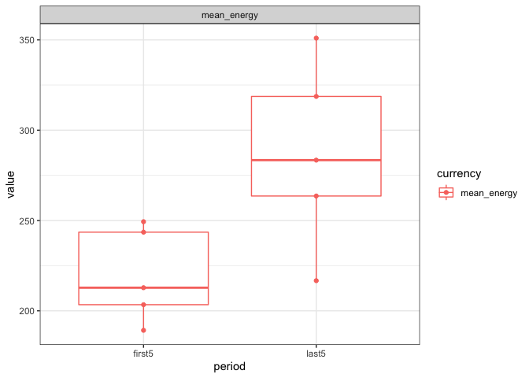
Detecting directional shifts in the ISD:
A directional shift results in a change in mean per capita energy use, E/ N.
To compare directly to ISD comparisons, compare E/N from first and last five year periods
For continuous time, use GAM method as with N and E separately (see next)
Boxplot of first and last 5 years mean energy
Wilcoxon p = 0.031, t-test p = 0.041
Means = 219, 286; ~30% increase
A directional shift means E is technically decoupled from N

Slide 13
Detecting changes in E and N:
Fit a GAM to E or N
Extract the 95% CI for the variable at the beginning and end of the timeseries
Yields an estimate of the change, with uncertainty
Not biased to 0
Not constrained to a linear trend
Intuitive estimate of the magnitude of change
Comparable across different absolute values for E and N

Slide 14
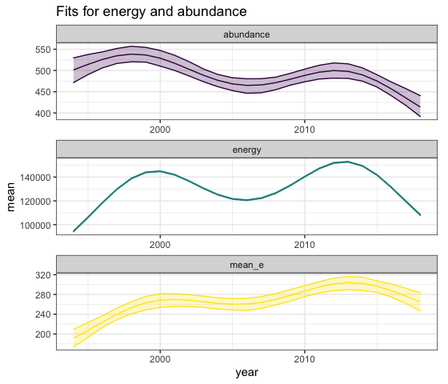
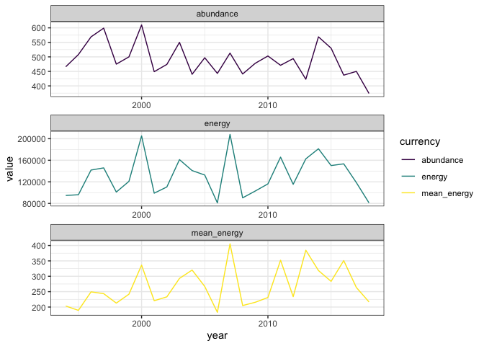
Left: actual values for energy, abundance, and mean energy. Right: GAM fits

Slide 15
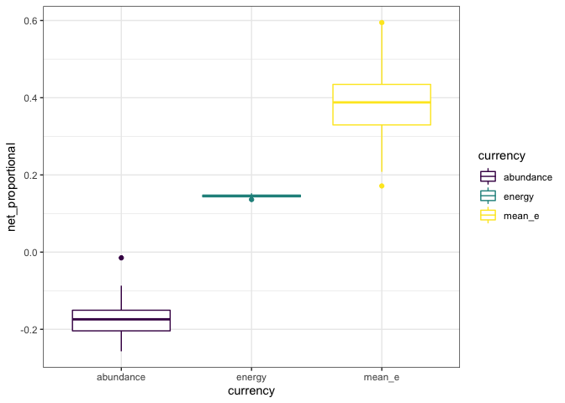
Proportional change from GAM fits.
Abundance: 17% decrease (9-23% decrease)
Energy: 14% increase (13-15% increase)
Mean energy: 38% increase (21-57% increase)

Slide 16
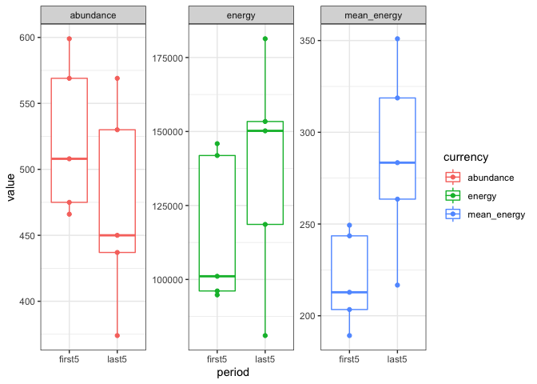
For energy, Wilcox p = .3, t-test p = .34
For abundance, .24, .27
For mean energy, .03, .04

Slide 17
This site (New Hartford, CT) has:
Had the ISD shift detectably – although note that a detectable shift is still very small!
The shift results in a slight increase in mean metabolic rate
Using GAMs, we find a slight increase in energy use compared to a decrease in abundance. (t-tests, etc not significant)
At scale, we can ask if
ISDs are shifting
Shifting ISDs are decoupling E from N
E and N are increasing or decreasing, and at what magnitude

