Slide 1
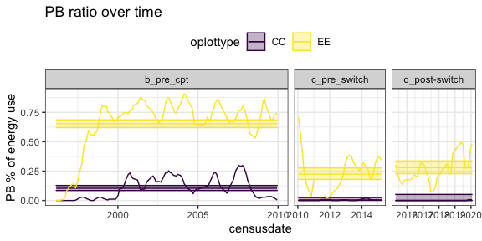
Takeaways –
PB has declined sharply
A decline to ~0 on controls
Still around 25% of EE energy
Methods -
Treatment-level means
All plot types, only CC and EE shown
PB energy / total treatment energy
Quasibinomial GLM, ~ timeperiod

Slide 2
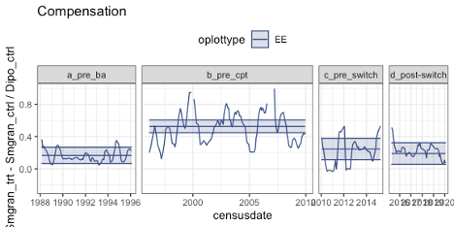
Result –
Compensation has declined to comparable to pre—1996
Means: .16; .52; .24; .19
Interpretation –
No other species has stepped up to compensate for PB
Despite the community-wide shift favoring small granivores, there is no increase in the proportion of Dipo resources that they can absorb
Methods -
Treatment-level means
All plot types, only EE shown
(SG_EE – SG_CC) / Dipo_CC
GLS, ~ timeperiod + autocorrelation

Slide 3
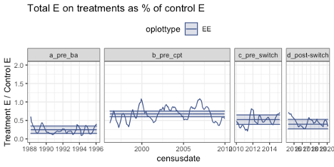
Takeaways –
Since 2010, a (weak) decrease in the ratio of EE to CC energy use
But still (weakly, on average) greater than pre-1996
Time period means: .25; .67; .52; .39
Significance of contrasts depends on time period breaks
Methods -
Treatment-level means
All plot types, only EE vs. CC shown
Total energy on EE / total energy on CC
GLS, ~ timeperiod + autocorrelation

Slide 4
No change in tiny granivore compensation
Despite a sitewide shift favoring small granivores, they have not increased the share of Dipo resources that they can access
Spatial partitioning between open vs. sheltered microhabitats?

Slide 5
Marginal habitat for PB?
PB crashed in 2010 and has not fully recovered, perhaps in an example of a community “reset” event
Combination of dispersal limitation, niche tracking, and competition may explain the time lag and subsequent decline in compensation?
1996-2010: Environmental conditions at Portal overlap enough with PB’s requirements for PB to establish and persist on all plot types, and dominate exclosures
2010-2020: Environmental conditions are no longer sufficiently matched to PB’s requirements for PB to recover from a crash, even though there is a small population present
Fluctuations in the strength of competition – from Dipo and/or PP – may contribute to this
We can’t know if PB would be doing better under these conditions if it didn’t also have to compete with the others

Slide 6
A role for limiting similarity limiting compensation?
This is a case study, and we can’t prove anything. But.
The characteristics that allow PB to compensate for kangaroo rats may be related to the reasons it cannot persist at the site long-term.
PB occupies an intermediate zone – body size, resource use – between the ride-or-die small granivores and krats
Short-term, this may make them susceptible to competitive exclusion
Evolution-term, it may contribute to Portal being marginal habitat for PB. Maybe PB evolved to more closely match habitats where kangaroo rats are less dominant and there is an open slot on the resource use axis

Slide 7
Implications for compensation in niche structured communities
Highly dependent on the trait composition of the community
Fluctuations over time depending on metacommunity dynamics (dispersal) and species’ responses to environmental fluctuations
Limiting similarity may be a significant impediment
Analogs might be less likely to be present in local assemblages. This makes dispersal necessary for compensation and introduces time lags
If analogs are less well-adapted to the local site (than whoever they replace), compensation may be less than complete and may not be durable over time as conditions change
In the wild, shifts in compensation occur over long – decadal – timescales
And emerge from the combination of: local conditions + metacommunity dynamics + evolutionary constraints on the regional species pool

Slide 8
Comments
The use of treatment means feels crude.
One can incorporate between-plot variation using GAMs, but the method is not 100%, and the additional complexity doesn’t yield different results.
Removed the switch from the main narrative
I don’t think there’s standing to really look at priority effects on CE plots
CE plots do not 100% match EE plots post-switch, but they also diverge from CC plots pre-switch.
Concern: is the switch crucial to “novelty”?
Switch might belong in supplement
EC plots match CC plots post-switch, meaning there’s not a long-term divergence in total potential energy use between exclosures and controls

Slide 9
Homes
Report at Ecology
Research paper at Oikos (might be a stretch)
Note at AmNat (also a stretch)
Notes communicate concise points, using either data or theory. Like Major Articles, they present insights of broad general significance and interest. Notes, on average, should be no more than 3000 words of text (not including the literature cited) and have no more than three figures and/or tables in print.

Slide 10
Plots showing CE, EC results

Slide 11
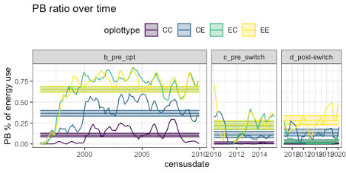
Takeaways –
PB is higher on CE plots than CC plots all the way to the switch
Post switch, it is lower on CE plots than EE plots
Methods -
Treatment-level means
All plot types
PB energy / total treatment energy
Quasibinomial GLM, ~ timeperiod

Slide 12
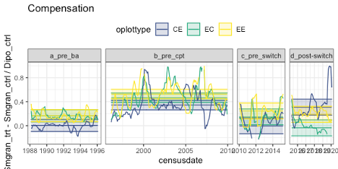
Result –
CE plots have more SG energy use than CC plots do before the switch. They have greater compensation than EE plots post switch.
I think the CE plots are just more small-granivore-friendly than the CC plots
Methods -
Treatment-level means
All plot types
(SG_EE – SG_CC) / Dipo_CC
GLS, ~ timeperiod + autocorrelation

Slide 13
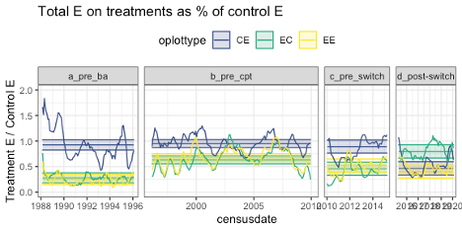
Takeaways –
CE tracks CC to switch and tracks EE post.
Methods -
Treatment-level means
All plot types
Total energy on EE / total energy on CC
GLS, ~ timeperiod + autocorrelation

