Slide 1
Energetic compensation: assemblage-level resource use/energy flux is maintained despite declines or losses of individual species, due to compensatory increases in energy use from other species
May occur as part of neutral dynamics - species are all similar, competing for a fully shared resource base
Or, may occur via functional replacement or complementarity between sets of similar, but not identical species in a more niche-structured community

Slide 2
When observed, energetic compensation…
Is consistent with a zero-sum dynamic - bottom-up constraint on ecological (competition, species richness) and evolutionary (speciation and extinction) dynamics
Means that assemblage-level function is resilient to change at lower levels of organization

Slide 3
Energetic compensation via niche structure is inherently contingent on functional similarity within the community or metacommunity
An assemblage needs to have sets of functionally similar species
Or, if they are not present in a local assemblage, they need to be able to disperse from a regional pool
This introduces the potential for context-dependence and long time lags in energetic compensation

Slide 4
Changing conditions may cause functional similarity to shift over time
Similar species may differ in how they respond to varying conditions
Shifting conditions may modulate the degree to which similar species overlap or partition resource space
Species that are partially redundant under some conditions may not be under others
Compensation may therefore vary over time, even within the same assemblage

Slide 5
If compensation fluctuates under shifting conditions…
Compensation is best thought of as a temporary and contingent phenomenon, not a fixed attribute of an assemblage
Assemblage-level energy use may be very sensitive to species losses
Emphasizes the importance of specifically temporal and metacommunity dynamics
Zero-sum constraint may wax and wane over short timescales, and may manifest more consistently in metacommunity and/or evolutionary dynamics
Notes:
Composition of the metacommunity and dispersal determine if/when assemblage-level function recovers from species loss
Shifting conditions may mean rapid dispersal is necessary for trait-condition matching to keep pace

Slide 6
Manipulative experiments can offer direct evidence for compensation
Manipulations (species removal) with a control community for reference
As direct a metric of energy use as possible
Long-term experiments allow us to test whether compensation is robust
Even as site-wide productivity fluctuate, the treatment-control comparison is valid
Monitoring for long enough to detect signals from shifting conditions
And to capture potential compensatory effects via natural metacommunity processes
Notes:
I would prefer to dodge BEF as much as I can.

Slide 7
Portal has provided some of the strongest evidence of compensation
Partial compensation by “tiny” granivores (1977-1996)
Near-complete compensation from PB, a “small” granivore (1996-?)
The compensation observed at Portal appears to have been
Strongly niche-structured
Achieved via functional similarity - not equivalence
In large part, contingent on dispersal from the metacommunity

Slide 8
Over the 40 years, we have seen conditions change with pronounced effects on the rodents
Long-term environmental shifts and rapid reorganization events coinciding with environmental perturbations
Since the PB compensation effect was observed
An ongoing transition from grass to shrubland
A rapid shift in composition coinciding with a drought in 2010
Changes in composition but not gains or losses from the local assemblage

Slide 9
We use the long-term experiment to test whether the energetic compensation effects observed in past decades have persisted despite fluctuations in biotic and abiotic context
We use a new set of manipulations, implemented in 2015, to test whether
Compensation occurs directly tied to the manipulations
Legacy effects result in divergent compensatory effects between long-term and new exclosure plots*
Notes:
This is not figuring large in the current framing because I honestly don’t think there will be, and if there are, we may be limited in what we can say about why. So my current thinking is that conversation about legacy effects would be more for post-hoc “maybe this helps explain it” analyses and discussion fodder, rather than setting up a strong logical test of ideas.
We can measure plant community composition and possibly seed size as different initial conditions, but of course there’s much more that the rodents are aware of

Slide 10
Specifically, we ask:
Long-term exclosures
Do we continue to see compensatory gains in energy use from small granivores on exclosure plots?
Does the magnitude of these gains still approximately make up for the missing kangaroo rats?
Which groups are responsible for these gains?
New exclosures
Following kangaroo rat removal, do we see compensatory gains from small granivores? Does it make up for kangaroo rat removal?
Do the long-term exclosures and new exclosures converge or have differing responses?

Slide 11
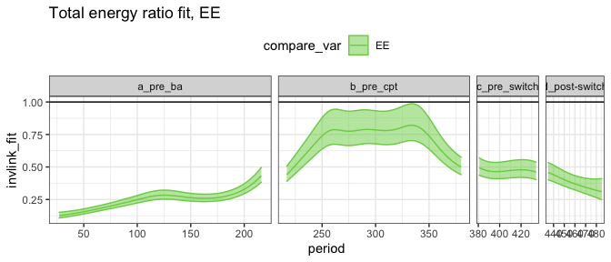
Ratio of total energy use on exclosure plots to controls
Near-compensation from 1996-2010
Increasing discrepancy since 2010, approaching the discrepancy seen in the early 1970s.
Compensatory effect seems to have weakened, even with PB present
By era: 24%; 73%; 43%; 39%
Horizontal line is 1

Slide 12
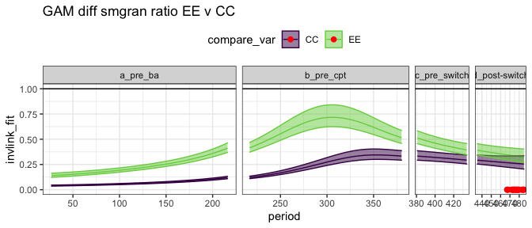
Small granivore (non-Dipo) energy use as % of total control energy use, for small granivores on exclosures and controls
Difference between exclosures and controls reflects compensatory gains by small granivores
In a.: Partial compensatory effect
In b.: Bailey’s, near full compensation
In c, d: Weakened to nonexistent compensatory effect.
Horizontal line is 1
Red is where GAM smooths overlap
GLS and GLM: No significant treatment effect in c, d

Slide 13
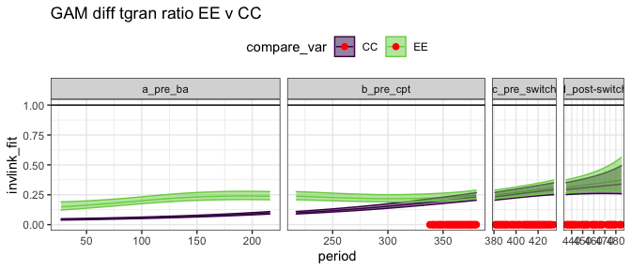
Tiny granivore (non-Dipo and non-PB) energy use as % of total control energy use
Partial compensatory effect in a.
No (net) effect b, c, or d
Horizontal line is 1
Red is where GAM smooths overlap
GLS and GLM: No significant treatment effect in b, c, or d
Notes:
Sometimes when you break this down by plot you find that post switch tinygran e on EE, and esp CE, exceeds controls. But not by as much as in the beginning.

Slide 14
Partial compensation in a
Near-full compensation in b, driven by PB
No compensation in c, d
Decline in compensation coincident with PB decline
Long-term decline in compensatory effect from tiny granivores.
PB may have suppressed others in 90s, but less likely now
Suggests long-term shift in degree of overlap between Dipo and tiny gran, simultaneous with sitewide increase in tiny gran.
Resulting in Dipo using a smaller % of energy, but being less replaceable

Slide 15
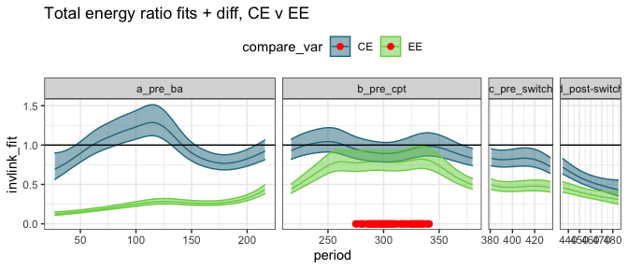
Total energy as a ratio of total control energy, for longterm exclosures and new exclosures
New exclosures drop similar to longterm exclosures following 2015
GLS finds no sig. diff, GLM finds p=0.04

Slide 16
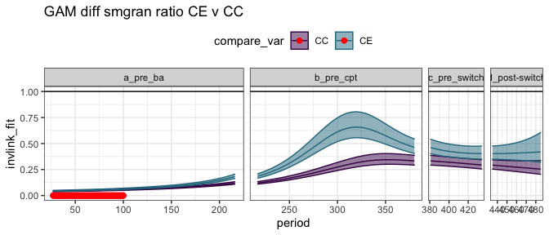
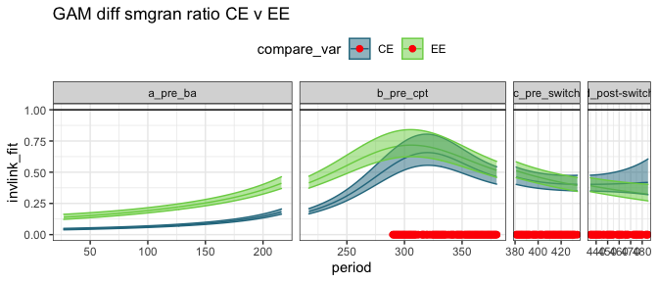
Small granivores on new exclosures v. control (top), and old exclosures v. new (bottom).
GLS finds no sig diff between any treatments in c or d; GLM finds sig diff between new and controls in d, but not between new and longterm.
Small granivore energy use has been higher on new exclosure plots than on control plots since the 90s– when those plots were controls.
Longterm and new exclosures have converged since b.
Notes:
I think you get fuzz around the since the 90s thing.

Slide 17
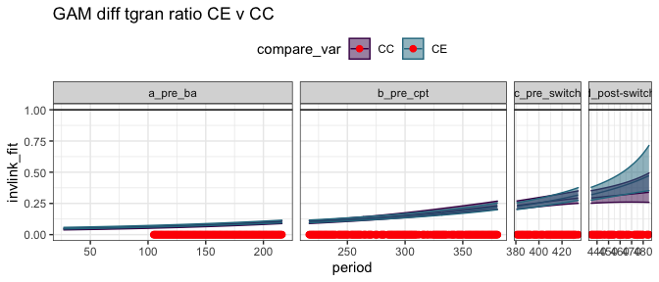
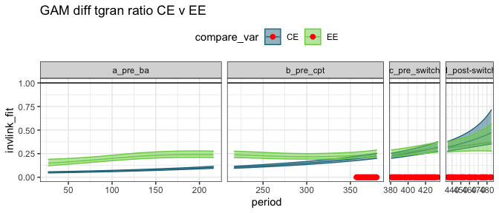
Tiny granivores on new exclosures v. control, and old exclosures v. new.
GLS and GLM find no sig diff between any treatments in b, c, or d
The higher small granivore energy use on new exclosures is mostly PB.
Longterm and new exclosures have converged since late in b.

Slide 18
Long-term and new controls behave mostly consistently following the switch:
Decline in energy use following krat removal
No definitive* compensatory gains from small granivores post 2015
Long-term convergence in tiny granivore energy use on plot types, insensitive to krat removal.

Slide 19
Long-term and new controls behave mostly consistently following the switch:
Decline in energy use following krat removal
No definitive* compensatory gains from small granivores post 2015
Long-term convergence in tiny granivore energy use on plot types, insensitive to krat removal.
*New exclosures have (very ambiguously) more small granivore energy than do controls.
Driven by there being slightly more PB on new exclosures than on longterm.
PB has preferred those plots all along.
Weak standing for legacy effects of kangaroo rats, instead of the lingering effects of whatever makes PB like those plots

Slide 20
Compensatory effects come and go over decades within the same assemblage
Major shifts may be driven by broad drivers: the regional pool, and long-term shifts in how species are using and partitioning resources
Resilience of ecosystem function to species loss is therefore a contingent and long-term phenomenon
Zero-sum/bottom up resource constraints may manifest over the long term and intermittently

