Slide 1
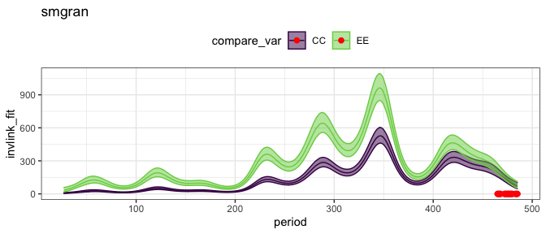
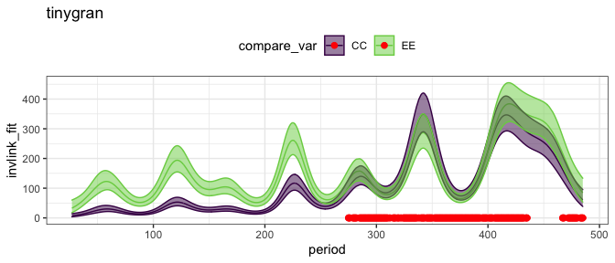
Energy use on trt v control plots over time
Small granivores (incl. pb, top panel) consistently use more energy on exclosure than on control plots early in the TS.
This difference gets smaller and vanishes in the 2010s.
Tiny granivores (excl. pb, bottom panel) use more energy on exclosures in the 1970s and 80s.
The difference for tiny granivores disappears by the late 1990s.

Slide 2
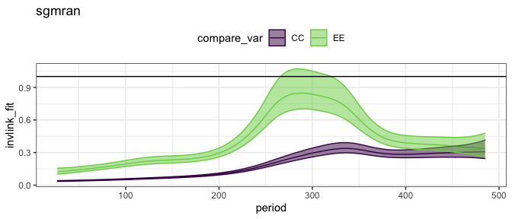
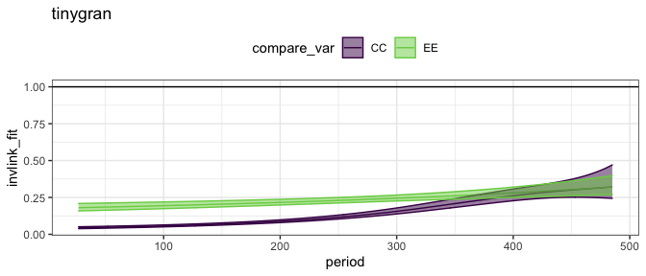
Ratio of energy use on trt:control plots over time
Small granivores approach 100% of control-level energy use in the 90s and early 2000s, but fade out.
Throughout it all, tiny granivores (excl. PB) use a much more constant amount of energy relative to total use on control plots. By the early 2000s, tiny granivores are using nearly the same share of energy on controls as exclosures.

