Slide 1
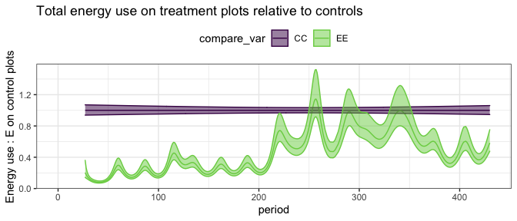
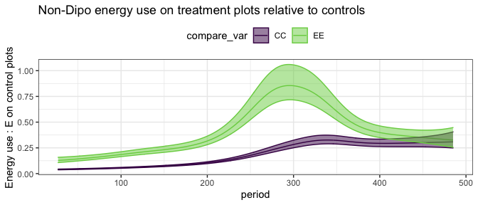
Notes:
Prior instances of compensation effects at Portal
In the 1970s and 1980s, small granivores on exclosure plots use more energy than do small granivores on control plots. (Green line is higher than purple line on bottom plot).
Interpreted as evidence that they compete strongly for shared resources, such that when kangaroo rats are removed, more resources are available for the small granivores to exploit, and the small granivores increase in abundance to use them.
The increase in energy use from small granivores did not make up for the decline in energy use on those plots caused by the loss of kangaroo rats.
If there had been no increases from small granivores (i.e. they maintained the proportion of energy use they do on controls), energy use on exclosure plots would have been 7% that of controls. Increases from small granivores meant that the total energy use on those plots averaged 22% that of controls.
In the 1990’s, small granivore energy use on treatment plots jumped to approach all energy use on control plots. (Green line starts to cross purple on on upper plot, and approaches 1 on lower plot).
PB established at the site in 1996; similar size to krats. PB preferentially uses the exclosure plots.
Interpreted as evidence that PB competes with krats and is sufficiently similar to access resources that other small granivores were not.
Compensatory effect greatly increased – to near 1 – via dispersal of a functionally similar analog.

Slide 2
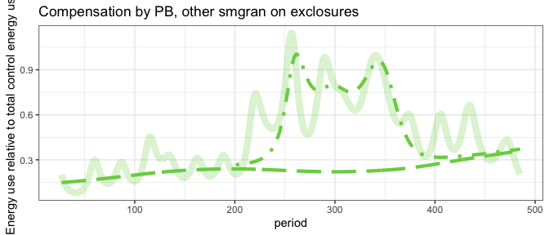
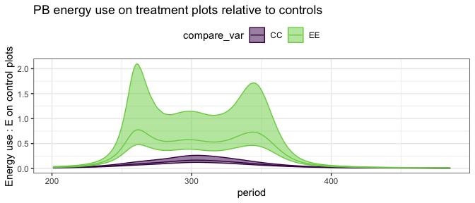
Notes:
PB uses much more energy on exclosure plots than on control plots.
Nearly the entire increase in compensation, following PB arrival, came from PB.
Long dashed line in top panel does not increase, but sketchy dashed line (PB) does.
It may be that PB suppresses other small granivores, so any increase in resources used by small granivores goes to PB.

Slide 3
Notes:
The compensation effect observed in the 2000s declines around 2010, coincident with a decline in PB.
After PB declines, total energy use on exclosure plots is about 40% that on controls, and almost all of that is non-PB species.

Slide 4
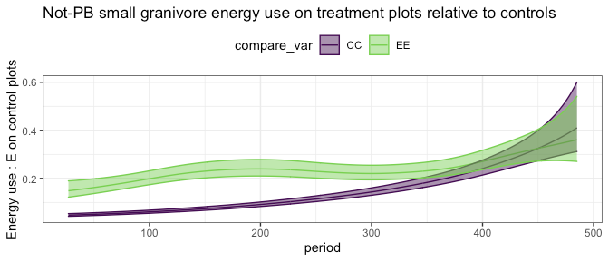
Notes:
There is no longer a difference in energy use by not-PB small granivores between treatments and controls.
It may be that PB makes the exclosures not on net preferable than the exclosures….while PB is dominant
Once PB fades out, there is a slight increase in smaller granivores sitewide.
But there is no longer any difference between exclosures and controls in energy use from smaller granivores. Meaning, unlike in the 70s and 80s, the small granivore energy piece is not expanded on the exclosures.

Slide 5
The dramatic compensation effect was species and context dependent.
Need specifically PB, or at least a PB analog, to disperse.
And needed context to be such that PB was able to functionally approximate a kangaroo rat. PB seem to differ from krats in how it responded to something that happened over the course of the late 2000’s, causing it to lose its grip in the system and fade out.

Slide 6
Also interesting that the closest krat analog is also looking to have the shortest tenure as a major player in the system
Whatever shifts are happening, PB is doing the worst job weathering them

Slide 7
The earlier compensation effect – the partial one – also appears to have faded out.
It may be that PB’s continued presence in the system suppresses the smaller ones, but PB abundances are greatly reduced now.
Removing krats now results in a smaller shortfall, but none of it is made up by compensatory gains from small granivores.
Suggests a shift in the extent to which they’re overlapping in the resources they use or can access. At present, small granivores are not expanding their horizons even with kangaroo rats gone.
Note also that small granivores are a lot more abundant in general now than they were in the early days.
To the extent that the rodents were engaged in a fluid zero-sum dynamic in the 1970s, that seems to be being replaced by a much more structured situation.
Kangaroo rats now have a smaller but less substitutable slice of the pie.

Slide 8
At no point have small species demonstrated the ability to fully compensate for krats.
Recently, their ceiling does not seem much impacted by removing krats.
Something about a shift in how their fundamental niches are lining up?
Fundamental niche – in theoretical ndimensional space
Filter that with environmental conditions, which can change – still calling this a version of the fundamental niche
e.g. maybe now things are shrubby, so small granivores are using shrub resources and krats are foraging in the open. The little ones aren’t going out in the open anyway, so removing the krats has no effect on them.
Or maybe there’s an upper limit on how many pps that doesn’t have to do with resources.

Slide 9
This isn’t to say that krats and smgran don’t interact…
E.g. Bledsoe 2019, Christensen 2019
But that the interactions there are perhaps kind of marginal, and not coming out at the scale of ecosystem function dynamics

Slide 10
Even an assemblage of very similar species, which have at one point been shown to overlap sufficient for compensation, are now sufficiently partitioned/structured that there isn’t a detectable compensatory effect.
Compensation isn’t a fixed property of an assemblage…context matters
Shifts in the compensatory effect may play out at larger spatial and temporal scales. If these shifts are happening driven by things like (rare) colonization events, broad shifts in habitat or climate… they may come and go at long time scales
And if they come and go at long time scales, it means the importance of the zero-sum/resource constraint is intermittent at short time scales
In one sense maybe E isn’t more stable than the species assemblage; in another, maybe it’s more stable in the short term? Maybe “little things” – I’m not sure what I mean by those – don’t

