Slide 2
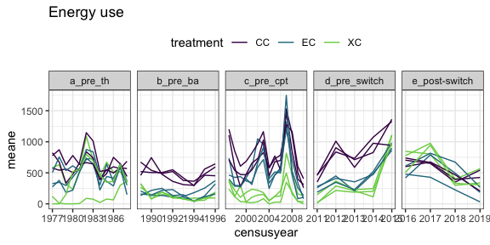
Raw energy use
Notes:
Annual means of energy use for all census periods, on longterm controls (CC), exclosures → controls (EC), removals → controls (XC). Each line is a plot.

Slide 3
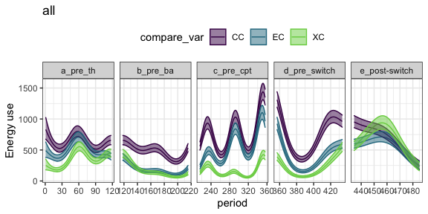
GAM of energy use
GAM, for visualization.
From this plot:
Do treatments and controls diverge in d.?
Do treatment types converge in e.?
Do the time period designations seem reasonable?
Notes:
Predicted values for a GAM fit to the energy use data by treatment. Primarily for visualization.

Slide 4
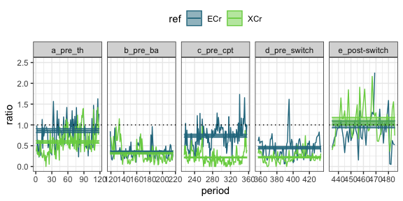
Trt:Ctrl ratio by era (MAIN PLOT)
Ratio of mean total energy on treatment plots to mean total energy on control plots.
ECr = exclosures → controls; XCr = removals → controls.
Horizontal lines are estimates with se from GLM.
For long term exclosures (e.g. ECr here, pre-switch):
Do estimates for d match c? Tells us whether the compensation documented in 2001/2010 papers persisted
How does the estimate for d compare to b? Tells us the degree of compensation pre-PB relative to post-change with PB.
Does the estimate for d match e? In the real data, nothing will have changed about our manipulations for the long-term plots, so we don’t expect a shift. However, if there is, that shift is the baseline compensation effect for when we look at manipulations.
Notes:
Predicted values for a GAM fit to the energy use data by treatment. Primarily for visualization.

Slide 5
Trt:Ctrl ratio by era (MAIN PLOT)
Ratio of mean total energy on treatment plots to mean total energy on control plots.
ECr = exclosures → controls; XCr = removals → controls.
Horizontal lines are estimates with se from GLM.
Comparing the treatments:
Do the estimates for the treatments converge following the switch (panel e)? Differing responses would suggest contingency on treatment effects between longterm plots and controls.
Where do the estimates fall post-switch? Do they both approach controls, both underperform controls (estimates <<1), or behave differently?
Notes:
Predicted values for a GAM fit to the energy use data by treatment. Primarily for visualization.

Slide 6
Contribution of PB, PP, and other smgmran to compensation
If PB declines and compensation declines, is the decline in compensation proportional/attributable 1:1 with the decline in PB?
I.e. does the ratio of trt/control post PB decline ~ the ratio of smgran-not-PB on control/ total control pre PB decline?
Notes:
Should perhaps switch this to % of energy use by PB, because absolute abundance will fluctuate

Slide 7
Comparison of smgran composition
Do longterm and new exclosures have the same post-switch smgran communities?
If they match in E but differ in species composition… is there a ceiling on smgran E that can be reached multiple ways
If the differ in E and in composition, might be possible to show who’s accounting for the difference…e.g. if PP likes longterm exclosures but not new exclosures, or something. Might be hard to pull apart.

