Slide 1
Energetic compensation: assemblage-level resource use/energy flux is maintained despite declines or losses of individual species, due to compensatory increases in energy use from other species
May occur as part of neutral dynamics - species are all similar, competing for a fully shared resource base
Or, may occur via functional replacement or complementarity between sets of similar, but not identical species in a more niche-structured community

Slide 2
When observed, energetic compensation…
Is consistent with a zero-sum dynamic - bottom-up constraint on ecological (competition, species richness) and evolutionary (speciation and extinction) dynamics
Means that assemblage-level function is resilient to change at lower levels of organization

Slide 3
Energetic compensation via niche structure is inherently contingent on the functional composition of the community and metacommunity
The assemblage needs to have sets of functionally similar species
Or, if they are not present in a local assemblage, they need to be able to disperse from a regional pool
This introduces the potential for context-dependence and long time lags in energetic compensation

Slide 4
It is also potentially contingent on fluctuating environmental conditions
Functionally similar species may differ in how they respond to varying conditions
Species that are partially redundant under some conditions may not be under others
Changing conditions may cause compensation to break down over time, even within the same assemblage

Slide 5
If compensation breaks down under shifting conditions…
Compensation is best thought of as a temporary and contingent phenomenon, not a fixed attribute of an assemblage
Assemblage-level energy use may be very sensitive to species losses
Emphasizes the importance of specifically temporal and metacommunity dynamics
Zero-sum constraint may wax and wane over short timescales, and may manifest more consistently in metacommunity and/or evolutionary dynamics
Notes:
Composition of the metacommunity and dispersal determine if/when assemblage-level function recovers from species loss
Shifting conditions may mean rapid dispersal is necessary for trait-condition matching to keep pace

Slide 6
Manipulative experiments can offer direct evidence for compensation
Manipulations (species removal) with a control community for reference
As direct a metric of energy use as possible
Long-term experiments allow us to test whether compensation is robust
Even as site-wide productivity fluctuate, the treatment-control comparison is valid
Monitoring for long enough to detect signals from shifting conditions
And to capture potential compensatory effects via natural metacommunity processes
Notes:
I would prefer to dodge BEF as much as I can.

Slide 7
Portal has provided some of the strongest evidence of compensation
The compensation observed at Portal appears to have been
Strongly niche-structured
Achieved via functional similarity - not equivalence
Contingent on dispersal from the metacommunity

Slide 8
Over the 40 years, we have seen conditions change with pronounced effects on the rodents
Long-term environmental shifts and rapid reorganization events coinciding with environmental perturbations
Since the compensation effect was observed
An ongoing transition from grass to shrubland
A rapid shift in composition coinciding with a drought in 2010
Changes in composition but not gains or losses from the local assemblage

Slide 9
We use the long-term experiment to test whether the energetic compensation observed 1996-2007 has persisted despite fluctuations in biotic and abiotic context
We use a new set of manipulations, implemented in 2015, to test whether legacy effects result in divergent compensatory effects between long-term and new exclosure plots*
Notes:
This is not figuring large in the current framing because I honestly don’t think there will be, and if there are, we may be limited in what we can say about why. So my current thinking is that conversation about legacy effects would be more for post-hoc “maybe this helps explain it” analyses and discussion fodder, rather than setting up a strong logical test of ideas.
We can measure plant community composition and possibly seed size as different initial conditions, but of course there’s much more that the rodents are aware of

Slide 10
Specifically, we ask:
Does energy use on long-term exclosures still approximate energy use on controls?
Does energy use on the new exclosures approximate controls following krat removal?
Do the long-term exclosures and new exclosures converge or have differing responses?

Slide 11
And some follow-ups:
If the compensation effect persists:
Is it still coming from PB, or has a different species taken over?
If longterm and new exclosures diverge:
Can we detect differences in initial conditions that offer intuition why?
Vegetation community, seed size, non-krat rodent composition

Slide 12
Planned analyses:
GAMs of total energy use, primarily for visualization
Compare treatments to controls in total energy use (ratio) in distinct time periods:
Pre-PB arrival, from PB arrival until 2010 (drought + changepoint), from 2010 until new manipulations in 2015, and from 2015-2020
GLM or GLS
Compare PB on treatments and controls in the same time periods
GLM or GLS
Compare plant communities in different treatments immediately preceding manipulations
pCCA, possible seed size

Slide 13
Demo plots (next slides) use Christensen (2019) plots!!

Slide 14
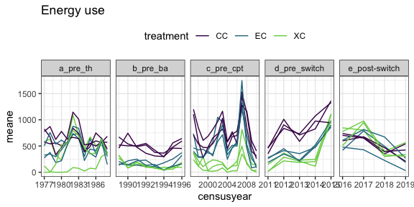
Notes:
Annual means of energy use for all census periods, on longterm controls (CC), exclosures → controls (EC), removals → controls (XC). Each line is a plot.

Slide 15
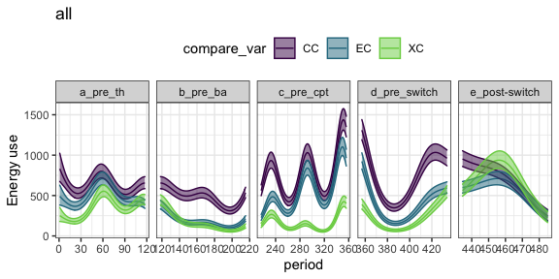
GAM, for visualization.
From this plot:
Do treatments and controls diverge in d.?
Do treatment types converge in e.?
Do the time period designations seem reasonable?
Notes:
Predicted values for a GAM fit to the energy use data by treatment. Primarily for visualization.

Slide 16
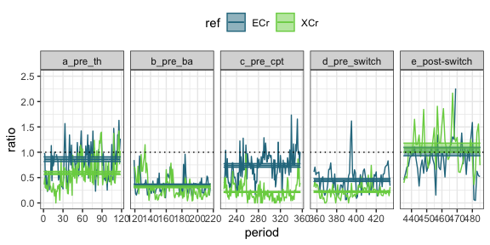
Ratio of mean total energy on treatment plots to mean total energy on control plots.
ECr = exclosures → controls; XCr = removals → controls.
Horizontal lines are estimates with se from GLM.
For long term exclosures (e.g. ECr here, pre-switch):
Do estimates for d match c? Tells us whether the compensation documented in 2001/2010 papers persisted
How does the estimate for d compare to b? Tells us the degree of compensation pre-PB relative to post-change with PB.
Does the estimate for d match e? In the real data, nothing will have changed about our manipulations for the long-term plots, so we don’t expect a shift. However, if there is, that shift is the baseline compensation effect for when we look at manipulations.
Notes:
Predicted values for a GAM fit to the energy use data by treatment. Primarily for visualization.

Slide 17
Ratio of mean total energy on treatment plots to mean total energy on control plots.
ECr = exclosures → controls; XCr = removals → controls.
Horizontal lines are estimates with se from GLM.
Comparing the treatments:
Do the estimates for the treatments converge following the switch (panel e)? Differing responses would suggest contingency on treatment effects between longterm plots and controls.
Where do the estimates fall post-switch? Do they both approach controls, both underperform controls (estimates <<1), or behave differently?
Notes:
Predicted values for a GAM fit to the energy use data by treatment. Primarily for visualization.

Slide 18
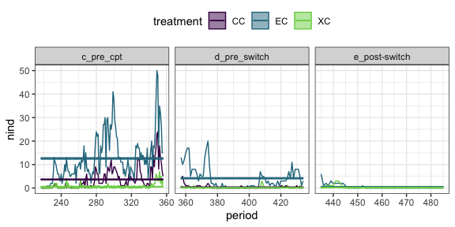
Total number of PB caught in each time period, with estimates from GLM
If compensation did not persist, and PB declines, suggests compensation was temporary so long as PB, specifically, was able to substitute
If compensation did persist despite PB declining, who stepped up?
Does PB on new exclosures converge to PB on longterm? If they don’t, and the plots diverge in E, this may be an explanation. If they don’t, but the plots converge in E, who stepped up in the other plots?
Notes:
Should perhaps switch this to % of energy use by PB, because absolute abundance will fluctuate

Slide 19
Vegetation analyses:
pCCA on plant communities leading up to switch. Data will be very similar to that in Christensen, and pCCA follows both Christensen and Supp
Possible test for differences in seed size distributions. Data from Valone/kew, but dependent on how many contemporary species have seed size data available.
These are indirect at best, and not finding a difference doesn’t mean there isn’t a difference between the treatments in ways that matter to the rodents.

