Slide 1
Hold these things gently….
We work with treatment means for now. Consistently across analyses. For some it is easy to incorporate plot, for others not. I have been checking to see when and where this matters.
When I can I am also adding autocorrelation, and checking if it matters.
What really matters is the big questions. What is your denominator?

Slide 2
General things I think are true…
PB has declined since 2010, but is still present
The total energy on treatments v controls has declined, but still exceeds pre-1996
Compensation has declined to comparable to pre-1996
The difference in small granivores between treatments and controls has gotten smaller

Slide 3
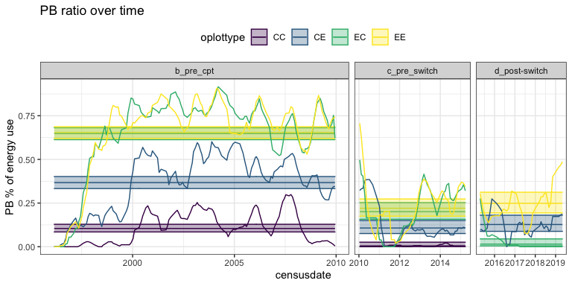
Fig/analysis notes:
Controls for d. are removed because they are all 0. Including them throws the whole model off. Removing controls entirely does not impact the estimates for other treatment types.
Accounting for plot lowers the estimate for EE in d. and does not change other outcomes.
Using a GLS to add an autocorrelation results in negative predictions, only changes the significance of b-c for CE, and is making a negative prediction for CE in c.
PB energy use as a % of treatment-level energy use over time. Lines are a moving average; ribbons are the estimated means and SE from a GLM.
PB’s contribution to treatment-level energy use has declined for all treatment types since ~2010. On controls it has reached ~0 on controls, and on exclosures it has declined from ~60% to ~20%.
Exclosure → Control plots tracked exclosures until the plot switch and then tracked controls. Control → Exclosure plots do not show a change with the switch, but these as these plots have had more PB than Control plots throughout the timeseries, it is not clear how to interpret the treatment effect there.

