Slide 1
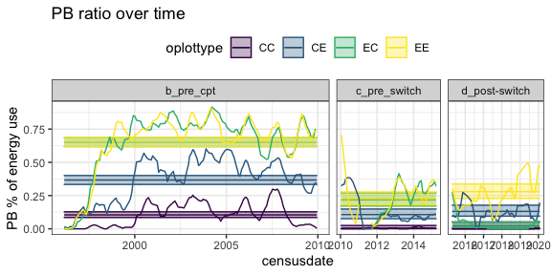
Fig/analysis notes:
Using a GLS to add an autocorrelation results in negative predictions, only changes the significance of b-c for CE, and is making a negative prediction for CE in c.
PB energy use as a % of treatment-level energy use over time. Lines are a moving average; ribbons are the estimated means and SE from a GLM.
PB’s contribution to treatment-level energy use has declined for all treatment types since ~2010. On controls it has reached ~0 on controls, and on exclosures it has declined from ~60% to ~20%.
Exclosure → Control plots tracked exclosures until the plot switch and then tracked controls. Control → Exclosure plots do not show a change with the switch, but as these plots have had more PB than Control plots throughout the timeseries, it is not clear how to interpret the treatment effect there.

Slide 2
Total energy used on treatment plots relative to control plots. Ribbons are means and CIs from a generalized least squares accounting for autocorrelation.
Exclosure means: 25%; 67%; 52%; 40%. C is not sig. diff. from B. D is not sig. diff. from A.

Slide 3
Compensation (Smgran_treatment – Smgran_control divided by Dipo_control). Ribbons are means and CIs from a generalized least squares accounting for autocorrelation.
Exclosure means: 16%; 52%; 24%; 19%. A is not sig.diff. from C or D.
CE plots have higher small granivore abundance than CC plots do in B. After the switch, they eventually outperform EE plots.

Slide 4
Small granivore E on treatments as % of small granivore E on EE plots
Small granivore energy use on non-EE plots relative to EE plots. Ribbons are means and CIs from a generalized least squares accounting for autocorrelation.
Control plots have gotten closer to 1 over time. In C, all the plot types are not significantly different from each other.
While EC plots track exclosures and then track controls, CE plots have higher small granivore (largely PB) energy use than CC plots. They outperform EE plots by the end of D.

Slide 7
General things I think are true…
PB has declined since 2010, but is still present
The total energy on treatments v controls has declined, but still exceeds pre-1996
Compensation has declined to comparable to pre-1996
The difference in small granivores between treatments and controls has gotten smaller

Slide 8
Hold these things gently….
We work with treatment means for now. Consistently across analyses. For some it is easy to incorporate plot, for others not. I have been checking to see when and where this matters.
When I can I am also adding autocorrelation, and checking if it matters.
What really matters is the big questions. What is your denominator?

