Slide 1
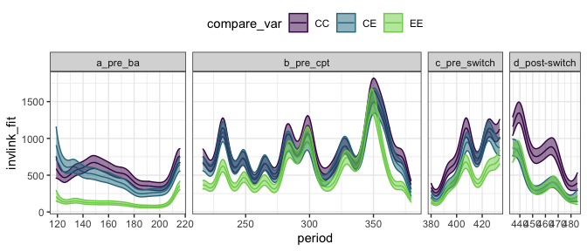
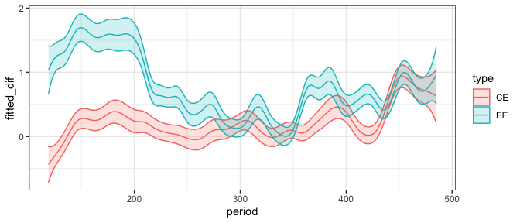
Total energy use on control, exclosure, and switch plots (top) and GAM diffs (bottom).

Slide 2
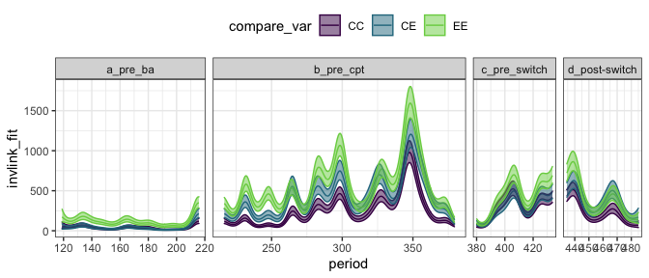
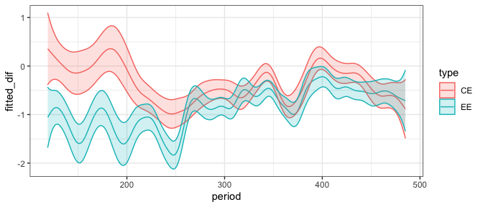
Small granivore energy use on control, exclosure, and switch plots (top) and GAM diffs from controls (bottom).
By the end of the TS, exclosures exceed controls and the diffs do not overlap zero.
The magnitude of the difference seems smaller than at the beginning (but note diffs are on the link scale)

Slide 3
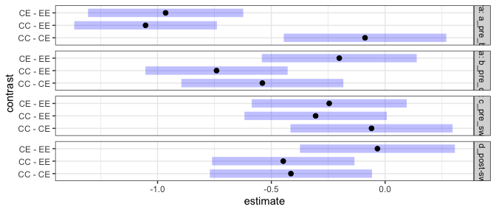
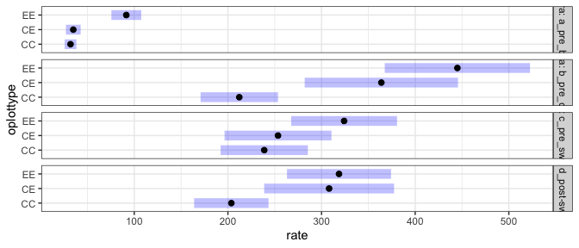
Top: Contrasts from generalized linear mixed model fitting small granivore energy use ~ era + a random effect of plot
Bottom: The means for those contrasts
If blue bar overlaps zero, contrast is not significant.
Exclosures exceed controls at the end. The significance is iffy, but the difference in the means is there.

Slide 4
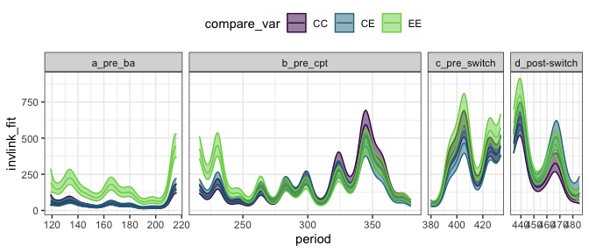
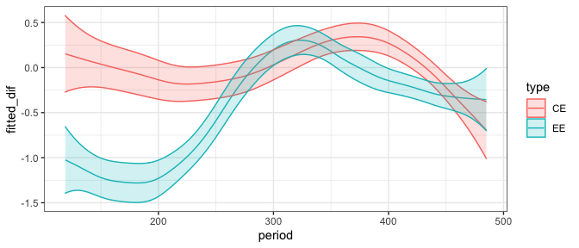
Tiny granivore (no PB) energy use on control, exclosure, and switch plots (top) and GAM diffs from controls (bottom).
As when PB is included, by the end of the TS, exclosures exceed controls and the diffs do not overlap zero. But it’s closer.
Again, the magnitude of the difference seems smaller than at the beginning (but note diffs are on the link scale)

Slide 5
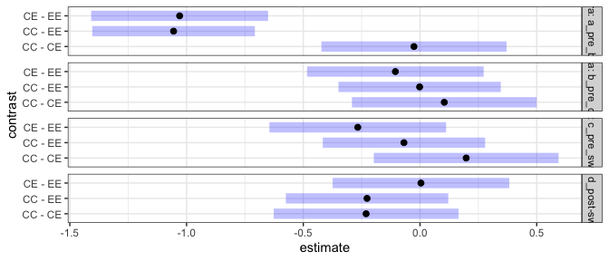
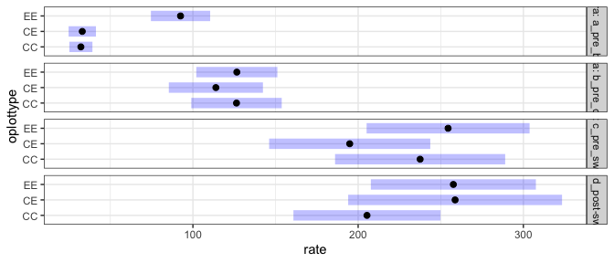
Top: Contrasts from generalized linear mixed model fitting tiny granivore energy use ~ era + a random effect of plot
Bottom: The means for those contrasts
If blue bar overlaps zero, contrast is not significant.
None of the differences are significant after the first time chunk.

Slide 6
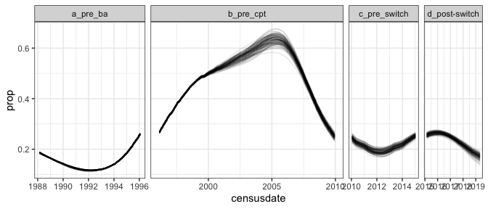
Increase in small granivore energy use on exclosures relative to controls as a proportion of Dipo energy use on controls

