Slide 1



Slide 2
𝚺
Notes:
Total biomass

Slide 3
𝚺
¾
¾
b
b
¾
¾
b
¾
b
¾
b
b
Notes:
Total energy

Slide 4
>
Notes:
Total biomass

Slide 5
≈
Notes:
Total biomass

Slide 6
≈
?

Slide 7
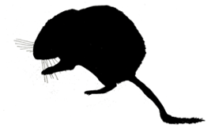
≈
X
≈
✓

Slide 8


≈
X
≈
✓

Slide 9


