Slide 1
DATA-DRIVEN COFFEE PROCUREMENT STRATEGY
Stocking The Neelsie Coffee Hub
This presentation explores optimal coffee selections, regional sourcing strategies, and preferred suppliers. The findings indicate the best options by evaluating a database of expert-reviewed coffees alongside the specific preferences of Stellenbosch University students.
Prepared for the Neelsie Coffee Project by Diaz Sangeve · Student Number - 24991422

Slide 2
METHODOLOGICAL APPROACH
Data Aggregation and Evaluation Strategy
2,095 | 3 | 84-98 | 12
Coffees Reviewed | Expert Reviews Per Coffee | Rating Range | Indicator Words Derived
Data Attributes. The dataset records the roaster, bean origin, roast strength, cost per 100g, an expert rating and three tasting reviews for each coffee.
Indicator Words. The entrepreneur mentioned a student survey of favourite-coffee words but did not supply the list, so we derive the indicators from the reviews. Every review word is ranked by how much its presence lifts the expert rating, and the top 12 are kept.
Validation. Deriving those words on one half of the coffees and scoring the other half, the count of indicator words tracks the expert rating at a held-out correlation of 0.52, so the signal is real and not a circular artefact.

Slide 3
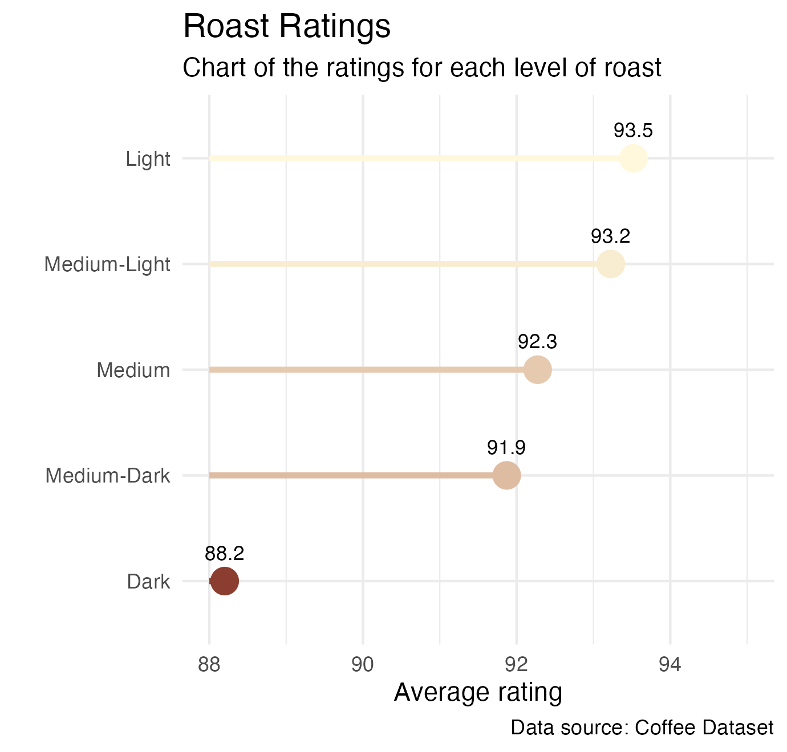
RECOMMENDATION 1 · ROAST
Prioritise Lighter Roasts
Lighter roasts win. Light and medium-light coffees average 93.5 and 93.2, ahead of medium and dark. Light roasting preserves the origin character that the expert reviews consistently reward.Lighter roasts win. Light and medium-light coffees average NA and NA, ahead of medium and dark. Light roasting preserves the origin character that the expert reviews consistently reward.
Optimal inventory strategy. The core range should be built from light and medium-light beans, with a small dark-roast selection kept for specific requests.

Slide 4
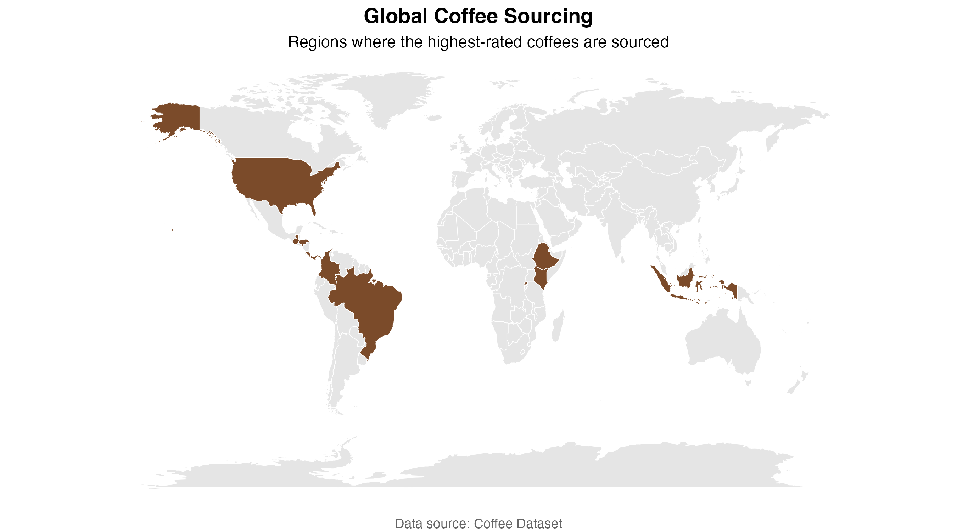
SOURCING
Where the best beans are grown

Slide 5
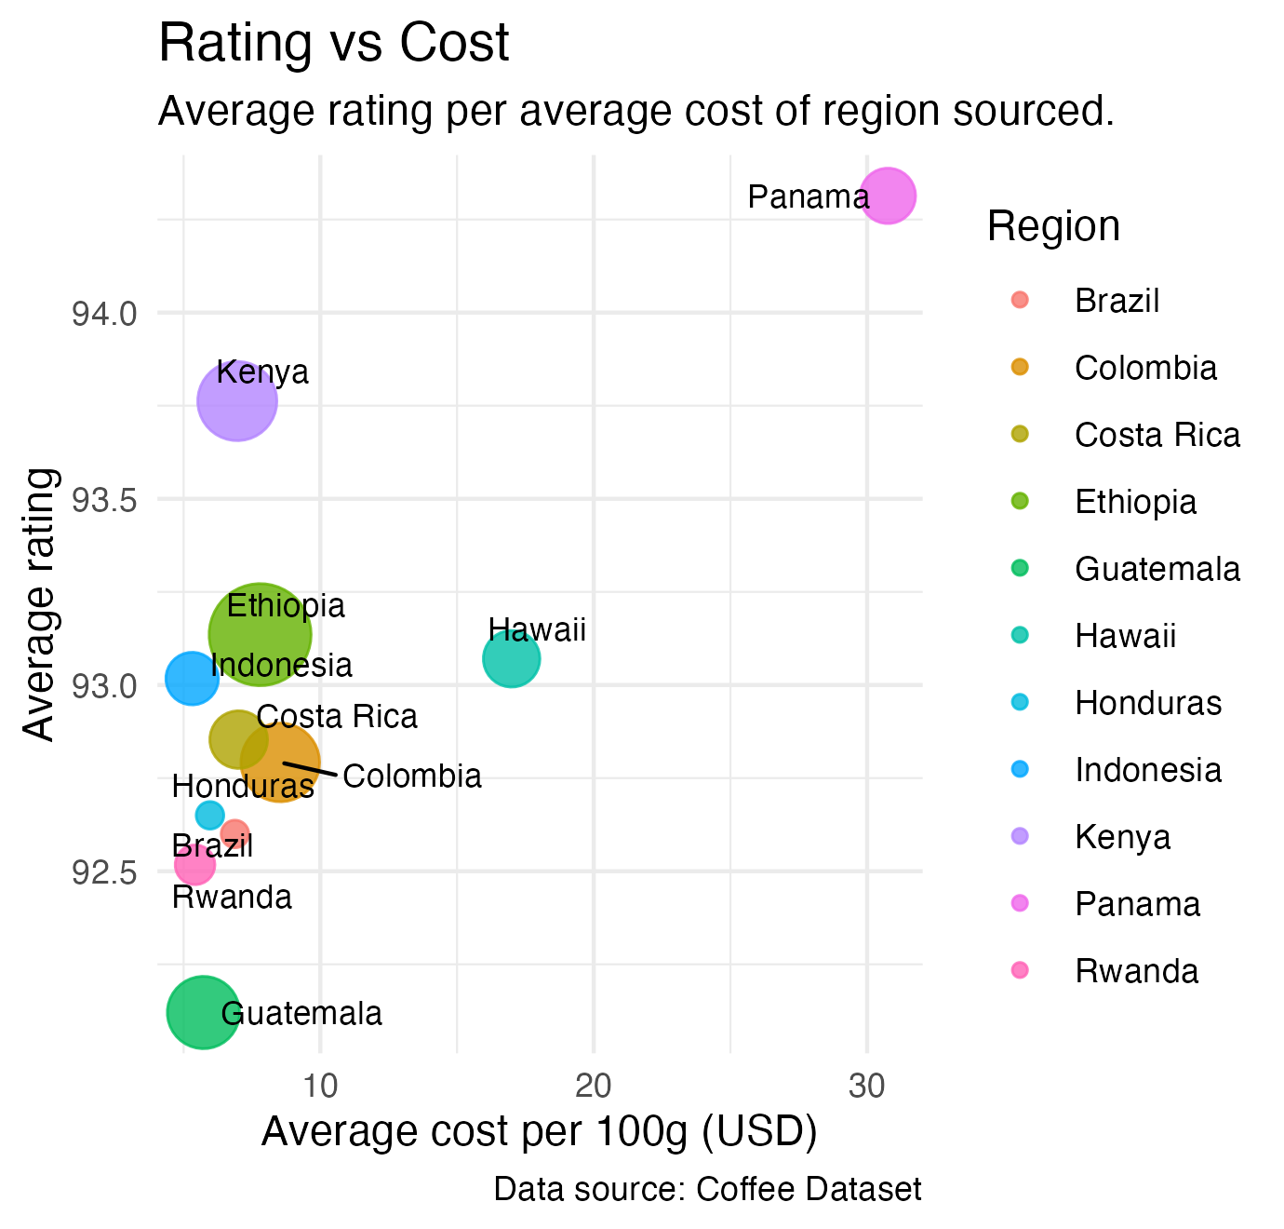
RECOMMENDATION 2 · SOURCING REGION
Where the value lives
East Africa is the sweet spot. Kenya averages 93.8 and Ethiopia 93.1, within a point of Panama's 94.3, yet they cost about $6.96 per 100g against Panama's $30.76. Ethiopia also offers the widest choice, with 355 coffees.
Lead with Kenya and Ethiopia. Make them the backbone of the menu, with a small premium shelf of Panama and Hawaii as showpieces.

Slide 6
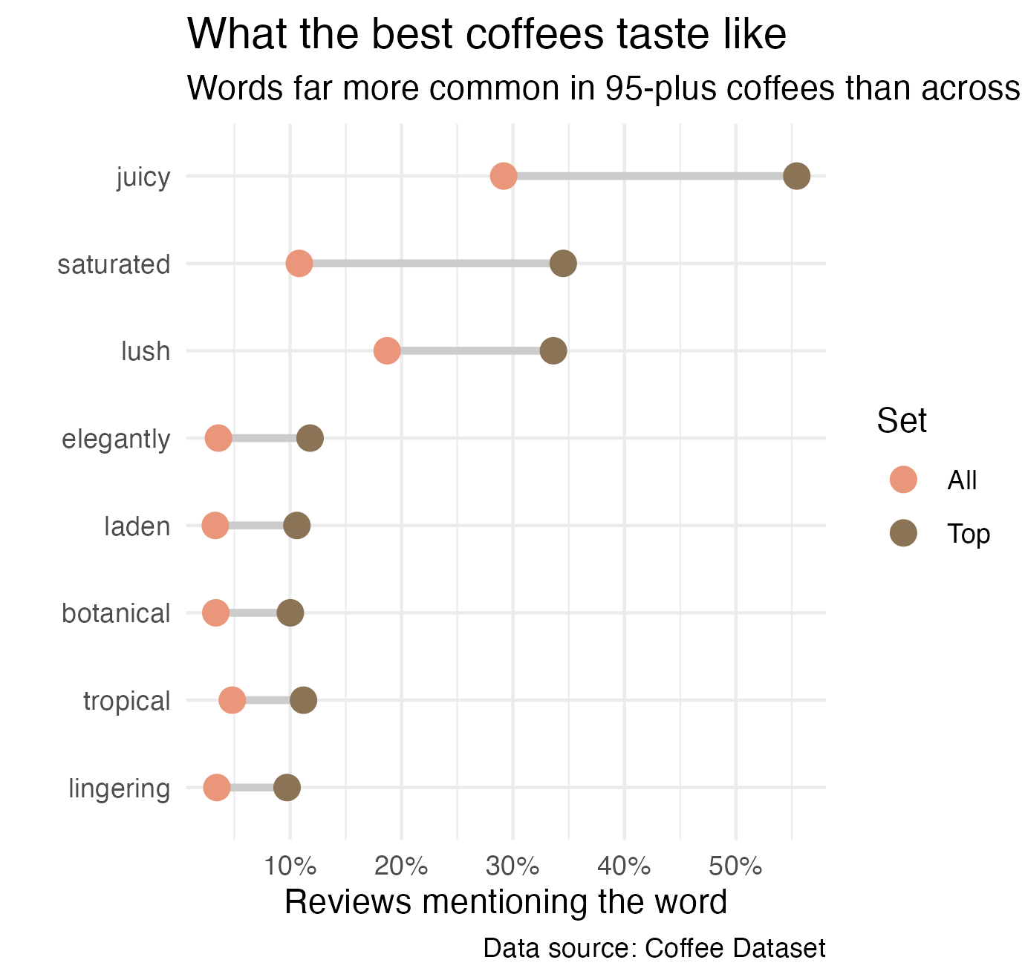
RECOMMENDATION 3 · FLAVOUR PROFILE
What the best cups taste like
The best cups share a profile. Ranking review words by rating lift, the strongest markers are frankincense, elegantly, saturated, juicy, carries, laden. Among coffees rating 95 and up, reviews are about 1.9 times as likely to read juicy and 3.2 times as likely to read saturated.
Buy for these markers. This juicy, tropical, floral-resinous signature is the washed East African profile. When choosing between lots, let words like frankincense, elegantly, saturated break the tie.

Slide 7
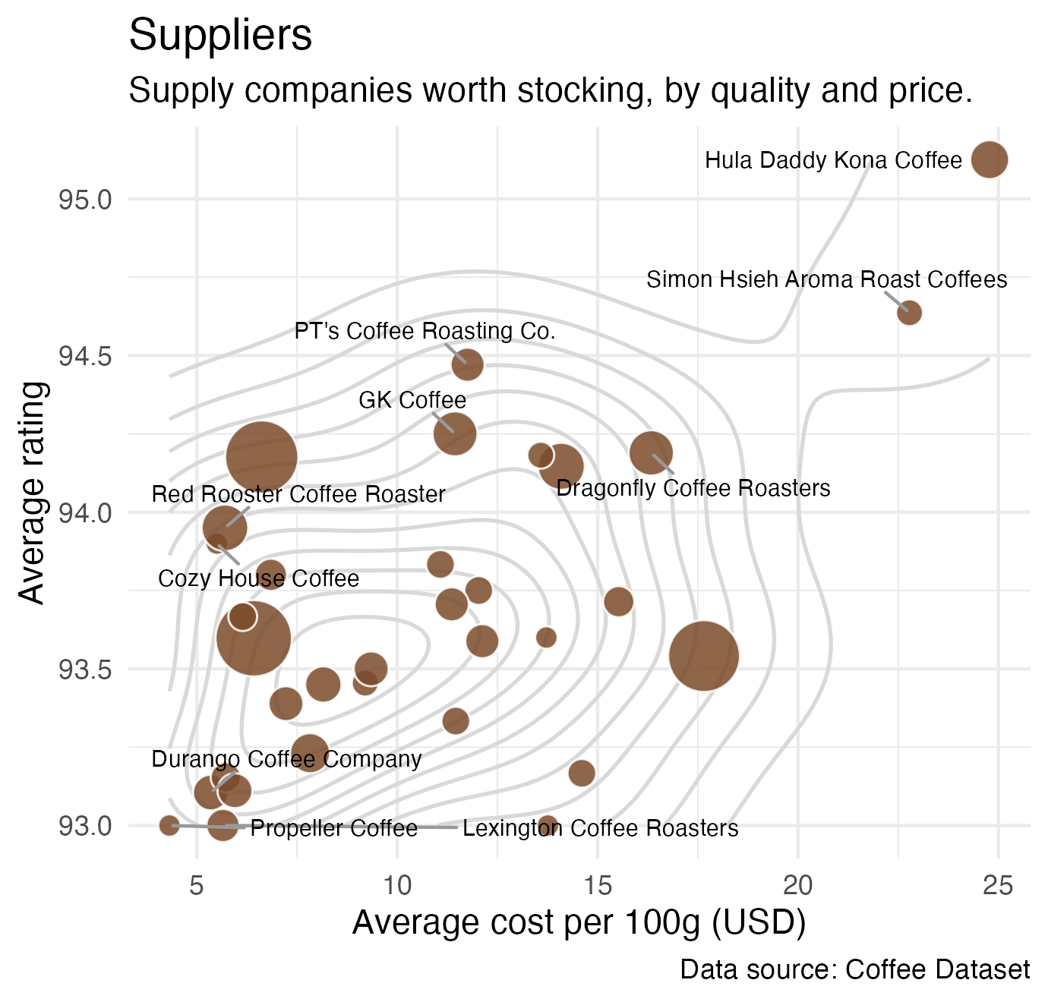
RECOMMENDATION 4 · PREFERRED SUPPLIERS
Strategic Procurement Options
Value champions. Red Rooster Coffee Roaster (94.0 at $5.70), JBC Coffee Roasters (93.6 at $6.42) and Kakalove Cafe (94.2 at $6.62) pair high scores with low prices across deep ranges, so they can anchor the everyday menu.
Premium showpieces. Hula Daddy Kona Coffee (95.1, top-rated), GK Coffee (94.2) and Dragonfly Coffee Roasters (94.2) bring the standout cups for the feature shelf.

Slide 8
PUTTING IT TOGETHER
A starter range for the shop
Shelf | Origin & roast | Why it earns its place | Buy from
Everyday hero | Kenya, light | 93.8 rating at about $6.96, juicy and bright | Kakalove, JBC
Deep bench | Ethiopia, medium-light | 93.1 rating, the widest choice (355 coffees) | JBC, Red Rooster
Value surprise | Indonesia, medium-light | 93.0 rating at the lowest cost, $5.31 | Kakalove, Red Rooster
Premium pour | Panama, light | 94.3 showpiece at $30.76 for the feature menu | Hula Daddy, Dragonfly
Ratings and prices are catalogue averages across the reviewed coffees

Slide 9
THE BUYING RECIPE
Five moves to a shelf that pours above its price
1. Roast. Build the core range from light and medium-light beans, which rate highest and keep the origin character.
2. Region. Lead with Kenya and Ethiopia, 93-plus cups at about a fifth of premium prices.
3. Flavour. Favour lots that read frankincense, elegantly, saturated, juicy, the markers the data ties to the very best.
4. Suppliers. Anchor on Red Rooster Coffee Roaster, JBC Coffee Roasters and Kakalove Cafe for value, with Hula Daddy Kona Coffee and GK Coffee as showpieces.
5. Price. Most of the quality sits near $6 to $7 per 100g, so a strong everyday menu need not be expensive.

