Slide 1

GAMS TUTORIAL
Presenter:
Diba Ravanshid
Dr. Hamid
2024

Slide 2
Table of contents
Page
3
4
5
6
7
Content
What is Gams?
How to install?
Get to know the environment
Supply chain manager
Coding

Slide 3
GAMS
General Algebraic Modeling System
It is used for solving mathematical models and optimizing them.
Due to the importance of optimization and resource limitations in agriculture, engineering, and economics, it has applications in these fields.

Slide 4
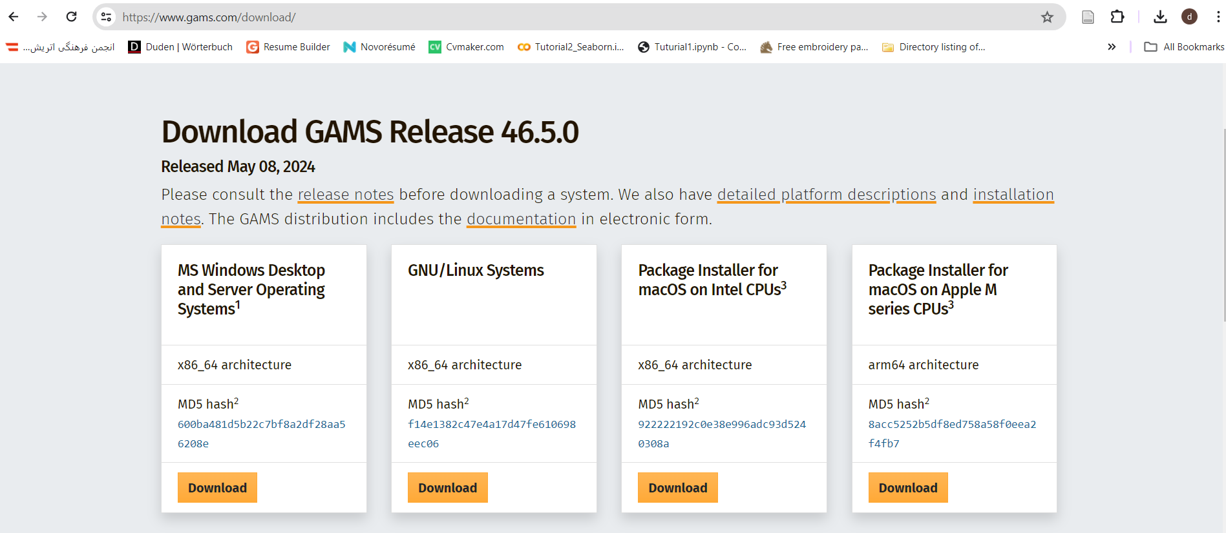
Install GAMS
gams.com

Slide 5
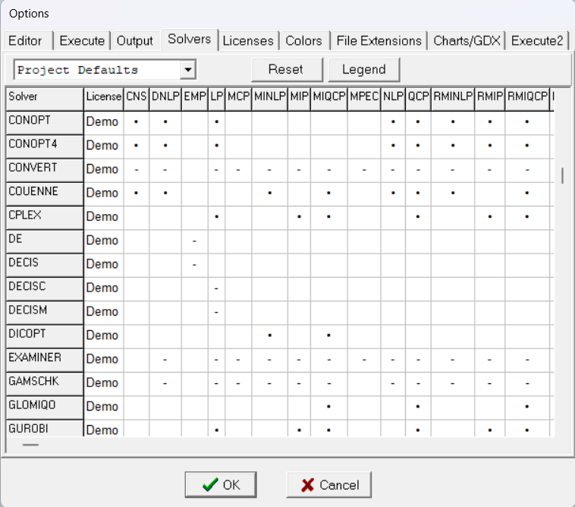
The environment
File
Options
Solvers
It has its own programming language.
To move to the next line, we use Enter.
How to add comments: * at the beginning of the line.
Uppercase and lowercase letters are not different.
Each code has different sections, and each section
ends with a semicolon (;).

Slide 6
Chain supply
k
Customers
i
Firms
Demand
j
Stores
Capacity
1
60
40
70
2
3
100
90
A
S
4
7
7
2
5
2
B
T
5
4
3
3

Slide 7
How to code?
Sets
Parameters
Variables
equations

Slide 8
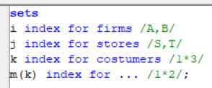
sets
Example:
Indices and the values they can take….
Key points to note: Names can be up to 63 characters long, They must not start with a number or symbol.
Example:
3A
A3
How to write a subset: m is a subset of k.

Slide 9
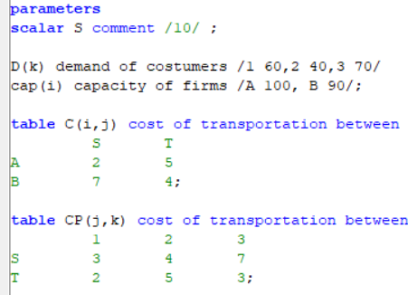
Parameters
Example:
Problem parameters and their values…
The input data is divided into three categories:
- Scalar: without an index
- Parameter: with a one-dimensional index
- Table: with more than one index
Key points to note:
- The default value for parameters is zero.
- We can use "parameters" to define multiple parameters, but we cannot write "tables."
1)
2)
3)

Slide 10
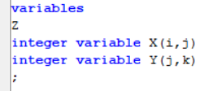
variables
Example:
Problem variables and their indices…….
Key points to note:
- The objective function is defined freely (z).
- For other variables, we must specify whether they are integer, binary, positive, etc.

Slide 11
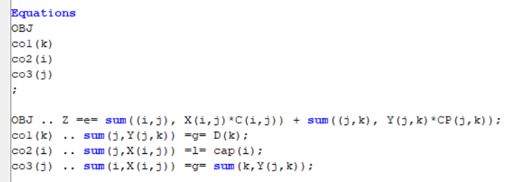
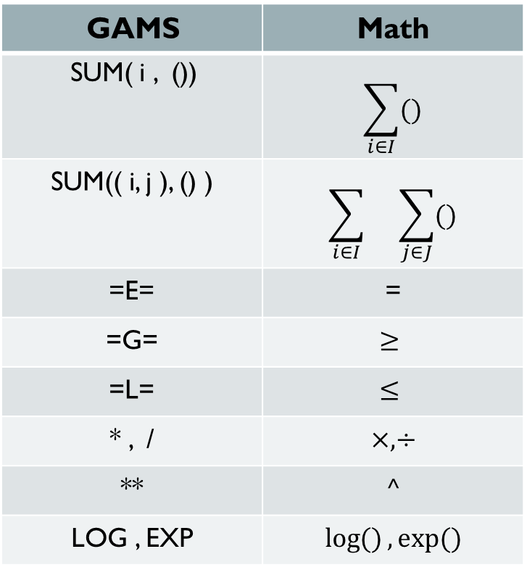
Equations
GAMS | Math
SUM( i , ()) | $$\sum_{i∈I}{()}$$
SUM(( i, j ), () ) | $$\sum_{i∈I}{}\sum_{j∈J}{()}$$
=E= | =
=G= | $$≥$$
=L= | $$≤$$
* , / | $$×, ÷$$
** | $$^$$
LOG , EXP | $$\log{()}, exp⁡()$$
Example:

Slide 12

solve
Example:
Last step………
All the equations
Which model to solve? → Mixed Integer Programming

Slide 13

