Slide 1
DevOps

Slide 2
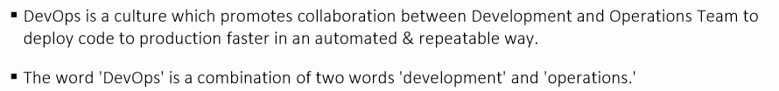
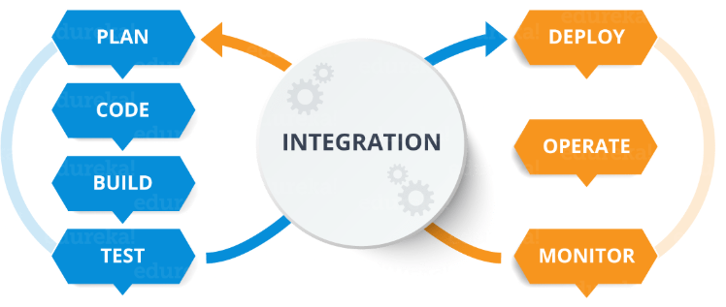
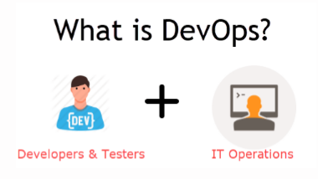
What is DevOps?

Slide 3
What is DevOps?
DevOps is a software development approach which involves continuous development, continuous testing, continuous integration, continuous deployment and continuous monitoring of the software throughout its development life cycle.
This is exactly the process adopted by all the top companies to develop high-quality software and shorter development life cycles, resulting in greater customer satisfaction, something that every company wants.

Slide 4
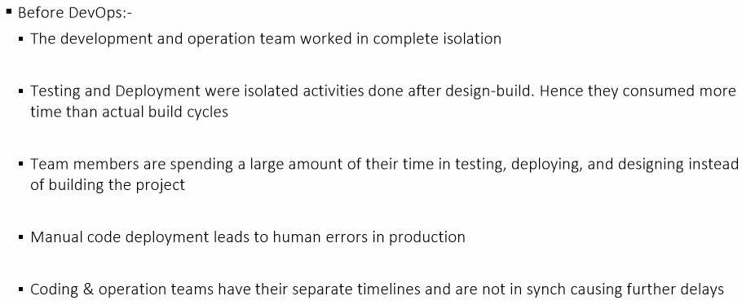
Why Devops?

Slide 5
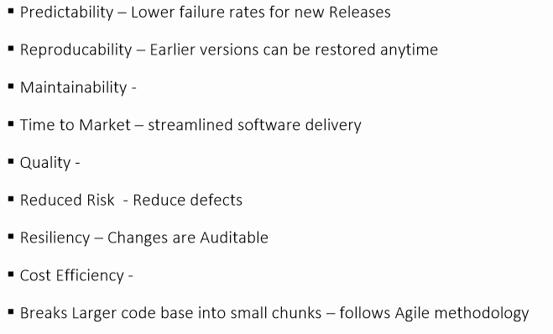
Why Devops?

Slide 6
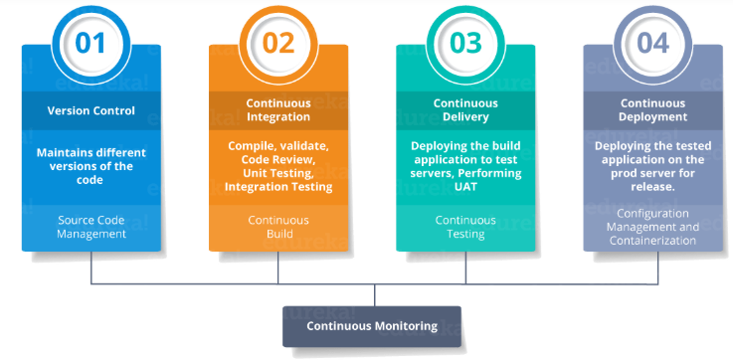
DevOps Stages

Slide 7
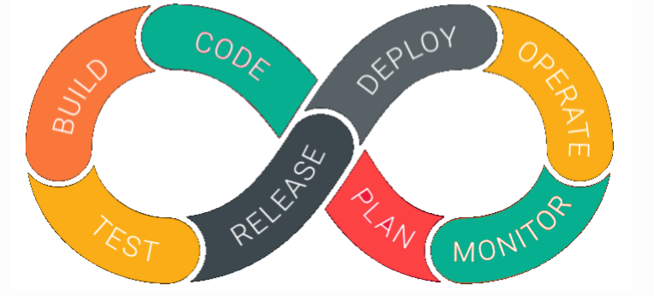
DevOps Lifecycle

Slide 8
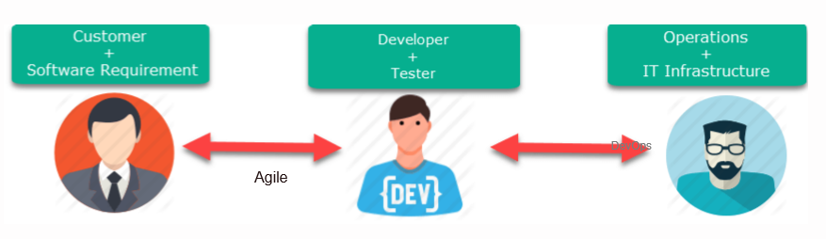
DevOps vs Agile

Slide 9
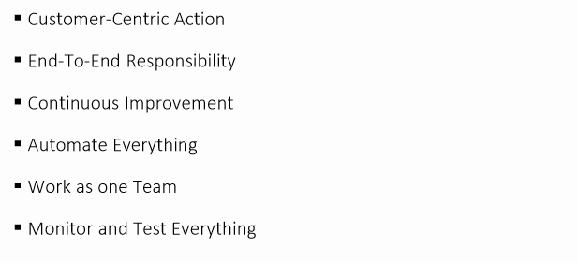
DevOps Principles

Slide 10
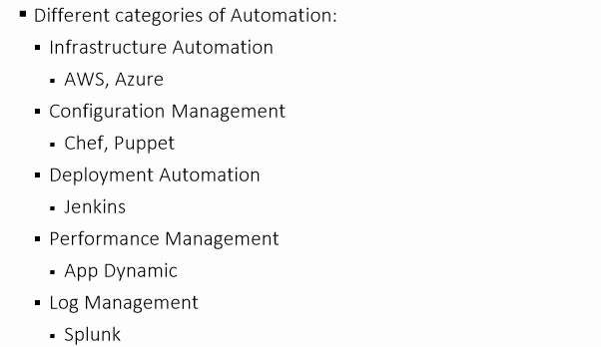
DevOps Automation Tools

Slide 11
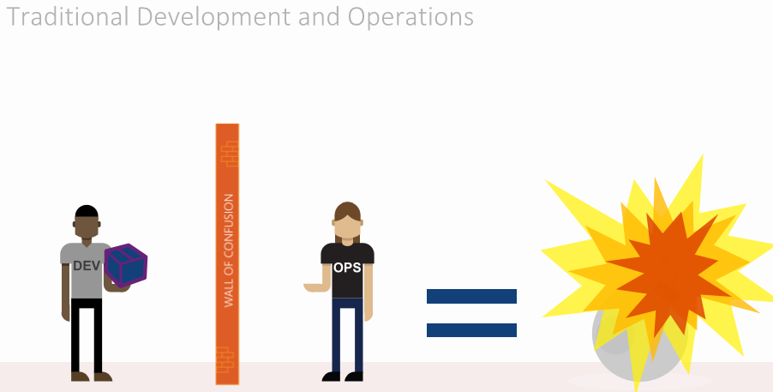
DevOps Automation Tools

Slide 12
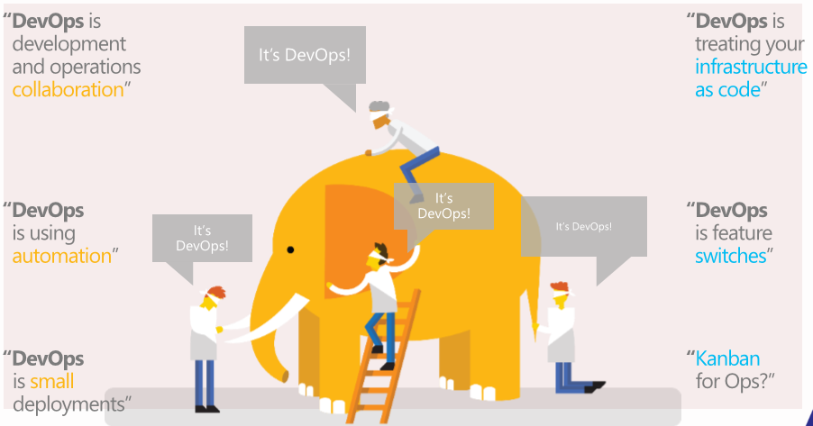
DevOps Automation Tools

Slide 13
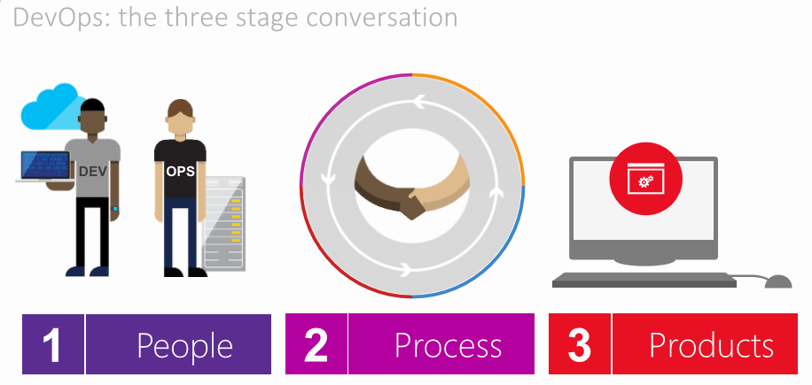
DevOps Automation Tools

Slide 14
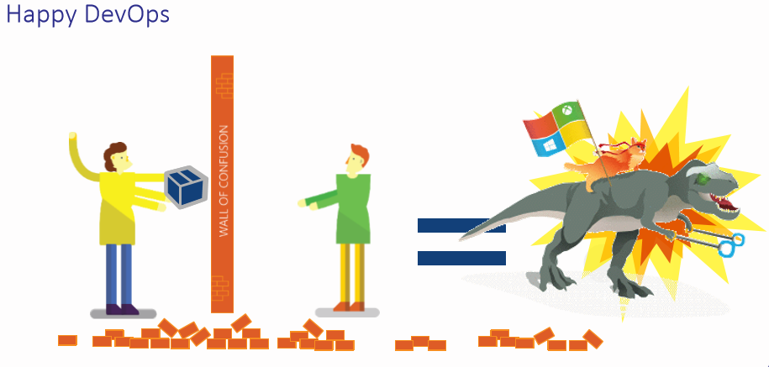
DevOps Automation Tools

Slide 15
What is CI ?
Continuous Integration(CI) is a development and testing phase of the software development.
As developers make changes to software code, these changes are immediately checked into a shared source code.
When the code is checked in, automated build processes and tests are triggered to make sure that the changes did not break the software application.
It helps us to caught coding errors more quickly, and this avoids bugs before code merges into the shared source code.

Slide 16
What is CD ?
Continuous Delivery (CD) means that as coding changes, new feature or bug fixes passes the automated build tests, then we have to do a set of configuration before ship changes to users land and deliver it rapidly as possible.

Slide 17
What is AWS CodeCommit?
AWS CodeCommit is a version control service hosted by Amazon Web Services that you can use to privately store and manage source code in the cloud.
We can state that it's alternative to GitHub only difference is that you can't make your repository public.
CodeCommit has great integration with CodeBuild and CodePipeline over other version control services.

Slide 18
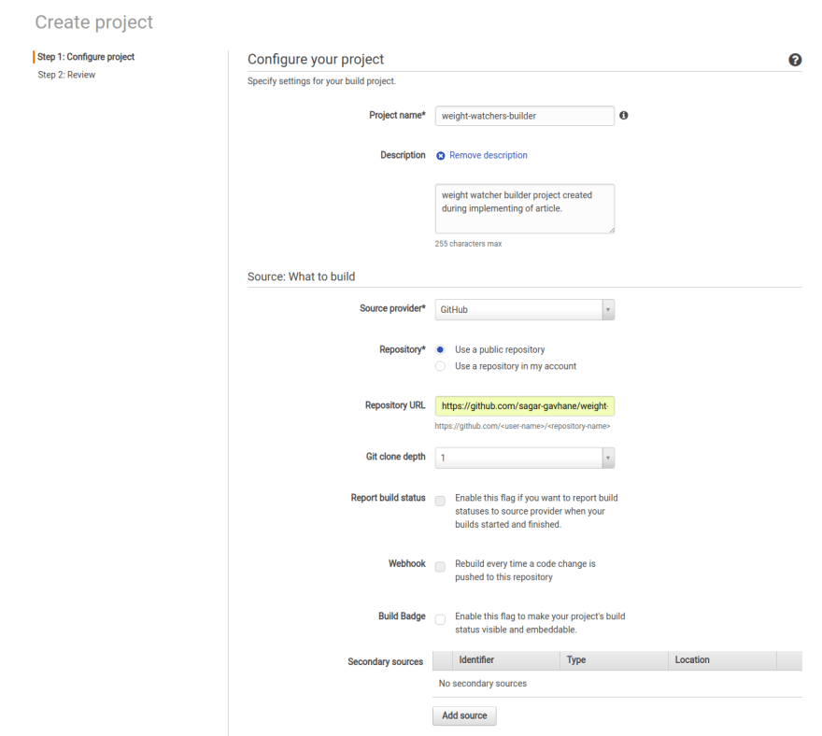
What is AWS CodeBuild ?
AWS CodeBuild is a continuous integration service that compiles source code, runs tests, and produces software packages that are ready to deploy.
We have just required to create CodeBuild project with proper settings.
Code Build is a fully managed continuous integration service that compile source code and produces the packaged software (WAR/JAR).

Slide 19
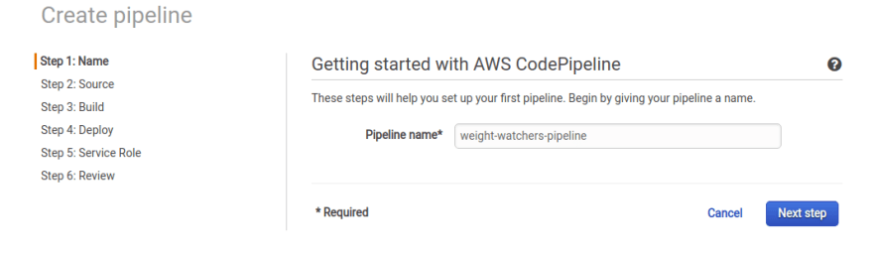
What is AWS CodePipeline ?
AWS CodePipeline is a continuous delivery service that helps us to rapidly and reliably deliver features and updates.
You can define your release process workflow and describes how a new code change progresses through your release process.
A pipeline comprises a series of stages (e.g., build, test, and deploy).
Each stage is made up of a sequence of actions, which are tasks such as building code or deploying to test environments.
CodePipeline creation divided into 6 steps as Name, Source, Build, Deploy, Service Role, Review.

Slide 20
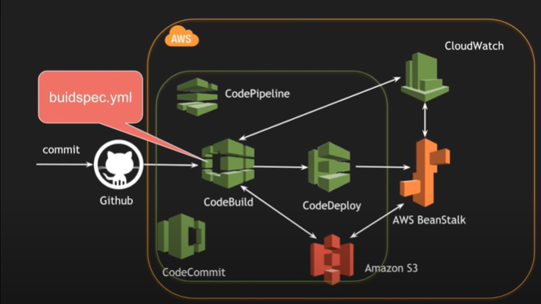

Slide 21
CI CD Pipeline
CI stands for Continuous Integration and CD stands for Continuous Delivery and Continuous Deployment.
CI/CD Pipeline implementation or the Continuous Integration / Continuous Deployment software is the backbone of the modern DevOps environment.
You can find the requirement of Continuous Integration & Continuous Deployment skills in various job roles such as Data Engineer, Cloud Architect, Data Scientist, etc. CI/CD bridges the gap between development and operations teams by automating build, test and deployment of applications.
You can think of it as a process which is similar to a software development lifecycle.

Slide 22
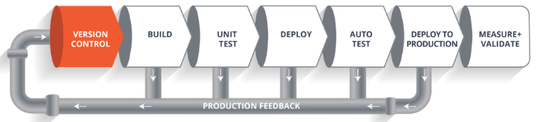
What is CI CD Pipeline?
Now let us see how does it work.
The above pipeline is a logical demonstration of how a software will move along the various phases or stages in this lifecycle, before it is delivered to the customer or before it is live on production.

Slide 23
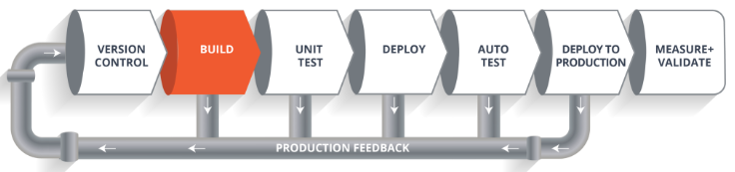
What is CI CD Pipeline?
Let’s take a scenario of CI CD Pipeline.
Imagine you’re going to build a web application which is going to be deployed on live web servers.
You will have a set of developers who are responsible for writing the code which will further go on and build the web application.
Now, when this code is committed into a version control system(such as git, svn) by the team of developers.
Next, it goes through the build phase which is the first phase of the pipeline, where developers put in their code and then again code goes to the version control system having a proper version tag.

Slide 24
What is CI CD Pipeline?
Let’s take a scenario of CI CD Pipeline.
Build Phase
Suppose we have a Java code and it needs to be compiled before execution.
So, through the version control phase, it again goes to build phase where it gets compiled.
You get all the features of that code from various branches of the repository, which merge them and finally use a compiler to compile it.
This whole process is called the build phase.

Slide 25
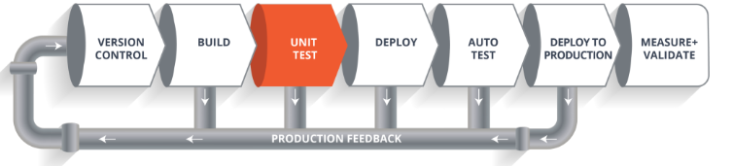
What is CI CD Pipeline?
Let’s take a scenario of CI CD Pipeline.
Testing Phase:
Once the build phase is over, then you move on to the testing phase.
In this phase, we have various kinds of testing, one of them is the unit test.
Here, you test the chunk/unit of software or for its sanity test.

Slide 26
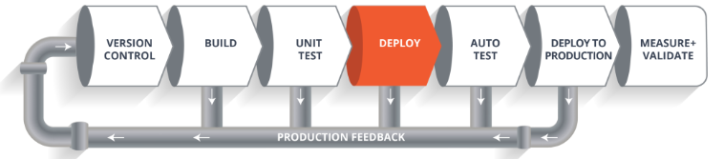
What is CI CD Pipeline?
Let’s take a scenario of CI CD Pipeline.
Deployment Phase:
When the test is completed, you move on to the deploy phase, where you deploy it into a staging or a test server.
Here, you can view the code or you can view the app in a simulator.

Slide 27
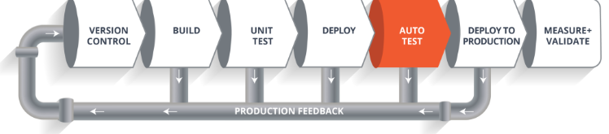
What is CI CD Pipeline?
Let’s take a scenario of CI CD Pipeline.
Auto Test Phase:
Once the code is deployed successfully, you can run another set of a sanity test.
If everything is accepted, then it can be deployed to production.

Slide 28
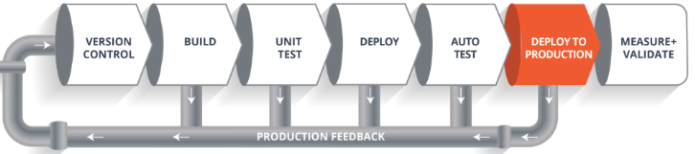
What is CI CD Pipeline?
Let’s take a scenario of CI CD Pipeline.
Deploy to Production:
Meanwhile in every step, if there is some error, you can shoot a mail back to the development team so that they can fix them.
Then they will push it into the version control system and goes back into the pipeline.
Once again if there is any error reported during testing, again the feedback goes to the dev team where they fix it and the process re-iterates if required.

Slide 29
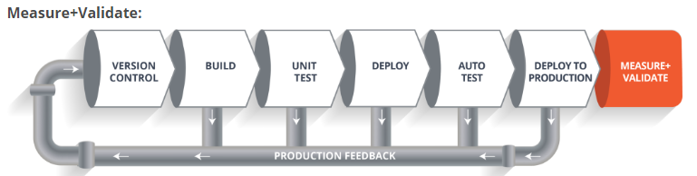
What is CI CD Pipeline?
Let’s take a scenario of CI CD Pipeline.
Measure+Validate:
So, this lifecycle continues until we get a code or a product which can be deployed in the production server where we measure and validate the code.

Slide 30
Lab :CICD using AWS CodePipeline and Elastic Bean Stalk

Slide 31
Lab :CICD using AWS CodePipeline and Elastic Bean Stalk
Make a Java Spring Boot Rest Application
Using maven build , convert it into jar file using maven package
Under AWS, load it into Elastic Beanstalk …. Run it .. Test it from browser.

Slide 32
Lab :CICD using AWS CodePipeline and Elastic Bean Stalk
In Git Repository, login in Git Hub…
Make a new repository.
Take the command “git remote add origin https://...... “
Now open project’s root folder location in command prompt and execute these commands:
git init
git remote add origin https://......
** Now your project under local git repository, for this , install git in local computer with configurations.
git add .
git commit –m “first update”
git push origin master
Now check your git hub account with repository.

Slide 33
Lab :CICD using AWS CodePipeline and Elastic Bean Stalk
In Git Repository, login in Git Hub…
Make a new repository.
Take the command “git remote add origin https://...... “
Now open project’s root folder location in command prompt and execute these commands:
git init
git remote add origin https://......
** Now your project under local git repository, for this , install git in local computer with configurations.
git add .
git commit –m “first update”
git push origin master
Now check your git hub account with repository.

Slide 34
Lab :CICD using AWS CodePipeline and Elastic Bean Stalk
create buildspec.yml under root folder of project as :
# This file controls the AWS CodeBuild
version: 0.2
phases:
pre_build:
commands:
- echo "Entered the pre-build phase"
build:
commands:
- echo "Entered build phase"
- mvn package
post_build:
commands:
- echo "Entered the post-build phase"
artifacts:
files:
- target/aws-beanstalk.jar

Slide 35
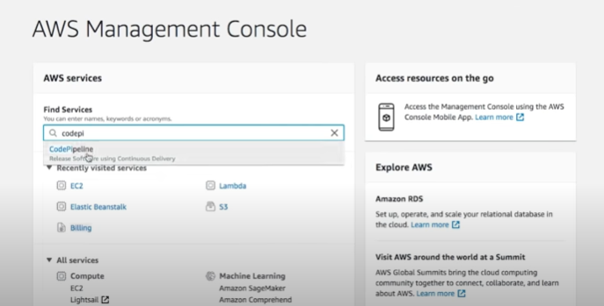
Lab :CICD using AWS CodePipeline and Elastic Bean Stalk

Slide 36
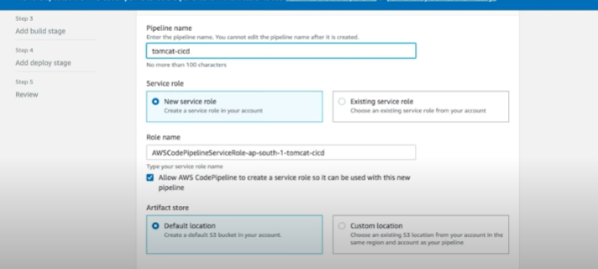
Lab :CICD using AWS CodePipeline and Elastic Bean Stalk

Slide 37
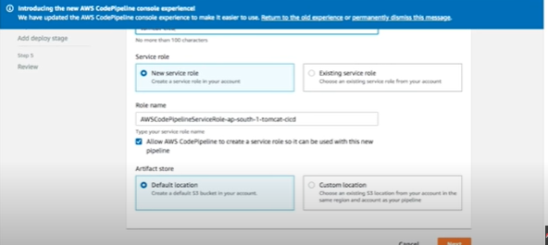
Lab :CICD using AWS CodePipeline and Elastic Bean Stalk

Slide 38
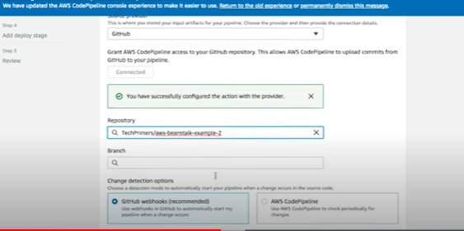
Lab :CICD using AWS CodePipeline and Elastic Bean Stalk
Branch : master
Branch : master

Slide 39
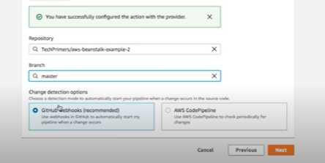
Lab :CICD using AWS CodePipeline and Elastic Bean Stalk
Branch : master
Branch : master

Slide 40
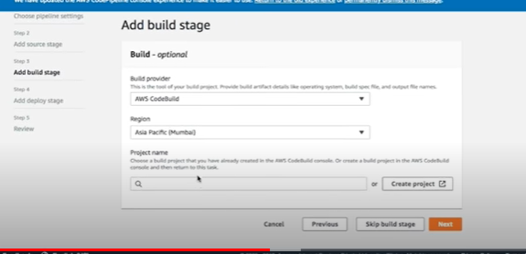
Lab :CICD using AWS CodePipeline and Elastic Bean Stalk
Branch : master

Slide 41
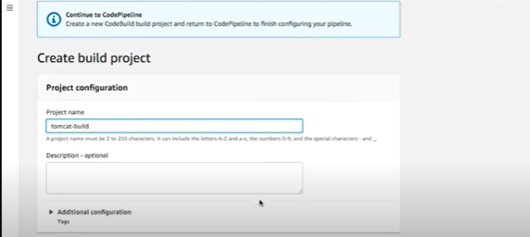
Lab :CICD using AWS CodePipeline and Elastic Bean Stalk
Branch : master

Slide 42
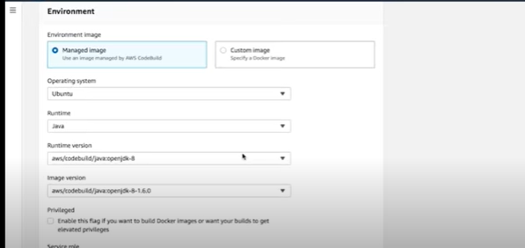
Lab :CICD using AWS CodePipeline and Elastic Bean Stalk
To associate buildspec.yml
Branch : master

Slide 43
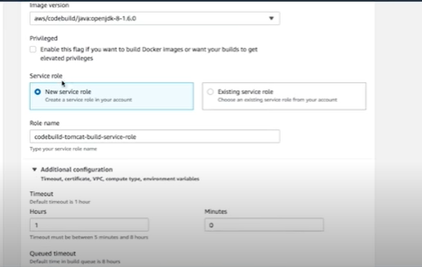
Lab :CICD using AWS CodePipeline and Elastic Bean Stalk
To associate buildspec.yml
Branch : master

Slide 44
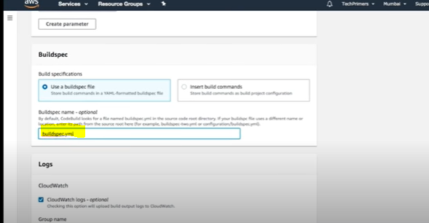
Lab :CICD using AWS CodePipeline and Elastic Bean Stalk
To associate buildspec.yml
Branch : master

Slide 45
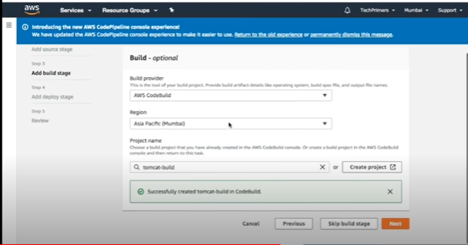
Lab :CICD using AWS CodePipeline and Elastic Bean Stalk
To associate buildspec.yml
Branch : master

Slide 46
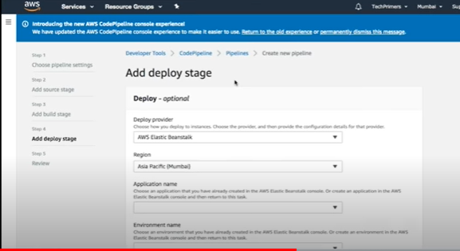
Lab :CICD using AWS CodePipeline and Elastic Bean Stalk
Now the deploy stage
Branch : master

Slide 47
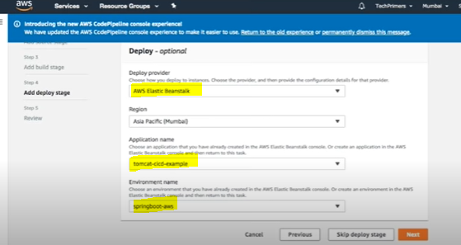
Lab :CICD using AWS CodePipeline and Elastic Bean Stalk
Now the deploy stage
Branch : master

Slide 48
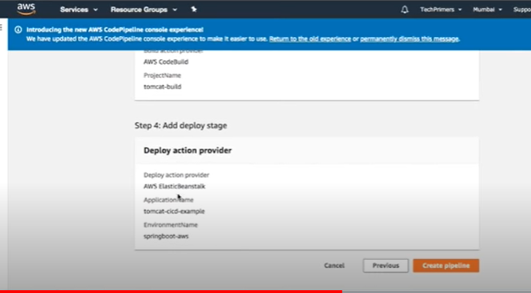
Lab :CICD using AWS CodePipeline and Elastic Bean Stalk
Now the deploy stage
Branch : master

Slide 49

Lab :CICD using AWS CodePipeline and Elastic Bean Stalk
Now test
Make some changes in code and then again push in github with commit as follows:
Now, check the Code Pipeline, it is automatically doing all CI/CD statements specified in code pipeline.

Slide 50
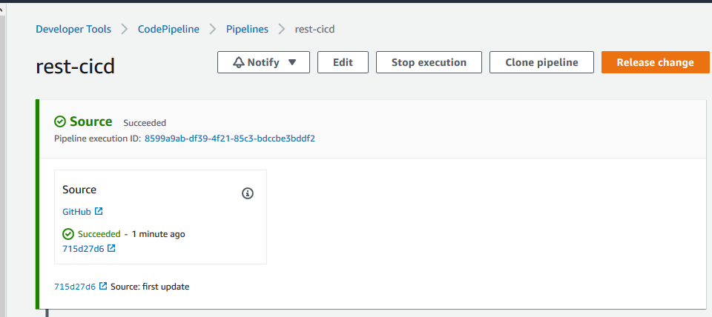
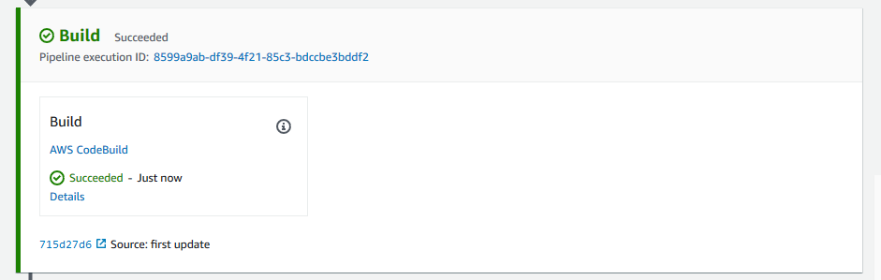
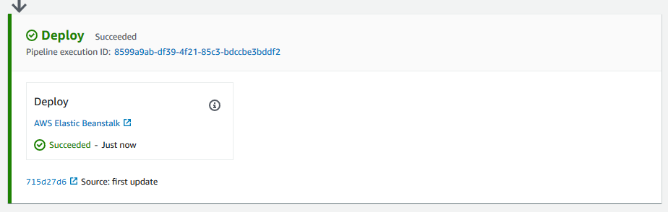
Lab :CICD using AWS CodePipeline and Elastic Bean Stalk
Now test

