Slide 1

AWS Identity and Access Management (IAM)

Slide 2
AWS Identity and Access Management (IAM)
AWS Identity and Access Management (IAM) enables you to manage access to AWS services and resources securely.
Using IAM, you can create and manage AWS users and groups, and use permissions to allow and deny their access to AWS resources.
IAM is a feature of your AWS account offered at no additional charge.
You will be charged only for use of other AWS services by your users.

Slide 3
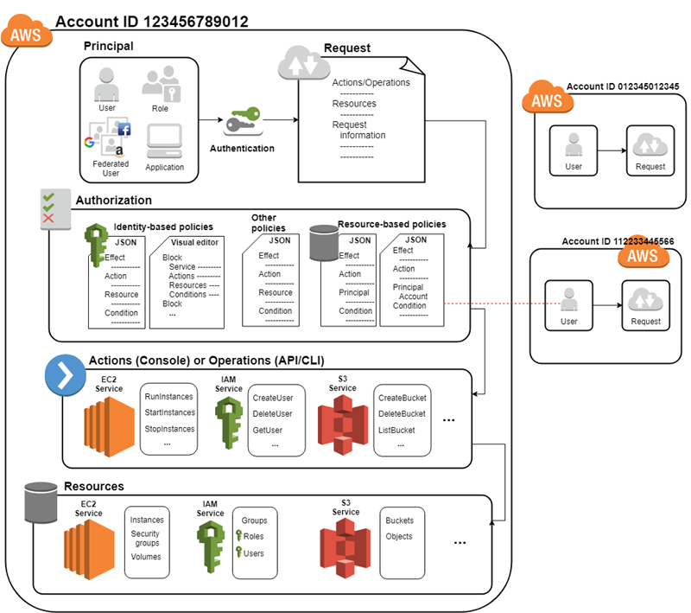
AWS Identity and Access Management (IAM)

Slide 4
AWS Identity and Access Management (IAM)
AWS Identity and Access Management (IAM) is a web service that helps you securely control access to AWS resources.
You use IAM to control who is authenticated (signed in) and authorized (has permissions) to use resources.
When you first create an AWS account, you begin with a single sign-in identity that has complete access to all AWS services and resources in the account.
This identity is called the AWS account root user and is accessed by signing in with the email address and password that you used to create the account.
We strongly recommend that you do not use the root user for your everyday tasks, even the administrative ones.

Slide 5
Elements of IAM
Resources
The user, group, role, policy, and identity provider objects that are stored in IAM. As with other AWS services, you can add, edit, and remove resources from IAM.
Identities
The IAM resource objects that are used to identify and group. You can attach a policy to an IAM identity. These include users, groups, and roles.
Entities
The IAM resource objects that AWS uses for authentication. These include users and roles. Roles can be assumed by IAM users and roles in your or another account. They can also be assumed by users federated through a web identity or SAML.
Principals
A person or application that uses the AWS account root user, an IAM user, or an IAM role to sign in and make requests to AWS.

Slide 6
Use of IAM
Fine-grained access control to AWS resources
IAM enables your users to control access to AWS service APIs and to specific resources.
IAM also enables you to add specific conditions such as time of day to control how a user can use AWS, their originating IP address, whether they are using SSL, or whether they have authenticated with a multi-factor authentication device.
Multi-factor authentication for highly privileged users
Protect your AWS environment by using AWS MFA, a security feature available at no extra cost that augments user name and password credentials.
MFA requires users to prove physical possession of a hardware MFA token or MFA-enabled mobile device by providing a valid MFA code.

Slide 7
Use of IAM
Analyze access
IAM helps you analyze access across your AWS environment.
Your security teams and administrators can quickly validate that your policies only provide the intended public and cross-account access to your resources.
You can also easily identify and refine your policies to allow access to only the services being used.
This helps you to better adhere to the principle of least privilege.
Integrate with your corporate directory
IAM can be used to grant your employees and applications federated access to the AWS Management Console and AWS service APIs, using your existing identity systems such as Microsoft Active Directory.
You can use any identity management solution that supports SAML 2.0, or feel free to use one of our federation samples (AWS Console SSO or API federation).

Slide 8
AWS IAM in Free Tier
AWS Identity and Access Management (IAM) is a feature of your AWS account and is offered at no additional charge (e.g., you will not be charged if you create an IAM user or group).
You will be charged only for use of other AWS services (outside of free tier) used by your IAM user(s).
AWS Identity and Access Management (IAM) and AWS Security Token Service (AWS STS) are features of your AWS account offered at no additional charge.
You are charged only when you access other AWS services using your IAM users or AWS STS temporary security credentials.

Slide 9
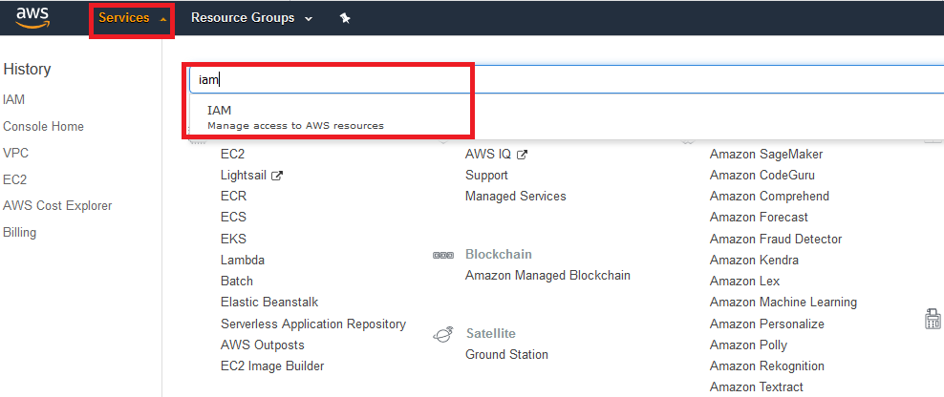
Go for IAM

Slide 10
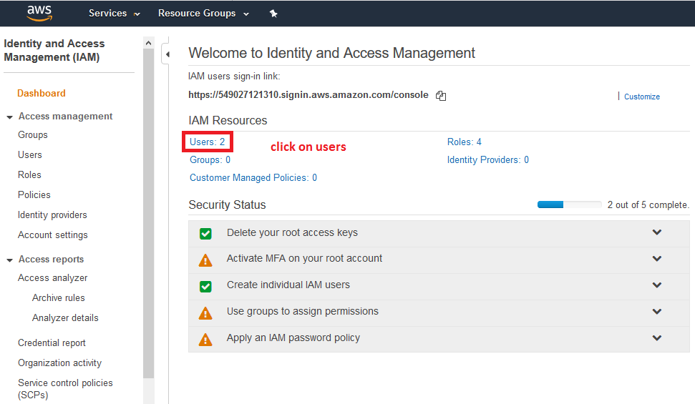
Create IAM User

Slide 11
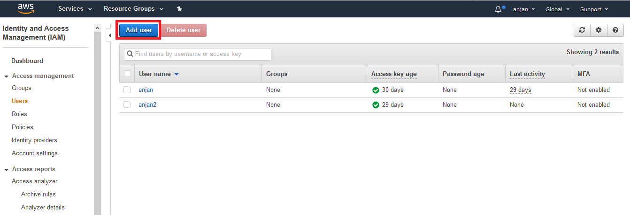
Create IAM User

Slide 12
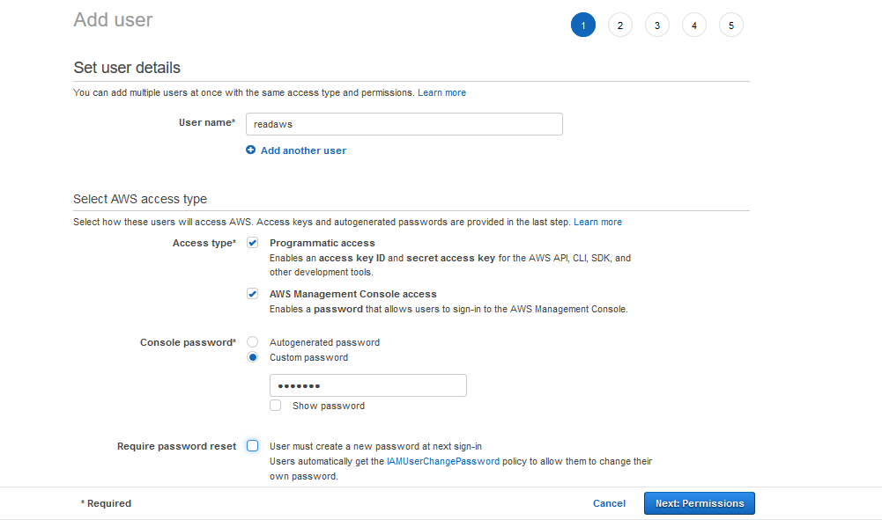
Create IAM User Step 1

Slide 13
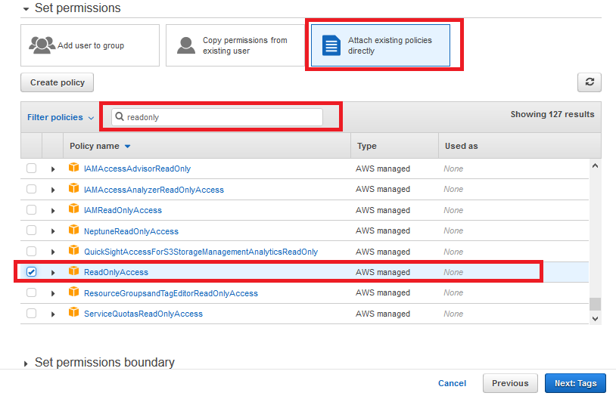
Select the policy Step 2

Slide 14
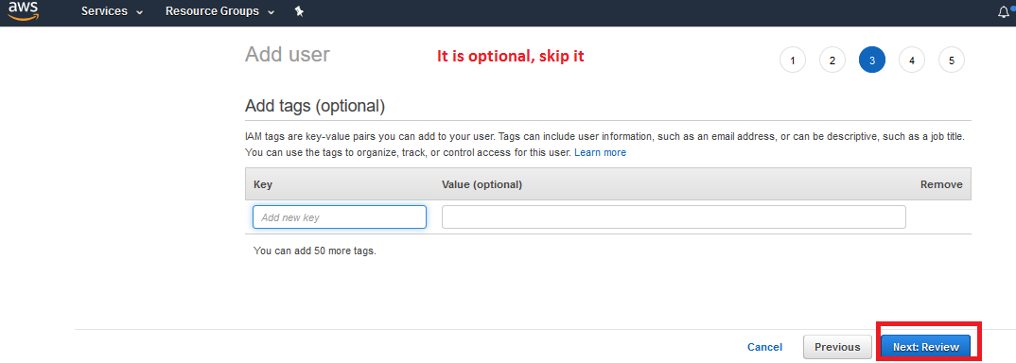
STEP 3

Slide 15
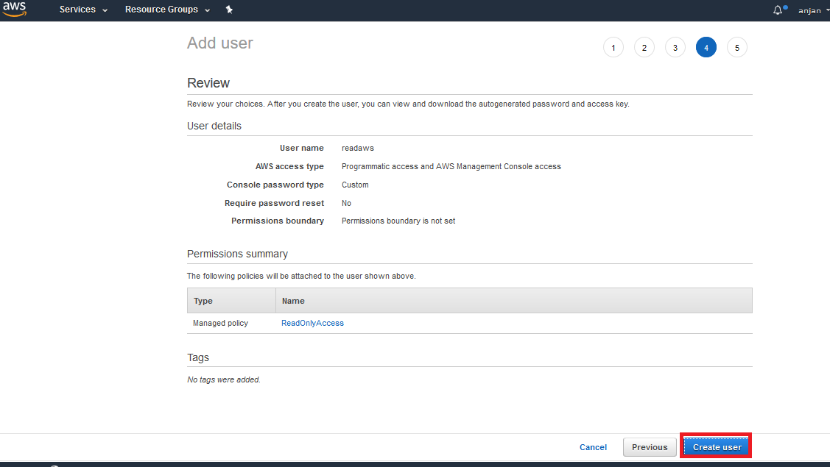

Slide 16
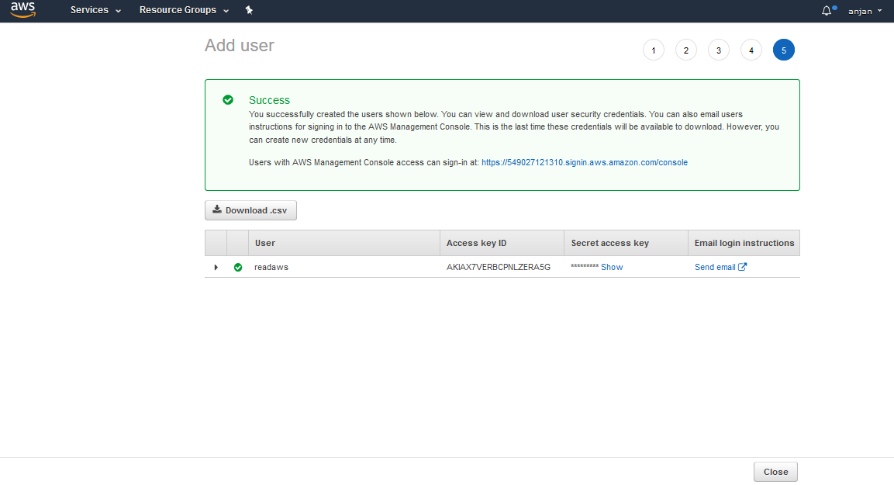
User created successfully

Slide 17
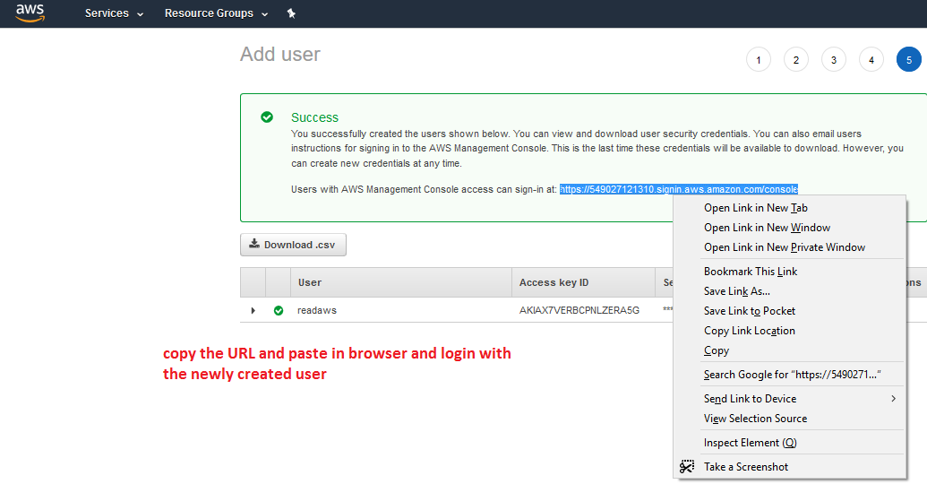
Access the new user

Slide 18
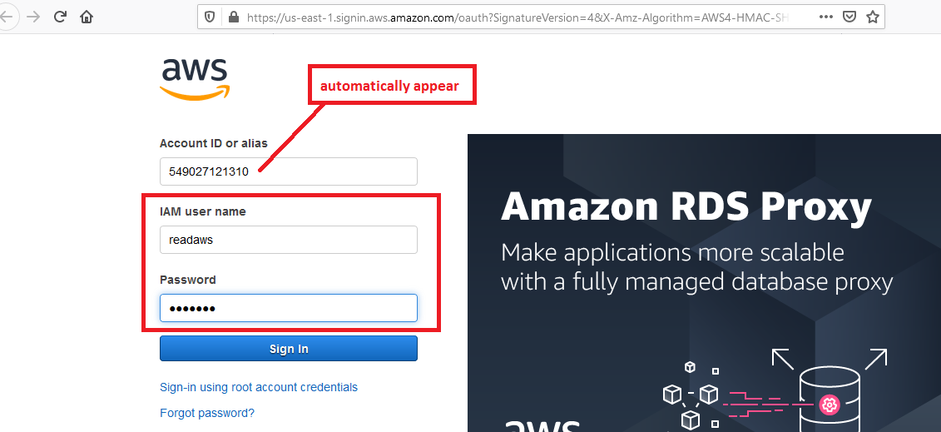

Slide 19
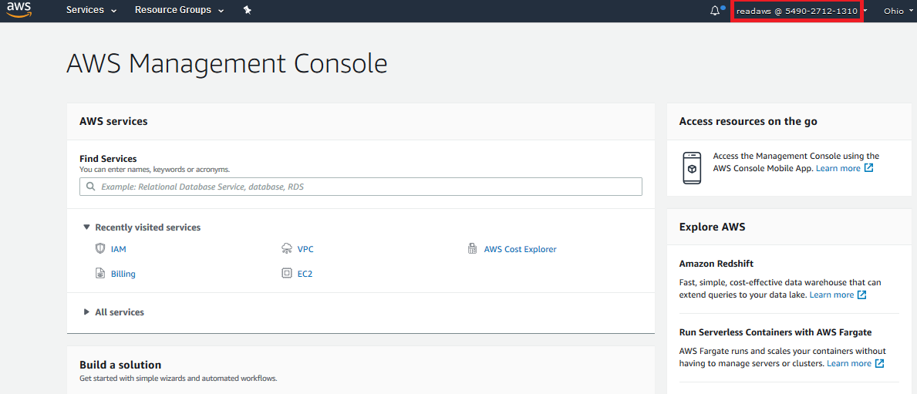
Login with Newly Created User

Slide 20
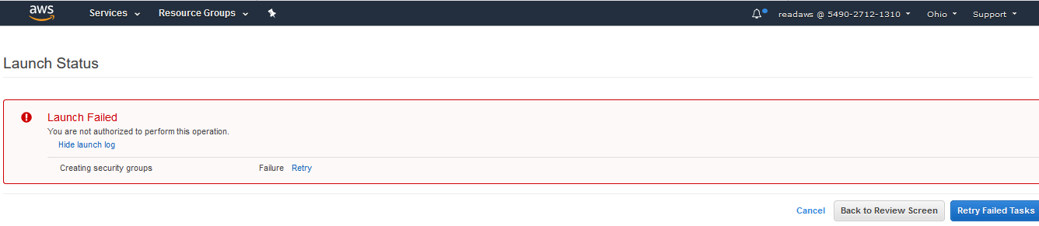
Try to create a EC2 Instance

Slide 21
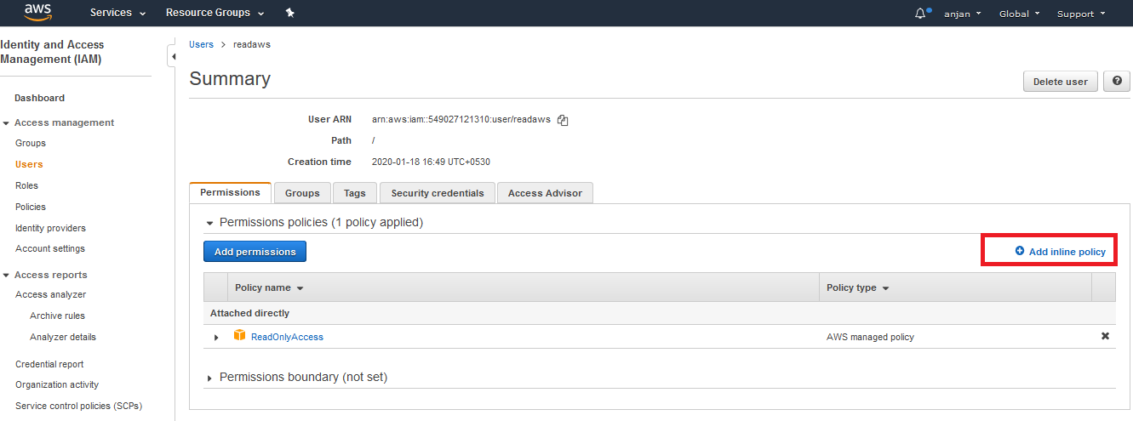
Add a policy

Slide 22
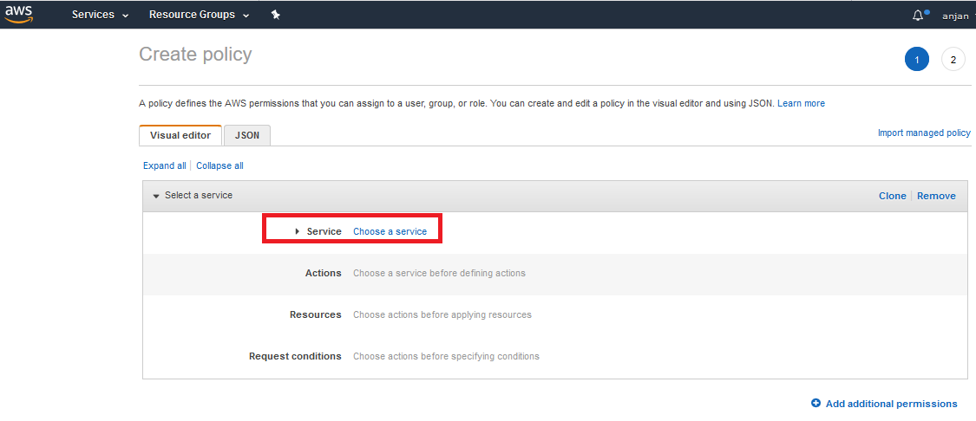
Create Policy

Slide 23
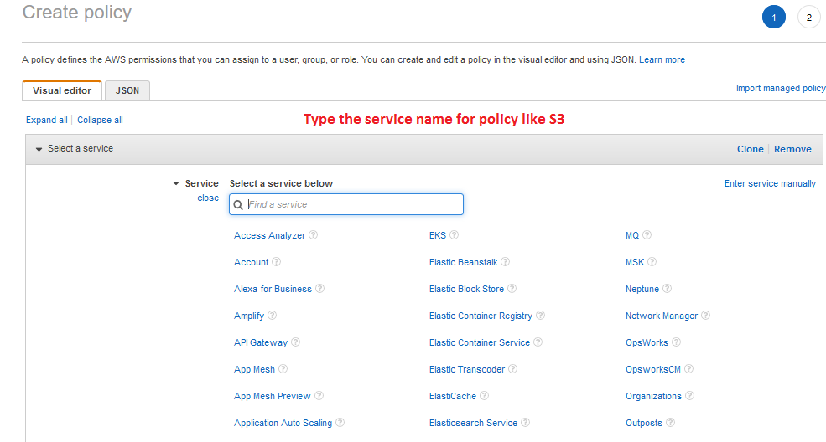
Filter the service for Policy

Slide 24
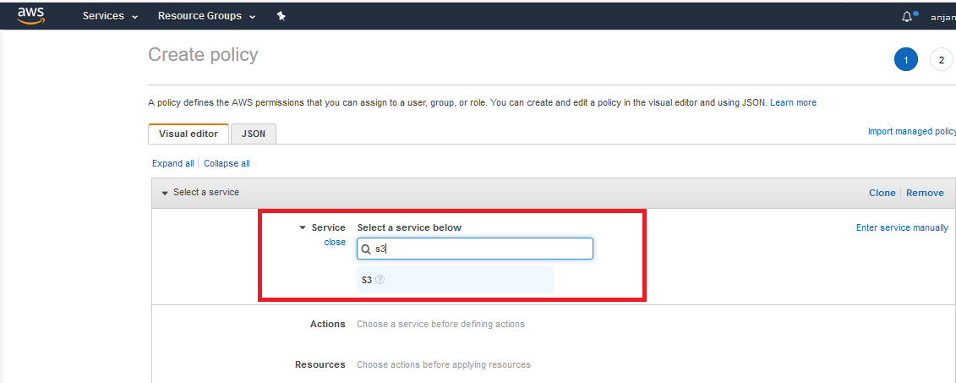
Select the service

Slide 25
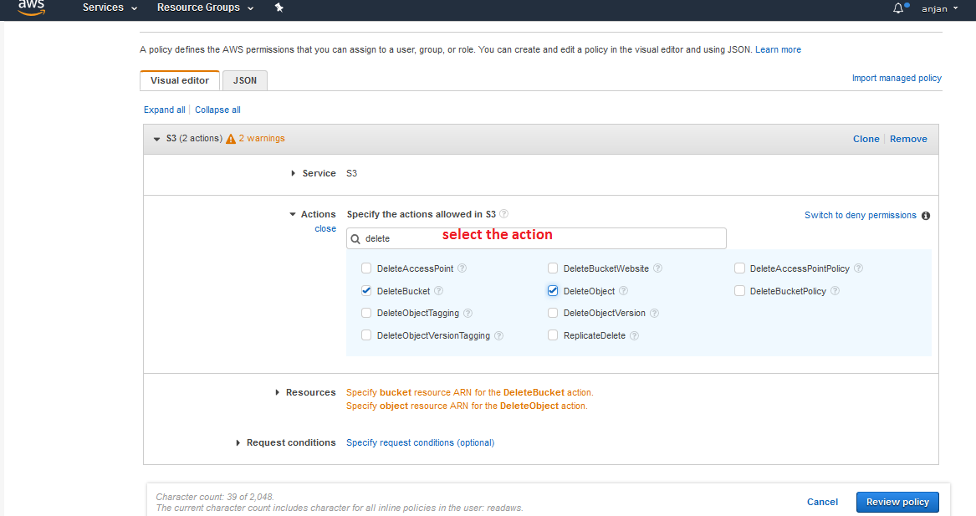
Select the Privilege

Slide 26
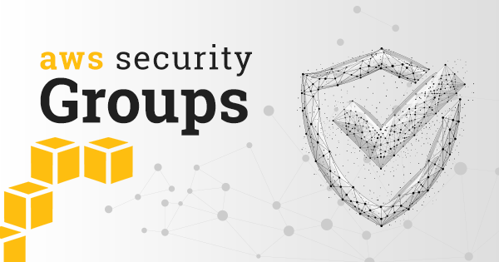

Slide 27
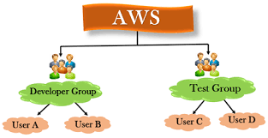

Slide 28
Groups
An IAM group is a collection of IAM users.
Groups let you specify permissions for multiple users, which can make it easier to manage the permissions for those users.
For example, you could have a group called Admins and give that group the types of permissions that administrators typically need.
Any user in that group automatically has the permissions that are assigned to the group.
If a new user joins your organization and needs administrator privileges, you can assign the appropriate permissions by adding the user to that group.
Similarly, if a person changes jobs in your organization, instead of editing that user's permissions, you can remove him or her from the old groups and add him or her to the appropriate new groups.

Slide 29
Characteristics of groups
A group can contain many users, and a user can belong to multiple groups.
Groups can't be nested; they can contain only users, not other groups.
There's no default group that automatically includes all users in the AWS account. If you want to have a group like that, you need to create it and assign each new user to it.
There's a limit to the number of groups you can have, and a limit to how many groups a user can be in.
For more information, see IAM and STS Limits.

Slide 30
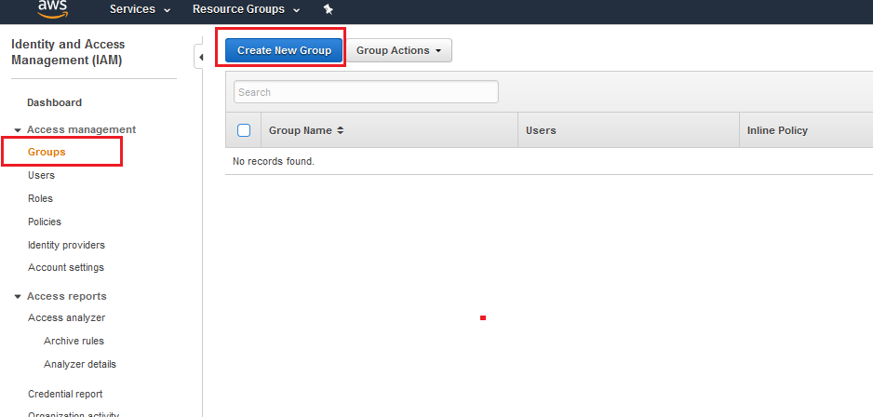
Creating a Group

Slide 31
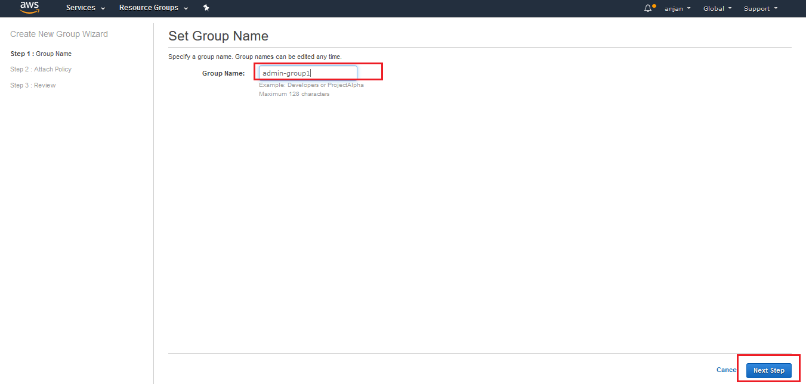
Type the group Name

Slide 32
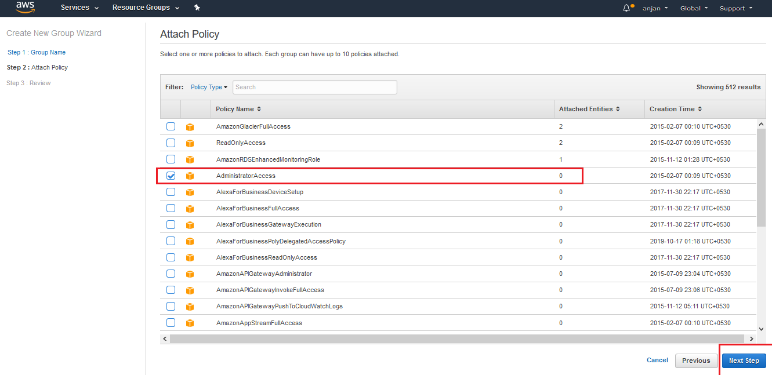
Add the Policy to the Group

Slide 33
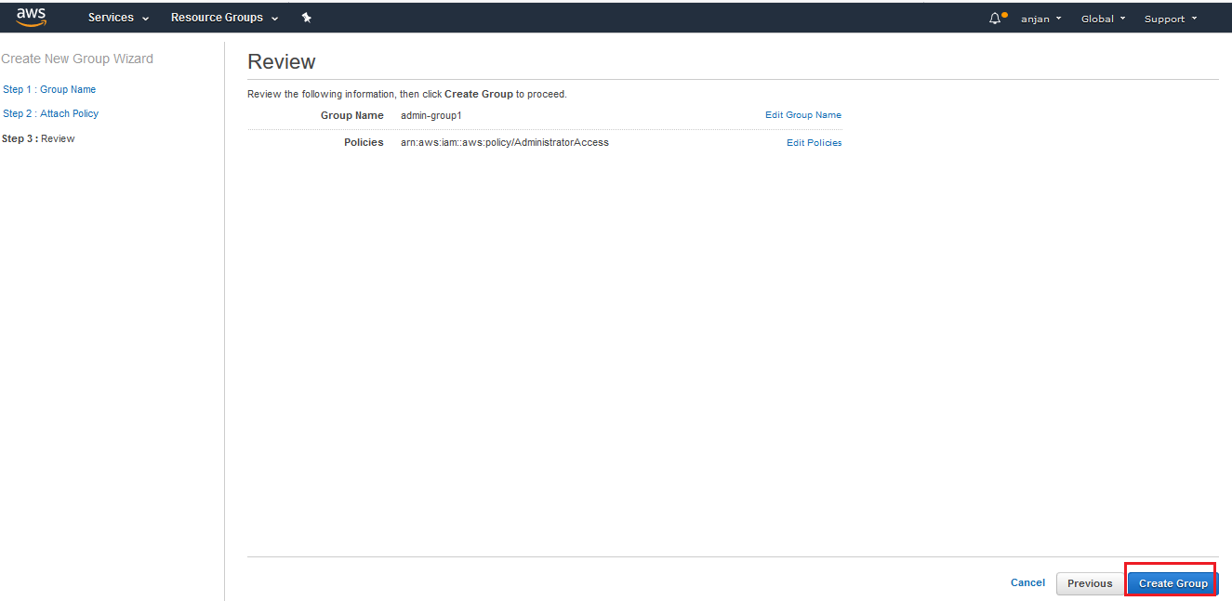
Create the Group

Slide 34
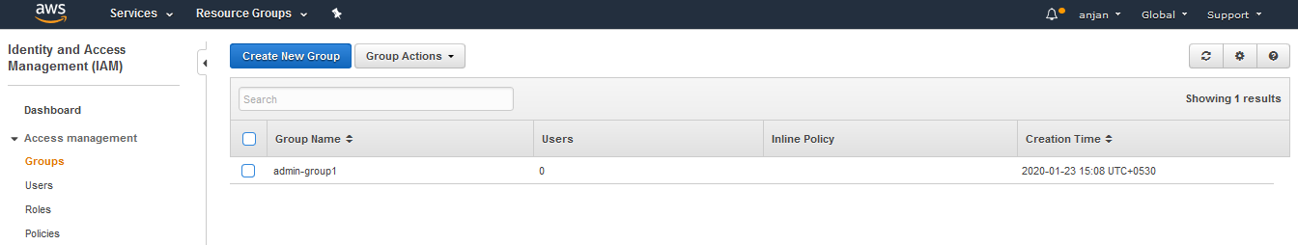
Group created

Slide 35
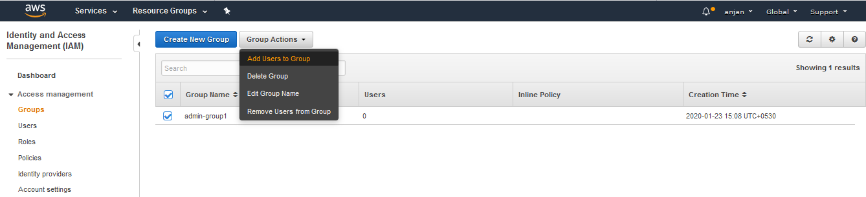
Assign Users to Goup

Slide 36
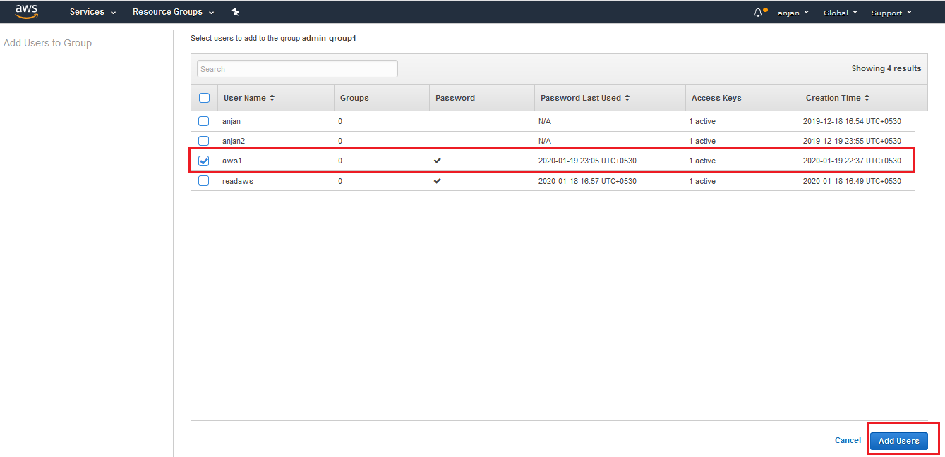
Select the Username

Slide 37
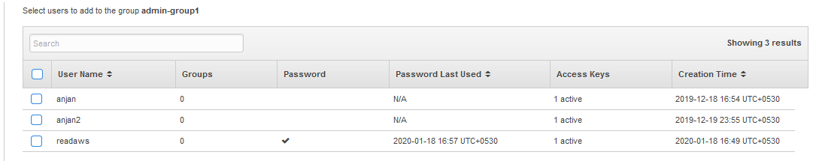
Remember
If a user is assigned to a group, next time that user is not displayed in the same group assignment.

Slide 38
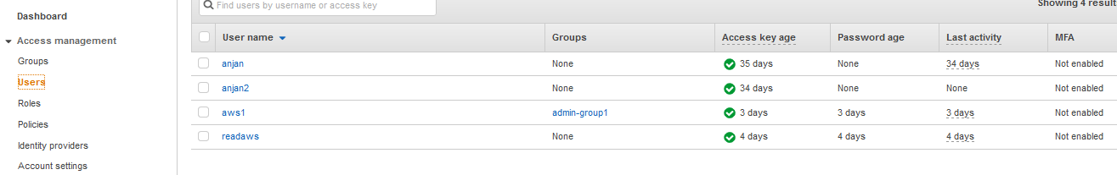
Check the user with the new group

Slide 39
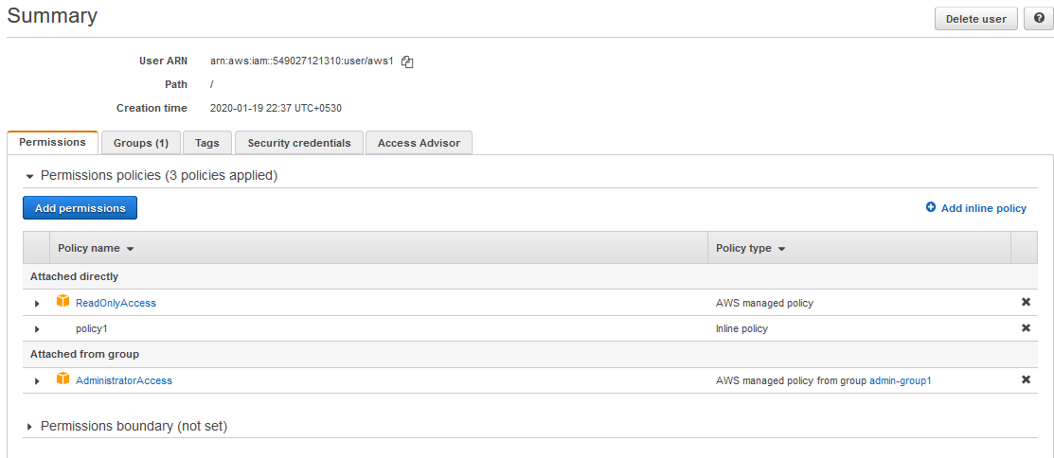
Summary of user aws1

Slide 40
Now we will login with aws1 and as he is a admin user , he can create a group or user or anything, test it.

