Slide 1

AWS Lambda

Slide 2
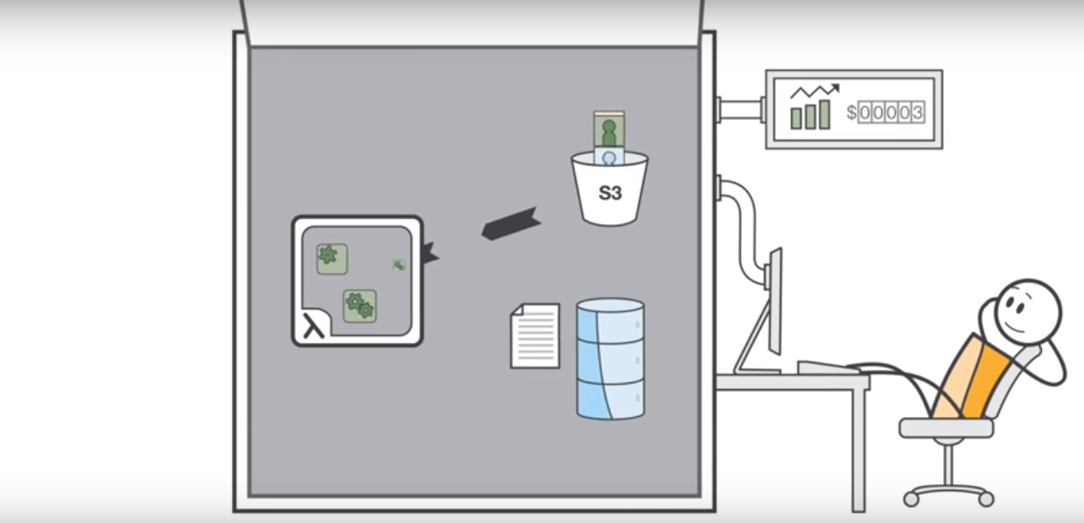
AWS Lambda

Slide 3
AWS Lambda
AWS Lambda lets you run code without provisioning or managing servers.
You pay only for the compute time you consume.
With Lambda, you can run code for virtually any type of application or backend service - all with zero administration.
Just upload your code and Lambda takes care of everything required to run and scale your code with high availability.
You can set up your code to automatically trigger from other AWS services or call it directly from any web or mobile app.

Slide 4
AWS Lambda
The code you run on AWS Lambda is called a “Lambda function.”
After you create your Lambda function it is always ready to run as soon as it is triggered, similar to a formula in a spreadsheet.
Each function includes your code as well as some associated configuration information, including the function name and resource requirements.
Lambda functions are “stateless,” with no affinity to the underlying infrastructure, so that Lambda can rapidly launch as many copies of the function as needed to scale to the rate of incoming events.

Slide 5
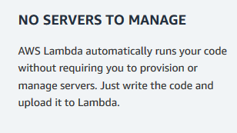
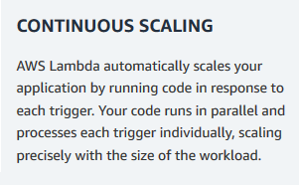
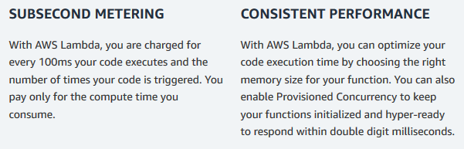
Benefits of Lambda

Slide 6
Features
Extend other AWS services with custom logic
AWS Lambda allows you to add custom logic to AWS resources such as Amazon S3 buckets and Amazon DynamoDB tables, making it easy to apply compute to data as it is enters or moves through the cloud.
It is easy to get started with AWS Lambda.
First you create your function by uploading your code (or building it right in the Lambda console) and choosing the memory, timeout period, and AWS Identity and Access Management (IAM) role.
Then, you specify the AWS resource to trigger the function, either a particular Amazon S3 bucket, Amazon DynamoDB table, or Amazon Kinesis stream.
When the resource changes, Lambda will run your function and launch and manage the compute resources as needed in order to keep up with incoming requests.

Slide 7
Build custom back-end services
You can use AWS Lambda to create new back-end services for your applications that are triggered on-demand using the Lambda API or custom API endpoints built using Amazon API Gateway.
By using Lambda to process custom events instead of servicing these on the client, you can avoid client platform variations, reduce battery drain, and enable easier updates.
Bring your own code
With AWS Lambda, there are no new languages, tools, or frameworks to learn.
You can use any third party library, even native ones. You can also package any code (frameworks, SDKs, libraries, and more) as a Lambda Layer and manage and share them easily across multiple functions.
Lambda natively supports Java, Go, PowerShell, Node.js, C#, Python, and Ruby code, and provides a Runtime API which allows you to use any additional programming languages to author your functions.

Slide 8
Only pay for what you use
With AWS Lambda, you pay for execution duration rather than by server unit.
When using Lambda functions, you only pay for requests served and the compute time required to run your code.
Billing is metered in increments of 100 milliseconds, making it cost-effective and easy to scale automatically from a few requests per day to thousands per second.
Flexible resource model
You choose the amount of memory you want to allocate to your functions and AWS Lambda allocates proportional CPU power, network bandwidth, and disk I/O.

Slide 9
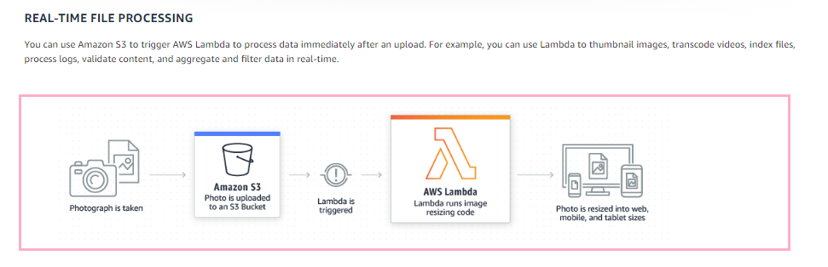
What Lambda does

Slide 10
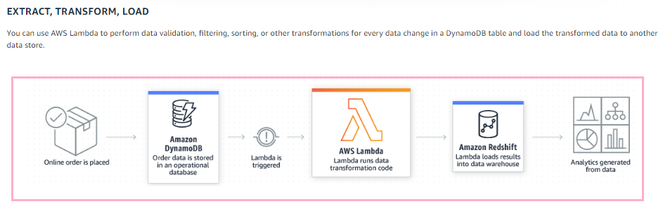
What Lambda does

Slide 11
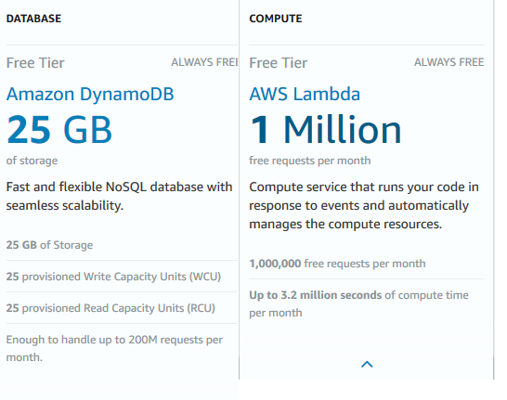
Free Tier

Slide 12
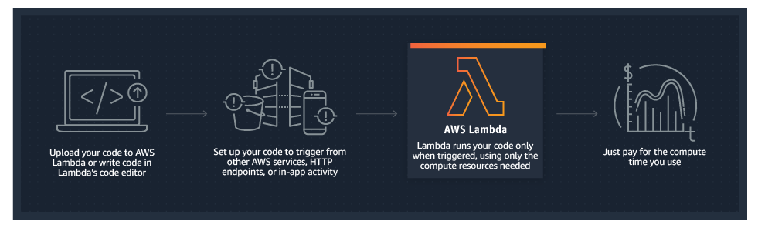
How it works

Slide 13
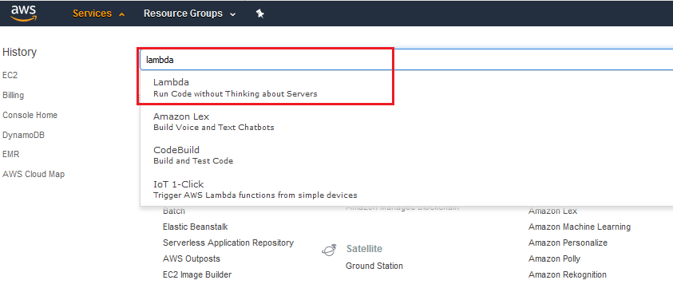
Open Lambda

Slide 14
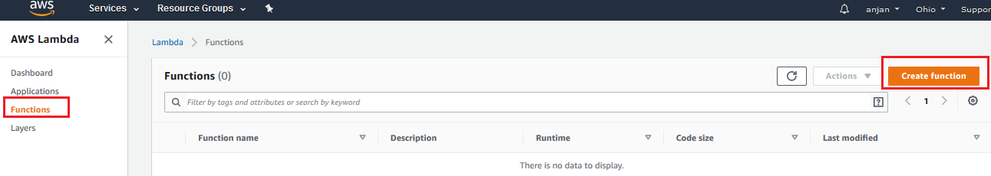
Create the lambda function

Slide 15
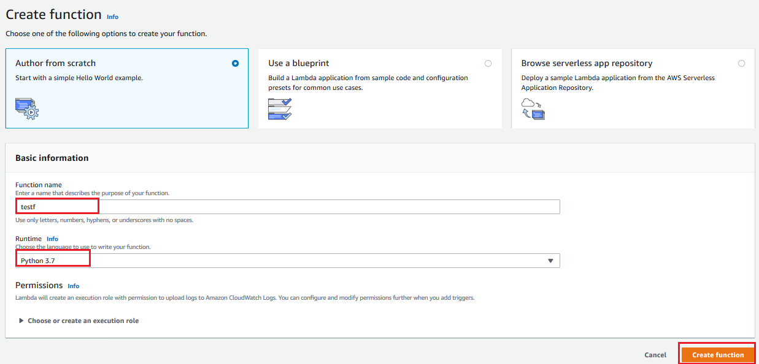
Create the lambda function

Slide 16
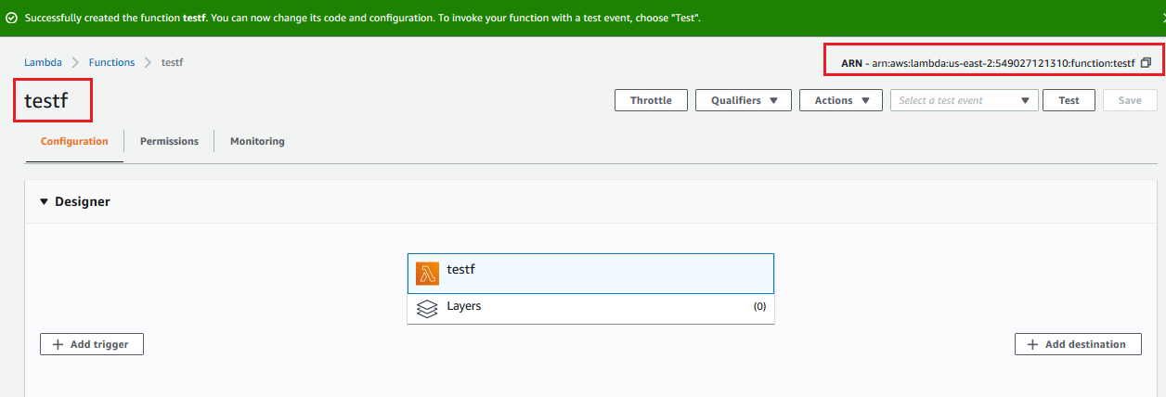
Lambda function created successfully

Slide 17
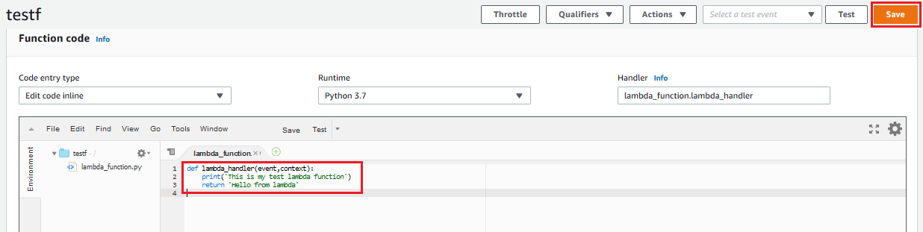
Write the Lambda function code then save and test
def lambda_handler(event,context):
print('This is my test lambda function')
return 'Hello from lambda'

Slide 18
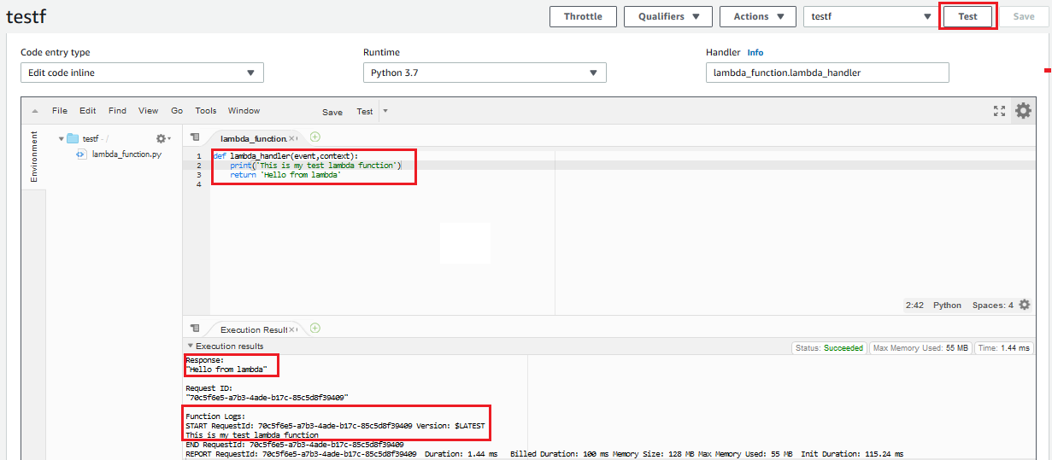
Test
After you run test give the eventhandler name same as the function name

Slide 19
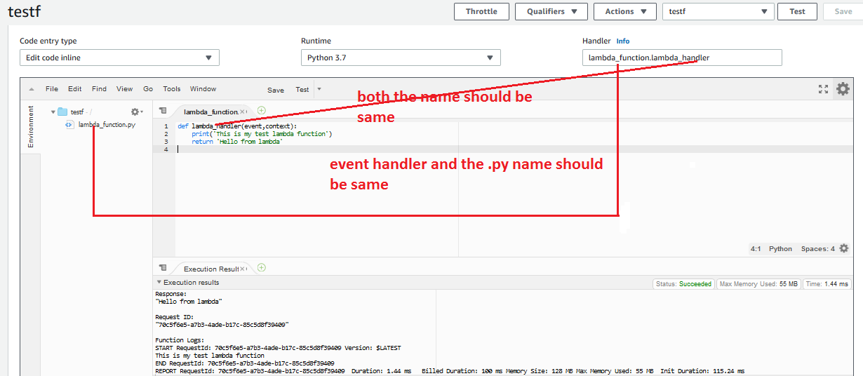
Event handler name and the .py file name should be same

Slide 20
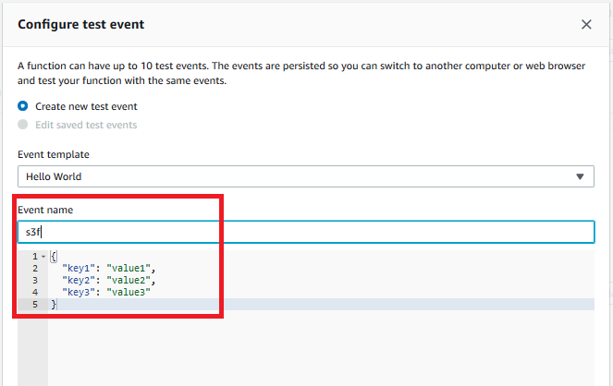
Type a event name same as the function

Slide 21
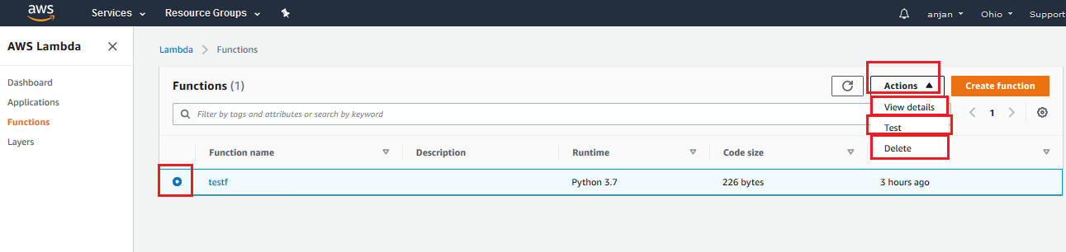
Operations in Lambda function

Slide 22
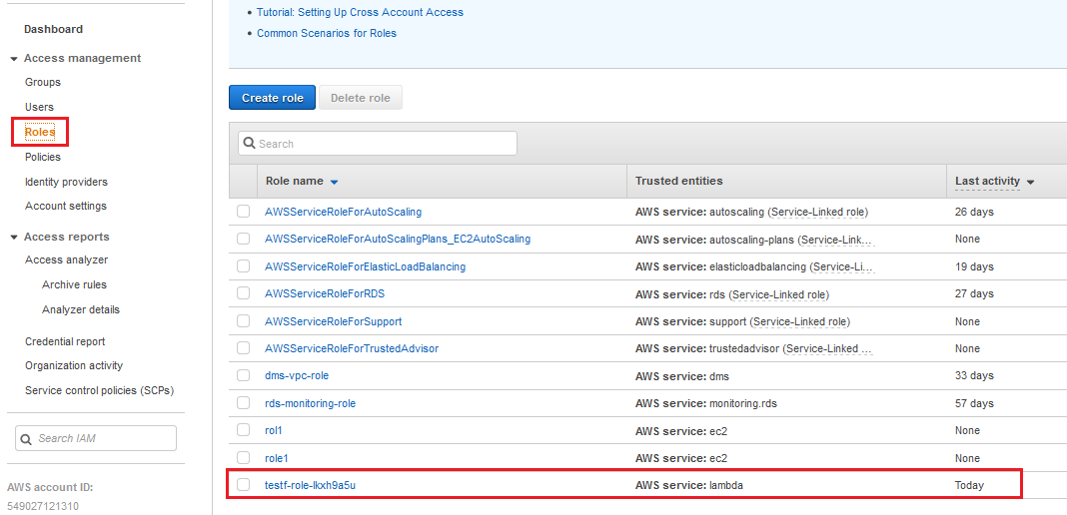
Role created for Lambda

Slide 23
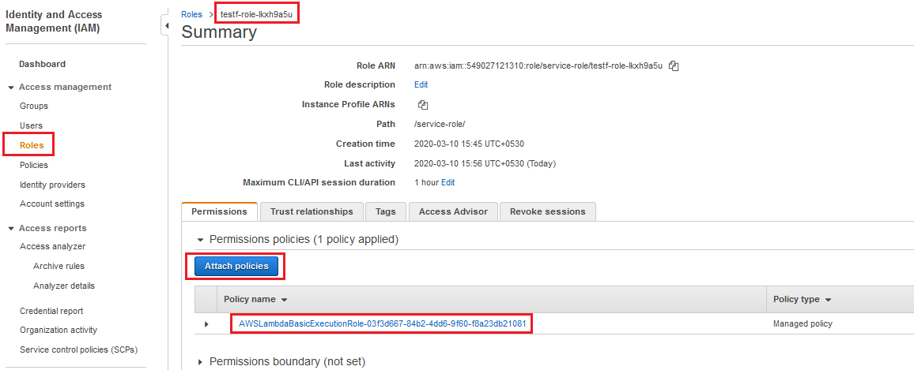
Trigger a lambda function for S3
Allow the role of lambda for full S3 access and cloudwatch

Slide 24
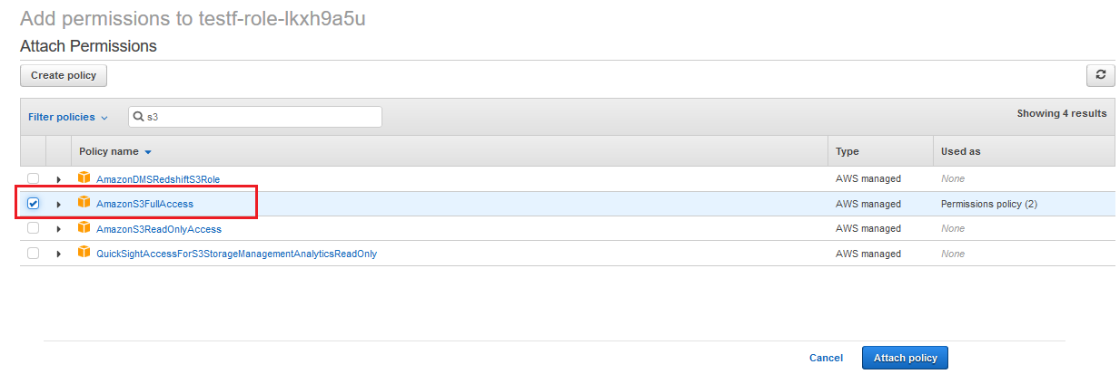
Allow the role of lambda for full S3 access and Cloudwatch

Slide 25
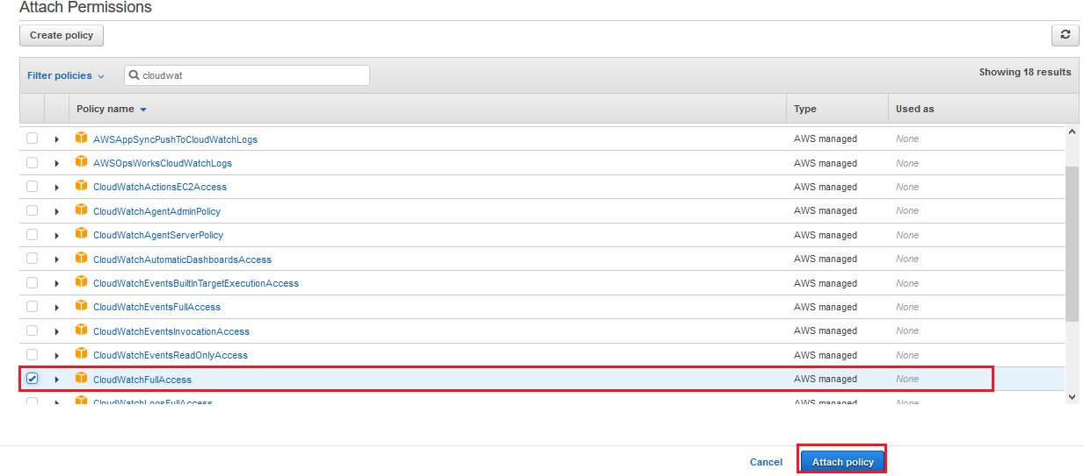
Allow Cloudwatch

Slide 26
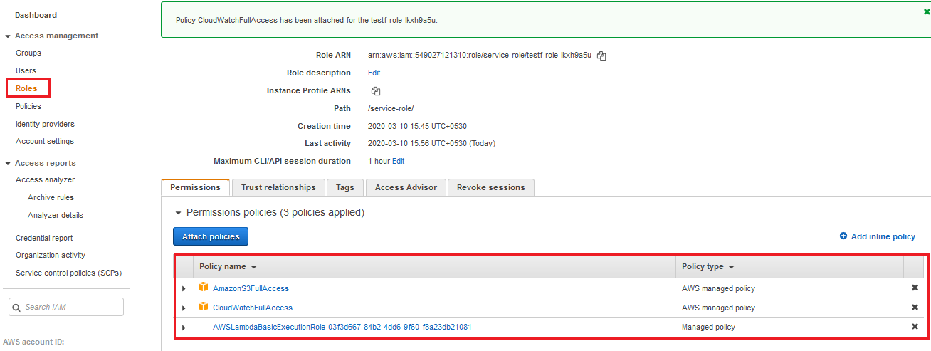
Permissions for Lambda function

Slide 27
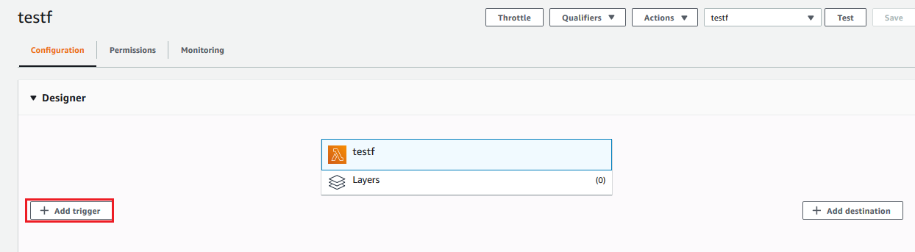
Add trigger

Slide 28
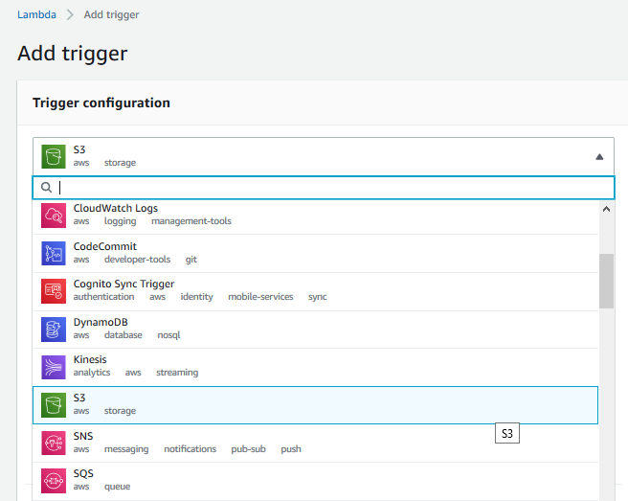
Select S3

Slide 29
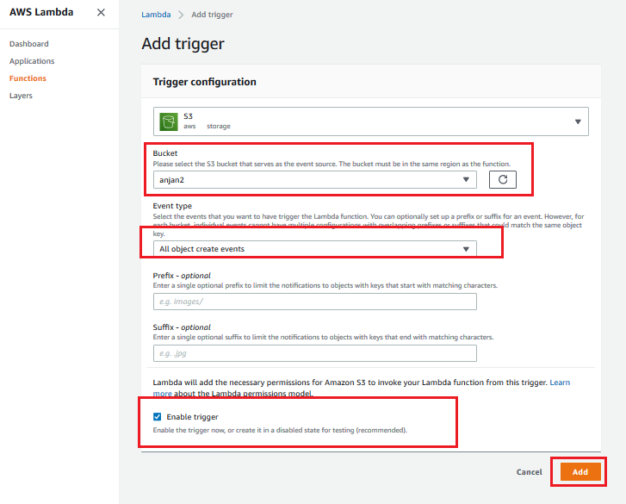
Add the Trigger

Slide 30
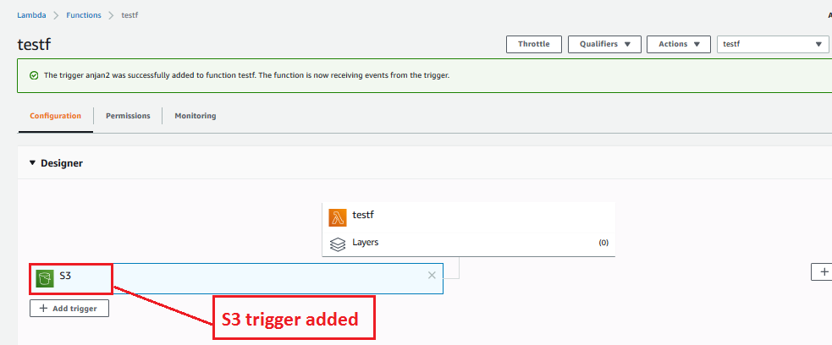
S3 trigger added in Lambda

Slide 31
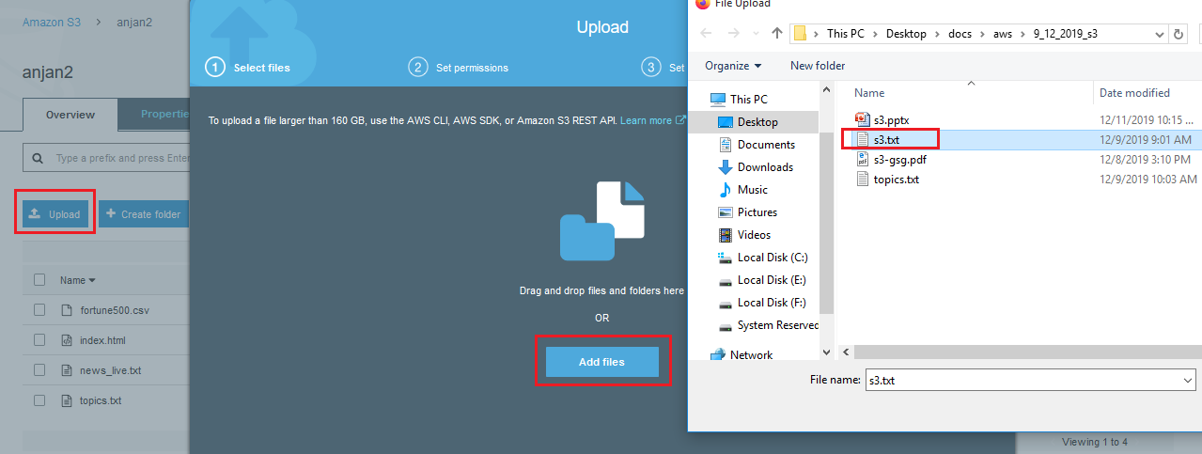
Now upload a file in S3

Slide 32
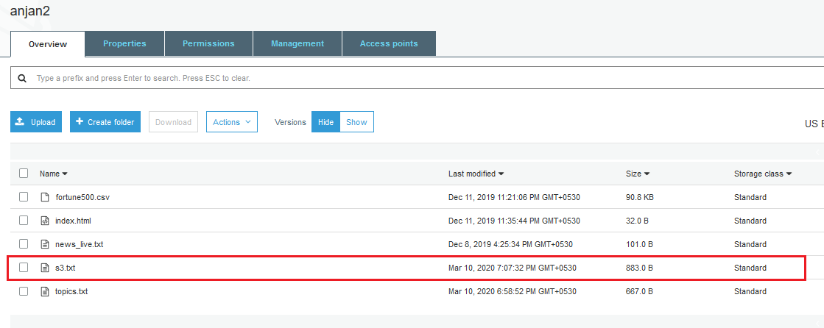
File uploaded in S3

Slide 33
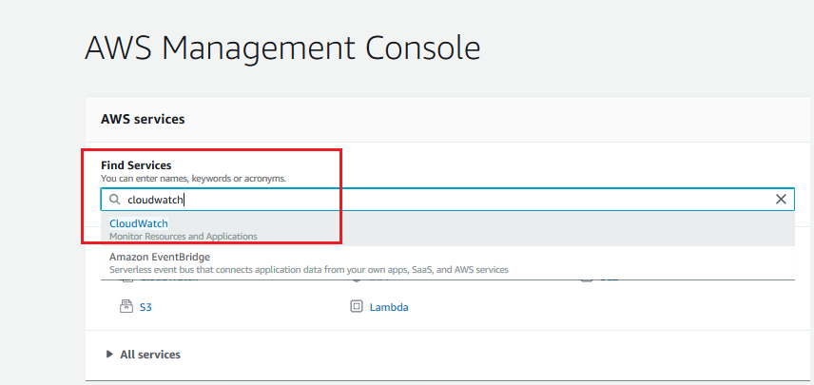
Now goto cloudwatch to verify lambda has triggered

Slide 34
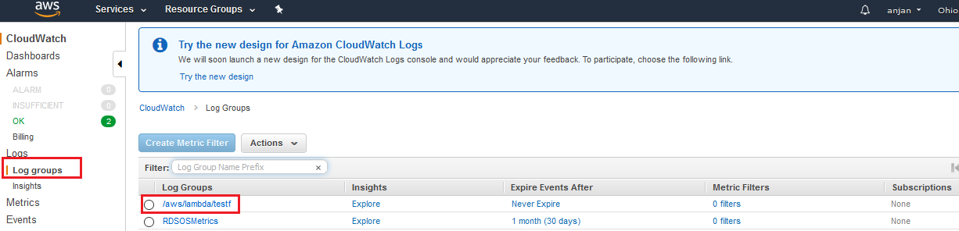

Slide 35
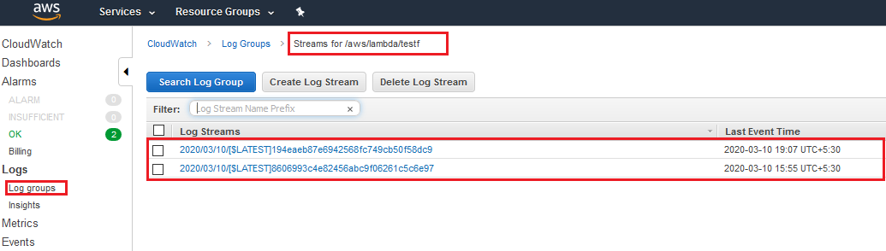

Slide 36
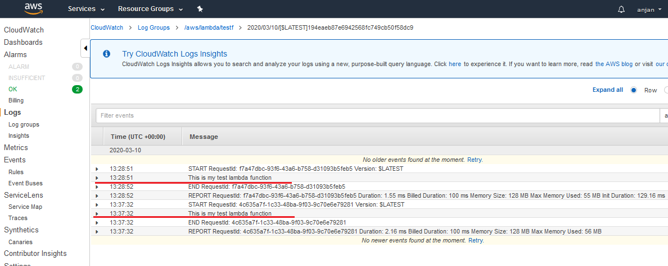
Cloudwatch Report after lambda function is fired by trigger

