Slide 1
Kubernetes

Slide 2
What Is Kubernetes?
Kubernetes is an open-source container management (orchestration) tool.
It’s container management responsibilities include container deployment, scaling & descaling of containers & container load balancing.

Slide 3
Why Use Kubernetes?
Companies out there maybe using Docker or Rocket or maybe simply Linux containers for containerizing their applications.
But, whatever it is, they use it on a massive scale ?
They don’t stop at using 1 or 2 containers in Prod. But rather, 10’s or 100’s of containers for load balancing the traffic and ensuring high availability.
Keep in mind that, as the traffic increases, they even have to scale up the number of containers to service the ‘n’ no of requests that come in every second. And, they have to also scale down the containers when the demand is less.
That is why, the need for container management tools is imminent.
Both Docker Swarm and Kubernetes are popular tools for Container management and orchestration.
Kubernetes for the reason simply being: Auto-scaling of containers based on traffic needs.

Slide 4
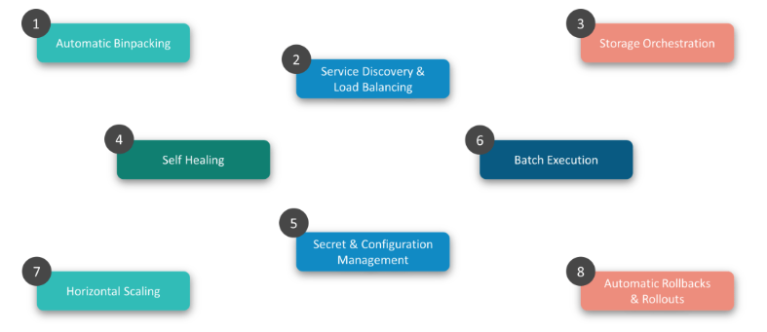
Features Of Kubernetes

Slide 5
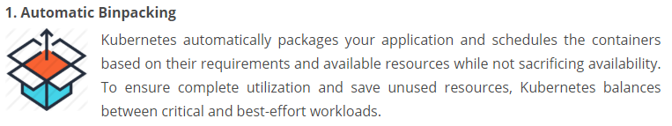
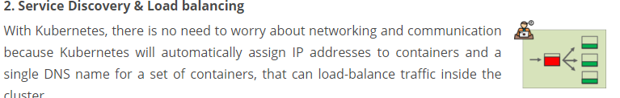
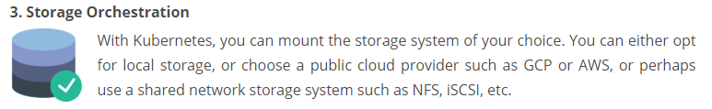
Features Of Kubernetes

Slide 6
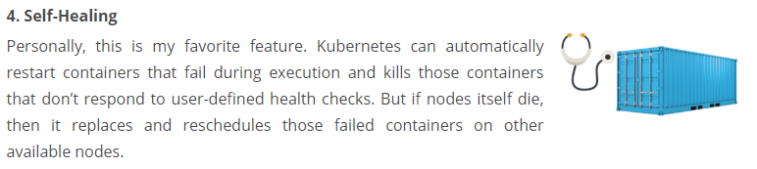
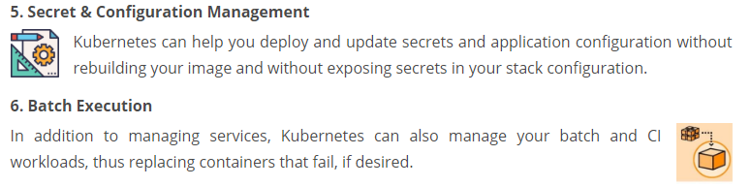
Features Of Kubernetes

Slide 7
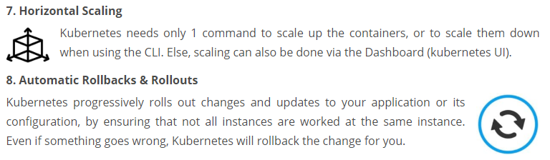
Features Of Kubernetes

Slide 8
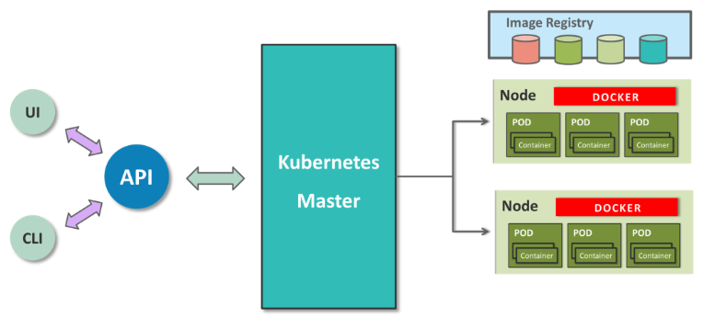
Kubernetes Architecture

Slide 9
Kubernetes Architecture
Kubernetes implements a cluster computing background, everything works from inside a Kubernetes Cluster.
This cluster is hosted by one node acting as the ‘master’ of the cluster, and other nodes as ‘nodes’ which do the actual ‘containerization‘.
Master controls the cluster, and the nodes in it. It ensures the execution only happens in nodes and coordinates the act.
Nodes host the containers; in-fact these Containers are grouped logically to form Pods. Each node can run multiple such Pods, which are a group of containers, that interact with each other, for a deployment.
Replication Controller is Master’s resource to ensure that the requested no. of pods are always running on nodes. Service is an object on Master that provides load balancing across a replicated group of Pods.

Slide 10
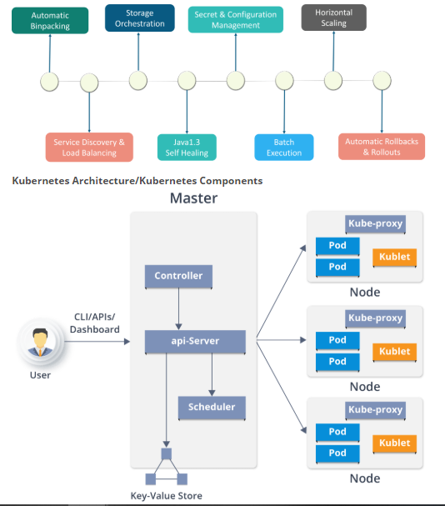
Kubernetes Architecture
Kubernetes Architecture
has the following main components:
Master nodes
Worker/Slave nodes
Distributed key-value store(etcd.)

Slide 11
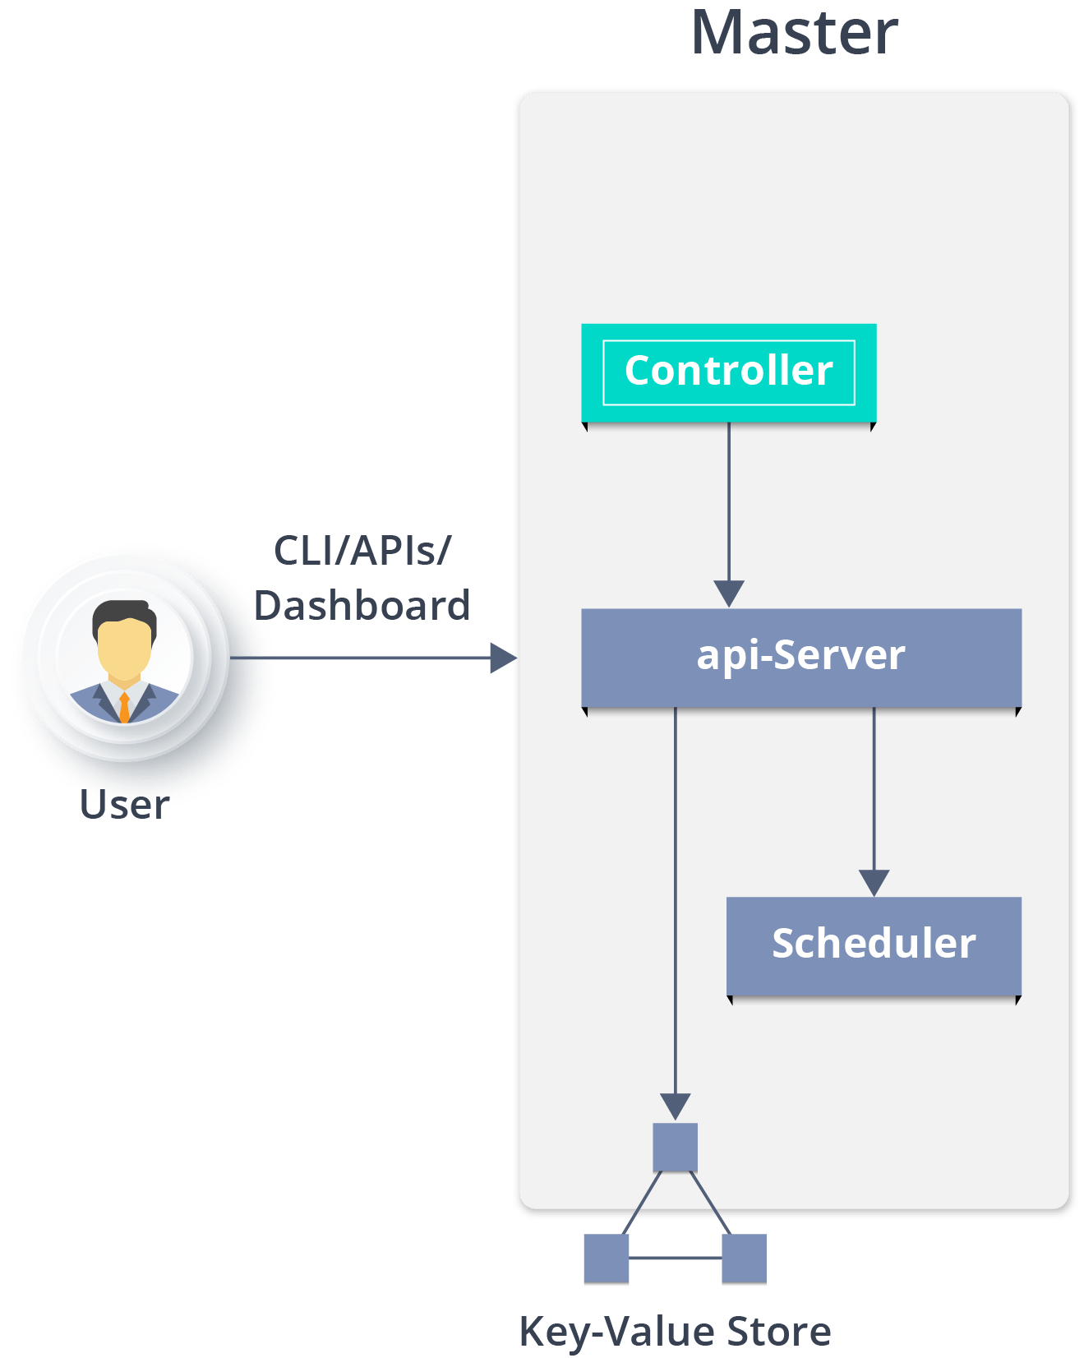
Kubernetes Architecture
Master Node
Master Node - Kubernetes Architecture - EdurekaIt is the entry point for all administrative tasks which is responsible for managing the Kubernetes cluster.
There can be more than one master node in the cluster to check for fault tolerance.
More than one master node puts the system in a High Availability mode, in which one of them will be the main node which we perform all the tasks.
For managing the cluster state, it uses etcd in which all the master nodes connect to it.

Slide 12
Kubernetes Architecture
API server:
Performs all the administrative tasks through the API server within the master node.
In this REST commands are sent to the API server which validates and processes the requests.
After requesting, the resulting state of the cluster is stored in the distributed key-value store.
Scheduler:
The scheduler schedules the tasks to slave nodes. It stores the resource usage information for each slave node.
It schedules the work in the form of Pods and Services.
Before scheduling the task, the scheduler also takes into account the quality of the service requirements, data locality, affinity, anti-affinity, etc.

Slide 13
Kubernetes Architecture
Controller manager:
Also known as controllers.
It is a daemon which regulates the Kubernetes cluster which manages the different non-terminating control loops.
It also performs lifecycle functions such as namespace creation and lifecycle, event garbage collection, terminated-pod garbage collection, cascading-deletion garbage collection, node garbage collection, etc.
Basically, a controller watches the desired state of the objects it manages and watches their current state through the API server.
If the current state of the objects it manages does not meet the desired state, then the control loop takes corrective steps to make sure that the current state is the same as the desired state.

Slide 14
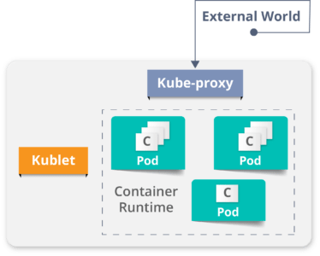
Kubernetes Architecture
Worker Node (formerly minions)
Worker Node - Kubernetes Architecture - EdurekaIt is a physical server or you can say a VM which runs the applications using Pods (a pod scheduling unit) which is controlled by the master node.
On a physical server (worker/slave node), pods are scheduled.
For accessing the applications from the external world, we connect to nodes.
Container runtime:
To run and manage a container’s lifecycle, we need a container runtime on the worker node.
Sometimes, Docker is also referred to as a container runtime, but to be precise, Docker is a platform which uses containers as a container runtime.

Slide 15
Kubernetes Case-Study
Yahoo! JAPAN is a web services provider headquartered in Sunnyvale, California.
As the company aimed to virtualize the hardware, company started using OpenStack in 2012.
Their internal environment changed very quickly.
However, due to the progress of cloud and container technology, the company wanted the capability to launch services on various platforms.
Problem: How to create images for all required platforms from one application code, and deploy those images onto each platform?

Slide 16
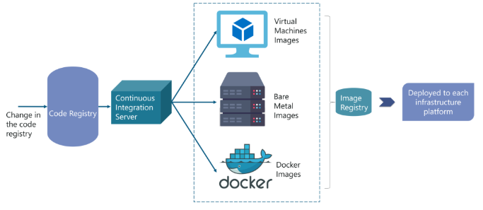
Kubernetes Case-Study
Solution:
When the code is changed at the code registry, then bare metal images, Docker containers, and VM images are created by continuous integration tools, pushed into the image registry, and then deployed to each infrastructure platform.

Slide 17
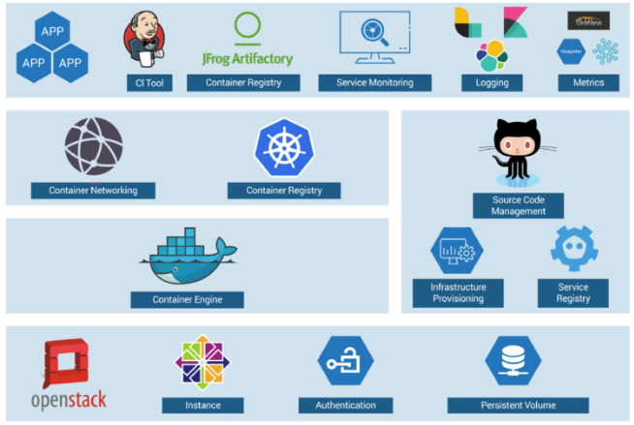
Kubernetes Case-Study
Solution:
container workflow
OpenStack instances are used, with Docker, Kubernetes, Calico, etcd on top of it to perform various operations like Container Networking, Container Registry, and so on.

Slide 18
Minikube to Create a Cluster
Kubernetes Clusters
Kubernetes coordinates a highly available cluster of computers that are connected to work as a single unit.
The abstractions in Kubernetes allow you to deploy containerized applications to a cluster without tying them specifically to individual machines.
To make use of this new model of deployment, applications need to be packaged in a way that decouples them from individual hosts: they need to be containerized.
Kubernetes automates the distribution and scheduling of application containers across a cluster in a more efficient way.
Kubernetes is an open-source platform and is production-ready.

Slide 19
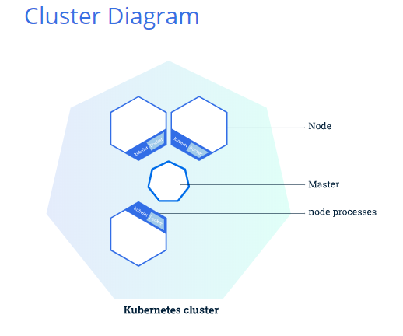
Minikube to Create a Cluster
Kubernetes Clusters
A Kubernetes cluster consists of two types of resources:
The Master coordinates the cluster
Nodes are the workers that run applications

Slide 20
Minikube to Create a Cluster
The Master is responsible for managing the cluster.
The master coordinates all activities in your cluster, such as scheduling applications, maintaining applications' desired state, scaling applications, and rolling out new updates.

Slide 21
Minikube to Create a Cluster
A node is a VM or a physical computer that serves as a worker machine in a Kubernetes cluster.
Each node has a Kubelet, which is an agent for managing the node and communicating with the Kubernetes master.
The node should also have tools for handling container operations, such as Docker or rkt.
A Kubernetes cluster that handles production traffic should have a minimum of three nodes.

Slide 22
Minikube to Create a Cluster
A Kubernetes cluster can be deployed on either physical or virtual machines.
To get started with Kubernetes development, you can use Minikube.
Minikube is a lightweight Kubernetes implementation that creates a VM on your local machine and deploys a simple cluster containing only one node.
Minikube is available for Linux, macOS, and Windows systems.
The Minikube CLI provides basic bootstrapping operations for working with your cluster, including start, stop, status, and delete.

Slide 23
Minikube to Create a Cluster
Online URL
https://kubernetes.io/docs/tutorials/kubernetes-basics/create-cluster/cluster-interactive/
Cluster up and running
To check that installed minikube is properly or not :
minikube version
Start the cluster, by running command:
minikube start
Now have a running Kubernetes cluster in terminal.
Minikube started a virtual machine for us, and a Kubernetes cluster is now running in that VM.

Slide 24
Minikube to Create a Cluster
Cluster version
To interact with Kubernetes ,use the command line interface, kubectl.
To check if kubectl is installed you can run the kubectl version command:
kubectl version

Slide 25
Minikube to Create a Cluster
Cluster details
To get kubectl cluster-info:
kubectl cluster-info
To view the nodes in the cluster, run the kubectl get nodes command:
kubectl get nodes
This command shows all nodes that can be used to host our applications.
Now may be there is only one node, and its status is ready (it is ready to accept applications for deployment).

Slide 26
Using kubectl to Create a Deployment
Kubernetes Deployments
Once you have a running Kubernetes cluster, you can deploy your containerized applications on top of it.
To do so, you create a Kubernetes Deployment configuration.
The Deployment instructs Kubernetes how to create and update instances of your application.
Once you've created a Deployment, the Kubernetes master schedules the application instances included in that Deployment to run on individual Nodes in the cluster.

Slide 27
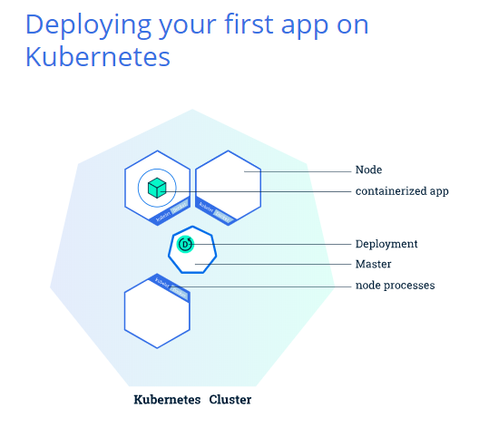
Using kubectl to Create a Deployment
Kubernetes Deployments
Once the application instances are created, a Kubernetes Deployment Controller continuously monitors those instances.
If the Node hosting an instance goes down or is deleted, the Deployment controller replaces the instance with an instance on another Node in the cluster.

Slide 28
Deploying an App
A Pod is the basic execution unit of a Kubernetes application.
Each Pod represents a part of a workload that is running on your cluster.
To deploy our first app on Kubernetes with the kubectl create deployment command.
We need to provide the deployment name and app image location (include the full repository url for images hosted outside Docker hub).
kubectl create deployment kubernetes-bootcamp --image=gcr.io/google-samples/kubernetes-bootcamp:v1
Kubectl get pods

Slide 29
Deploying an App
searched for a suitable node where an instance of the application could be run (have only 1 available node)
scheduled the application to run on that Node
configured the cluster to reschedule the instance on a new Node when needed
To list deployments use the get deployments command:
kubectl get deployments
We see that there is 1 deployment running a single instance of your app.
The instance is running inside a Docker container on your node.

Slide 30
Deploying an App
View our app
Pods that are running inside Kubernetes are running on a private, isolated network.
By default they are visible from other pods and services within the same kubernetes cluster, but not outside that network.
When we use kubectl, we're interacting through an API endpoint to communicate with our application.

Slide 31
Deploying an App
View our app
The kubectl command can create a proxy that will forward communications into the cluster-wide, private network.
The proxy can be terminated by pressing control-C and won't show any output while its running.
We will open a second terminal window to run the proxy.
echo -e "\n\n\n\e[92mStarting Proxy. After starting it will not output a response. Please click the first Terminal Tab\n";
kubectl proxy

Slide 32
Deploying an App
View our app
We now have a connection between our host (the online terminal) and the Kubernetes cluster.
The proxy enables direct access to the API from these terminals.
You can see all those APIs hosted through the proxy endpoint.
For example, we can query the version directly through the API using the curl command:
curl http://localhost:8001/version

Slide 33
Deploying an App
View our app
If Port 8001 is not accessible, ensure that the kubectl proxy started above is running.
The API server will automatically create an endpoint for each pod, based on the pod name, that is also accessible through the proxy.
First we need to get the Pod name, and we'll store in the environment variable POD_NAME:
export POD_NAME=$(kubectl get pods -o go-template --template '{{range .items}}{{.metadata.name}}{{"\n"}}{{end}}') echo Name of the Pod: $POD_NAME

Slide 34
Viewing Pods and Nodes
Kubernetes Pods
When you created a Deployment, Kubernetes created a Pod to host your application instance.
A Pod is a Kubernetes abstraction that represents a group of one or more application containers (such as Docker or rkt), and some shared resources for those containers. Those resources include:
Shared storage, as Volumes
Networking, as a unique cluster IP address
Information about how to run each container, such as the container image version or specific ports to use

Slide 35
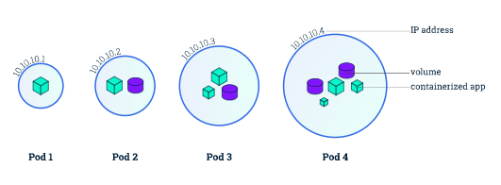
Viewing Pods and Nodes
Kubernetes Pods
Pods are the atomic unit on the Kubernetes platform.
When we create a Deployment on Kubernetes, that Deployment creates Pods with containers inside them (as opposed to creating containers directly).
Each Pod is tied to the Node where it is scheduled, and remains there until termination (according to restart policy) or deletion.
In case of a Node failure, identical Pods are scheduled on other available Nodes in the cluster.

Slide 36
Viewing Pods and Nodes
Nodes
A Pod always runs on a Node.
A Node is a worker machine in Kubernetes and may be either a virtual or a physical machine, depending on the cluster.
Each Node is managed by the Master. A Node can have multiple pods, and the Kubernetes master automatically handles scheduling the pods across the Nodes in the cluster.
The Master's automatic scheduling takes into account the available resources on each Node.

Slide 37
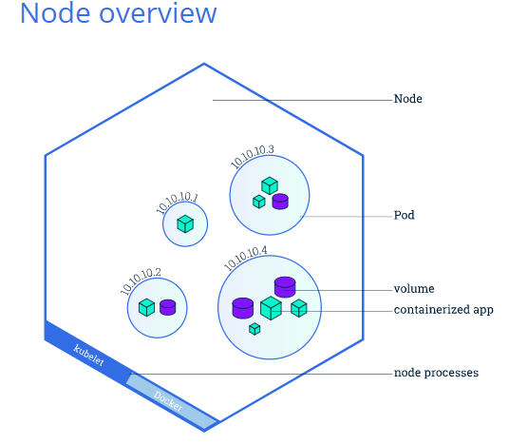
Viewing Pods and Nodes
Nodes
Every Kubernetes Node runs at least:
Kubelet, a process responsible for communication between the Kubernetes Master and the Node; it manages the Pods and the containers running on a machine.
A container runtime (like Docker, rkt) responsible for pulling the container image from a registry, unpacking the container, and running the application.

Slide 38
Viewing Pods and Nodes
kubectl commands:
kubectl get - list resources
kubectl describe - show detailed information about a resource
kubectl logs - print the logs from a container in a pod
kubectl exec - execute a command on a container in a pod
You can use these commands to see when applications were deployed, what their current statuses are, where they are running and what their configurations are.

Slide 39
Viewing Pods and Nodes
Exploring Your App
Step 1 Check application configuration
Let’s verify that the application we deployed in the previous scenario is running.
use the kubectl get command and look for existing Pods:
kubectl get pods
Next, to view what containers are inside that Pod and what images are used to build those containers we run the describe pods command:
kubectl describe pods
details about the Pod’s container: IP address, the ports used and a list of events related to the lifecycle of the Pod.

Slide 40
Viewing Pods and Nodes
Exploring Your App
Step 2 Show the app in the terminal
Recall that Pods are running in an isolated, private network - so we need to proxy access to them so we can debug and interact with them.
To do this, we'll use the kubectl proxy command to run a proxy in a second terminal window.
echo -e "\n\n\n\e[92mStarting Proxy. After starting it will not output a response. Please click the first Terminal Tab\n"; kubectl proxy
Now again, we'll get the Pod name and query that pod directly through the proxy.
To get the Pod name and store it in the POD_NAME environment variable:
export POD_NAME=$(kubectl get pods -o go-template --template '{{range .items}}{{.metadata.name}}{{"\n"}}{{end}}') echo Name of the Pod: $POD_NAME
To see the output of our application, run a curl request.
curl http://localhost:8001/api/v1/namespaces/default/pods/$POD_NAME/proxy/
The url is the route to the API of the Pod.

Slide 41
Viewing Pods and Nodes
Exploring Your App
Step 3 View the container logs
Anything that the application would normally send to STDOUT becomes logs for the container within the Pod. We can retrieve these logs using the kubectl logs command:
kubectl logs $POD_NAME

Slide 42
Viewing Pods and Nodes
Exploring Your App
Step 4 Executing command on the container
We can execute commands directly on the container once the Pod is up and running.
For this, we use the exec command and use the name of the Pod as a parameter.
Let’s list the environment variables:
kubectl exec $POD_NAME env
Next let’s start a bash session in the Pod’s container:
kubectl exec -ti $POD_NAME bash
We have now an open console on the container where we run our NodeJS application. The source code of the app is in the server.js file:
cat server.js
You can check that the application is up by running a curl command:
curl localhost:8080

Slide 43
Viewing Pods and Nodes
Exploring Your App
Step 4 Executing command on the container
We can execute commands directly on the container once the Pod is up and running.
For this, we use the exec command and use the name of the Pod as a parameter.
Let’s list the environment variables:
kubectl exec $POD_NAME env
Next let’s start a bash session in the Pod’s container:
kubectl exec -ti $POD_NAME bash
We have now an open console on the container where we run our NodeJS application. The source code of the app is in the server.js file:
cat server.js
You can check that the application is up by running a curl command:
curl localhost:8080
To close your container connection type exit.

Slide 44
Kubernetes Services

Slide 45
Kubernetes Services
Kubernetes Pods are mortal. Pods in fact have a lifecycle. When a worker node dies, the Pods running on the Node are also lost.
A ReplicaSet might then dynamically drive the cluster back to desired state via creation of new Pods to keep your application running.
Example, consider an image-processing backend with 3 replicas.
Those replicas are exchangeable
The front-end system should not care about backend replicas or even if a Pod is lost and recreated.
That said, each Pod in a Kubernetes cluster has a unique IP address, even Pods on the same Node
so there needs to be a way of automatically reconciling changes among Pods so that your applications continue to function.

Slide 46
Kubernetes Services
A Service in Kubernetes is an abstraction which defines a logical set of Pods and a policy by which to access them. Services enable a loose coupling between dependent Pods.
A Service is defined using YAML or JSON, like all Kubernetes objects.
The set of Pods targeted by a Service is usually determined by a LabelSelector.

Slide 47
Kubernetes Services
Although each Pod has a unique IP address, those IPs are not exposed outside the cluster without a Service.
Services allow your applications to receive traffic.
Services can be exposed in different ways by specifying a type in the ServiceSpec:
ClusterIP (default) - Exposes the Service on an internal IP in the cluster. This type makes the Service only reachable from within the cluster.
NodePort - Exposes the Service on the same port of each selected Node in the cluster using NAT. Makes a Service accessible from outside the cluster using <NodeIP>:<NodePort>. Superset of ClusterIP.
LoadBalancer - Creates an external load balancer in the current cloud (if supported) and assigns a fixed, external IP to the Service. Superset of NodePort.
ExternalName - Exposes the Service using an arbitrary name (specified by externalName in the spec) by returning a CNAME record with the name. No proxy is used. This type requires v1.7 or higher of kube-dns.

Slide 48
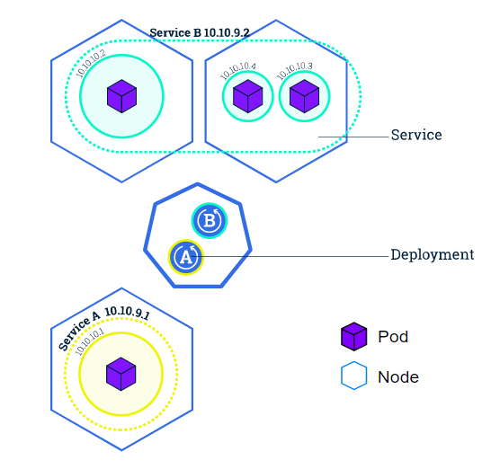
Kubernetes Services
Services and Labels
A Service routes traffic across a set of Pods.
Services are the abstraction that allow pods to die and replicate in Kubernetes without impacting your application.
Discovery and routing among dependent Pods (such as the frontend and backend components in an application) is handled by Kubernetes Services.
Services match a set of Pods using labels and selectors, a grouping primitive that allows logical operation on objects in Kubernetes.
Labels are key/value pairs attached to objects and can be used in any number of ways:
Designate objects for development, test, and production
Embed version tags
Classify an object using tags

Slide 49
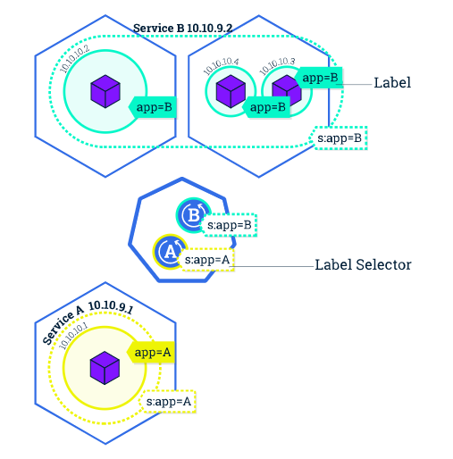
Kubernetes Services
Services and Labels
Labels can be attached to objects at creation time or later on.
They can be modified at any time.

Slide 50
Kubernetes Services
Step 1 Create a new service
Let’s verify that our application is running. use the kubectl get command and look for existing Pods:
kubectl get pods
If no pods are running then it means the interactive environment is still reloading its previous state. Please wait a couple of seconds and list the Pods again.
Next, let’s list the current Services from our cluster:
kubectl get services
We have a Service called kubernetes that is created by default when minikube starts the cluster.
To create a new service and expose it to external traffic we’ll use the expose command with NodePort as parameter (minikube does not support the LoadBalancer option yet).
kubectl expose deployment/kubernetes-bootcamp --type="NodePort" --port 8080

Slide 51
Kubernetes Services
Step 1 Create a new service
Let’s run again the get services command:
kubectl get services
We have now a running Service called kubernetes-bootcamp.
Here see that the Service received a unique cluster-IP, an internal port and an external-IP (the IP of the Node).
To find out what port was opened externally (by the NodePort option) we’ll run the describe service command:
kubectl describe services/kubernetes-bootcamp
Create an environment variable called NODE_PORT that has the value of the Node port assigned:
export NODE_PORT=$(kubectl get services/kubernetes-bootcamp -o go-template='{{(index .spec.ports 0).nodePort}}') echo NODE_PORT=$NODE_PORT
Now we can test that the app is exposed outside of the cluster using curl, the IP of the Node and the externally exposed port:
curl $(minikube ip):$NODE_PORT
And we get a response from the server. The Service is exposed.

Slide 52
Kubernetes Services
Step 2: Using labels
The Deployment created automatically a label for our Pod.
With describe deployment command you can see the name of the label:
kubectl describe deployment
Let’s use this label to query our list of Pods. We’ll use the kubectl get pods command with -l as a parameter, followed by the label values:
kubectl get pods -l run=kubernetes-bootcamp
You can do the same to list the existing services:
You can do the same to list the existing services:
kubectl get services -l run=kubernetes-bootcamp

Slide 53
Kubernetes Services
Step 2: Using labels
Get the name of the Pod and store it in the POD_NAME environment variable:
export POD_NAME=$(kubectl get pods -o go-template --template '{{range .items}}{{.metadata.name}}{{"\n"}}{{end}}') echo Name of the Pod: $POD_NAME
To apply a new label we use the label command followed by the object type, object name and the new label:
kubectl label pod $POD_NAME app=v1
This will apply a new label to our Pod (we pinned the application version to the Pod), and we can check it with the describe pod command:
kubectl describe pods $POD_NAME
We see here that the label is attached now to our Pod. And we can query now the list of pods using the new label:
kubectl get pods -l app=v1
And we see the Pod.

Slide 54
Kubernetes Services
Step 3 Deleting a service
To delete Services you can use the delete service command.
Labels can be used also here:
kubectl delete service -l run=kubernetes-bootcamp
Confirm that the service is gone:
kubectl get services
This confirms that our Service was removed.
To confirm that route is not exposed anymore you can curl the previously exposed IP and port:
curl $(minikube ip):$NODE_PORT
This proves that the app is not reachable anymore from outside of the cluster.
You can confirm that the app is still running with a curl inside the pod:
kubectl exec -ti $POD_NAME curl localhost:8080
We see here that the application is up. This is because the Deployment is managing the application.
To shut down the application, you would need to delete the Deployment as well.

Slide 55
Running Multiple Instances of Your App

Slide 56
Running Multiple Instances of Your App
Scaling an application
In the previous modules we created a Deployment, and then exposed it publicly via a Service.
The Deployment created only one Pod for running our application.
When traffic increases, we will need to scale the application to keep up with user demand.
Scaling is accomplished by changing the number of replicas in a Deployment

Slide 57
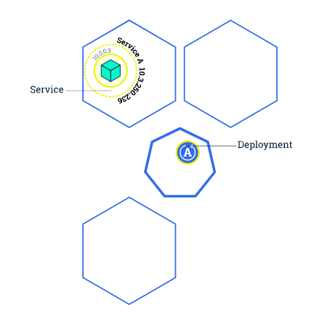
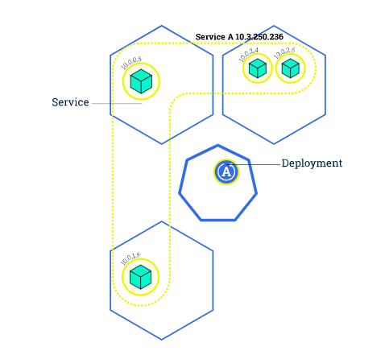
Running Multiple Instances of Your App
Scaling an application
Scaling out a Deployment will ensure new Pods are created and scheduled to Nodes with available resources.
Scaling will increase the number of Pods to the new desired state. Kubernetes also supports autoscaling of Pods. Scaling to zero is also possible, and it will terminate all Pods of the specified Deployment.
Running multiple instances of an application will require a way to distribute the traffic to all of them.
Services have an integrated load-balancer that will distribute network traffic to all Pods of an exposed Deployment.
Services will monitor continuously the running Pods using endpoints, to ensure the traffic is sent only to available Pods.
Once you have multiple instances of an Application running, you would be able to do Rolling updates without downtime.

Slide 58
Running Multiple Instances of Your App
Step 1: Scaling a deployment
To list your deployments use the get deployments command: kubectl get deployments
This shows:
NAME lists the names of the Deployments in the cluster.
READY shows the ratio of CURRENT/DESIRED replicas
UP-TO-DATE displays the number of replicas that have been updated to achieve the desired state.
AVAILABLE displays how many replicas of the application are available to your users.
AGE displays the amount of time that the application has been running.

Slide 59
Running Multiple Instances of Your App
Step 1: Scaling a deployment
To see the ReplicaSet created by the Deployment, run kubectl get rs
Notice that the name of the ReplicaSet is always formatted as [DEPLOYMENT-NAME]-[RANDOM-STRING].
The random string is randomly generated and uses the pod-template-hash as a seed.
Two important columns of this command are:
DESIRED displays the desired number of replicas of the application, which you define when you create the Deployment. This is the desired state.
CURRENT displays how many replicas are currently running.

Slide 60
Running Multiple Instances of Your App
Step 1: Scaling a deployment
Next, let’s scale the Deployment to 4 replicas, use the kubectl scale command, followed by the deployment type, name and desired number of instances:
kubectl scale deployments/kubernetes-bootcamp --replicas=4
To list your Deployments once again, use get deployments:
kubectl get deployments
The change was applied, and we have 4 instances of the application available. Next, let’s check if the number of Pods changed:
kubectl get pods -o wide
There are 4 Pods now, with different IP addresses. The change was registered in the Deployment events log. To check that, use the describe command:
kubectl describe deployments/kubernetes-bootcamp

Slide 61
Running Multiple Instances of Your App
Step 2: Load Balancing
Let’s check that the Service is load-balancing the traffic.
To find out the exposed IP and Port we can use the describe service as we learned in the previously Module:
kubectl describe services/kubernetes-bootcamp
Create an environment variable called NODE_PORT that has a value as the Node port:
export NODE_PORT=$(kubectl get services/kubernetes-bootcamp -o go-template='{{(index .spec.ports 0).nodePort}}') echo NODE_PORT=$NODE_PORT
Next, we’ll do a curl to the exposed IP and port. Execute the command multiple times:
curl $(minikube ip):$NODE_PORT
We hit a different Pod with every request.
This demonstrates that the load-balancing is working.

Slide 62
Running Multiple Instances of Your App
Step 3: Scale Down
To scale down the Service to 2 replicas, run again the scale command:
kubectl scale deployments/kubernetes-bootcamp --replicas=2
List the Deployments to check if the change was applied with the get deployments command:
kubectl get deployments
The number of replicas decreased to 2. List the number of Pods, with get pods:
kubectl get pods -o wide
This confirms that 2 Pods were terminated.

