Slide 1

AWS Lambda

Slide 2
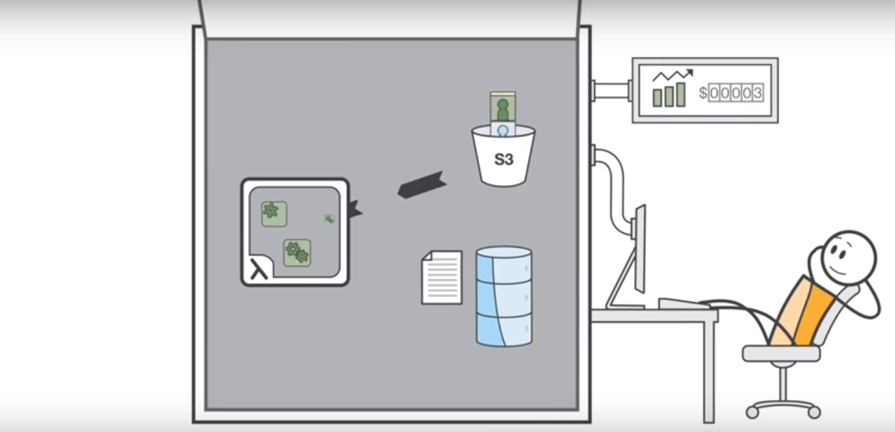
AWS Lambda

Slide 3
AWS Lambda
AWS Lambda lets you run code without provisioning or managing servers.
You pay only for the compute time you consume.
With Lambda, you can run code for virtually any type of application or backend service - all with zero administration.
Just upload your code and Lambda takes care of everything required to run and scale your code with high availability.
You can set up your code to automatically trigger from other AWS services or call it directly from any web or mobile app.

Slide 4
AWS Lambda
The code you run on AWS Lambda is called a “Lambda function.”
After you create your Lambda function it is always ready to run as soon as it is triggered, similar to a formula in a spreadsheet.
Each function includes your code as well as some associated configuration information, including the function name and resource requirements.
Lambda functions are “stateless,” with no affinity to the underlying infrastructure, so that Lambda can rapidly launch as many copies of the function as needed to scale to the rate of incoming events.

Slide 5
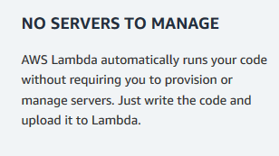
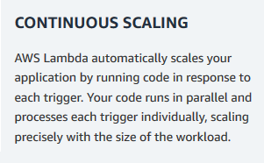
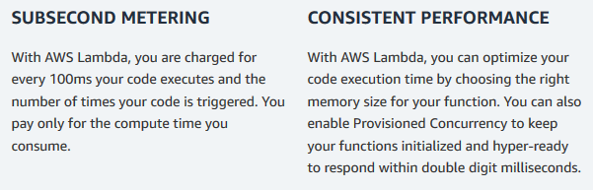
Benefits of Lambda

Slide 6
Features
Extend other AWS services with custom logic
AWS Lambda allows you to add custom logic to AWS resources such as Amazon S3 buckets and Amazon DynamoDB tables, making it easy to apply compute to data as it is enters or moves through the cloud.

Slide 7
Features
Extend other AWS services with custom logic
It is easy to get started with AWS Lambda.
First you create your function by uploading your code (or building it right in the Lambda console) and choosing the memory, timeout period, and AWS Identity and Access Management (IAM) role.
Then, you specify the AWS resource to trigger the function, either a particular Amazon S3 bucket, Amazon DynamoDB table, or Amazon Kinesis stream.
When the resource changes, Lambda will run your function and launch and manage the compute resources as needed in order to keep up with incoming requests.

Slide 8
Build custom back-end services
.
Bring your own code
With AWS Lambda, there are no new languages, tools, or frameworks to learn. You can use any third party library, even native ones.
You can also package any code (frameworks, SDKs, libraries, and more) as a Lambda Layer and manage and share them easily across multiple functions.
Lambda natively supports Java, Go, PowerShell, Node.js, C#, Python, and Ruby code, and provides a Runtime API which allows you to use any additional programming languages to author your functions.

Slide 9
Completely automated administration
AWS Lambda manages all the infrastructure to run your code on highly available, fault-tolerant infrastructure, freeing you to focus on building differentiated back-end services.
With Lambda, you never have to update the underlying OS when a patch is released, or worry about resizing or adding new servers as your usage grows.
AWS Lambda seamlessly deploys your code, does all the administration, maintenance, and security patches, and provides built-in logging and monitoring through Amazon CloudWatch.

Slide 10
Built-in fault tolerance
Lambda has built-in fault tolerance. AWS Lambda maintains compute capacity across multiple Availability Zones in each region to help protect your code against individual machine or data center facility failures.
Both AWS Lambda and the functions running on the service provide predictable and reliable operational performance.
AWS Lambda is designed to provide high availability for both the service itself and for the functions it operates.
There are no maintenance windows or scheduled downtimes.

Slide 11
Automatic scaling
AWS Lambda invokes your code only when needed and automatically scales to support the rate of incoming requests without requiring you to configure anything.
There is no limit to the number of requests your code can handle. AWS Lambda typically starts running your code within milliseconds of an event, and since Lambda scales automatically, the performance remains consistently high as the frequency of events increases.
Since your code is stateless, Lambda can start as many instances of it as needed without lengthy deployment and configuration delays.

Slide 12
Connect to relational databases
Use Amazon RDS Proxy to take advantage of fully managed connection pools for relational databases.
RDS Proxy efficiently manages thousands of concurrent database connections to relational databases, making it easy to build highly scalable, secure, Lambda-based serverless applications that need to interact with relational databases.
Currently, RDS Proxy offers support for MySQL and Aurora.
You can use RDS Proxy for your serverless applications through the Amazon RDS console or through the AWS Lambda console.

Slide 13
Fine grained control over performance
Provisioned Concurrency gives you greater control over the performance of your serverless application. When enabled, Provisioned Concurrency keeps functions initialized and hyper-ready to respond in double-digit milliseconds. Provisioned Concurrency is ideal for any application built using AWS Lambda that needs greater control over function start time. You can easily configure the appropriate amount of concurrency that your application needs. You can increase the level of concurrency during times of high demand and lower it, or turn it off completely, when demand decreases. Taking advantage of Provisioned Concurrency requires no changes to your code. Provisioned Concurrency is an efficient way to achieve consistent performance for latency-sensitive applications as you need it, without having to manage compute resources.
Run code in response to Amazon CloudFront requests
With Lambda@Edge, AWS Lambda can run your code across AWS locations globally in response to Amazon CloudFront events, such as requests for content to or from origin servers and viewers. This makes it easier to deliver richer, more personalized content to your end users with lower latency.

Slide 14
Orchestrate multiple functions
You can coordinate multiple AWS Lambda functions for complex or long-running tasks by building workflows with AWS Step Functions. Step Functions lets you define workflows that trigger a collection of Lambda functions using sequential, parallel, branching, and error-handling steps. With Step Functions and Lambda, you can build stateful, long-running processes for applications and backends.
Integrated security model
AWS Lambda allows your code to securely access other AWS services through its built-in AWS SDK and integration with AWS Identity and Access Management (IAM). AWS Lambda runs your code within a VPC by default. You can optionally also configure AWS Lambda to access resources behind your own VPC, allowing you to leverage custom security groups and network access control lists to provide your Lambda functions access to your resources within a VPC.
AWS Lambda is SOC, HIPAA, PCI, ISO compliant. For the latest in Lambda certification and compliance readiness, please see the full services in scope.

Slide 15
Only pay for what you use
With AWS Lambda, you pay for execution duration rather than by server unit. When using Lambda functions, you only pay for requests served and the compute time required to run your code. Billing is metered in increments of 100 milliseconds, making it cost-effective and easy to scale automatically from a few requests per day to thousands per second. With Provisioned Concurrency, you pay for the amount of concurrency that you configure and for the period of time that you configure it. When Provisioned Concurrency is enabled for your function and you execute it, you also pay for requests and execution duration. To learn more about pricing, please visit AWS Lambda Pricing.
Flexible resource model
You choose the amount of memory you want to allocate to your functions and AWS Lambda allocates proportional CPU power, network bandwidth, and disk I/O.

Slide 16
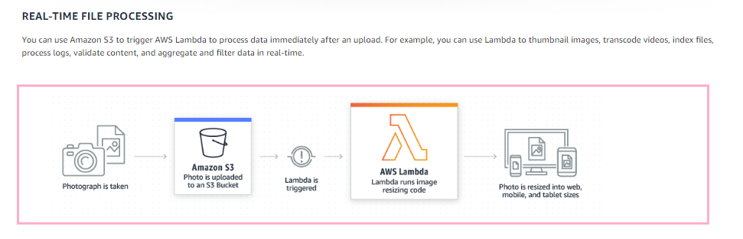
What Lambda does

Slide 17
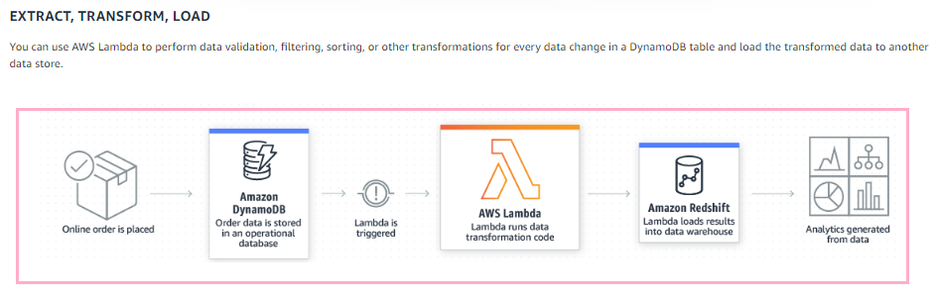
What Lambda does

Slide 18
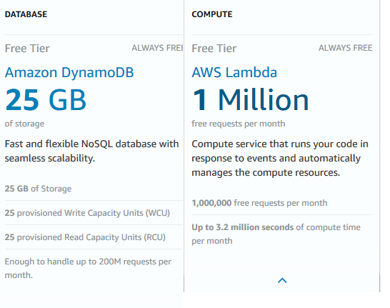
Free Tier

Slide 19
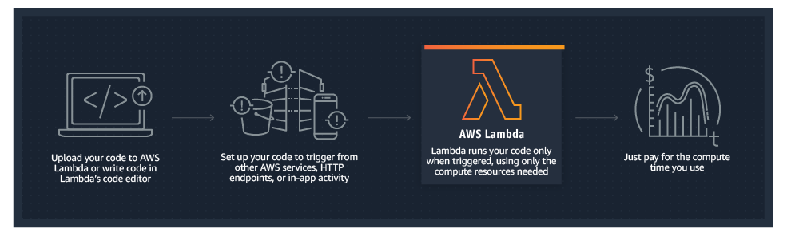
How it works

Slide 20
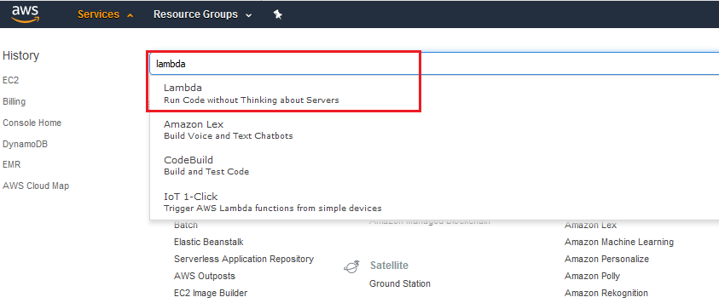
Open Lambda

Slide 21
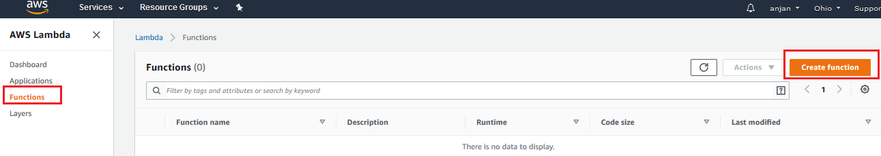
Create the lambda function

Slide 22
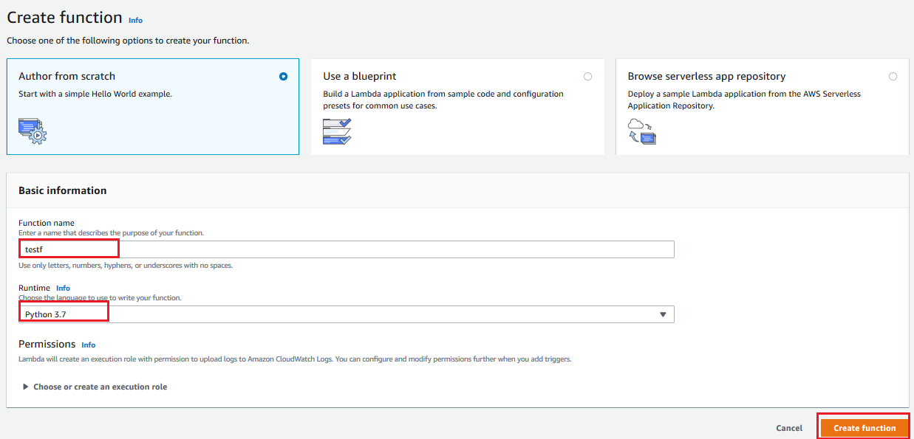
Create the lambda function

Slide 23
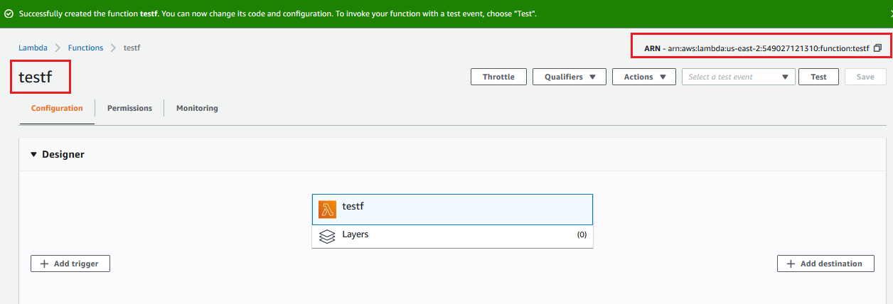
Lambda function created successfully

Slide 24
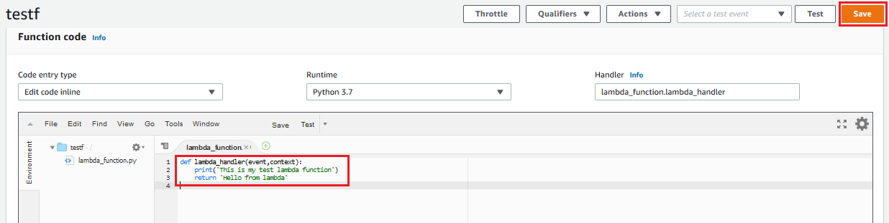
Write the Lambda function code then save and test
def lambda_handler(event,context):
print('This is my test lambda function')
return 'Hello from lambda'

Slide 25
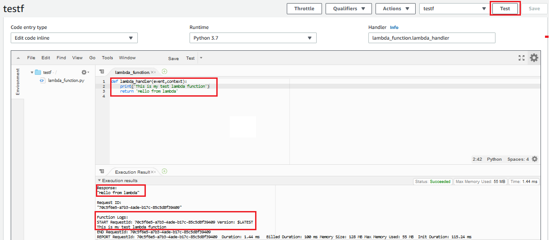
Test
After you run test give the eventhandler name same as the function name

Slide 26
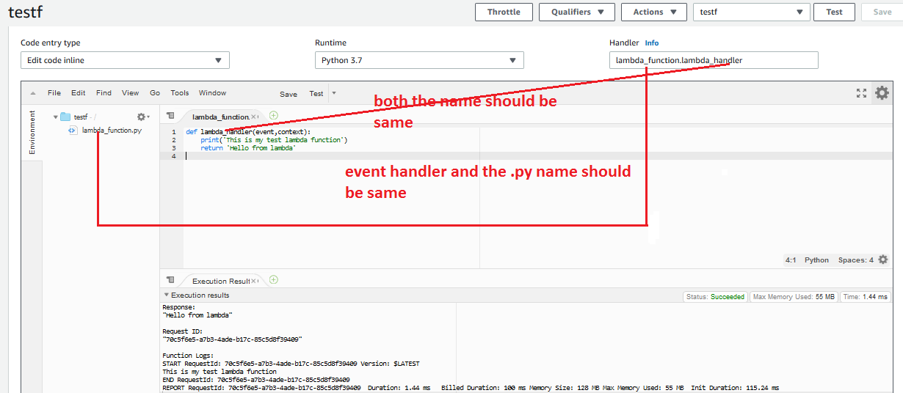
Event handler name and the .py file name should be same

Slide 27
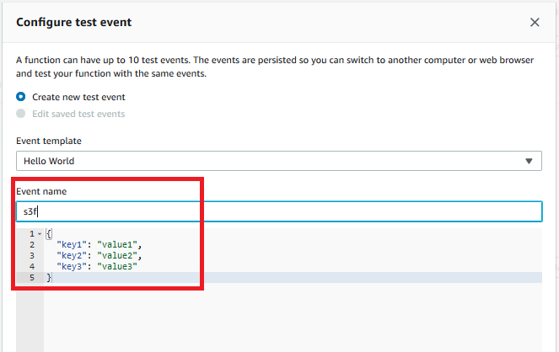
Type a event name same as the function

Slide 28
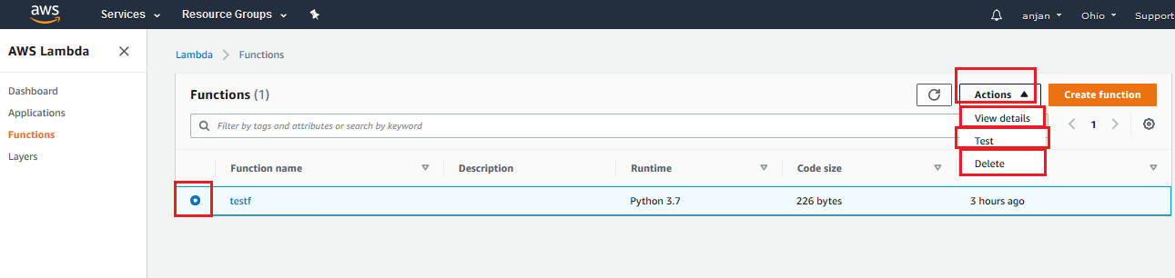
Operations in Lambda function

Slide 29
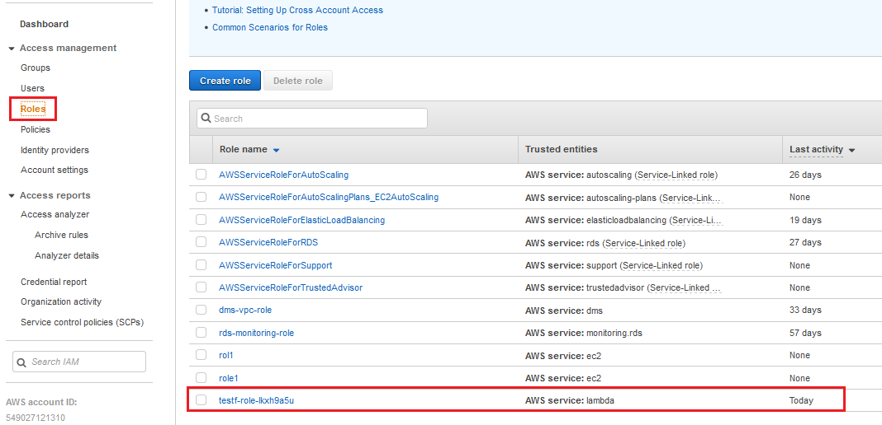
Role created for Lambda

Slide 30
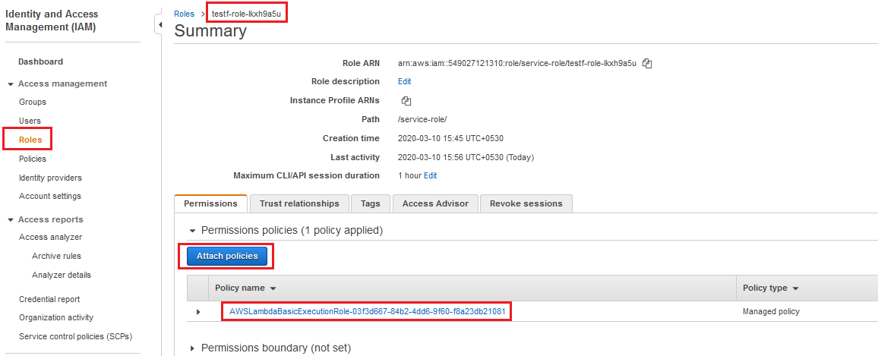
Trigger a lambda function for S3
Allow the role of lambda for full S3 access and cloudwatch

Slide 31
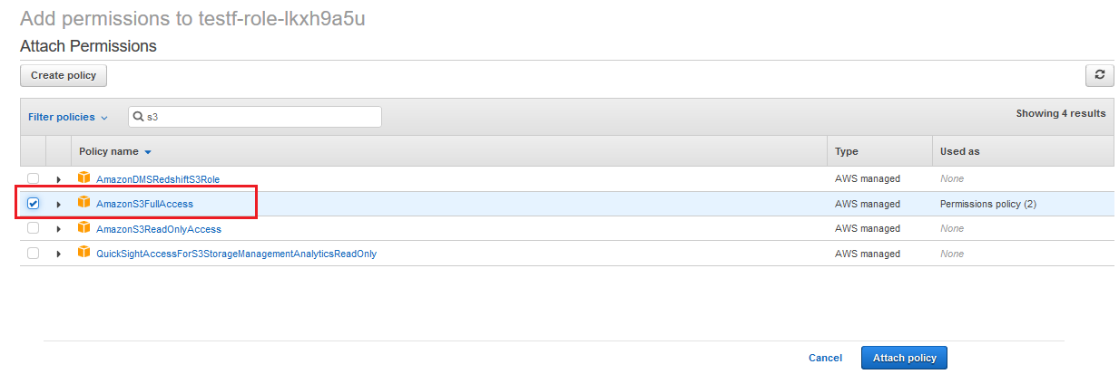
Allow the role of lambda for full S3 access and Cloudwatch

Slide 32
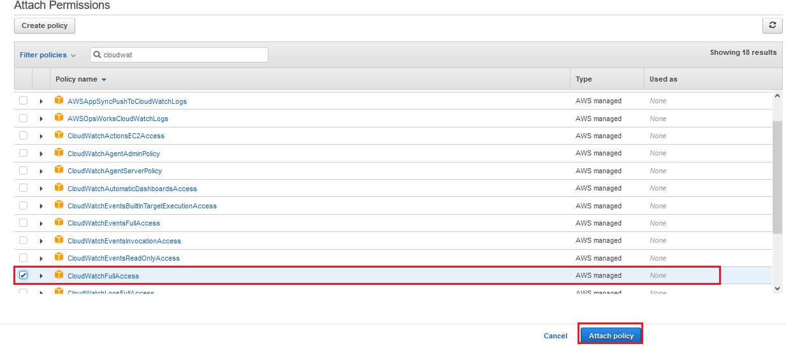
Allow Cloudwatch

Slide 33
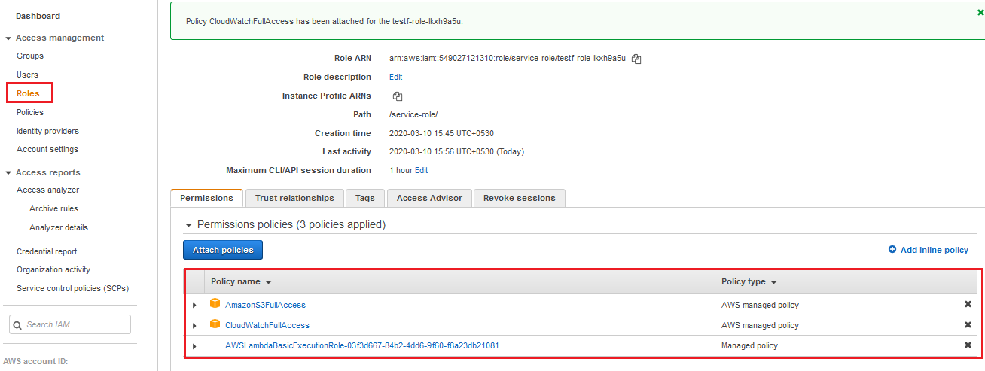
Permissions for Lambda function

Slide 34
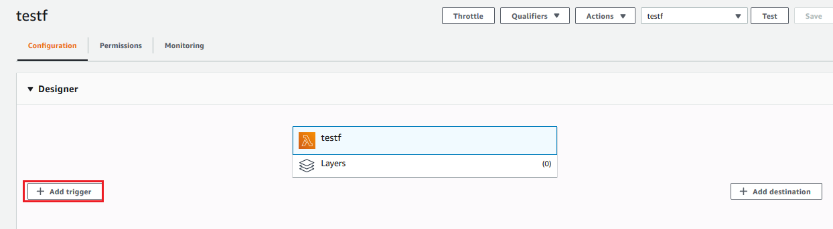
Add trigger

Slide 35
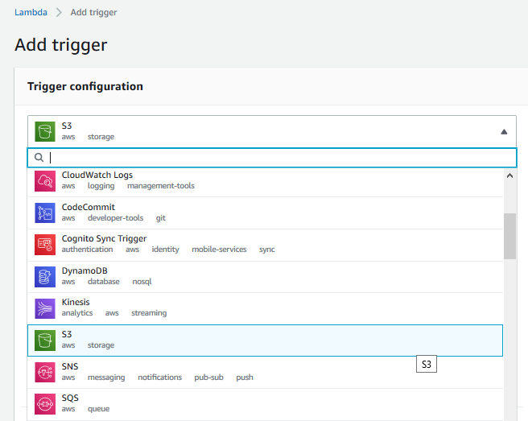
Select S3

Slide 36
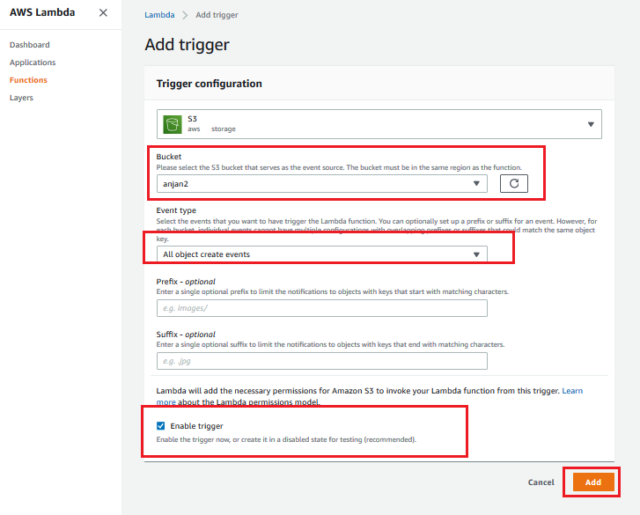
Add the Trigger

Slide 37
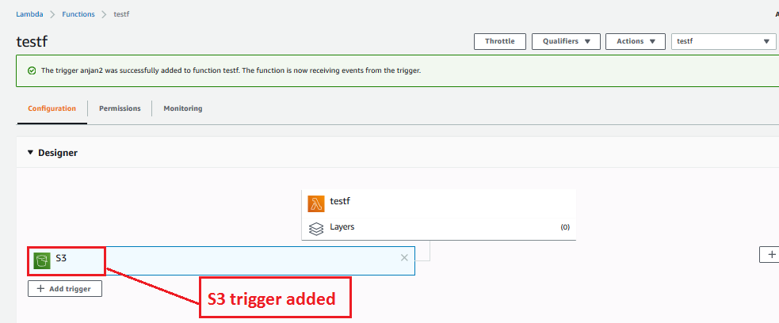
S3 trigger added in Lambda

Slide 38
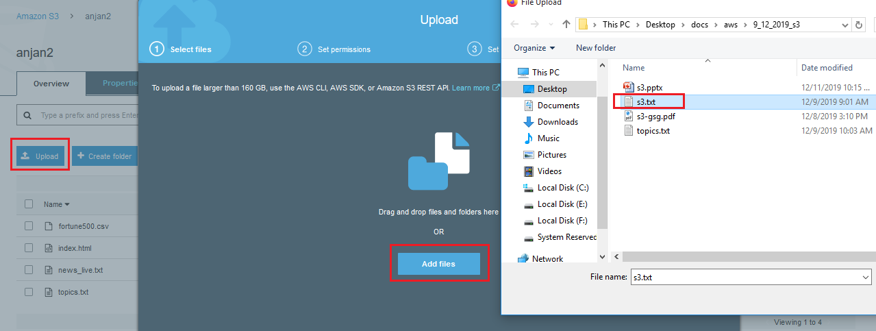
Now upload a file in S3

Slide 39
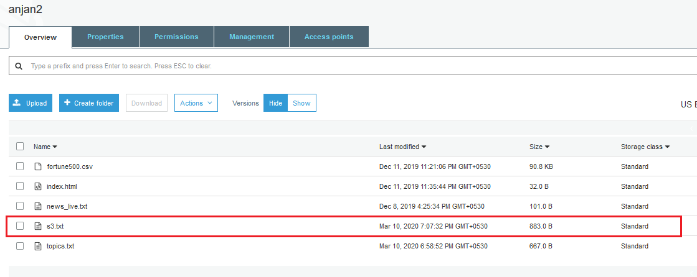
File uploaded in S3

Slide 40
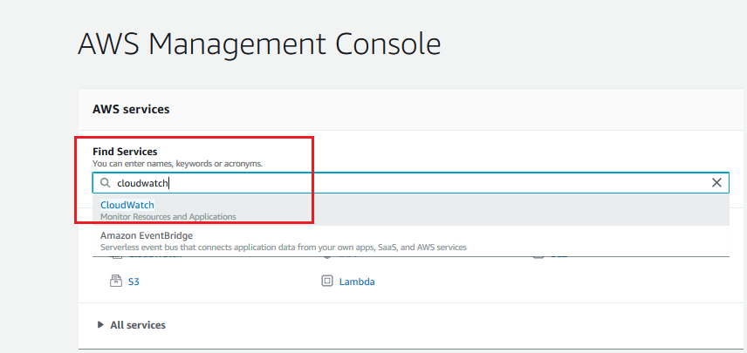
Now goto cloudwatch to verify lambda has triggered

Slide 41
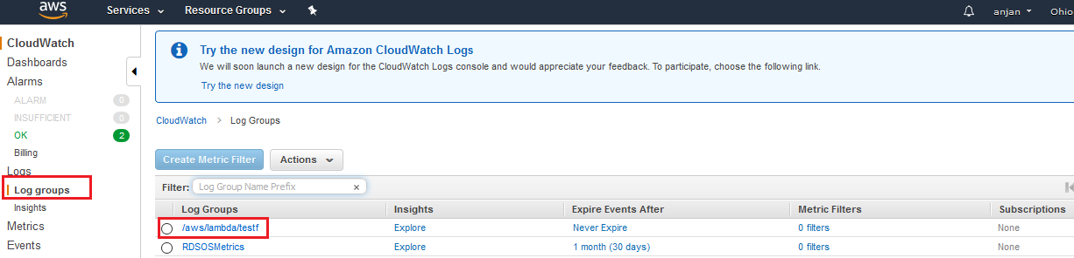

Slide 42
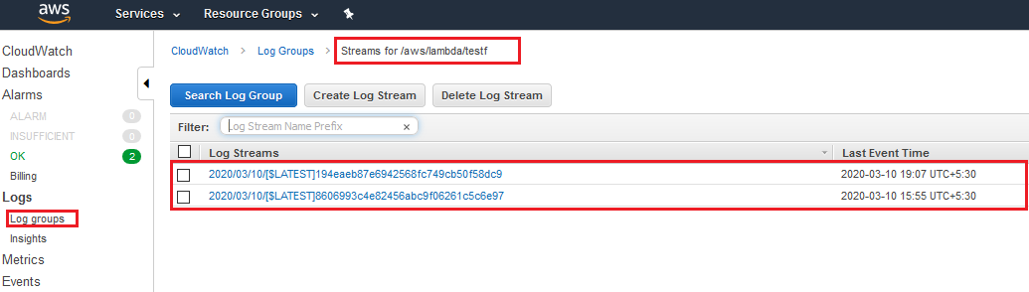

Slide 43
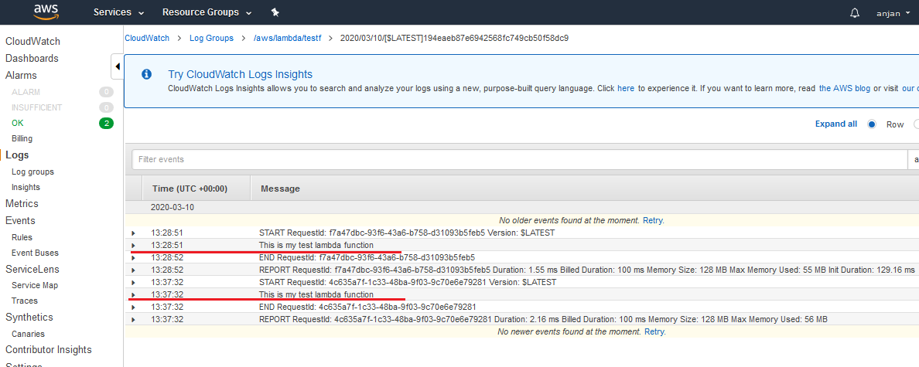
Cloudwatch Report after lambda function is fired by trigger

