Slide 1
Junit
an open source Unit Testing Framework for JAVA

Slide 2
What is Junit?
JUnit is an open source Unit Testing Framework for JAVA.
It is useful for Java Developers to write and run repeatable tests.
Erich Gamma and Kent Beck initially develop it.
It is an instance of xUnit architecture.
As the name implies, it is used for Unit Testing of a small chunk of code.

Slide 3
What is Unit Testing?
Unit Testing is used to verify a small chunk of code by creating a path, function or a method.
The term "unit" exist earlier than the object-oriented era.
It is basically a natural abstraction of an object oriented system i.e. a Java class or object (its instantiated form).
Unit Testing is used to identify defects early in software development cycle.

Slide 4
Why you need JUnit testing
It finds bugs early in the code, which makes our code more reliable.
JUnit is useful for developers, who work in a test-driven environment.
Unit testing forces a developer to read code more than writing.
You develop more readable, reliable and bug-free code which builds confidence during development.

Slide 5
How to define a test in JUnit?
A JUnit test is a method contained in a class which is only used for testing. This is called a Test class.
To define that a certain method is a test method, annotate it with the @Test annotation.
This method executes the code under test. You use an assert method, provided by JUnit or another assert framework, to check an expected result versus the actual result.
These method calls are typically called asserts or assert statements.

Slide 6
Example JUnit test
import static org.junit.jupiter.api.Assertions.assertEquals;
import org.junit.jupiter.api.Test;
public class MyTests {
@Test
public void multiplicationOfZeroIntegersShouldReturnZero() {
MyClass tester = new MyClass(); // MyClass is tested
// assert statements
assertEquals(0, tester.multiply(10, 0), "10 x 0 must be 0");
assertEquals(0, tester.multiply(0, 10), "0 x 10 must be 0");
assertEquals(0, tester.multiply(0, 0), "0 x 0 must be 0");
}
}

Slide 7
JUnit naming conventions
There are several potential naming conventions for JUnit tests.
A widely-used solution for classes is to use the "Test" suffix at the end of test classes names.
As a general rule, a test name should explain what the test does.
If that is done correctly, reading the actual implementation can be avoided.
One possible convention is to use the "should" in the test method name.
For example, "ordersShouldBeCreated" or "menuShouldGetActive".
This gives a hint what should happen if the test method is executed.

Slide 8
Run your test from the command line
You can also run your JUnit tests outside our IDE via standard Java code.
package de.vogella.junit.first;
import org.junit.runner.JUnitCore;
import org.junit.runner.Result;
import org.junit.runner.notification.Failure;
public class MyTestRunner {
public static void main(String[] args) {
Result result = JUnitCore.runClasses(MyClassTest.class);
for (Failure failure : result.getFailures()) {
System.out.println(failure.toString());
}
}
}

Slide 9
Test execution order
JUnit assumes that all test methods can be executed in an arbitrary order.
Well-written test code should not assume any order, i.e., tests should not depend on other tests.
As of JUnit 4.11 the default is to use a deterministic, but not predictable, order for the execution of the tests.
You can use an annotation to define that the test methods are sorted by method name, in lexicographic order.
To activate this feature, annotate your test class with the @FixMethodOrder(MethodSorters.NAME_ASCENDING) annotation.
You can also explicitely set the default by using the MethodSorters.
DEFAULT parameter in this annotation.
You can also use MethodSorters.JVM which uses the JVM defaults, which may vary from run to run.

Slide 10
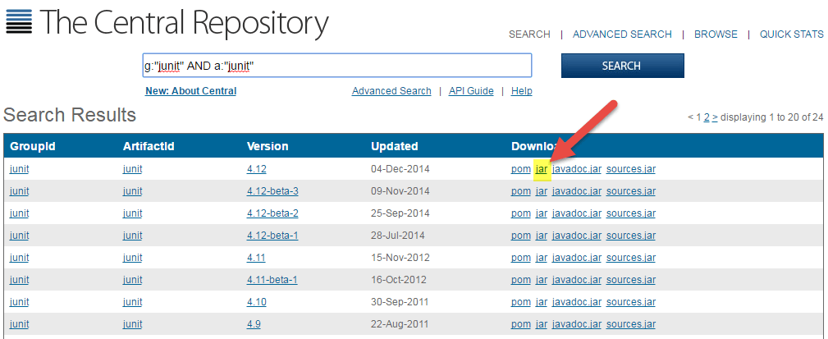
How to Download and Install JUnit in Eclipse
PART 1) Install Java
PART 2) Download JUnit
Step 1) Visit http://junit.org/junit4/ and click Download and Install
Step 2) Click junit.jar
Step 3) In the central repository you are shown all versions of Junit that can be downloaded. Usually, you will select the latest version. Click on jar link to download Junit version 4.12 as shown below.
Step 4) Visit https://github.com/junit-team/junit4/wiki/Download-and-Install again. Click hamcrest-core.jar
Step 5) Download the Jar
For JUnit installation, you need JUnit jars, and you can download the desired version of JUnit jar file from JUnit official youbsite http://www.junit.org
Here is the jars list:
JUnit.jar
hamcrest-core.jar

Slide 11
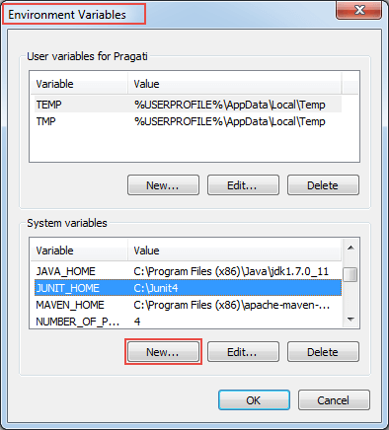
How to Download and Install JUnit in Eclipse
PART 3) JUnit Environment Setup
You need to set JUNIT_HOME environment variable to point out the base location where you have placed JUnit Jars.

Slide 12
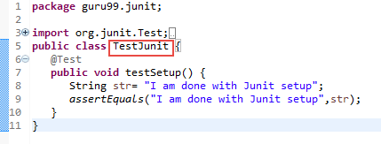
Verify JUnit setup
You can create a simple JUnit test to verify JUnit setup. See below test class:
Create a java class named TestJUnit.java and provide a simple assert statement.
package pack;
import org.junit.Test;
import static org.junit.Assert.assertEquals;
public class TestJunit {
@Test
public void testSetup() {
String str= "I am done with Junit setup";
assertEquals("I am done with Junit setup",str);
}
}

Slide 13
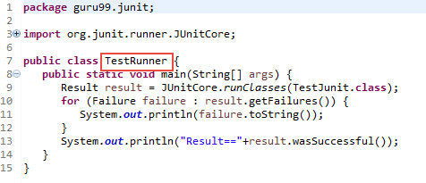
Verify JUnit setup
Create a Test Runner class to execute above test.package pack;
package pack;
import org.junit.runner.JUnitCore;
import org.junit.runner.Result;
import org.junit.runner.notification.Failure;
public class TestRunner {
public static void main(String[] args) {
Result result = JUnitCore.runClasses(TestJunit.class);
for (Failure failure : result.getFailures()) {
System.out.println(failure.toString());
}
System.out.println("Result=="+result.wasSuccessful());
}
}

Slide 14
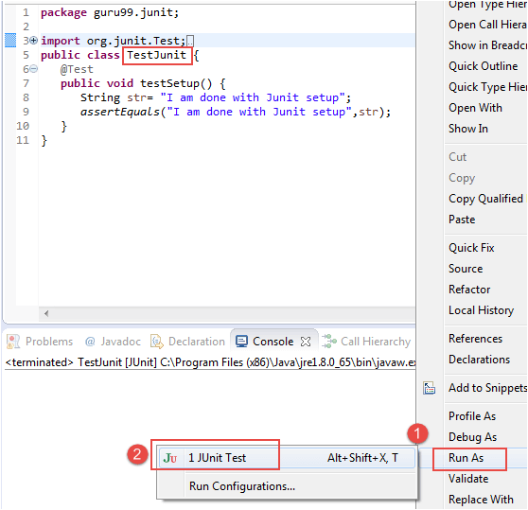
Verify JUnit setup
To execute the test, follow below steps:
Right click on TestRunner.java and click on "Run As" as shown below
Another window will be open once you click on "Run As", click on "1 JUnit Test" as shown below:

Slide 15
JUnit Test Cases Annotation
JUnit uses annotations to mark methods as test methods and to configure them.
JUnit 4 | Description
import org.junit.* | Import statement for using the following annotations.
@Test | Identifies a method as a test method.
@Before | Executed before each test. It is used to prepare the test environment (e.g., read input data, initialize the class).
@After | Executed after each test. It is used to clean-up the test environment (e.g., delete temporary data, restore defaults). It can also save memory by cleaning up expensive memory structures.
@BeforeClass | Executed once, before the start of all tests. It is used to perform time intensive activities, for example, to connect to a database. Methods marked with this annotation need to be defined as static to work with JUnit.
@AfterClass | Executed once, after all tests have been finished. It is used to perform clean-up activities, for example, to disconnect from a database. Methods annotated with this annotation need to be defined as static to work with JUnit.

Slide 16
JUnit Test Cases Annotation
JUnit uses annotations to mark methods as test methods and to configure them.
JUnit 4 | Description
@Ignore or @Ignore("Why disabled") | Marks that the test should be disabled. This is useful when the underlying code has been changed and the test case has not yet been adapted. Or if the execution time of this test is too long to be included. It is best practice to provide the optional description, why the test is disabled.
@Test (expected = Exception.class) | Fails if the method does not throw the named exception.
@Test(timeout=100) | Fails if the method takes longer than 100 milliseconds.
@Ignore or @Ignore("Why disabled") | Marks that the test should be disabled. This is useful when the underlying code has been changed and the test case has not yet been adapted. Or if the execution time of this test is too long to be included. It is best practice to provide the optional description, why the test is disabled.
@Test (expected = Exception.class) | Fails if the method does not throw the named exception.
@Test(timeout=100) | Fails if the method takes longer than 100 milliseconds.

Slide 17
Assert statements
JUnit provides static methods to test for certain conditions via the Assert class.
These assert statements typically start with assert.
They allow you to specify the error message, the expected and the actual result.
An assertion method compares the actual value returned by a test to the expected value.
It throws an AssertionException if the comparison fails.

Slide 18
Assert statements
Methods to assert test results
Fail Message
If you want to throw any assertion error, you have fail() that always results in a fail verdict.
Fail(message);
fail([message])
Let the method fail.
Might be used to check that a certain part of the code is not reached or to have a failing test before the test code is implemented.
The message parameter is optional.

Slide 19
Assert statements
Methods to assert test results
Fail Message
If you want to throw any assertion error, you have fail() that always results in a fail verdict.
Fail(message);
fail([message])
Let the method fail.
Might be used to check that a certain part of the code is not reached or to have a failing test before the test code is implemented.
The message parameter is optional.
Boolean
If you want to test the boolean conditions (true or false), you can use following assert methods
assertTrue(condition)
assertFalse(condition)
Here the condition is a boolean value.

Slide 20
Assert statements
Methods to assert test results
Null object
If you want to check the initial value of an object/variable, you have the following methods:
assertNull(object)
assertNotNull(object)
assertNull([message,] object)
Checks that the object is null.
assertNotNull([message,] object)
Checks that the object is not null.

Slide 21
Assert statements
Methods to assert test results
Identical
If you want to check whether the objects are identical (i.e. comparing two references to the same java object), or different.
assertSame(expected, actual), It will return true if expected == actual
assertNotSame(expected, actual)
assertSame([message,] expected, actual)
Checks that both variables refer to the same object.
assertNotSame([message,] expected, actual)
Checks that both variables refer to different objects.

Slide 22
Assert statements
Methods to assert test results
Assert Equals
If you want to test equality of two objects, you have the following methods
assertEquals(expected, actual)
It will return true if: expected.equals( actual ) returns true.
Assert Array Equals
If you want to test equality of arrays, you have the following methods as given below:
assertArrayEquals(expected, actual)
Above method must be used if arrays have the same length, for each valid value for i, you can check it as given below:
assertEquals(expected[i],actual[i])
assertArrayEquals(expected[i],actual[i])

Slide 23
Assert statements
package pack;
import static org.junit.Assert.*;
import org.junit.Test;
public class Junit4AssertionTest {
@Test
public void testAssert(){
//Variable declaration
String string1="Junit“, string2="Junit“,string3="test“, string4="test“ , string5=null;
int variable1=1 , variable2=2;
int[] airethematicArrary1 = { 1, 2, 3 };
int[] airethematicArrary2 = { 1, 2, 3 };
//Assert statements
assertEquals(string1,string2);
assertSame(string3, string4);
assertNotSame(string1, string3);
assertNotNull(string1);
assertNull(string5);
assertTrue(variable1<variable2);
assertArrayEquals(airethematicArrary1, airethematicArrary2);
}
}

Slide 24
Assert statements
package pack;
import org.junit.runner.JUnitCore;
import org.junit.runner.Result;
import org.junit.runner.notification.Failure;
public class TestRunner {
public static void main(String[] args) {
Result result = JUnitCore.runClasses(Junit4AssertionTest.class);
for (Failure failure : result.getFailures()) {
System.out.println(failure.toString());
}
System.out.println("Result=="+result.wasSuccessful());
}
}

Slide 25
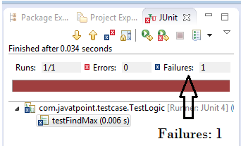
Simple JUnit example
package pack;
public class Calculation {
public static int findMax(int arr[]){
int max=0;
for(int i=1;i<arr.length;i++){
if(max<arr[i])
max=arr[i];
}
return max;
}
}
To run this example, right click on TestLogic class -> Run As -> 1Junit Test.
Output:Assertion Error
As you can see, when we pass the negative values, it throws AssertionError because second time findMax() method returns 0 instead of -1. It means our program logic is incorrect.
package com.javatpoint.testcase;
import static org.junit.Assert.*;
import com.javatpoint.logic.*;
import org.junit.Test;
public class TestLogic {
@Test
public void testFindMax(){
assertEquals(4,Calculation.findMax(new int[]{1,3,4,2}));
assertEquals(-1,Calculation.findMax(new int[]{-12,-1,-3,-4,-2}));
}
}

Slide 26
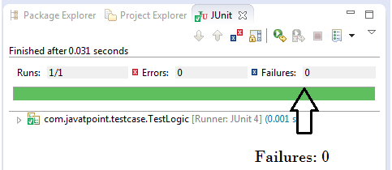
Simple JUnit example
Correct program logic
package pack;
public class Calculation {
public static int findMax(int arr[]){
int max=arr[0];//arr[0] instead of 0
for(int i=1;i<arr.length;i++){
if(max<arr[i])
max=arr[i];
}
return max;
}
}
If you run the junit program again, you will see the following output.
package com.javatpoint.testcase;
import static org.junit.Assert.*;
import com.javatpoint.logic.*;
import org.junit.Test;
public class TestLogic {
@Test
public void testFindMax(){
assertEquals(4,Calculation.findMax(new int[]{1,3,4,2}));
assertEquals(-1,Calculation.findMax(new int[]{-12,-1,-3,-4,-2}));
}
}

Slide 27
Another example of Junit framework
package com.javatpoint.logic;
public class Calculation {
public static int findMax(int arr[]){
int max=0;
for(int i=1;i<arr.length;i++){
if(max<arr[i])
max=arr[i]; }
return max;
}
public static int cube(int n){
return n*n*n; }
public static String reverseWord(String str){
StringBuilder result=new StringBuilder();
StringTokenizer tokenizer=new StringTokenizer(str," ");
while(tokenizer.hasMoreTokens()) {
StringBuilder sb=new StringBuilder();
sb.append(tokenizer.nextToken());
sb.reverse();
result.append(sb);
result.append(" ");
}
return result.toString();
}
}

Slide 28
Another example of Junit framework
package pack;
import static org.junit.Assert.assertEquals;
import org.junit.After;
import org.junit.AfterClass;
import org.junit.Before;
import org.junit.BeforeClass;
import org.junit.Test;
import com.javatpoint.logic.Calculation;
public class TestCase2 {
@BeforeClass
public static void setUpBeforeClass() throws Exception {
System.out.println("before class"); }
@Before
public void setUp() throws Exception {
System.out.println("before"); }
@Test
public void testFindMax(){
System.out.println("test case find max");
assertEquals(4,Calculation.findMax(new int[]{1,3,4,2}));
assertEquals(-2,Calculation.findMax(new int[]{-12,-3,-4,-2})); }
@Test
public void testCube(){
System.out.println("test case cube");
assertEquals(27,Calculation.cube(3)); }
@Test
public void testReverseWord(){
System.out.println("test case reverse word");
assertEquals("ym eman si nahk",Calculation.reverseWord("my name is khan"); }
@After
public void tearDown() throws Exception {
System.out.println("after"); }
@AfterClass
public static void tearDownAfterClass() throws Exception {
System.out.println("after class");}
}

