Slide 1
Maven

Slide 2
What is Maven?
Maven is a project management and comprehension tool that provides developers a complete build lifecycle framework.
Development team can automate the project's build infrastructure in almost no time as Maven uses a standard directory layout and a default build lifecycle.

Slide 3
What is Maven?
Maven simplifies and standardizes the project build process.
Maven handles compilation, distribution, documentation, team collaboration and other tasks seamlessly.
Maven increases reusability and takes care of most of the build related tasks.

Slide 4
problem without Maven
1) Adding set of Jars in each project:
For struts, spring, hibernate frameworks, need to add set of jar files in each project as well as include all the dependencies of jars also.
2) Creating the right project structure:
Create the right project structure in servlet, struts etc, otherwise it will not be executed.
3) Building and Deploying the project:
must have to build and deploy the project so that it may work.

Slide 5
Solved problem by Maven
Maven simplifies the above mentioned problems.
It does mainly following tasks.
It makes a project easy to build
It provides uniform build process (maven project can be shared by all the maven projects)
It provides project information (log document, cross referenced sources, mailing list, dependency list, unit test reports etc.)
It is easy to migrate for new features of Maven

Slide 6
Objective: Maven
The primary goal of Maven is to provide developer with the following −
A comprehensive model for projects, which is reusable, maintainable, and easier to comprehend.
Plugins or tools that interact with this declarative model.
Apache Maven helps to manage
Builds
Documentation
Reporting
Releases
Distribution

Slide 7
Objective: Maven
Maven project structure and contents are declared in an xml file, pom.xml.
pom.xml is referred as Project Object Model (POM).
It is the fundamental unit of the entire Maven system.

Slide 8
Objective: Maven
The following table shows the default values for :
project source code files,
resource files
and other configurations.
Assuming, ${basedir} denotes the project location −
Item Default
source code ${basedir}/src/main/java
Resources ${basedir}/src/main/resources
Tests ${basedir}/src/test
Complied byte code ${basedir}/target
distributable JAR ${basedir}/target/classes

Slide 9
Features : Maven
Simple project setup that follows best practices.
Consistent usage across all projects.
Dependency management including automatic updating.
A large and growing repository of libraries.
Extensible, with the ability to easily write plugins in Java or scripting languages.
Instant access to new features with little or no extra configuration.

Slide 10
Maven - Environment Setup
Step 1 - Verify Java Installation on your Machine
Step 2 - Set JAVA Environment
Set the JAVA_HOME environment variable
Append Java compiler location to System Path.
Verify Java Installation using java -version command
For Windows | Set the environment variable JAVA_HOME to C:\Program Files\Java\jdk1.7.0_60
For Linux | export JAVA_HOME=/usr/local/java-current
Windows | Append the string “;C:\Program Files\Java\jdk1.7.0.60\bin” to the end of the system variable, Path.
Linux | export PATH=$PATH:$JAVA_HOME/bin/

Slide 11
Maven - Environment Setup
Step 3 - Download Maven Archive
Download Maven 2.2.1 from https://maven.apache.org/download.cgi.
Step 4 - Extract the Maven Archive
Step 5 - Set Maven Environment Variables
Add M2_HOME, M2, MAVEN_OPTS to environment variables.
Windows | Set the environment variables using system properties. M2_HOME=C:\ProgramFiles\ApacheSoftwareFoundation\apache-maven-3.3.1 M2=%M2_HOME%\bin MAVEN_OPTS=-Xms256m -Xmx512m
Linux | Open command terminal and set environment variables. export M2_HOME=/usr/local/apache-maven/apache-maven-3.3.1 export M2=$M2_HOME/bin export MAVEN_OPTS=-Xms256m -Xmx512m

Slide 12
Maven - Environment Setup
Step 6 - Add Maven bin Directory Location to System Path
Now append M2 variable to System Path.
Step 7 - Verify Maven Installation
Now open console and execute the following mvn command.
Windows | Append the string ;%M2% to the end of the system variable, Path.
Linux | export PATH=$M2:$PATH
Windows | Open Command Console | c:\> mvn --version
Linux | Open Command Terminal | $ mvn --version

Slide 13
Maven - POM
POM stands for Project Object Model. It is fundamental unit of work in Maven.
It is an XML file that resides in the base directory of the project as pom.xml.
The POM contains information about the project and various configuration detail used by Maven to build the project(s).

Slide 14
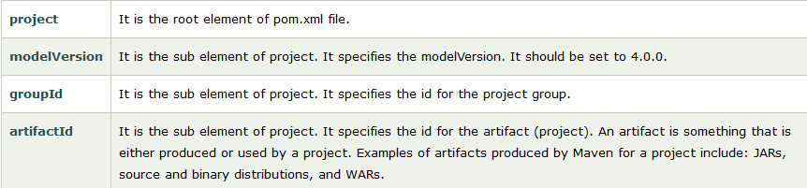
Elements of maven pom.xml file

Slide 15
POM Example
<project xmlns = "http://maven.apache.org/POM/4.0.0"
xmlns:xsi = "http://www.w3.org/2001/XMLSchema-instance"
xsi:schemaLocation = "http://maven.apache.org/POM/4.0.0
http://maven.apache.org/xsd/maven-4.0.0.xsd">
<modelVersion>4.0.0</modelVersion>
<groupId>com.companyname.project-group</groupId>
<artifactId>project</artifactId>
<version>1.0</version>
</project>

Slide 16
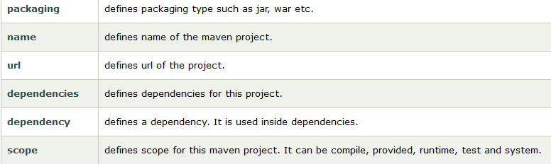
Elements of maven pom.xml file

Slide 17
POM Example : Jar Dependency
For MySql:
<dependencies>
<dependency>
<groupId>mysql</groupId>
<artifactId>mysql-connector-java</artifactId>
<version>5.1.22</version>
</dependency>
........
</dependencies>

Slide 18
POM Example : Jar Dependency
For Servlet:
<dependencies>
<dependency>
<groupId>javax.servlet</groupId>
<artifactId>servlet-api</artifactId>
<version>2.5</version>
</dependency>
........
</dependencies>

Slide 19
POM Example : Jar Dependency
For JUnit:
<dependencies>
<dependency>
<groupId>junit</groupId>
<artifactId>junit</artifactId>
<version>3.8.1</version>
<scope>test</scope>
</dependency>
........
</dependencies>

Slide 20
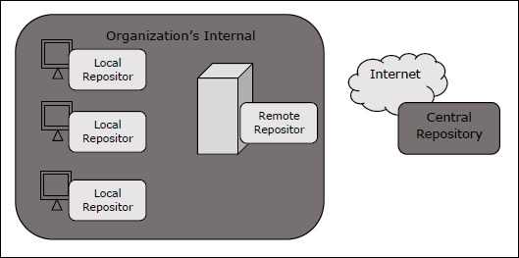
Maven - Repositories
What is a Maven Repository?
In Maven terminology, a repository is a directory where all the project jars, library jar, plugins or any other project specific artifacts are stored and can be used by Maven easily.
Maven repository are of three types.
The following illustration will give an idea regarding these three types.
local
central
remote

Slide 21
Maven - Repositories
Local Repository
Maven local repository is a folder location on your machine.
It gets created when you run any maven command for the first time.
Maven local repository keeps project's all dependencies (library jars, plugin jars etc.).
When run a Maven build, then Maven automatically downloads all the dependency jars into the local repository.
It helps to avoid references to dependencies stored on remote machine every time a project is build.
<settings xmlns = "http://maven.apache.org/SETTINGS/1.0.0"
xmlns:xsi = "http://www.w3.org/2001/XMLSchema-instance"
xsi:schemaLocation = "http://maven.apache.org/SETTINGS/1.0.0
http://maven.apache.org/xsd/settings-1.0.0.xsd">
<localRepository>C:/MyLocalRepository</localRepository>
</settings>

Slide 22
Maven - Repositories
Central Repository
Maven central repository is repository provided by Maven community.
It contains a large number of commonly used libraries.
When Maven does not find any dependency in local repository, it starts searching in central repository using following URL − https://repo1.maven.org/maven2/
Key concepts of Central repository are as follows −
This repository is managed by Maven community.
It is not required to be configured.
It requires internet access to be searched.

Slide 23
Maven - Repositories
Remote Repository
Sometimes, Maven does not find a mentioned dependency in central repository as well.
It then stops the build process and output error message to console.
To prevent such situation, Maven provides concept of Remote Repository, which is developer's own custom repository containing required libraries or other project jars.

Slide 24
Maven - Repositories
Remote Repository
For example, using below mentioned POM.xml, Maven will download dependency (not available in central repository) from Remote Repositories mentioned in the same pom.xml.
<dependencies>
<dependency>
<groupId>com.companyname.common-lib</groupId>
<artifactId>common-lib</artifactId>
<version>1.0.0</version>
</dependency>
<dependencies>
<repositories>
<repository>
<id>companyname.lib1</id>
<url>http://download.companyname.org/maven2/lib1</url>
</repository>
<repository>
<id>companyname.lib2</id>
<url>http://download.companyname.org/maven2/lib2</url>
</repository>
</repositories>

Slide 25
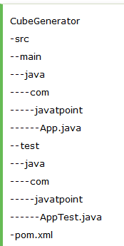
Maven - Labs
Create a simple maven java project:
To create a simple java project using maven, you need to open command prompt and run the archetype:generate command of mvn tool.
Syntax :
mvn archetype:generate -DgroupId=groupid -DartifactId=artifactid
-DarchetypeArtifactId=maven-archetype-quickstart -DinteractiveMode=booleanValue
Example:
mvn archetype:generate -DgroupId=com.javatpoint -DartifactId=CubeGenerator
-DarchetypeArtifactId=maven-archetype-quickstart -DinteractiveMode=false

Slide 26
Maven - Labs
Compile the Maven Java Project:
To compile the project, go to the project directory,
command prompt: mvn clean compile
Run the Maven Java Project:
To run the project, go to the project directory\target\classes,
command prompt: java com.javatpoint.App
Build the maven project or package maven project:
command prompt: mvn package
Now a jar file is created inside the project/target directory.
run the maven project by the jar file:
java -classpath target\CubeGenerator-1.0-SNAPSHOT.jar;.; com.pack.App
(Here App is the main class)

Slide 27
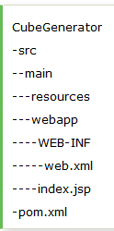
Maven – Labs Maven Web Application
To create a simple maven web application :
Syntax
mvn archetype:generate -DgroupId=groupid -DartifactId=artifactid
-DarchetypeArtifactId=maven-archetype-webapp -DinteractiveMode=booleanValue
Example
mvn archetype:generate -DgroupId=com.javatpoint -DartifactId=CubeGeneratorWeb
-DarchetypeArtifactId=maven-archetype-webapp -DinteractiveMode=false

Slide 28
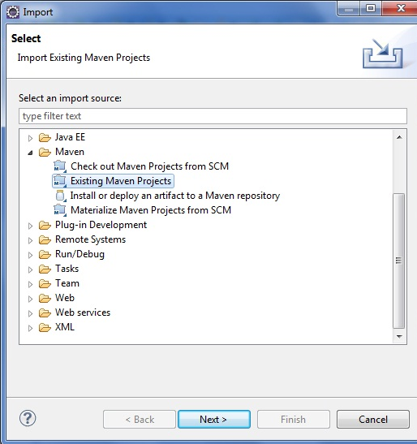
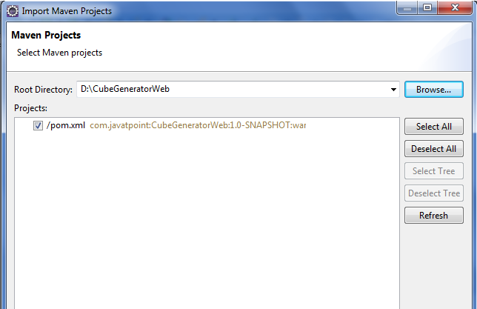
Maven – Labs Maven Webapp in Eclipse
1) Open eclipse IDE
2) Import the maven project
File Menu -> Import -> Maven -> Existing Maven Projects
-> Finish.
3) Run the maven web project
Right click on project -> Run As -> Run on Server

Slide 29
Maven - Plugins
Maven is actually a plugin execution framework where every task is actually done by plugins.
Plugin Types
Build plugins They execute during the build process. should be configured in the <build/> element of pom.xml. | Reporting plugins They execute during the site generation process. should be configured in the <reporting/> element of the pom.xml.

Slide 30
Maven Core Plugins
Maven is actually a plugin execution framework where every task is actually done by plugins.
Plugin Types
Plugin clean compiler deploy install resources | Description clean up after build. compiles java source code. deploys the artifact to the remote repository. installs the built artifact into the local repository. copies the resources to the output directory for including in the JAR.

