Slide 1
EGIT
Git Plugin For Eclipse

Slide 2
EGit Client for Eclipse
Git for an Eclipse plugin is EGIT
use (or update) from the following Eclipse Update site (Help > Install New Software):
http://download.eclipse.org/egit/updates

Slide 3
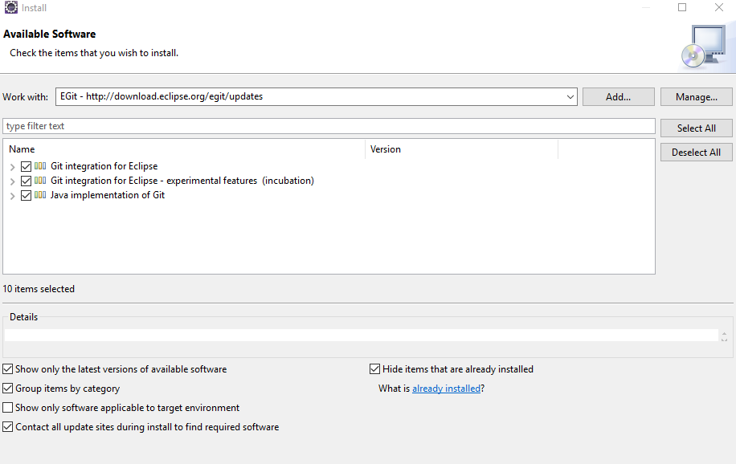
EGit Client for Eclipse
Git for an Eclipse plugin is EGIT
use (or update) from the following Eclipse Update site (Help > Install New Software):
http://download.eclipse.org/egit/updates

Slide 4
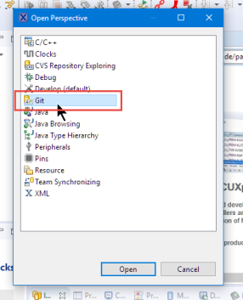
EGit Client for Eclipse
Git Perspective and Repository Setup in Eclipse
In Eclipse, switch to the Git perspective:

Slide 5
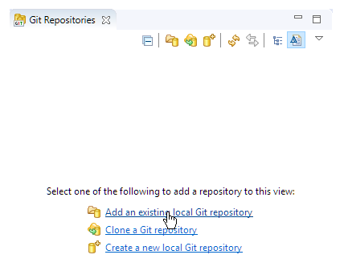
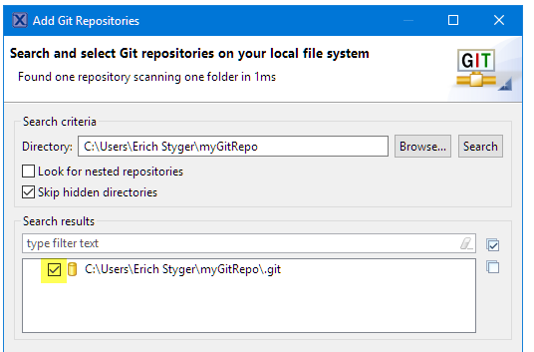
Git perspective
From the Git perspective, can add an existing repository
Then browse to the repository folder and add it:

Slide 6
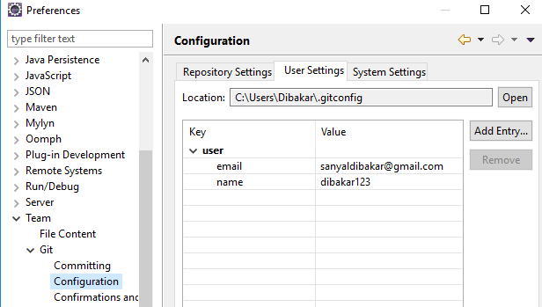
Git configure
In your Eclipse IDE, selec the Window →Preferences →Team →Git Configuration entry.
Ensure that full name and email is available in the user settings.
As the Eclipse IDE uses the same settings as the Git command line, this might already be done.

Slide 7
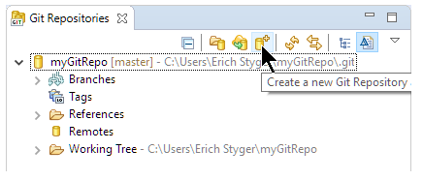
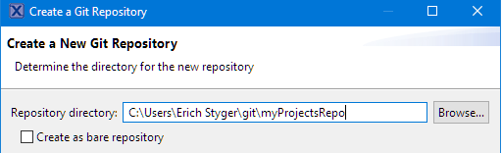
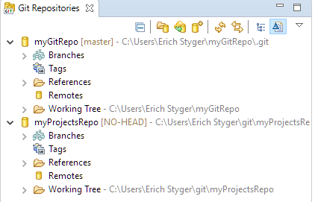
Git perspective
From the Git perspective, create new repository
Then it asks for the repository folder name:
adds it to the available repositories:

Slide 8
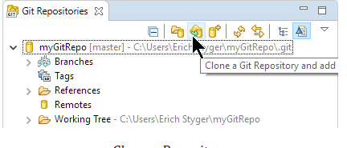
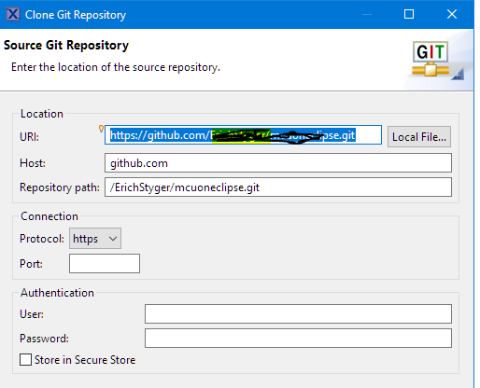
Git perspective
Clone from an existing repository, e.g. from GitHub.

Slide 9
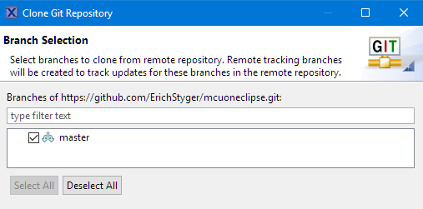
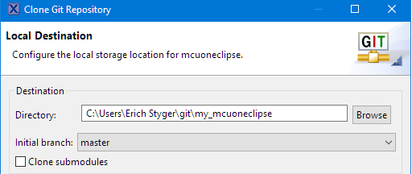
Git perspective
Clone from an existing repository, e.g. from GitHub.
Press next and select the desired
branch (if any).
Then specify the (new/empty) directory name where to clone the repository
Press Finish and it will download repository content

Slide 10
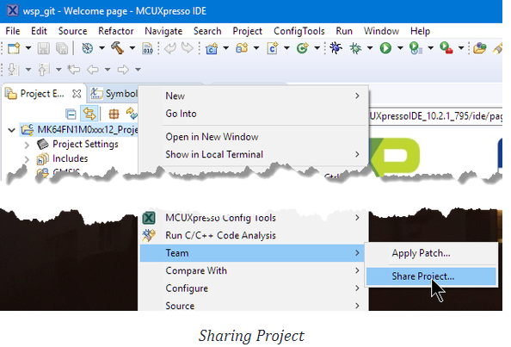
Adding Projects to Repository
With the repository configured, add an existing project to a repository.
Right-Click on the project and select Team > Share Project…

Slide 11
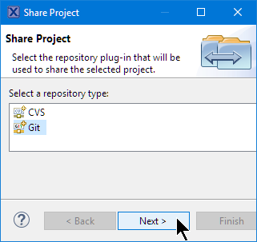
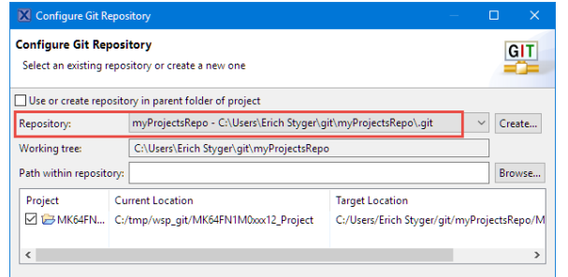
Adding Projects to Repository
Select the VCS to use:
Select the repository to use and press Finish:

Slide 12
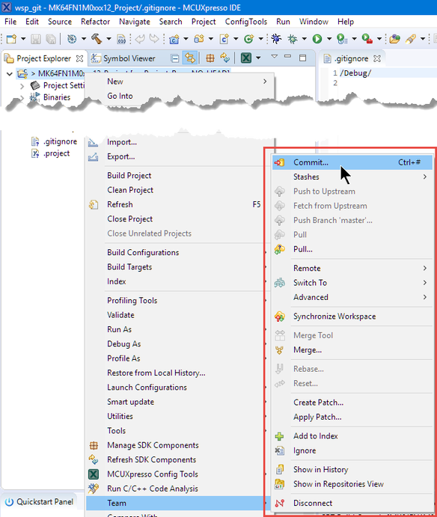
Commit
Added the project to the list of changes.
But not yet stored in the repository.
For this need to do a commit.

Slide 13
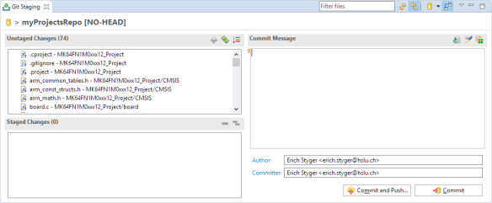
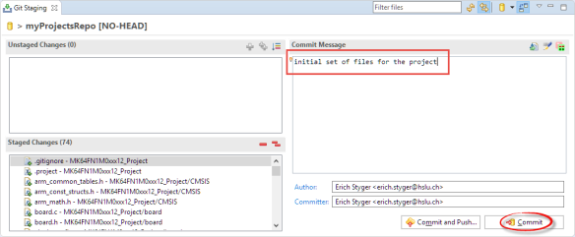
Commit
With the "Commit…" menu item ,get a Git Staging view:
The left upper area shows all the changes, have to stage them into the lower left area using drag&drop or using the "+" and "++" icons in that toolbar and add a commit message:

Slide 14
Commit
Then can commit (make the change in the local repository and push later)
or do a commit with a push to the remote repository.
***prefer to make smaller commits and then push them later.
With a local (not shared) repository a push is not needed/possible as the push is to the remote repository.

Slide 15
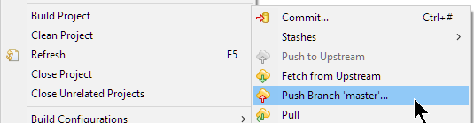
Push, Pull and Compare
The push action is available in the Team menu:
Here, in the same menu, get the pull actions (to get the changes from the repository) also.

Slide 16
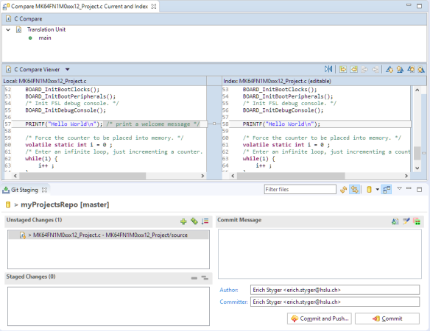
Push, Pull and Compare
To compare the changes, double-click on the file and it opens the Eclipse diff view:

Slide 17
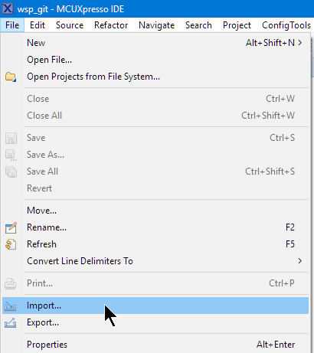
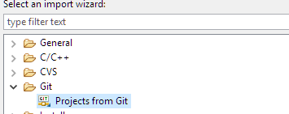
Import from Git
import projects from Git into workspace , by using the Import item from the File menu:
Then select import from Git:

Slide 18
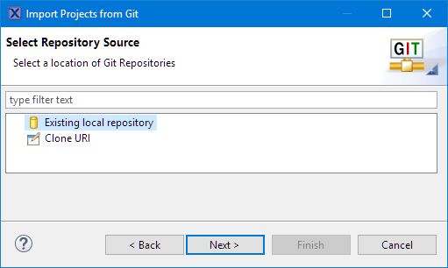
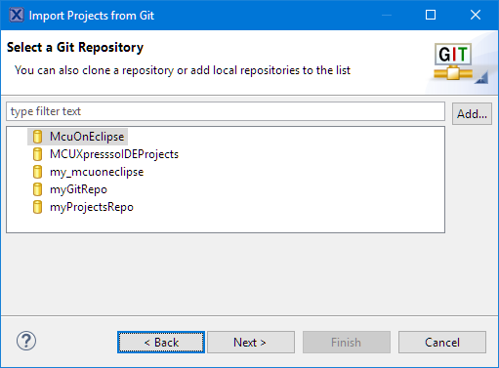
Import from Git
Select the repository source:
cloned the existing repository, can select that one or any of repositories:

Slide 19
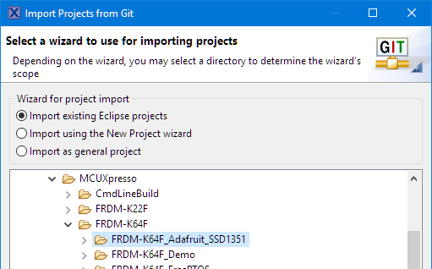
Import from Git
Then select the folder with the project(s) to import:

