Slide 1
GIT
Distributed Versioning Control Tool

Slide 2
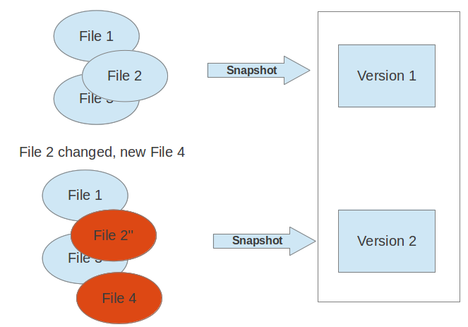
version control: definition
A version control system (VCS) allows to track the history of a collection of files.
It supports creating different versions of this collection.
Each version captures a snapshot of the files at a certain point in time and the VCS allows you to switch between these versions.
These versions are stored in a specific place, typically called a repository.

Slide 3
version control : benifits
Version control systems are a category of software tools that help a software team manage changes to source code over time.
Version control software keeps track of every modification to the code in a special kind of database.
If a mistake is made, developers can turn back the clock and compare earlier versions of the code to help fix the mistake while minimizing disruption to all team members.

Slide 4
Git : define
Git is currently the most popular implementation of a distributed version control system.
Git originates from the Linux kernel development and was founded in 2005 by Linus Torvalds.
Nowadays it is used by many popular open source projects, e.g., the Android or the Eclipse developer teams, as well as many commercial organizations.

Slide 5
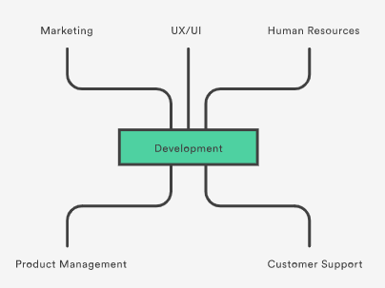
Git for organization
Switching from a centralized version control system to Git changes the way development team creates software.

Slide 6
Git repository :define
A Git repository contains the history of a collection of files starting from a certain directory.
The process of copying an existing Git repository via the Git tooling is called cloning. After cloning a repository the user has the complete repository with its history on his local machine. Git also supports the creation of new repositories.
If want to delete a Git repository, simply delete the folder which contains the repository.
If clone a Git repository, by default, Git assumes that want to work in this repository as a user.
Git also supports the creation of repositories targeting the usage on a server.

Slide 7
Working Tree:define
A local non-bare Git repository is typically called local repository.
A local repository provides at least one collection of files which originate from a certain version of the repository. This collection of files is called the working tree.
It corresponds to a checkout of one version of the repository with potential changes done by the user.
The user can change the files in the working tree by modifying existing files and by creating and removing files.

Slide 8
Working Tree:define
A file in the working tree of a Git repository can have different states.
untracked: the file is not tracked by the Git repository. This means that the file never staged nor committed.
tracked: committed and not staged
staged: staged to be included in the next commit
dirty / modified: the file has changed but the change is not staged
After doing changes in the working tree, user can add these changes to the Git repository or revert these changes.

Slide 9
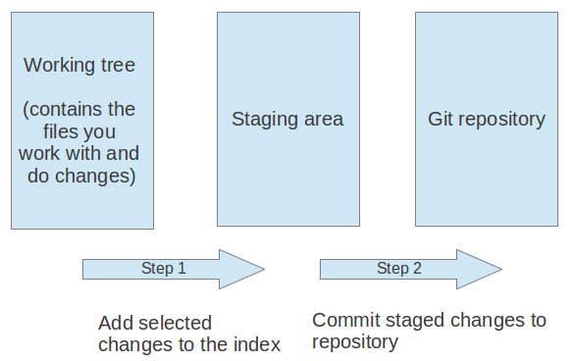
Git flow:define
Modify (if any) on working tree and try to persist changes in local repository using 2 steps:
add the selected changes to the staging area (also known as index) via the git add command
commit the staged changes into the Git repository via the git commit command

Slide 10
Git flow:define
The git add command stores a snapshot of the specified files in the staging area.
It allows to incrementally modify files, stage them, modify and stage them again until satisfied with changes.
After adding the selected files to the staging area, can commit these files to add them permanently to the Git repository.
Committing creates a new persistent snapshot (called commit or commit object) of the staging area in the Git repository. A commit object, like all objects in Git, is immutable.
The staging area keeps track of the snapshots of the files until the staged changes are committed.
For committing the staged changes use the git commit command.
If commit changes to Git repository, create a new commit object in the Git repository.

Slide 11
Branching:define
Git supports branching which means that can work on different versions of collection of files.
A branch allows the user to switch between these versions so that he can work on different changes independently from each other.
For example, if want to develop a new feature, can create a branch and make the changes in this branch. This does not affect the state of files in other branches.
Branches in Git are local to the repository.

Slide 12
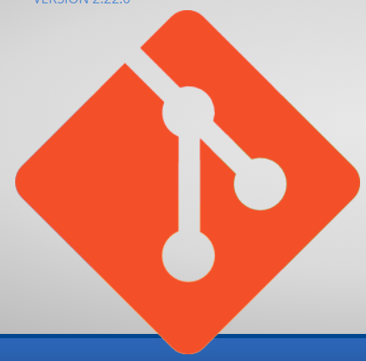
Git: install
Git for Windows stand-alone installer
Download the latest https://gitforwindows.org/
Start Git Setup wizard screen. Follow the Next and Finish prompts to complete the installation. The default options are pretty sensible for most users.
Open a Command Prompt (or Git Bash if during installation elected not to use Git from the Windows Command Prompt).

Slide 13
Git: configuration
The git config command allows you to configure your Git settings.
These settings can be system wide, user or repository specific.
User credential configuration
# configure the user which will be used by Git
git config --global user.name "Firstname Lastname"
# configure the email address
git config --global user.email "your.email@example.org"
Push configuration
# set default so that only the current branch is pushed
git config --global push.default simple

Slide 14
Git: configuration
To query your Git settings, execute the following command:
git config --list
If you want to query the global settings you can use the following command.
git config --global --list
Run the following commands to configure Git username and email using the following commands:
git config --global user.name “username"
git config --global user.email “useremailid"

Slide 15
Git: configuration-lab
Exercise: Setting up Git via the command line
After the installation of the Git tooling for the command line you need to configure Git.
The minimum required information to use Git is the user name and the email which Git should use.
# configure the user which will be used by Git
git config --global user.name "Firstname Lastname"
# configure the email address
git config --global user.email "your.email@example.org"
# use rebase instead of merge in the `git pull` command.
# this avoids merge commits during the pull operation
git config --global branch.autosetuprebase always

Slide 16
Basic Git commands

Slide 17
Basic Git commands
git init
initializes a brand new Git repository and begins tracking an existing directory.
It adds a hidden subfolder within the existing directory that houses the internal data structure required for version control.
git clone
creates a local copy of a project that already exists remotely.
The clone includes all the project’s files, history, and branches.
git add
stages a change.
Git tracks changes to a developer’s codebase, but it’s necessary to stage and take a snapshot of the changes to include them in the project’s history.

Slide 18
Basic Git commands
git commit
saves the snapshot to the project history and completes the change-tracking process.
In short, a commit functions like taking a photo.
Anything that’s been staged with git add will become a part of the snapshot with git commit.
git status
shows the status of changes as untracked, modified, or staged.
git branch
shows the branches being worked on locally.

Slide 19
Basic Git commands
git merge
merges lines of development together.
This command is typically used to combine changes made on two distinct branches.
For example, a developer would merge when they want to combine changes from a feature branch into the master branch for deployment.
git pull
updates the local line of development with updates from its remote counterpart.
Developers use this command if a teammate has made commits to a branch on a remote, and they would like to reflect those changes in their local environment.
git push
updates the remote repository with any commits made locally to a branch.

Slide 20
Git commands -labs
Create a repo within an existing project folder :
cd /path/to/your/existing/code
git init
Cloning an existing repository: git clone
If a project has already been set up in a central repository, the clone command is the most common way for users to obtain a local development clone.
git clone <repo url>
git clone is used to create a copy or clone of remote repositories.
Cloning an existing repository for a specific branch:
git clone --single-branch --branch set-1 https://github.com/dibakar123/samplerepo.git

Slide 21
Git commands -labs
Lab:
Performing a local Git workflow via the command line

Slide 22
Git commands -labs
Saving changes to the repository: git add and git commit
Now that you have a repository cloned or initialized, you can commit file version changes to it.
The following example assumes you have set up a project at /path/to/project. The steps ::
Change directories to /path/to/project
Create a new file CommitTest.txt with contents :"test content for git tutorial"
To the repository staging area , use command : git add CommitTest.txt
Create a new commit with a message describing what work was done in the commit
cd /path/to/project
echo "test content for git tutorial" >> CommitTest.txt
git add CommitTest.txt
git commit -m "added CommitTest.txt to the repo"
After executing this example, your repo will now have CommitTest.txt added to the history and will track future updates to the file.

Slide 23
Git commands -labs
Repo-to-repo collaboration: git push
Now that you have a repository cloned or initialized, you can commit file version changes to it.
The following example assumes you have set up a project at /path/to/project. The steps ::
Change directories to /path/to/project
Create a new file CommitTest.txt with contents :"test content for git tutorial"
To the repository staging area , use command : git add CommitTest.txt
Create a new commit with a message describing what work was done in the commit
cd /path/to/project
echo "test content for git tutorial" >> CommitTest.txt
git add CommitTest.txt
git commit -m "added CommitTest.txt to the repo"
After executing this example, your repo will now have CommitTest.txt added to the history and will track future updates to the file.

Slide 24
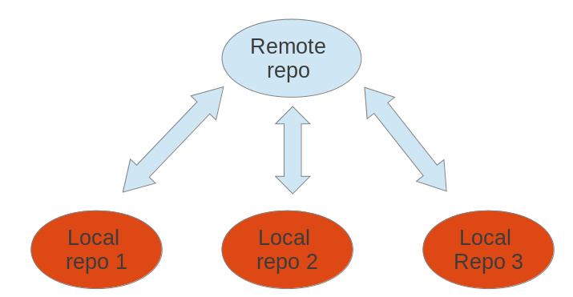
Git commands -labs
Remote repositories
Git allows that you can synchronize your repository with more than one remote repository.
In the local repository you can address each remote repository by a shortcut.
This shortcut is simply called remote. Such a remote repository point to another remote repository that can hosted on the Internet, locally or on the network.
You can specify properties for the remove, e.g. URL, branches to fetch or branches to push.

Slide 25
Git commands -labs
Remote repositories

Slide 26
GitHub

Slide 27
What is GitHub?
GitHub is a code hosting platform for version control and collaboration.
It lets you and others work together on projects from anywhere.
You need a github account using this URL:
https://github.com/

Slide 28
How GitHub works ?
GitHub builds collaboration directly into the development process.
Work is organized into repositories, where developers can outline requirements or direction and set expectations for team members.
Then, using the GitHub flow, developers simply :
create a branch to work on updates
commit changes to save them
open a pull request to propose and discuss changes
merge pull requests once everyone is on the same page.

Slide 29
GitHub flow
GitHub flow is a lightweight, branch-based workflow built around core Git commands used by teams around the globe—including ours.
It has six steps:
Create a branch: Topic branches created from the canonical deployment branch (usually master) allow teams to contribute to many parallel efforts.
Add commits: Snapshots of development efforts within a branch create safe, revertible points in the project’s history.
Open a pull request: Pull requests publicize a project’s ongoing efforts and set the tone for a transparent development process.
Discuss and review code: Teams participate in code reviews by commenting, testing, and reviewing open pull requests. Code review is at the core of an open and participatory culture.
Merge: Upon clicking merge, GitHub automatically performs the equivalent of a local ‘git merge’ operation. GitHub also keeps the entire branch development history on the merged pull request.
Deploy: Teams can choose the best release cycles or incorporate continuous integration tools and operate with the assurance that code on the deployment branch has gone through a robust workflow.

Slide 30
GitHub - labs
Creating and Using Repository
A repository is usually used to organize a single project. Repositories can contain folders and files, images, videos, spreadsheets, and data sets – anything your project needs.
Steps to create a new repository:
Step 1: In the upper right corner, next to your username, click and then click New repository. Step 2: Name your repository “java-Project“. Step 3: Write a short description. Step 4: Select Initialize this repository with a README. Step 5: Click Create repository.

Slide 31
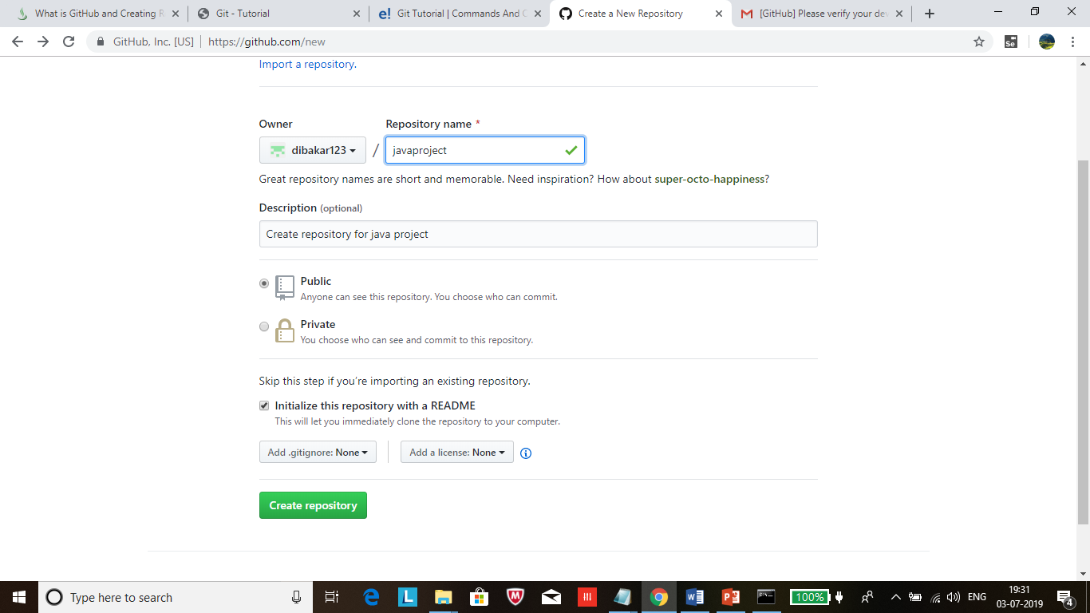
GitHub flow

Slide 32
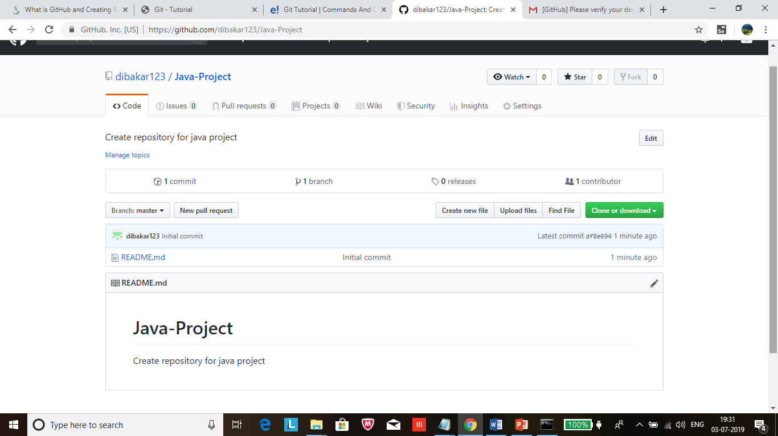
GitHub flow
GitHub flow is a lightweight, branch-based workflow built around core Git commands used by teams around the globe—including ours.
It has six steps:
Create a branch: Topic branches created from the canonical deployment branch (usually master) allow teams to contribute to many parallel efforts.
Add commits: Snapshots of development efforts within a branch create safe, revertible points in the project’s history.
Open a pull request: Pull requests publicize a project’s ongoing efforts and set the tone for a transparent development process.
Discuss and review code: Teams participate in code reviews by commenting, testing, and reviewing open pull requests. Code review is at the core of an open and participatory culture.
Merge: Upon clicking merge, GitHub automatically performs the equivalent of a local ‘git merge’ operation. GitHub also keeps the entire branch development history on the merged pull request.
Deploy: Teams can choose the best release cycles or incorporate continuous integration tools and operate with the assurance that code on the deployment branch has gone through a robust workflow.

Slide 33
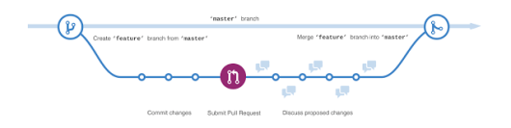
GitHub - labs
Create New Branch and Managing
Branching is the way to work on different versions of a repository at one time.
By default your repository has one branch named master which is considered to be the definitive branch.
Use branches to experiment and make edits before committing them to master.
When create a branch off the master branch, making a copy, or snapshot, of master as it was at that point in time. If someone else made changes to the master branch while you were working on your branch, you could pull in those updates.

Slide 34
GitHub - labs
Create New Branch and Managing
For creating a new branch have to use following Steps.
Step 1: Go to your new repository Spring-Project. Step 2: Click the drop down at the top of the file list that says branch: master. Step 3: Type a branch name, “set-1”, into the new branch text box. Step 4: Select the blue Create branch box or hit “Enter” on your keyboard.

Slide 35
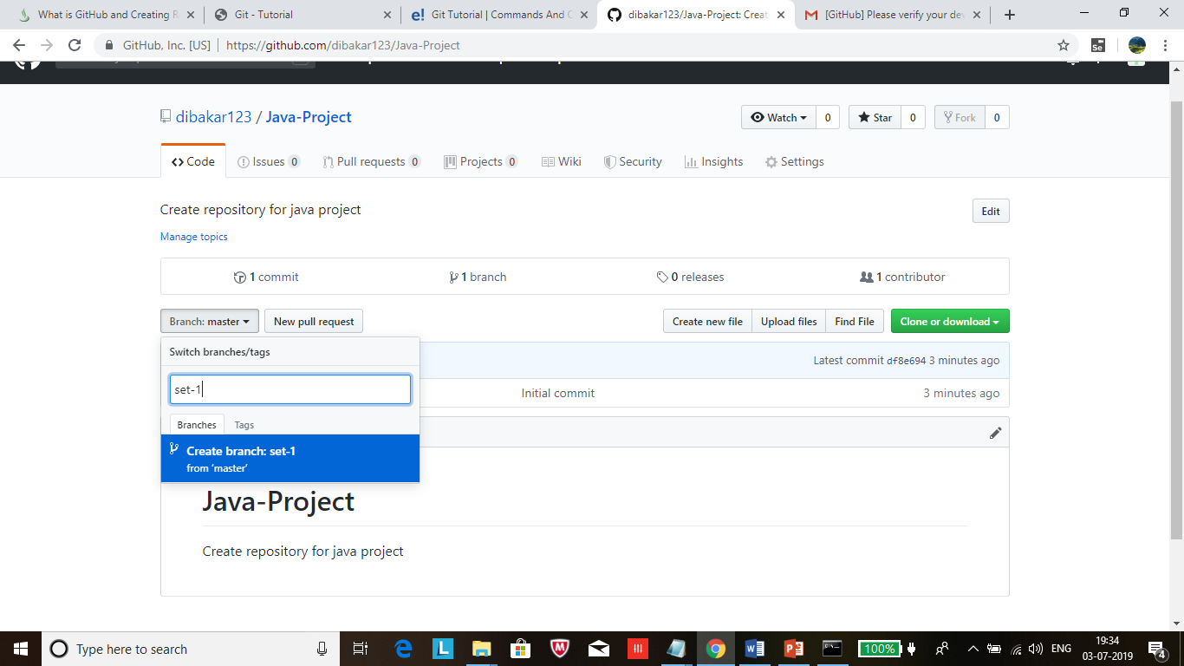
GitHub flow
GitHub flow is a lightweight, branch-based workflow built around core Git commands used by teams around the globe—including ours.
It has six steps:
Create a branch: Topic branches created from the canonical deployment branch (usually master) allow teams to contribute to many parallel efforts.
Add commits: Snapshots of development efforts within a branch create safe, revertible points in the project’s history.
Open a pull request: Pull requests publicize a project’s ongoing efforts and set the tone for a transparent development process.
Discuss and review code: Teams participate in code reviews by commenting, testing, and reviewing open pull requests. Code review is at the core of an open and participatory culture.
Merge: Upon clicking merge, GitHub automatically performs the equivalent of a local ‘git merge’ operation. GitHub also keeps the entire branch development history on the merged pull request.
Deploy: Teams can choose the best release cycles or incorporate continuous integration tools and operate with the assurance that code on the deployment branch has gone through a robust workflow.

Slide 36
GitHub - labs
Pushing changes to a file to GitHub as commits
On GitHub, saved changes are called commits.
Each commit has an associated commit message, which is a description explaining why a particular change was made.
Commit messages capture the history of your changes, so other contributors can understand what you’ve done and why.
Use following steps for Make and commit changes
Step 1: Click the README.md file. Step 2: Click the pencil icon in the upper right corner of the file view to edit. Step 3: In the editor, write a bit about yourself. Step 4: Write a commit message that describes your changes. Step 5: Click Commit changes button.
These changes will be made to just the README file on your set-1 branch, so now this branch contains content that’s different from master.

Slide 37
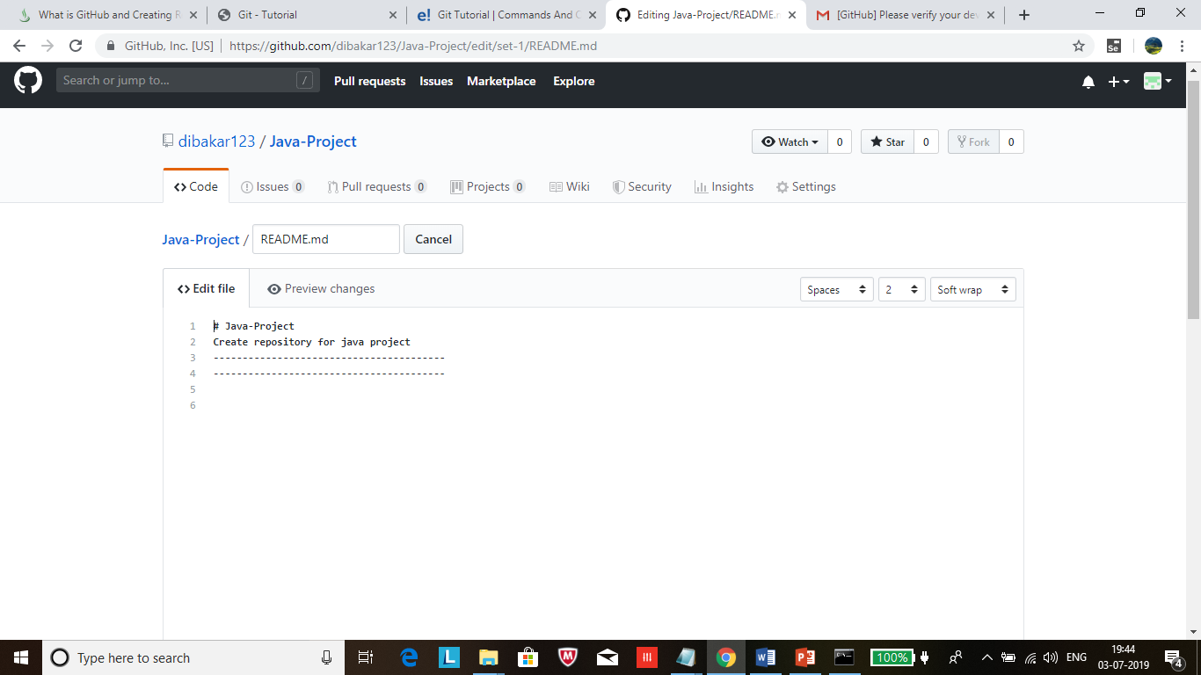
GitHub flow
GitHub flow is a lightweight, branch-based workflow built around core Git commands used by teams around the globe—including ours.
It has six steps:
Create a branch: Topic branches created from the canonical deployment branch (usually master) allow teams to contribute to many parallel efforts.
Add commits: Snapshots of development efforts within a branch create safe, revertible points in the project’s history.
Open a pull request: Pull requests publicize a project’s ongoing efforts and set the tone for a transparent development process.
Discuss and review code: Teams participate in code reviews by commenting, testing, and reviewing open pull requests. Code review is at the core of an open and participatory culture.
Merge: Upon clicking merge, GitHub automatically performs the equivalent of a local ‘git merge’ operation. GitHub also keeps the entire branch development history on the merged pull request.
Deploy: Teams can choose the best release cycles or incorporate continuous integration tools and operate with the assurance that code on the deployment branch has gone through a robust workflow.

Slide 38
GitHub - labs
Open and merge a pull request
Now that you have changes in a branch off of master, you can open a pull request.
Pull Requests are the heart of collaboration on GitHub.
When you open a pull request, you’re proposing your changes and requesting that someone review and pull in your contribution and merge them into their branch.
Pull requests show diffs, or differences, of the content from both branches. The changes, additions, and subtractions are shown in green and red.
For Open a Pull Request for changes to the README as following steps
Step 1: Click the Pull Request tab, then from the Pull Request page, click the green New pull request button. Step 2: Select the branch you made, “UAT”, to compare with master (the original).
Step 3: Look over your changes in the diffs on the Compare page, make sure they’re what you want to submit.
Step 4: When you’re satisfied that these are the changes you want to submit, click the big green Create Pull Request button.
Step 5: Give your pull request a title and write a brief description of your changes.

Slide 39
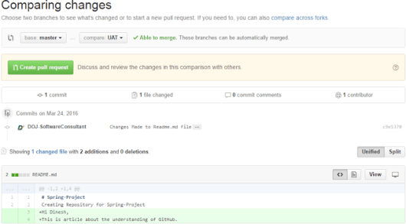
GitHub - labs
Open and merge a pull request
Now that you have changes in a branch off of master, you can open a pull request.
Pull Requests are the heart of collaboration on GitHub.
When you open a pull request, you’re proposing your changes and requesting that someone review and pull in your contribution and merge them into their branch.
Pull requests show diffs, or differences, of the content from both branches. The changes, additions, and subtractions are shown in green and red.
For Open a Pull Request for changes to the README as following steps
Step 1: Click the Pull Request tab, then from the Pull Request page, click the green New pull request button. Step 2: Select the branch you made, “UAT”, to compare with master (the original).
Step 3: Look over your changes in the diffs on the Compare page, make sure they’re what you want to submit.
Step 4: When you’re satisfied that these are the changes you want to submit, click the big green Create Pull Request button.
Step 5: Give your pull request a title and write a brief description of your changes.

Slide 40
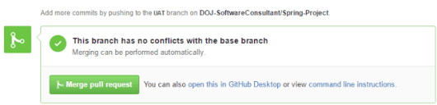
GitHub - labs
Merge your Pull Request
In this final step, it’s time to bring your changes together –
merging your set-1branch into the master branch.
Step 1: Click the green Merge pull request button to merge the changes into master. Step 2: Click Confirm merge. Step 3: Go ahead and delete the branch, since its changes have been incorporated, with the Delete branch button in the purple box.

Slide 42
EGit Client for Eclipse
Git for an Eclipse plugin is EGIT
use (or update) from the following Eclipse Update site (Help > Install New Software):
http://download.eclipse.org/egit/updates

Slide 43
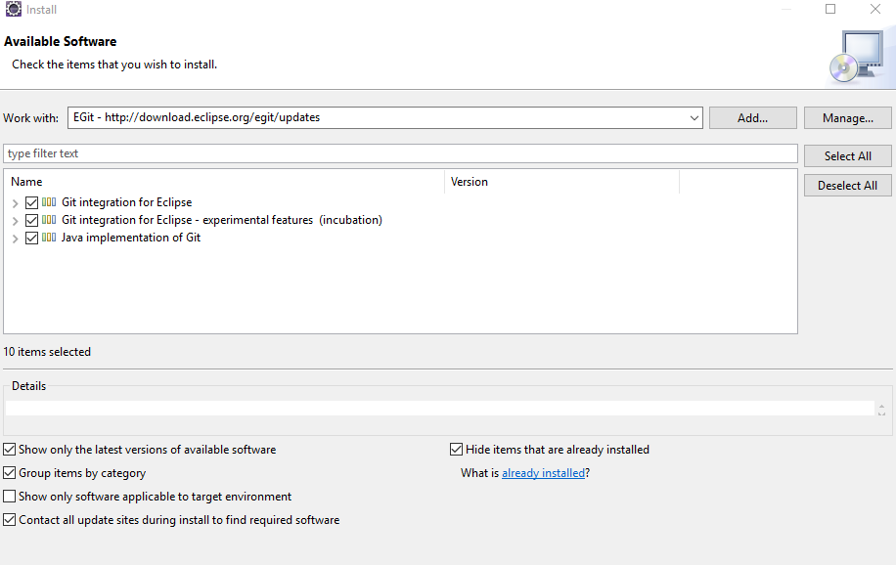
EGit Client for Eclipse
Git for an Eclipse plugin is EGIT
use (or update) from the following Eclipse Update site (Help > Install New Software):
http://download.eclipse.org/egit/updates

Slide 44
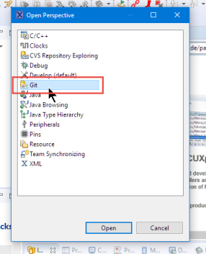
EGit Client for Eclipse
Git Perspective and Repository Setup in Eclipse
In Eclipse, switch to the Git perspective:

Slide 45
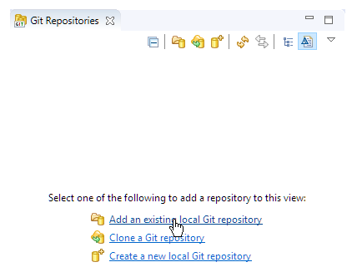
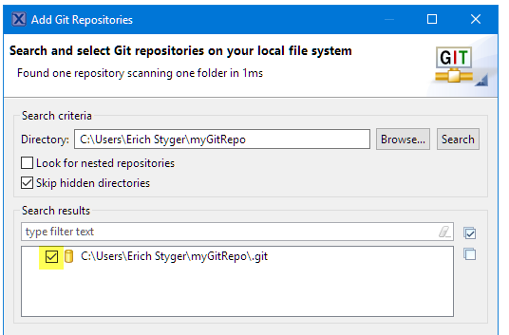
Git perspective
From the Git perspective, can add an existing repository
Then browse to the repository folder and add it:

Slide 46
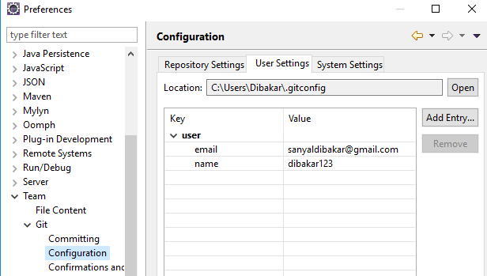
Git configure
In your Eclipse IDE, selec the Window →Preferences →Team →Git Configuration entry.
Ensure that full name and email is available in the user settings.
As the Eclipse IDE uses the same settings as the Git command line, this might already be done.

Slide 47
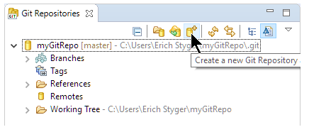
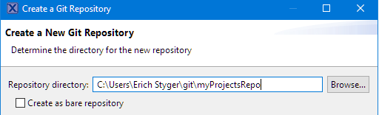
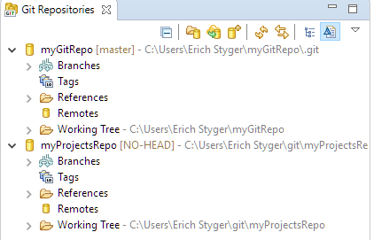
Git perspective
From the Git perspective, create new repository
Then it asks for the repository folder name:
adds it to the available repositories:

Slide 48
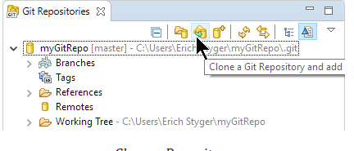
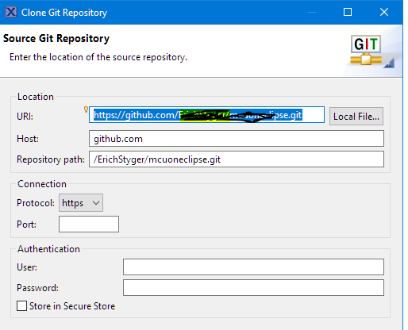
Git perspective
Clone from an existing repository, e.g. from GitHub.

Slide 49
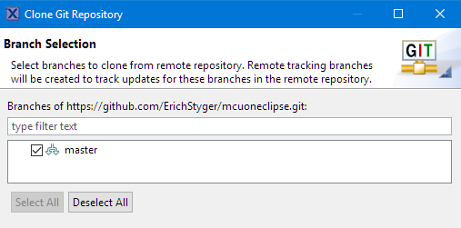
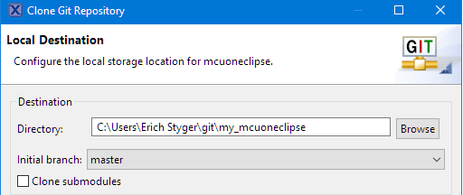
Git perspective
Clone from an existing repository, e.g. from GitHub.
Press next and select the desired
branch (if any).
Then specify the (new/empty) directory name where to clone the repository
Press Finish and it will download repository content

Slide 50
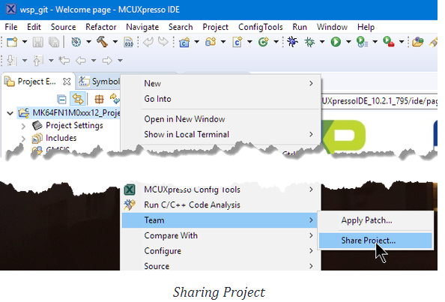
Adding Projects to Repository
With the repository configured, add an existing project to a repository.
Right-Click on the project and select Team > Share Project…

Slide 51
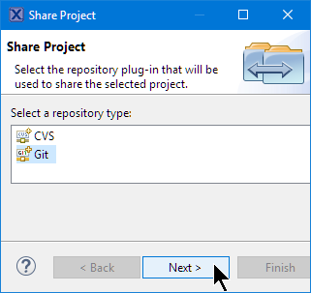
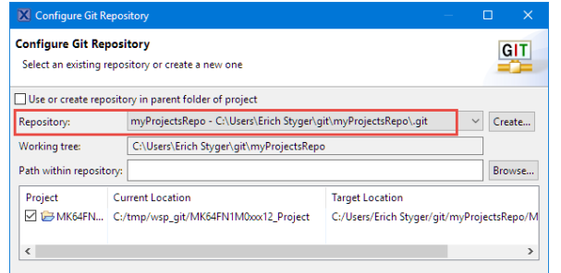
Adding Projects to Repository
Select the VCS to use:
Select the repository to use and press Finish:

Slide 52
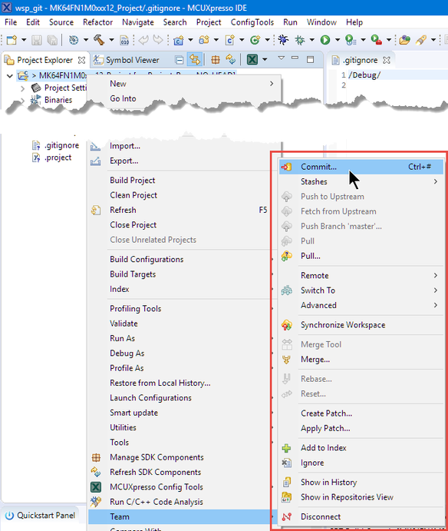
Commit
Added the project to the list of changes.
But not yet stored in the repository.
For this need to do a commit.

Slide 53
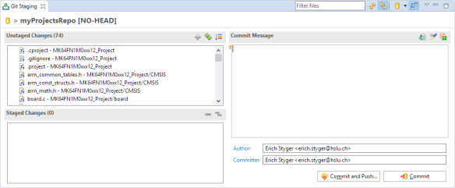
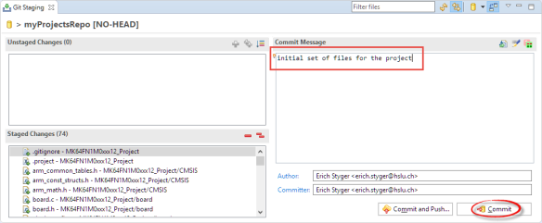
Commit
With the "Commit…" menu item ,get a Git Staging view:
The left upper area shows all the changes, have to stage them into the lower left area using drag&drop or using the "+" and "++" icons in that toolbar and add a commit message:

Slide 54
Commit
Then can commit (make the change in the local repository and push later)
or do a commit with a push to the remote repository.
***prefer to make smaller commits and then push them later.
With a local (not shared) repository a push is not needed/possible as the push is to the remote repository.

Slide 55
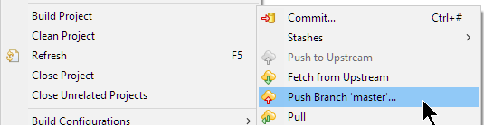
Push, Pull and Compare
The push action is available in the Team menu:
Here, in the same menu, get the pull actions (to get the changes from the repository) also.

Slide 56
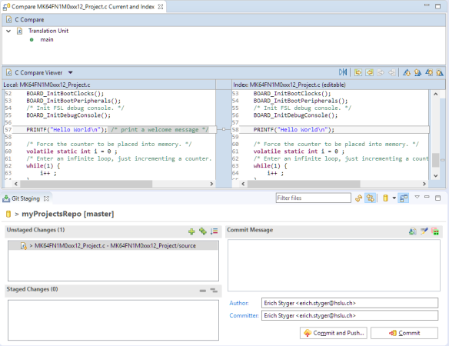
Push, Pull and Compare
To compare the changes, double-click on the file and it opens the Eclipse diff view:

Slide 57
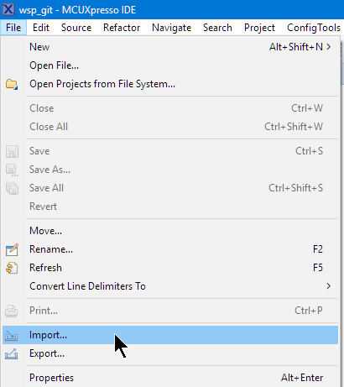
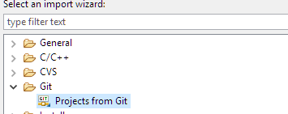
Import from Git
import projects from Git into workspace , by using the Import item from the File menu:
Then select import from Git:

Slide 58
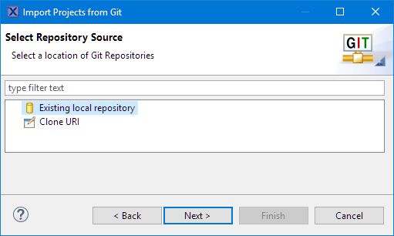
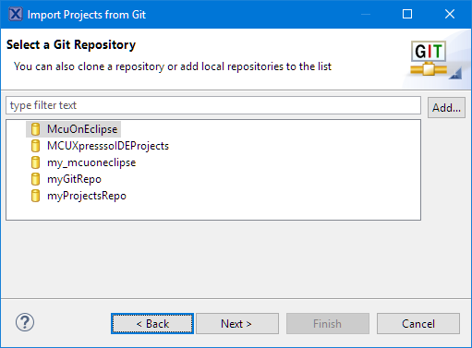
Import from Git
Select the repository source:
cloned the existing repository, can select that one or any of repositories:

Slide 59
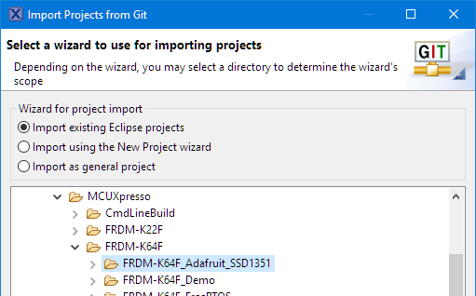
Import from Git
Then select the folder with the project(s) to import:

