Slide 1
Java Threads
A thread is a lightweight process – a single sequential flow of execution within a program
Threads make possible the implementation of programs that seem to perform multiple tasks at the same time.
A threads makes process lighter , increases efficiency of code, increases utilization of resources maximum and provides sharing resources.

Slide 2
Process/Thread States:
running
scheduler
decision
“wait for event”
“yield”
runnable
blocked
“event”
Process: Each running instance of a program is a process.
Process is heavy weight component.
Thread : Each sequence of control within a program is a Thread.
Thread is light weight component.

Slide 3
Thread Life Cycle
new
new
start
runnable
yield,
time slice
notify, notifyAll,
IO compl, sleep exp,
join compl.
scheduler
running
blocked
IO, sleep,
wait, join
term
dead

Slide 4
Types of Threads
Java threads can be of two types: user threads or daemon threads
A daemon thread runs in background and doesn’t prevent JVM from terminating.
  Like: Garbage Collection is a daemon process
When all user threads have terminated, daemon threads can also be terminated and the main program terminates.

Slide 5
How to create Java Threads
There are two ways to create a Java thread:
Extend the java.lang.Thread class
Implement the java.lang.Runnable interface

Slide 6
Extending the Thread class
In order to create a new thread we may subclass java.lang.Thread and customize what the thread does by overriding its empty run method.
The run method is where the action of the thread takes place.
The execution of a thread starts by calling the start method.

Slide 7
Example -
public class MyThread extends Thread {
public MyThread(String a){super(a);}
public void run(){
for( int i=1 ; i<=10; i++){
System.out.println(i+ " " + getName() );
try{ sleep(1000);}
catch(Exception e){}
}
}
public static void main(String[] args) {
MyThread th1 = new MyThread("AAAA"); th1.start();
MyThread th2 = new MyThread("BBBB"); th2.start();
}
}

Slide 8
Implementing the Runnable interface
In order to create a new thread we may also provide a class that implements the java.lang.Runnable interface
A Runnable object can be wrapped up into a Thread object
  Thread(Runnable target)
  Thread(Runnable target, String name)
The thread’s logic is included inside the run method of the runnable object

Slide 9
Runnable Example
public class MyThread1 implements Runnable{ Thread t;
public MyThread1(String a){
t = new Thread(this,a);
t.start(); }
public void run(){
for( int i=1 ; i<=10; i++){
System.out.println(i+ " " + t.getName() );
try{ t.sleep(1000);}
catch( InterruptedException e){ }
}
}
public static void main(String[] args) {
MyThread1 th1 = new MyThread1("AAAA");
MyThread1 th2 = new MyThread1("BBBB");
}
}

Slide 10
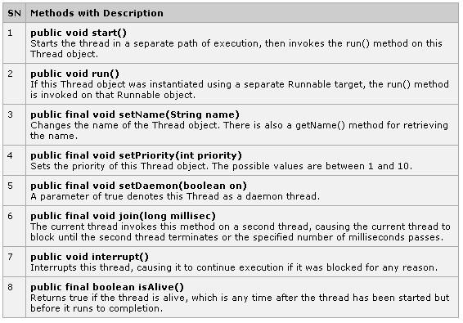
Thread Methods:
These all methods are invoked on a particular Thread object.

Slide 11
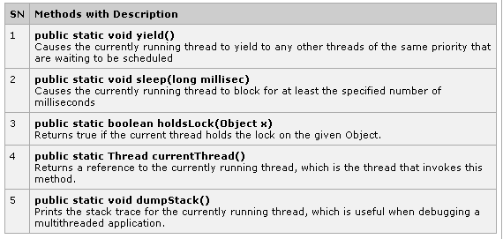
Thread Methods:
These all methods are static, so can be invoked on Thread Class.

Slide 12
Thread Scheduling
In general, the runnable thread with the highest priority is active (running)
Java is priority-preemptive
  If a high-priority thread wakes up, and a low-priority thread is running
  Then the high-priority thread gets to run immediately
Allows on-demand processing
  Efficient use of CPU

Slide 13
Thread Starvation
If a high priority thread never blocks
Then all other threads will starve
Must be clever about thread priority
Java.lang.Thread has 3 fields-
public static final int MAX_PRIORITY;
public static final int MIN_PRIORITY;
public static final int NORM_PRIORITY;

Slide 14
Race Conditions
A Race condition is a problem which occurs in the multithreaded programming when various threads execute simultaneously accessing a shared resource at the same time.
The proper use of synchronization can avoid the Race condition.

Slide 15
Synchronization of Threads
In many cases concurrently running threads share data and must consider the state and activities of other threads.
If two threads can both execute a method that modifies the state of an object then the method should be declared to be synchronized, allowing only one thread to execute the method at a time.
If a class has at least one synchronized methods, each instance of it has a monitor. A monitor is an object that can block threads and notify them when it is available.

Slide 16
Thread Synchronization
Language keyword: synchronized
Takes out a monitor lock on an object
If lock is currently unavailable, thread will block
Example:
public synchronized void updateRecord() {
// critical code goes here …
}

Slide 17
Joining
One thread can wait (with or without a timeout) for another thread (the target) to terminate by issuing the join method call on the target's thread object
The isAlive method allows a thread to determine if the target thread has terminated

Slide 18
Java - Multithreading
Multithreading is a process of executing multiple threads simultaneously.
Multithreading is used to obtain the multitasking.
It consumes less memory and gives the fast and efficient performance.

Slide 19
Inter-Thread Communication
Multiple-threads can communicate with each-other. This way reduces the CPU’s idle time i.e. A process where, a thread is paused running in its critical region and another thread is allowed to enter (or lock) in the same critical section to be executed.
  This technique is known as Interthread communication.
It is implemented by some methods. These methods are defined in "java.lang" package and can only be called within synchronized code.
wait( ) , notify( ) , notifyAll( )

Slide 20
Inter-Thread Communication
wait( )
one which waits indefinitely for any other thread to call notify or notifyAll method on the object to wake up the current thread. Other puts the current thread in wait for specific amount of time before they wake up.
notify ( )
wakes up only one thread waiting on the object and that thread starts execution. So if there are multiple threads waiting for an object, this method will wake up only one of them. The choice of the thread to wake depends on the OS implementation of thread management.
notifyAll ( )
wakes up all the threads waiting on the object, although which one will process first depends on the OS implementation.

Slide 21
Dead-Lock
Deadlock is a situation in which every thread is waiting for a resource which is held by some other waiting thread.
In this situation, Neither of the thread executes nor it gets the chance to be executed.

